Slide 1
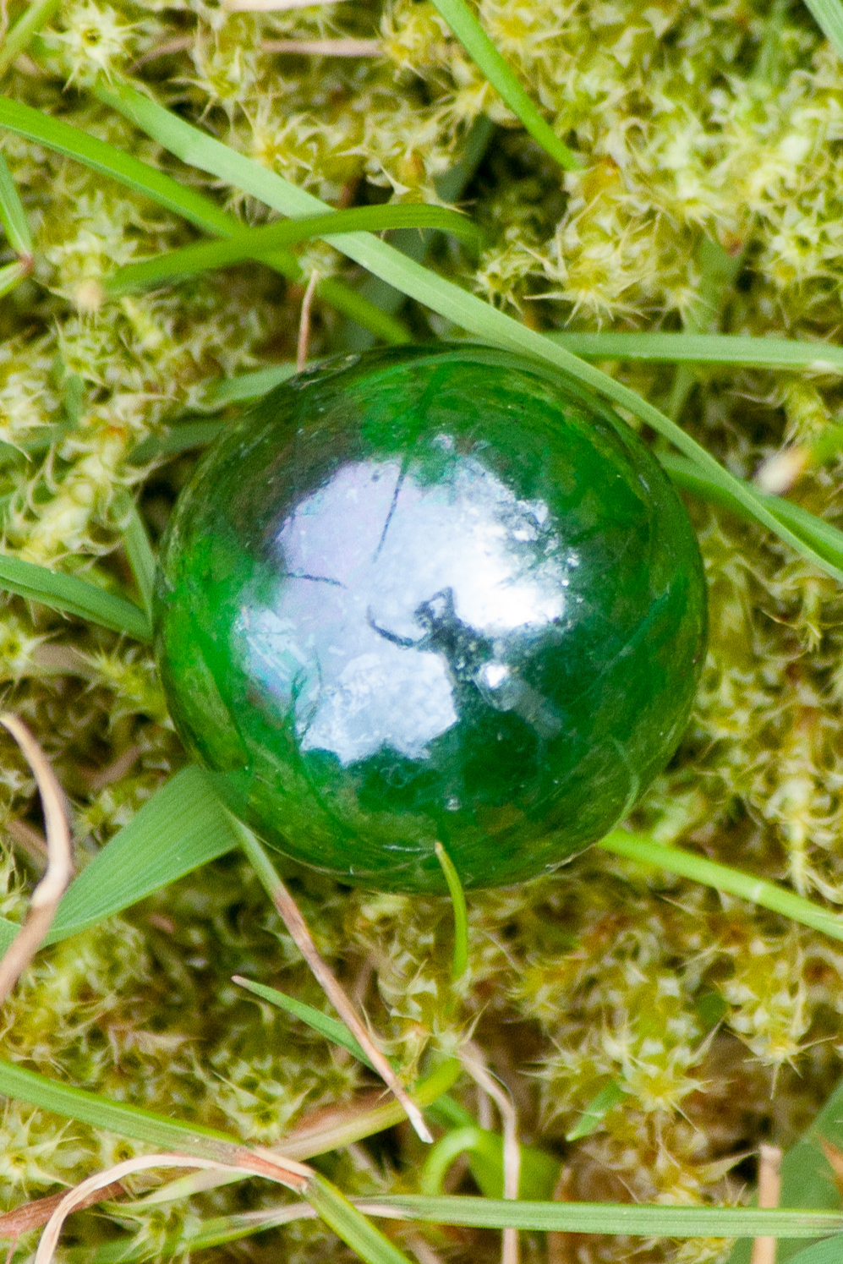
Análisis de abundancia diferencial
Erick Cardenas Poire

Slide 2
Justificación
Análisis de diversidad beta miden cambios en el perfil global de OTUs de una muestra
Perfil esta influenciado por muchos grupos, especialmente los abundantes
El análisis de abundancia diferencia evalúa la distribución de OTUs individuales en el contexto de un tratamiento.

Slide 3
Objetivos
Los estudiantes podrán justificar el porque se hacen análisis de abundancias diferenciales
Los estudiantes podrán mencionar dos tipos de análisis de abundancias diferenciales
Los alumnos podrán entender cuales son las limitaciones de este tipo de análisis

Slide 4
Analysis of variation
Evaluate each OTU separately (one model per OTU).
Can use ANOVA (with aov function) or a non-parametric test (Kruskal-Wallis).
Results are often filtered to correct the p-value for multiple test and to select those OTUs with high adjusted R²
Implemented in R with aov(), can be applied to multiple rows with tapply()
Easy to understand
Needs a post-hoc test if more than two levels are tested
Needs multiple test correction

Slide 5
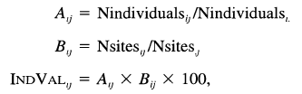
Indicator species analysis
Finds species with high abundance in specific sample or group of samples
P-value is calculated using a bootstrap permutation test

Slide 6
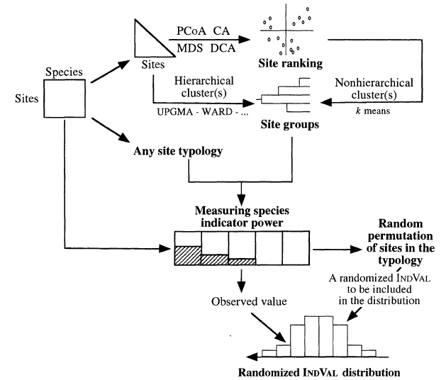
Indicator species analysis
Finds species with high abundance in specific sample or group of samples
P-value is calculated using a bootstrap permutation test
Implemented in R in indicspecies
Dufrene and Legendre, 1997. Ecological Monographs, 67(3):345-366

Slide 7
Finding indicators of uranium reduction
Microbial characterization of sediments using 16S rRNA gene surveys
454 pyrosequencing (5000 sequences per sample, 200-300 bases long)
Groundwater flow
FW101
FW102
FW026
FW024
FW105
FW103
FW104
FW100
Multilevel sampling wells
Meters
Wells
0
1
2
3

Slide 8
FW105 (4.66)
Procedur
Started with clustering of sample
Defined the number of clusters (n=4)
Used K-means to get the group membership
Applied indicator species analysis to set
FW103 (5.92)
L
FW102-1 (6.4)
FW101-4 (5.6)
FW100-4 (5.8)
FW102-4 (4.4)
FW104 (5.8)
FW026 (5.7)
FW101-3 (6.1)
H
FW101-2 (6.2)
FW102-3 (6.2)
FW102-2 (6.5)
FW100-3 (5.9)
M1
FW024 (5.9)
FW100-2 (5.5)
M2
0.2
0.3
0.4
0.5
0.6
Sorensen Abundance Based Distance

Slide 9
Known uranium reducers are indicator species of high activity wells
Group Rank | Classification | Closest isolated in RDP | Similarity to closest isolate in RDP (%)
01 | Desulfosporosinus (Firmicutes) | Desulfosporosinus sp. 5apy; AF159120 | 99.0
02 | Desulfosporosinus (Firmicutes) | Desulfosporosinus sp. 5apy; AF159120 | 99.0
03 | U. Burkholderiales (Betaproteobacteria) | Vogesella indigofera; ATCC 19706T; AB021385 | 95.6
04 | U. Peptococcaceae (Firmicutes) | Anaerobic bacterium Prop2; AY756143 | 92.7
05 | U. Chlamydiales (Chlamydiae) | Endosymbiont of Acanthamoeba sp. UWC22; AF083616 | 91.7
06 | Desulfosporosinus (Firmicutes) | Desulfosporosinus sp. 5apy; AF159120 | 98.0
07 | Desulfovibrio (Deltaproteobacteria) | Desulfovibrio putealis (T); DSM 16056; AY574979 | 99.5
08 | U. Firmicutes | Clostridium sp. 9B4; AY554416 | 92.7
09 | Desulfovibrio (Deltaproteobacteria) | Sulfate-reducing bacterium F1-7b; AJ012594 | 99.5
10 | U. Bacteria | Novel bacteria | 86.3
11 | U. BRC1 | Novel bacteria | 82.8
12 | U. Betaproteobacteria | Thauera sp. R-28312; AM084110 | 99.0
13 | Anaeromyxobacter (Deltaproteobacteria) | Anaeromyxobacter dehalogenans (T); 2CP-1; ATCC BAA-258; AF382396 | 96.1
14 | U. Alphaproteobacteria | Endosymbiont of Acanthamoeba polyphaga; AF132138 | 90.2
15 | U. Betaproteobacteria | Gallionella ferruginea subsp. capsiferriformans; DQ386262 | 96.6

Slide 10
Indicator species
Easy to understand
Works with multiple categories
Computational – Intensive for combinations of groups

Slide 11
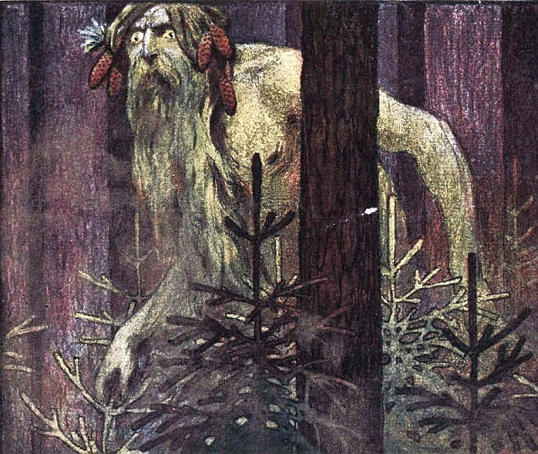
Random forests
What is?
What information it provides
Who is this guy and what he has to do?
Notes:
^ Breiman, Leo (2001). "Random Forests". Machine Learning 45 (1): 5–32. doi:10.1023/A:1010933404324.
Feature Selection with the Boruta Package

Slide 12
Random forests is related to classification and regression trees
Search each predictor to find a value of single predictor that best splits the data into two groups.
For the two resulting groups, the process is repeated until a hierarchical structure (a "tree") is created.

Slide 13
Regression tree to predict the C content based on pH and CEC. Model used 661 forest soil samples
CEC < 28.695
|
CEC < 21.165
CEC < 43.525
pH < 4.705
1.905
14.050
29.6
16.8
35.520

Slide 14
Random Predictor Illustration
Randomly select a subset of variables from original data
Dataset 1
Dataset 2
Dataset M
Build trees
Prediccion
Predict
Predict
Final Prediction
Slide from “Model Building Training” by Max Kuhn & Kjel Johnson.
Notes:
Available at zoo.cs.yale.edu/classes/cs445/slides/Pfizer_Yale_Version.ppt

Slide 15
Random Forest provides
Classification error
cazy.rf.Layer1
Call: randomForest(formula = Layer ~ ., data = cazy3, mtry = 2, importance = TRUE, do.trace = 100, ntree = 1000)
Type of random forest: classification
Number of trees: 1000
No. of variables tried at each split: 2
OOB estimate of error rate: 0%
Confusion matrix:
Mineral Organic class.error
Mineral 12 0 0
Organic 0 9 0

Slide 16
Random Forest provides
Classification error
Importance of explanatory variables (variables that when removed decrease accuracy)
A model for doing prediction
Predictor | Mineral | Organic | MeanDecreaseAccuracy | MeanDecreaseGini
CE1 | 2.25E-03 | 2.73E-03 | 2.39E-03 | 0.063831933
CE10 | 3.03E-03 | 4.87E-03 | 3.64E-03 | 0.097083875
CE11 | 2.77E-03 | 2.00E-03 | 2.47E-03 | 0.092517349
CE12 | 2.93E-03 | 4.25E-03 | 3.34E-03 | 0.06768254
CE13 | 5.15E-03 | 7.32E-03 | 5.70E-03 | 0.130081385
CE14 | 3.04E-03 | 6.28E-03 | 3.59E-03 | 0.109041167
CE15 | 2.95E-03 | 4.00E-03 | 3.27E-03 | 0.060318579
CE16 | 9.83E-04 | 1.57E-03 | 1.11E-03 | 0.044688679
CE2 | 2.90E-03 | 3.50E-03 | 3.08E-03 | 0.053630252
CE3 | 4.41E-03 | 4.43E-03 | 4.07E-03 | 0.083155067
CE4 | -2.00E-04 | 0.00E+00 | -1.25E-04 | 0.002666667
CE5 | 0.00E+00 | 1.33E-03 | 6.65E-04 | 0.036663736
CE6 | 5.22E-03 | 5.13E-03 | 4.89E-03 | 0.093645658
 | … | … | … | …

Slide 17
Feature selection with Boruta
Runs several rounds of Random Forests and selects predictors that are consistent across multiple runs

Slide 18
Feature selection with Boruta
Runs several rounds of Random Forests and selects predictors that are consistent across multiple runs
Boruta = pine tree in ancient Slavic
Slavic Lord of wood and hunting
Should one ever encounter one must thwart him immediately by turning all one's clothes inside out and backwards, and placing one's shoes on the opposite feet.

Slide 19
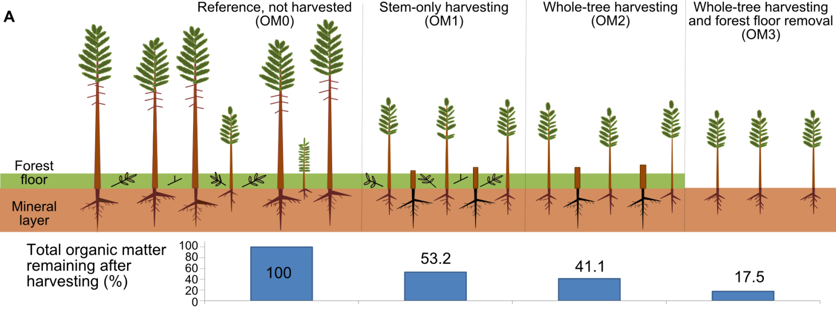
Finding predictors of forest harvesting and soil layers

Slide 21
Random Forest + Boruta
Provides classification information
Provides list of features
Provides predictive model
Not sensitive to overfitting
Computational – Intensive
Hard to understand

Slide 22
DESeq2
R packaged developed for RNASeq
Uses similar approach to data organization as Phyloseq
First does normalization to adjust for differences in :
Sample size: Samples with more reads have higher counts
Sample composition. Since all the sequencing data is relative change in the expression/ abundance of one group will afffect the counts for other groups
Explained here:
OTU | Sample1 (n=635) | Sample2 (n=1270)
OTU1 | 30 | 60
OTU2 | 22 | 44
OTU3 | 2 | 4
OTU4 | 563 | 1126
OTU5 | 5 | 10
OTU6 | 13 | 26
OTU | Sample1 (n=635) | Sample2 (n=635)
OTU1 | 30 | 235
OTU2 | 24 | 188
OTU3 | 0 | 2
OTU4 | 563 | 0
OTU5 | 5 | 39
OTU6 | 13 | 100

Slide 23
DESeq2
library("DESeq2") # Requires previous installation.
# Convert to DESeq object
# Replace Treament with the key variable(s) to test
deseq2_object = phyloseq_to_deseq2(phyloseq_objetct,
~ Treatment)
# Run differential abundance test
deseq2_object = DESeq(diagdds, test="Wald", fitType="parametric")
## estimating size factors
## estimating dispersions
## gene-wise dispersion estimates
## mean-dispersion relationship
## final dispersion estimates
## fitting model and testing
After normalization, DESeq2 uses a formula to do the differential abundance testing
Function phyloseq_to_deseq() can convert one object into another

Slide 24
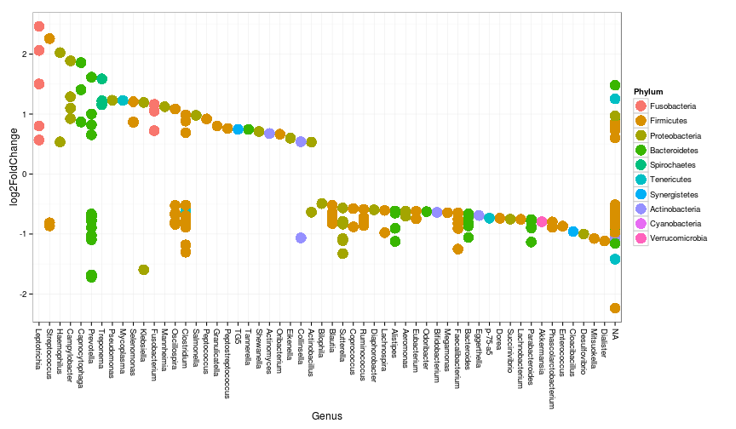
Example: Genomic analysis identifies association of Fusobacterium with colorectal carcinoma.
Microbiome data (Metagenomes) from nine tumor/normal pairs
Analyzed in DESeq2
Example from here

Slide 25
DESeq2
Great normalization approach
Does not throw data (more power)
Hard to install package
Need to specify the experimental design when creating object (as in Phyloseq)

Slide 26
Conclusions
Different tools are available for testing for differential abundance
A balance between information, simplicity, and speed may not be easy to achieve

