Slide 1
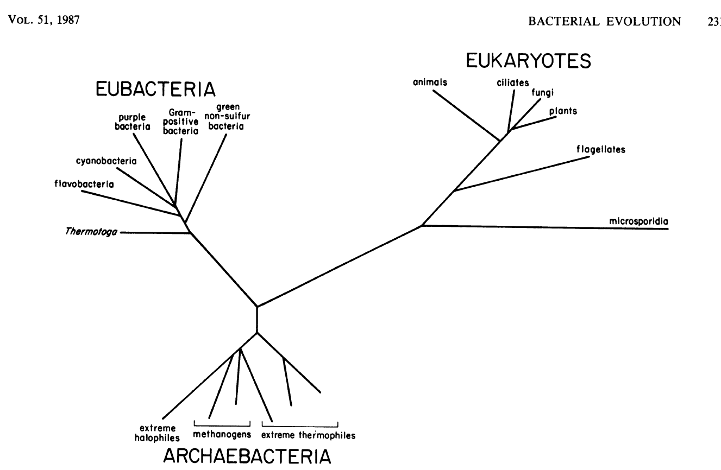

Slide 2
Objectives
Identify characteristics of that makes 16S rRNA a good phylogenetic marker
Explain what is an OTU

Slide 3
Pre-assessment
Phylogenetic markers?
Characteristic of a good phylogenetic marker
What genes can be used?

Slide 4
Phylogenetic marker requirements
Universal distribution.
Homologous function in all organisms.
No of horizontal transfer
Alignable sequence.
Sequence with highly conserved zones for big evolutionary distances (alignment) and some variable regions.
Enough information.
Examples:
16S rRNA (18S rRNA)
23S rRNA
rpoN
recA
Internal transcribed spacer (ITS)
Mitochondrial DNA

Slide 5
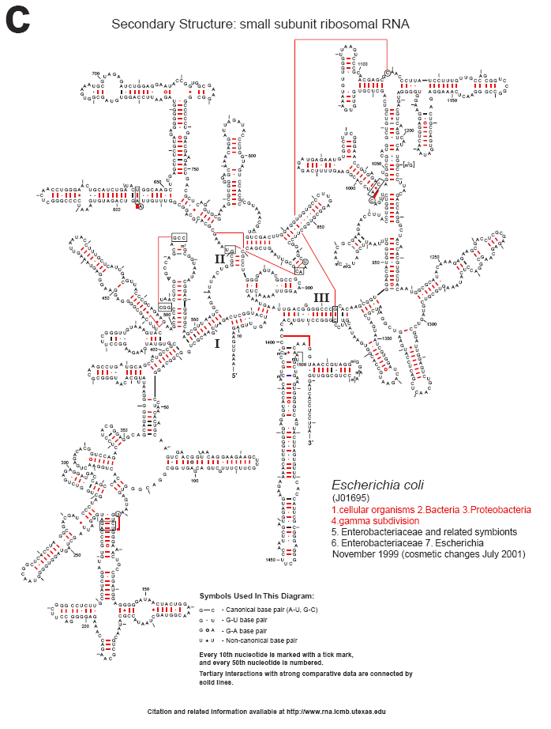
Essential function
Highly conserved sequence (1°, 2°)
~ 1500 bases
Highly conserved (primers) and variable regions (information)
Cannone, 2002. BMC Bioinformatics. 3:2

Slide 6
Who is there?
How abundant are the groups?
How is the community structured?
How similar are my samples?
How diverse is my community?
α
β
α
How novel are my sequences?
How does species X varies among my samples?

Slide 7

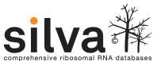

Tools for rRNA analysis
Features:
Data is organized under a taxonomic structure
Sequences are aligned
Curated sequences
Some metadata
Provide specialized analysis tools
Specialized Databases

Slide 8


Pipelines for processing and analysis of rRNA
Features
Pipelines that incorporate tools from different sources.
Processing can be done in your own computer
Have problems of their own:
Dependencies
Compatibility
Versions
Defaults

Slide 9
Phylogeny
General processing flow
Raw data
Clean data
Aligned sequences
Distance matrix
OTUs
Taxonomic classification
Diversity analysis

Slide 10
Traditional processing does
not scale well….

Slide 11
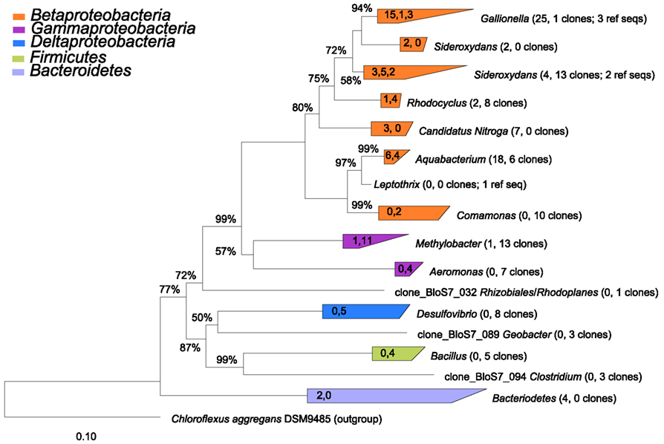
Taxonomic classification
Phylogenetic tree reconstruction
Require references
Needs alignments
Slow, does not scale well
Front. Microbiol., 22 May 2012 | http://dx.doi.org/10.3389/fmicb.2012.00172

Slide 12
Taxonomic classification
Assign sequences to pre-existing taxonomy
Does not need alignment (Memory)
Fast and precise
Sufficient for some analysis.
Classification scheme may change over time.
Groups may not be internally consistent.
RDP Bayesian classifier
K-nearest neighbours (KNN)

Slide 13
K-Nearest neighbours
Seq1
Seq2
Query
Seq3
Database
Seq4
Seq5
Seq5
k related sequences vote for taxonomic assignment.
Consensus taxonomy is assigned
3
Query word’s frequency
(8-mers)
Database word frequency
(8-mer)
1
2

Slide 14
Bayesian Classifier¹
Seq1
Seq2
Query
Seq3
Database
Seq4
Seq5
3
Seq5
Compares frequency to assign probability for each genus.
Reports genus with highest probability
Includes bootstrap value
Query word’s frequency
(8-mers)
Database word frequency
(8-mer)
1
2
¹Wang et al. 2007: doi:10.1128/AEM.00062-07

Slide 15
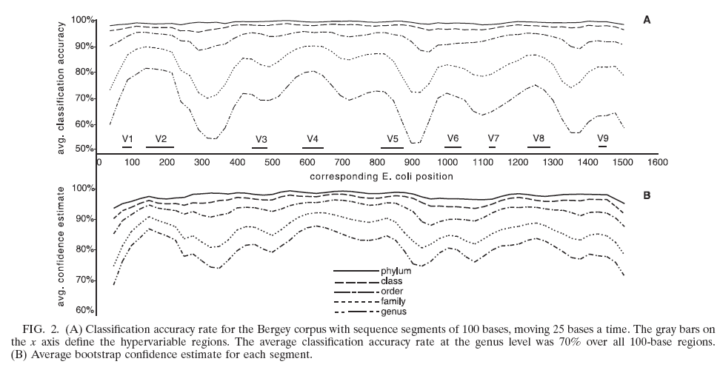
16S rRNA gene regions provide different amount of information
Wang Q, Garrity GM, Tiedje JM, Cole JR.
Appl Environ Microbiol. 2007 Aug;73(16):5261-7. Epub 2007 Jun 22.

Slide 16
The OTU conundrum

Slide 17
Operational taxonomic units (OTUs) analysis
Hard to define species in bacteria
OTUs are species proxies.
Groups based on distances among aligned sequences.
Groups with at least 97% similarity (3% distances) are considered to be from the same species*.
Sequences
Aligned sequences
Distance
matrix
Clustering groups
Sample x OTU table

Slide 18
Alignment
Traditional
Compare all sequences, align closest pair, add more sequences until no more remain
Implemented in ClustalW, Muscle
Slow
Does not scale well (N²)
New models
NAST aligner (Greengenes)
RDP aligner

Slide 19
NAST aligner
Master alignment
1
4
All query sequences are
aligned to model and
thus to each other
Identify relative in master alignment
using k-mers or blast
Align candidate against reference
using gaps of model and
Needleman–Wunsch algorithm
2
3

Slide 20
RDP Model aligner
Model uses both primary and secondary structure information.
Once sequences are aligned to se model they are aligned to each other.
Uses a Hidden Markov model.
1. Nawrocki et al 2009. Bioinformatics. May 15;25(10):1335-7. Epub 2009 Mar 23.

Slide 21
Distance matrix
Complete linkage clustering
Aligned sequences

Slide 22
Distance matrix
Complete linkage clustering
Aligned sequences

Slide 23
Distance matrix
Complete linkage clustering
Aligned sequences

Slide 24
Distance matrix
Complete linkage clustering
Aligned sequences

Slide 25
Distance matrix
Complete linkage clustering
Aligned sequences

Slide 26
Distance matrix
Complete linkage clustering
Aligned sequences

Slide 27
Distance matrix
Complete linkage clustering
Aligned sequences
Guarantees distance within a group
Can have some artefacts
Singletons can have closely related sequences
Number of OTUs can change when more samples are added

Slide 28
Species x sites table (OTU x Samples)
 | OTU1 | OTU2 | OTU3 | OTU4 | OTU5 |  | H’ | S
Sample1 | 20 | 15 | 50 | 10 | 0 |  | 1.194 | 4
Sample2 | 15 | 30 | 35 | 20 | 0 |  | 1.335 | 4
Sample3 | 0 | 12 | 0 | 100 | 0 |  | 0.3405 | 2
Sample4 | 0 | 10 | 100 | 0 | 1 |  | 0.3533 | 3
0.32
Sample 4
0.16
 | Sample1 | Sample2 | Sample3 | Sample4
Sample1 | 0.000 | 0.231 | 0.787 | 0.417
Sample2 | 0.231 | 0.000 | 0.698 | 0.573
Sample3 | 0.787 | 0.698 | 0.000 | 0.910
Sample4 | 0.417 | 0.573 | 0.910 | 0.00
Coordinate 2
Sample 3
0.00
Sample 1
-0.16
-0.32
Sample 2
-0.80
-0.48
-0.16
0.16
0.48
Coordinate 1
Sample 4
Sample 2
Sample 1
Sample 3
0.2
0.3
0.4
0.5
0.6
0.7
0.8
0.9
1.0
Bray-Curtis similarity

Slide 29
Species x sites table (OTU x Samples)
 | OTU1 | OTU2 | OTU3 | OTU4 | OTU5 |  | H’ | S
Sample1 | 20 | 15 | 50 | 10 | 0 |  | 1.194 | 4
Sample2 | 15 | 30 | 35 | 20 | 0 |  | 1.335 | 4
Sample3 | 0 | 12 | 0 | 100 | 0 |  | 0.3405 | 2
Sample4 | 0 | 10 | 100 | 0 | 1 |  | 0.3533 | 3
0.32
Sample 4
0.16
 | Sample1 | Sample2 | Sample3 | Sample4
Sample1 | 0.000 | 0.231 | 0.787 | 0.417
Sample2 | 0.231 | 0.000 | 0.698 | 0.573
Sample3 | 0.787 | 0.698 | 0.000 | 0.910
Sample4 | 0.417 | 0.573 | 0.910 | 0.00
Coordinate 2
Sample 3
0.00
Sample 1
-0.16
-0.32
Sample 2
-0.80
-0.48
-0.16
0.16
0.48
Coordinate 1
Sample 4
Sample 2
Sample 1
Sample 3
0.2
0.3
0.4
0.5
0.6
0.7
0.8
0.9
1.0
Bray-Curtis similarity

Slide 30
Alignment-independent methods Greedy algorithm
Traditional algorithms
Nearest, average, farthest neighbor.
Require a distance matrix (memory).
Systematic.
Guaranteed consistency.
Sequences
Aligned sequences
Distance
matrix
Clustering groups
Sample x OTU table

Slide 31
Greedy clustering
Query
Database (Seeds)
Clusters

Slide 32
Alignment-independent methods Greedy algorithm
Does not need global alignment.
Does not need a distance matrix (Low memory).
Extremely fast.
Good if sequences do not align well.
Heuristics, may not be optimal or consistent.
UCLUST
Crunchclust
VCLUST.

Slide 33
Reference based methods
OTU1
OTU2
OTU3
OTU4
OTU1
OTU2
OTU3
OTU4
OTU5
1
Master alignment
4
OTU counts are assigned
2
Sequences are aligned against the master alignment and assigned to the reference OTU
Unaligned sequences are discarded
(Closed reference)
or
Unaligned sequences are aligned to each other to create OTUs de novo
(Open reference)
3

Slide 34
Reference based methods
Useful when comparing sequences from different regions
E.g. Metanalysis
Database dependent
Implemented in QIIME

Slide 35
What is coming?

Slide 36
What is the coming?
Better replication, more robust statistical analysis
More longitudinal, spatial analysis
More, more, more data (new challenges).
Wider market penetration
Role of microbiome in more diseases
Routine analysis for monitoring

Slide 37
What is coming? - Technologies
Pacific Bioscience
Very long reads (1000 -3000 bases)
Smaller output (30K reads)
Accuracy ~85%
High equipment costs ($ 700K)
Can be optimize for complete gene
Ion Torrent
Similar chemistry to 454
Low costs: equipment, processing
Not the best cost per base

Slide 38
 | Illumina Miseq | llumina Hiseq | Pacific Biosciences | Ion Torrent | Nanopore Minion
Read length | 2 x 300 | 2 x 250 | ~8.3kb (10kb -40kb) | 400 | 2kb
Output (Gb) | 15 | 300 | 0.5 – 1 | 50 Mb- 1Gb | ?
Per base accuracy (%) | 0.1 | 0.1 | 85 | 1 | 65-70
Quality | >Q30 | >Q30 | >Q10 single >Q50 consensut | >Q20 | >Q5
Error type | Substitution | Substitution | Indel | Indel | Indel
Run time (h) | 27 | 1-10 d | 2 | 2
Cost /MB | 0.15 | 0.05 | 0.13 – 0.60 | 1
Cost equipment | 125k | 654 | 695k | 80k

Slide 39
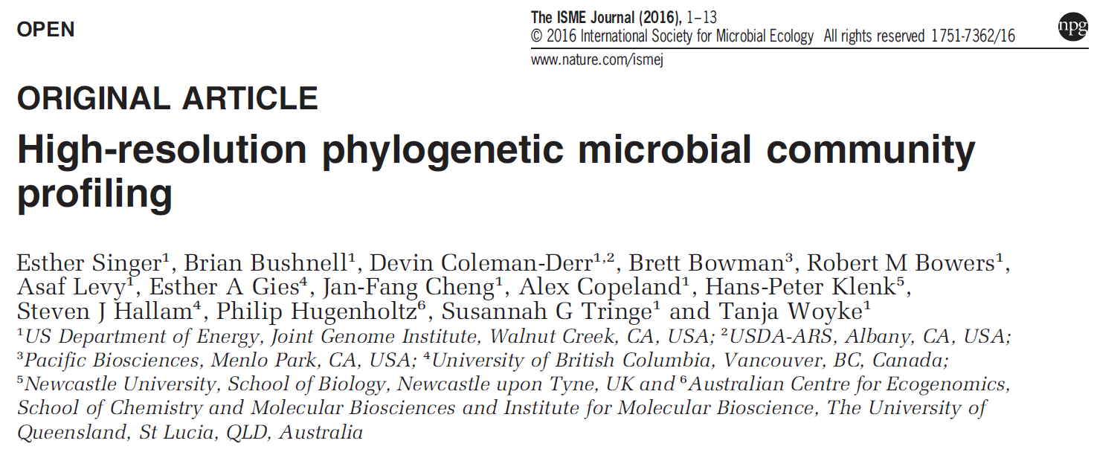

Slide 40
Now a quiz

Slide 41
Why is the 16S rRNA gene a good phylogenetic?
Essential, homologous function
No HGT
Conserved and variable regions
Long enough to provide enough information
Good databases and analysis tools

Slide 42
What was a OTUs?
Operational taxonomic unit.
Proxy because it is hard to define the species (other taxa) concept in bacteria.
Species usually defined at 97% similarity.

Slide 43
Summary
16S rRNA gene is the preferred phylogenetic marker
OTUs are proxy for species
97% = Species
Specialized tools and procedures are required to navigate computational problems

Slide 44
Questions?

