Slide 1

Mothur MiSeq Processing

Slide 2
Pre-Assessment
Experience with Mothur? Qiime?
Experience with command line?

Slide 3
Objectives Requirements
Learn how to run mothur with Miseq data.
Understand rationale behind steps.
Used processed data for diversity analysis.
A computer Mas/PC/Linux with Mothur installed
Protocol
Documents also here
https://github.com/carden24/MIC506-Workshop

Slide 4
What is Mothur ?
Patrick Schloss
DOTUR, 2005 (Distance-based OTU and Richness)
SONS, 2006 (Shared OTUs and Similarity)
MOTHUR, 2009
Available at www.mothur.org

Slide 5
How can I run mothur?
Interactively
Move required files into mothur folder
Initialize mothur
Type commands
Batch mode
Prepare plain text script with commands
Execute script with
mothur <script.batch>

Slide 6
Pipeline
Sequencing files
(Pair of fastq files
per sample)
Script
(Instructions)
<.batch>
List of files
<.files>
Master alignment
<.fasta>
Taxonomic scheme

Slide 7
stability.files
Sample
Pair1
Pair2
F3D0 | F3D0_S188_L001_R1_001.fastq | F3D0_S188_L001_R2_001.fastq
F3D141 | F3D141_S207_L001_R1_001.fastq | F3D141_S207_L001_R2_001.fastq
F3D142 | F3D142_S208_L001_R1_001.fastq | F3D142_S208_L001_R2_001.fastq
F3D143 | F3D143_S209_L001_R1_001.fastq | F3D143_S209_L001_R2_001.fastq
F3D144 | F3D144_S210_L001_R1_001.fastq | F3D144_S210_L001_R2_001.fastq
F3D145 | F3D145_S211_L001_R1_001.fastq | F3D145_S211_L001_R2_001.fastq
F3D146 | F3D146_S212_L001_R1_001.fastq | F3D146_S212_L001_R2_001.fastq
F3D147 | F3D147_S213_L001_R1_001.fastq | F3D147_S213_L001_R2_001.fastq
F3D148 | F3D148_S214_L001_R1_001.fastq | F3D148_S214_L001_R2_001.fastq
F3D149 | F3D149_S215_L001_R1_001.fastq | F3D149_S215_L001_R2_001.fastq
F3D150 | F3D150_S216_L001_R1_001.fastq | F3D150_S216_L001_R2_001.fastq
F3D1 | F3D1_S189_L001_R1_001.fastq | F3D1_S189_L001_R2_001.fastq
F3D2 | F3D2_S190_L001_R1_001.fastq | F3D2_S190_L001_R2_001.fastq
F3D3 | F3D3_S191_L001_R1_001.fastq | F3D3_S191_L001_R2_001.fastq
F3D5 | F3D5_S193_L001_R1_001.fastq | F3D5_S193_L001_R2_001.fastq
F3D6 | F3D6_S194_L001_R1_001.fastq | F3D6_S194_L001_R2_001.fastq
F3D7 | F3D7_S195_L001_R1_001.fastq | F3D7_S195_L001_R2_001.fastq
F3D8 | F3D8_S196_L001_R1_001.fastq | F3D8_S196_L001_R2_001.fastq
F3D9 | F3D9_S197_L001_R1_001.fastq | F3D9_S197_L001_R2_001.fastq
Mock | Mock_S280_L001_R1_001.fastq | Mock_S280_L001_R2_001.fastq

Slide 8
Join pairs
Filter seqs
Remove badly aligned
Filter alignment
(Dereplicate)
(Precluster)
(Dereplicate)
Align
Clean Sequences
Raw Sequences
Aligned sequences
Refined alignment
Classify
Remove
Chimeras and contaminants
Phylotypes
Greedy
clustering
Final alignment
Create
matrix
Cluster
split
Distance matrix
+ Classify OTUs
Create table
Cluster
Sites by species table
Clustering result

Slide 9
Contents of stability.batch
 |  | pcr.seqs(fasta=silva.bacteria.fasta, start=11894, end=25319, keepdots=F)
 |  | system(mv silva.bacteria.pcr.fasta silva.v4.fasta)
 |  | system(rename silva.bacteria.pcr.fasta silva.v4.fasta)
 |  | make.contigs(file=stability.files, processors=8)
 |  | screen.seqs(fasta=current, group=current, maxambig=0, maxlength=275)
 |  | unique.seqs()
 |  | count.seqs(name=current, group=current)
 |  | align.seqs(fasta=current, reference=silva.v4.fasta)
 |  | screen.seqs(fasta=current, count=current, start=1968, end=11550, maxhomop=8)
 |  | filter.seqs(fasta=current, vertical=T, trump=.)
 |  | unique.seqs(fasta=current, count=current)
 |  | pre.cluster(fasta=current, count=current, diffs=2)
 |  | chimera.uchime(fasta=current, count=current, dereplicate=t)
 |  | remove.seqs(fasta=current, accnos=current)
 |  | classify.seqs(fasta=current, count=current, reference=trainset9_032012.pds.fasta, taxonomy=trainset9_032012.pds.tax, cutoff=80)
 |  | remove.lineage(fasta=current, count=current, taxonomy=current, taxon=Chloroplast-Mitochondria-unknown-Archaea-Eukaryota)
 |  | remove.groups(count=current, fasta=current, taxonomy=current, groups=Mock)
 |  | cluster.split(fasta=current, count=current, taxonomy=current, splitmethod=classify, taxlevel=4, cutoff=0.15)
 |  | make.shared(list=current, count=current, label=0.03)
 |  | classify.otu(list=current, count=current, taxonomy=current, label=0.03)
Quality control step
Reducing computational stress step
Plattform-specific step

Slide 10
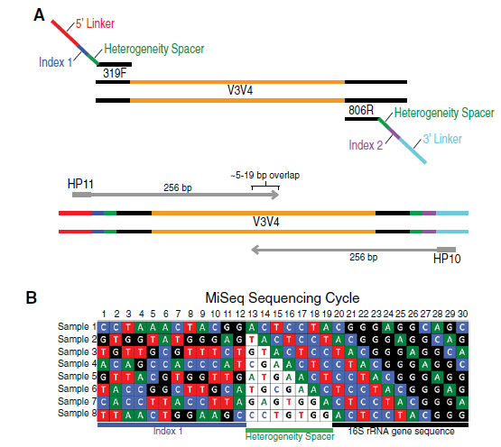

Multiplex approach
Allow for sequencing of multiple samples in one run.

Slide 11
Make.contigs()

Slide 12
What is pre-clustering

Slide 13
Analysis of communities
Today’s task
Run the pipeline
Open .shared file in Excel
Open .design file in Excel
Today’s questions
How many species were detected in total?
Which treatment has more species?
Which treatment has higher diversity?

