Slide 1

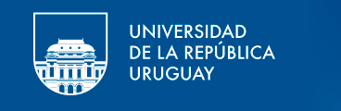

Analysis of sequencing data for the study of microbial communities
AGENCIA NACIONAL DE INVESTIGACIÓN E INNOVACIÓN

Slide 2
What is this course about:
Introduction to basic tools and concepts on the analysis of microbial communities
Emphasis on next generation sequencing
Emphasis on 16S rRNA gene analysis
Some functional gene analysis of communities

Slide 3
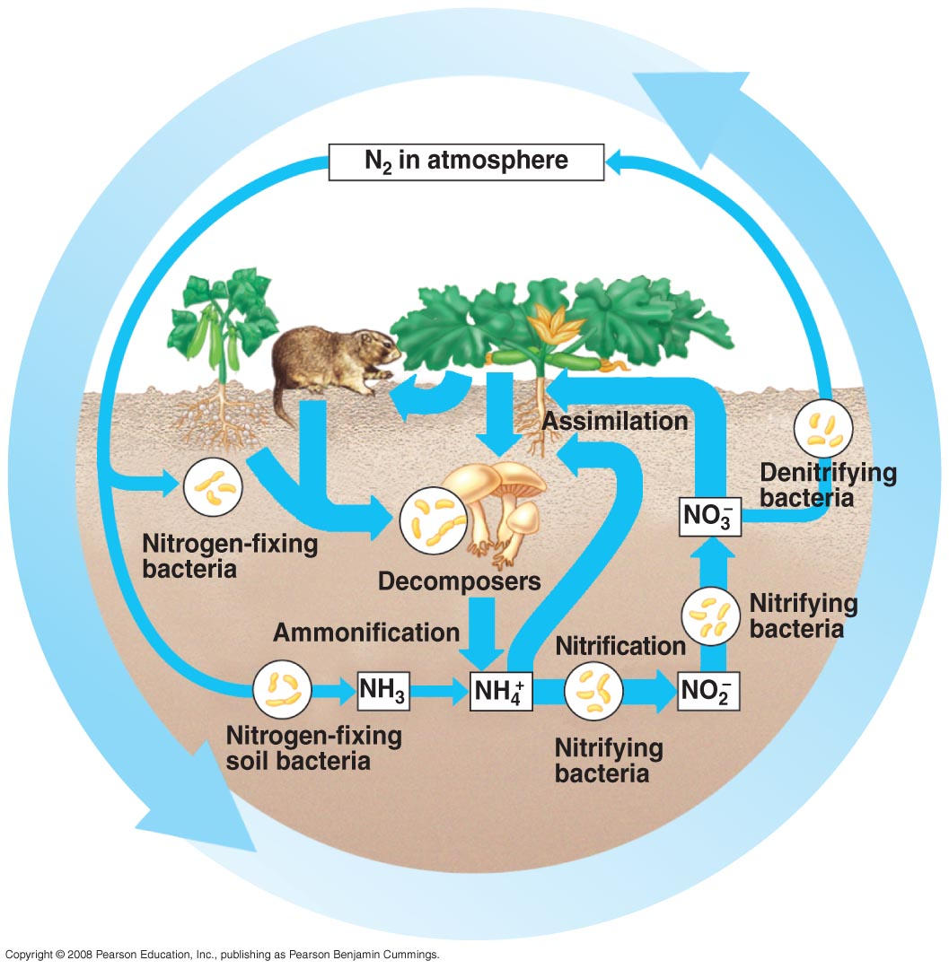
Why is this course relevant?
1. Microbes have important roles in biology
Microbes are key players in biogeochemical cycles
http://apbiosemonefinalreview.pbworks.com/f/55_14cNitrogenCycle-L.jpg

Slide 4
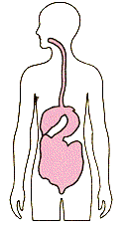
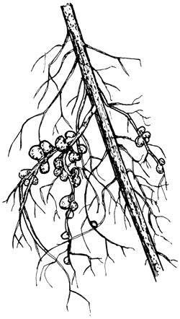
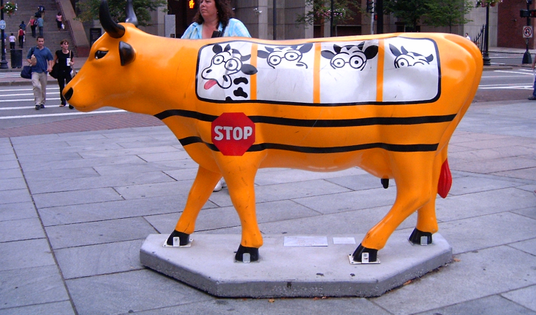
Why is this course relevant?
1. Microbes have important roles in biology
Microbes interact with other organisms of human interest
http://www.fao.org/docrep/006/ad228e/AD228E93.gif

Slide 5
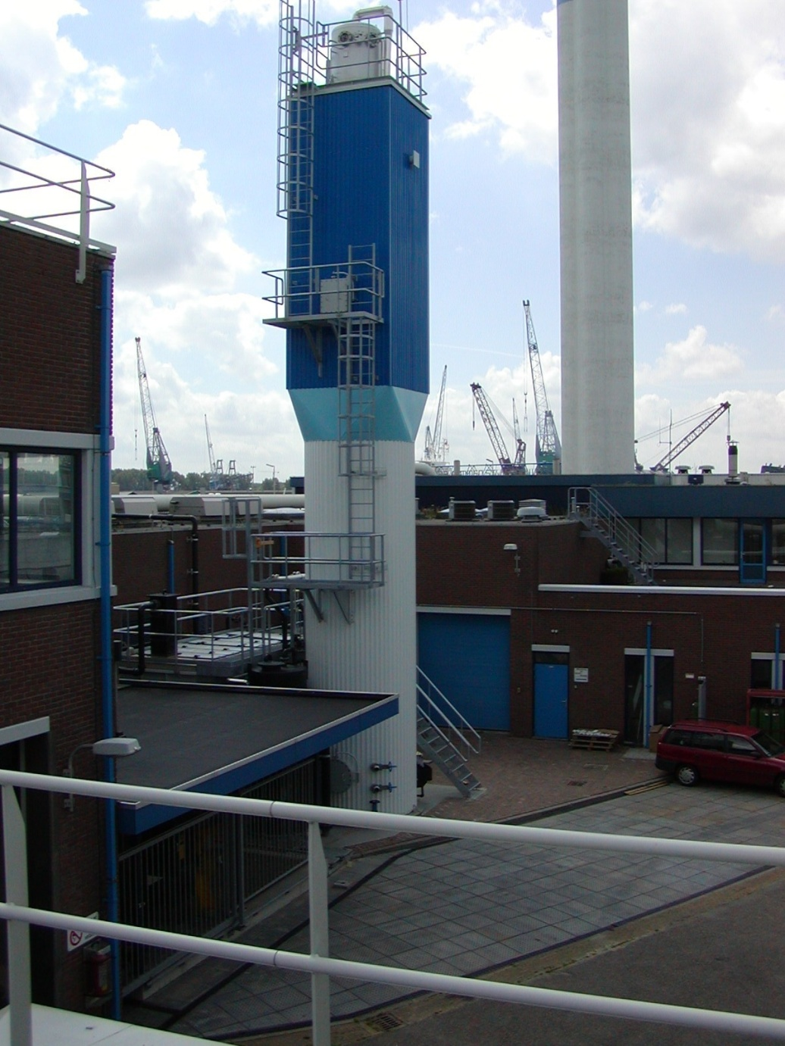
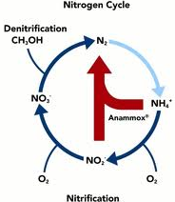
Why is this course relevant?
1. Microbes have important roles in biology
Biotechnological potential
e.g. Anaerobic ammonia oxidation as novel wastewater treatment process
↓60% energy consumption
↓ 88% CO2 emissions
↓ 50% land consumption
Anammox bioreacton from:
http://www.twanetwerk.nl/default.ashx?DocumentId=7881

Slide 6
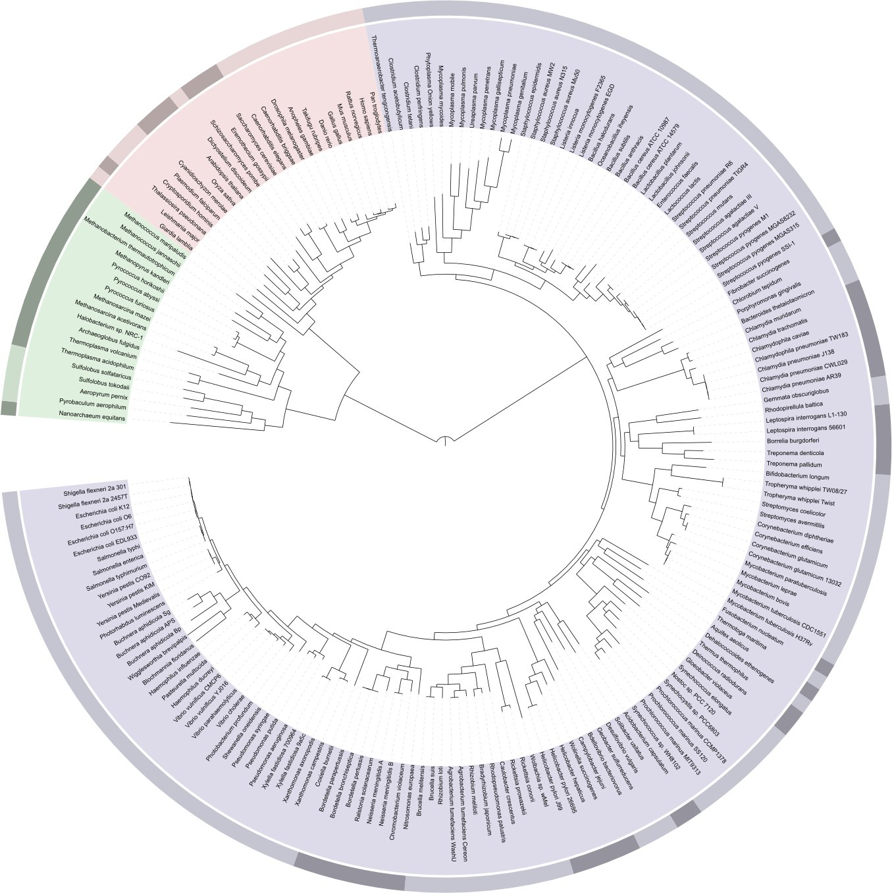
Why is this course relevant?
Humans
1. Microbes have important roles in biology
Microbes show great metabolic diversity
http://upload.wikimedia.org/wikipedia/en/3/36/ITOL_Tree_of_life.jpg

Slide 7
Why is this course relevant?
2. Sequencing has become cheaper and more with massive outputs
Data from National Human Geneome Research Institute
http://www.genome.gov/sequencingcosts/

Slide 8
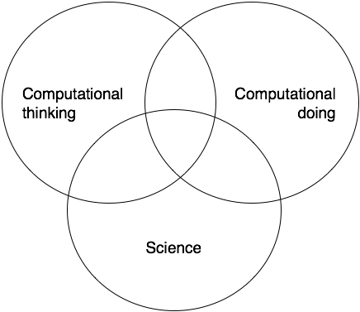
Why is this course relevant?
3. The limiting steps has moved to data analysis
Good computational scientist are needed
Does the computation work as intended?
Does it address the scientific question?
Does it answer the question?
Does the answer make sense?
Would we be able to tell if the answer was right?

Slide 9
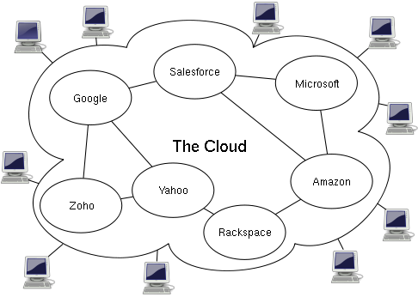
Why is this course relevant?
4. Computer power is cheaper and more accessible
Cloud computing:
provision of computational resources on demand via a network
Image from Sam Johnston under CC license

Slide 10
Why is this course relevant?
5. Bioinformatics is becoming an important part of biology
General knowledge
What is possible
Limitations of techniques
How can we use it for my research
Critical thinking when reviewing bioinformatics work

Slide 11
Questions?

Slide 12
Microbial diversity
What it is? How do we measure it? Why should we care?

Slide 13
Why do we study the microbial diversity?
To detect organisms responsible for functions
E.g methanogenesis to Archaea, nitrogen fixation to Rhizobium
To find novel microorganisms and functions
To estimate how stressful are the conditions
To compare biological systems.
Similar communities should have similar functions

Slide 14
Diversity, some definitions
Magurran: “the variety and abundance of species in a defined unit of study”
α diverisity: diversity property of a defined spatial unit (single community)
β diversity: a measure of the extent to which the diversity of two or more spatial units differs (multiple communities)

Slide 15
Alpha diversity
Diversity within a community
Richness : How many different species
Evenness: How are they distributed
= Richness =
< Evenness >

Slide 16
Indices of alpha diversity
Take into consideration one or both components of diversity to get a metric. Most commonly used:
Shannon (H’)
Simpson (D)
Chao1

Slide 17
Shannon index (H’)
number of species
proportion of population
constituted by species i

Slide 18
Shannon index boundaries
Range : 0 - ∞
Strongly influenced by richness

Slide 19
Shannon index calculations
Sample 1
Sample 2
H’= 1.279854
H’=0.940448
 | Count |  | Pi |  | ln(pi) |  | pi.ln(pi)
 | Sample1 | Sample2 | Sample1 | Sample2 | Sample1 | Sample2 | Sample1 | Sample2
Sp1 | 4 | 7 | 0.4 | 0.7 | -0.91629 | -0.35667 | -0.36652 | -0.24967
Sp2 | 3 | 1 | 0.3 | 0.1 | -1.20397 | -2.30259 | -0.36119 | -0.23026
Sp3 | 2 | 1 | 0.2 | 0.1 | -1.60944 | -2.30259 | -0.32189 | -0.23026
Sp4 | 1 | 1 | 0.1 | 0.1 | -2.30259 | -2.30259 | -0.23026 | -0.23026
 | 10 | 10 |  |  |  |  | -1.27985 | -0.94045

Slide 20
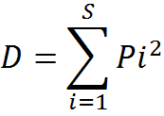
Simpson index
number of species
proportion of population
constituted by species i
Probability that if two members of the community are draw are random they will be the same

Slide 21
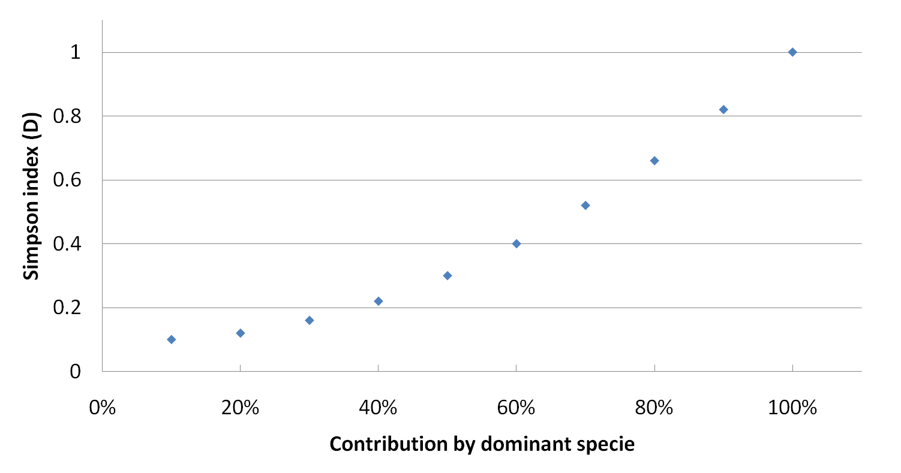
Simpson index boundaries
Range : <0 – 1],
Strongly influenced by evenness
Usually presented as (1-D), so high diversity is 1, low diversity 0

Slide 22
Simpson index calculation
Sample 1
Sample 2
D=0.3
1-D =0.7
D=0.52
1-D =0.48
 | Count |  | Pi |  | Pi2
 | Sample1 | Sample2 | Sample1 | Sample2 | Sample1 | Sample2
Sp1 | 4 | 7 | 0.4 | 0.7 | 0.16 | 0.49
Sp2 | 3 | 1 | 0.3 | 0.1 | 0.09 | 0.01
Sp3 | 2 | 1 | 0.2 | 0.1 | 0.04 | 0.01
Sp4 | 1 | 1 | 0.1 | 0.1 | 0.01 | 0.01
 | 10 | 10 |  |  | 0.3 | 0.52

Slide 23
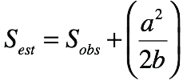
Chao1 index
Corrects observed number of OTUs by a factor based on rare OTUs
a=singletons, b=doubletons
Helps define the lower limits of richness
May be too sensitive to sequencing errors and massive sequencing
Observed Species (S_{obs}) = 5
Singletons (a) = 2
Doubletons (b) =2
S_{est}= 5+(2²/1) = 9

Slide 24
Presenting alpha diversity
Show richness and eveness
A high slope can be indicative of an stressful environment with strong selection
Softer slopes indicate more homogenous distribution of resources

Slide 25
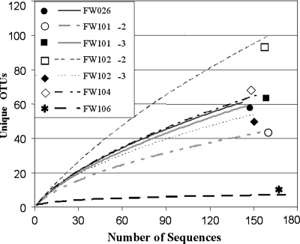
Rarefaction curves
Used to compare communities with different number of samples
E.g go back in curve to make comparisons at same level of sampling
Cannot be extrapolated
More frequently used to estimated coverage and if incomplete sampling has occurred (reached an asymptote)

Slide 26
Definitions
Magurran: “the variety and abundance of species in a defined unit of study”
α diverisity: diversity property of a defined spatial unit (single community)
β diversity: a measure of the extent to which the diversity of two or more spatial units differs (multiple communities)

Slide 27
Beta diversity
Use abundance and/or presence-absence information to find out if diversity between two communities is similar
Common measures (Range 0-1)
Jaccard (1/0)
Sørensen (1/0)
Bray-Curtis
Chao-Sørensen

Slide 28
Presence/absence based indices
Sample1
Sample2
a
b
c
Jaccard = b/ (a+b+c)
Sorensen (QS) = 2b /(a+2b+c))
Sorennsen gives more weight to shared species

Slide 29

Beta diversity indices
Bray Curtis
Sum of absolute difference of abundances divided by sum of abundance in both sites
Chao-Sorensen
Sorensen index that takes into account abundance and assumes undersampling

Slide 30
Use of beta diversity indices
Compare communities
Create distance matrix
Use matrix to create a clustering tree
 | Sp1 | Sp2 | Sp3 | Sp4 | Sp5 | Sp6
Sample1 | 8 | 0 | 12 | 10 | 1 | 100
Sample2 | 3 | 0 | 12 | 40 | 5 | 0
Sample3 | 10 | 0 | 12 | 10 | 11 | 15
Sample4 | 4 | 1 | 12 | 2 | 8 | 3
Sample1 Sample2 Sample3
Sample2 0.84
Sample3 0.67 0.65
Sample4 0.84 0.67 0.50
Cluster Dendrogram
0.80
0.70
0.60
Sample1
Height
0.50
Sample2
Sample3
Sample4

Slide 31
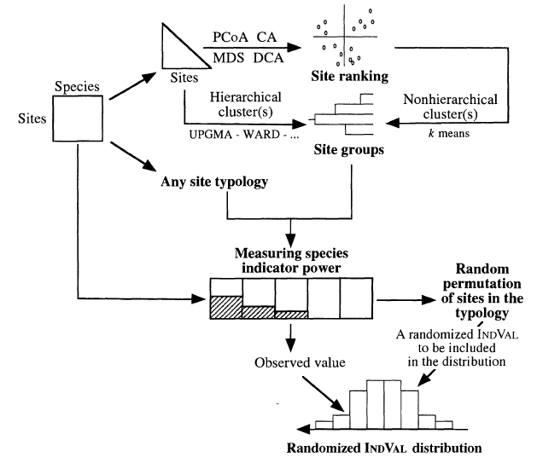
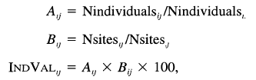
Indicator species analysis
Finds species with high abundance in specific sample or group of samples
P-value is calculated using a bootstrap permutation test
Dufrene and Legendre, 1997. Ecological Monographs, 67(3):345-366

Slide 32
Common community analysis questions
Who is there? (Richness)
How is the community structured? (α diversity)
Which groups are abundant? (α diversity)
How similar are the communities according to their diversity pattern? (β diversity)
How is distribution of the group X among my samples (Indicator species)

Slide 33
Common community analysis questions
How similar is my bacteria to other bacteria? (rRNA)
What is the classification of my sequences (rRNA)
What is the evolutionary history of my sequences? (Phylogenetic trees)
What is the functional diversity of my community (functional genes)

Slide 34
Conclusions
Understanding the microbial diversity is key to understand the biological processes
Diversity can be studied at different levels and has multiple components
In the future more microbial community analysis are expected for all environments and sequencing technologies are driving this efforts by making the technology cheaper

Slide 35
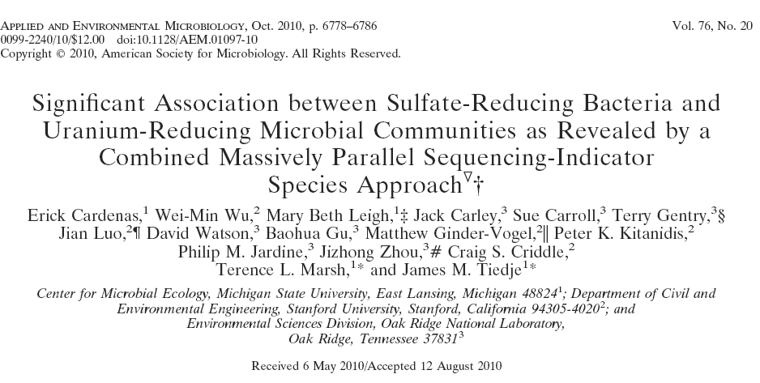
Example

Slide 36
Experimental design
Microbial characterization of sediments using 16S rRNA gene surveys
454 pyrosequencing (5000 sequences per sample, 200-300 bases long)
Groundwater flow
FW101
FW102
FW026
FW024
FW105
FW103
FW104
FW100
Multilevel sampling wells
Meters
Wells
0
1
2
3

Slide 37
Microbial community structure is related to the connection to the injection well and pH
FW105 (4.66)
FW103 (5.92)
Low activity wells
L
FW101
FW102
FW102-1 (6.4)
FW026
FW024
FW101-4 (5.6)
FW100-4 (5.8)
FW105
FW102-4 (4.4)
FW103
FW104
Multilevel sampling Wells
FW100
FW104 (5.8)
H1
FW026 (5.7)
High activity wells
FW101-3 (6.1)
H
FW101-2 (6.2)
H2
Clustering by Chao-Sorensen index, also called Sorensen abundance-based distance
FW102-3 (6.2)
FW102-2 (6.5)
H1
FW100-3 (5.9)
M1
FW024 (5.9)
Medium activity wells
FW100-2 (5.5)
M2
0.2
0.3
0.4
0.5
0.6
Sorensen Abundance Based Distance

Slide 38
Richness is not related to uranium reduction

Slide 39
Microbial communities were dominated by Proteobacteria and Acidobacteria
L
H
M1
M2

Slide 40
Differences in proteobacterial composition located in Gamma, Delta and Alpha classes
L
H
M1
M2

Slide 41
Indicator species analysis
FW105 (4.66)
FW103 (5.92)
L
FW102-1 (6.4)
FW101-4 (5.6)
FW100-4 (5.8)
FW102-4 (4.4)
FW104 (5.8)
FW026 (5.7)
FW101-3 (6.1)
H
FW101-2 (6.2)
FW102-3 (6.2)
FW102-2 (6.5)
FW100-3 (5.9)
M1
FW024 (5.9)
FW100-2 (5.5)
M2
0.2
0.3
0.4
0.5
0.6
Sorensen Abundance Based Distance

Slide 42
Known uranium reducers are indicator species of high activity wells
Group Rank | Classification | Closest isolated in RDP | Similarity to closest isolate in RDP (%)
01 | Desulfosporosinus (Firmicutes) | Desulfosporosinus sp. 5apy; AF159120 | 99.0
02 | Desulfosporosinus (Firmicutes) | Desulfosporosinus sp. 5apy; AF159120 | 99.0
03 | U. Burkholderiales (Betaproteobacteria) | Vogesella indigofera; ATCC 19706T; AB021385 | 95.6
04 | U. Peptococcaceae (Firmicutes) | Anaerobic bacterium Prop2; AY756143 | 92.7
05 | U. Chlamydiales (Chlamydiae) | Endosymbiont of Acanthamoeba sp. UWC22; AF083616 | 91.7
06 | Desulfosporosinus (Firmicutes) | Desulfosporosinus sp. 5apy; AF159120 | 98.0
07 | Desulfovibrio (Deltaproteobacteria) | Desulfovibrio putealis (T); DSM 16056; AY574979 | 99.5
08 | U. Firmicutes | Clostridium sp. 9B4; AY554416 | 92.7
09 | Desulfovibrio (Deltaproteobacteria) | Sulfate-reducing bacterium F1-7b; AJ012594 | 99.5
10 | U. Bacteria | Novel bacteria | 86.3
11 | U. BRC1 | Novel bacteria | 82.8
12 | U. Betaproteobacteria | Thauera sp. R-28312; AM084110 | 99.0
13 | Anaeromyxobacter (Deltaproteobacteria) | Anaeromyxobacter dehalogenans (T); 2CP-1; ATCC BAA-258; AF382396 | 96.1
14 | U. Alphaproteobacteria | Endosymbiont of Acanthamoeba polyphaga; AF132138 | 90.2
15 | U. Betaproteobacteria | Gallionella ferruginea subsp. capsiferriformans; DQ386262 | 96.6

