Slide 1
Tools for microbial community analysis

Slide 2
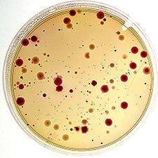
What I am not going to talk
Culture dependent analysis
Isolate all possible colonies
Infer community
Test functions of pure cultures
Physiology tests are best way to prove function
Different nutritional requirements
Different growth rates
Image from http://www.ars.usda.gov/is/ar/archive/oct05/air1005.htm?pf=1

Slide 3
Factors to be considered in technique selection
Information provided: profile vs. sequence
Profile: (1/0)+ abundance
Sequence: For phylogenetics, classification, and OTUs
OTUs is a species proxy that bypasses species discussion
Coverage: whole community vs. sampling
Costs
PCR and cloning needs
These techniques are not exclusive for 16S rRNA genes
Expensive
Microarrays X
Clone libraries X
Profiling
(whole community)
Sequencing
(sampling)
X Genotyping
X TRFLP
X Pyrotags
X
DGGE
Cheap

Slide 4
Denaturing gradient gel electrophoresis (DGGE)
1. Extract DNA from communities
2. Amplify
community genes
3. Denaturing gel electrophoresis
Increasing denaturant
Different sequences have different denaturing conditions
Region to be amplified need to have regions susceptible to melting
Profile

Slide 5
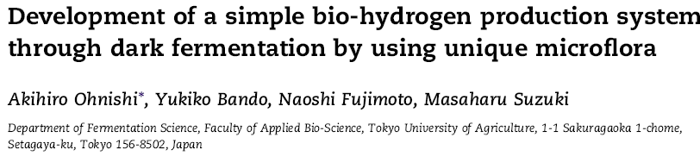
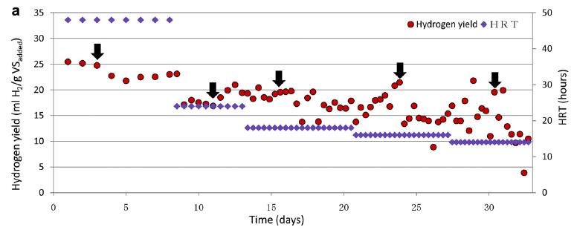
System that does not rely on Clostridium, therefore no heat, acid, or base pretreatment needed

Slide 6
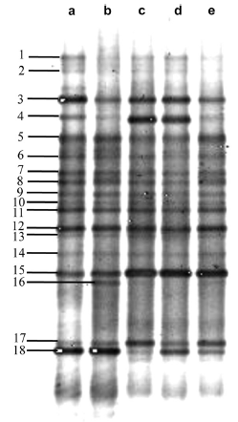
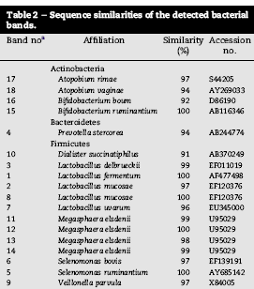
Lactic-acid-producing bacteria dominated the microbial communities

Slide 7
DGGE summary
Whole community profiling
Bands can be excised and sequenced
Cheap
Fast
PCR bias
Primer bias
Cannot resolve more than 50 bands
PCR product cannot be too long (<500bp)
Overlapping bands
Technically complicated
Not good for high GC genes

Slide 8
Terminal restriction fragment length polymorphisms (TRFLP)
1. Extract DNA from communities
2. Amplify community genes with fluorescently-labeled primers
3. Digest with restriction enzymes
4. Separation by electrophoresis
5. Detection of fluorescent peaks

Slide 9
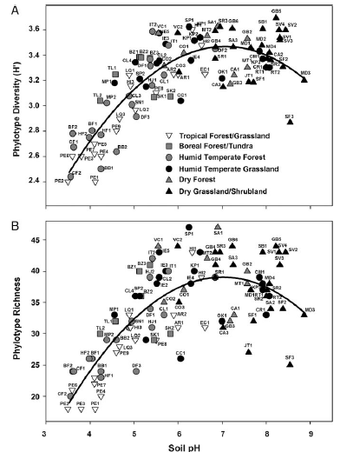
The diversity and biogeography of soil bacterial communities
Soil samples (n=89) from North and South America were profiled by TRFLP using 16S rRNA universal primers (8F and 492)
Correlation between soil pH and diversity
Fierer and R. Jackson. 2006.PNAS 103:626-631

Slide 10
TRFLP summary
One peak per PCR product
Provides whole community profile
Cheap ($4.6/sample)
Fast
Primer bias
PCR bias
A single organism can produce different peaks
Multiple organisms can produce same peak

Slide 11
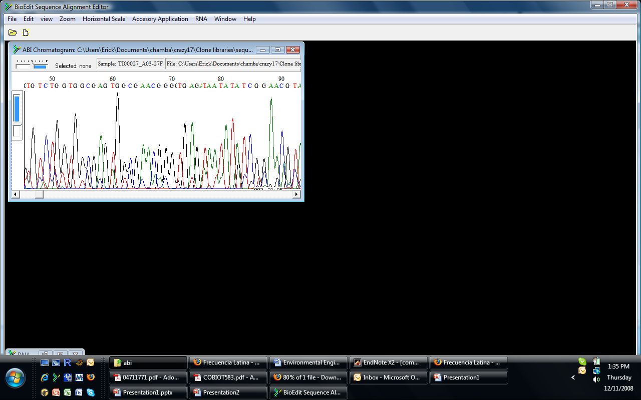
Clone libraries
3.Clone PCR products into cloning vectors
1. Extract DNA from communities
2. Amplify community genes
4. Insert vector into host
5. Grow host in selective media
6. Extract plasmid and sequence insert
Chromatogram tracer files

Slide 12
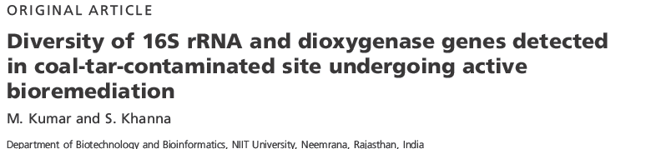
DNA from coal-tar-contaminated soils was recovered and clone libraries were constructed for:
16S rRNA genes
α nd β subunits of the dioxygenase

Slide 13
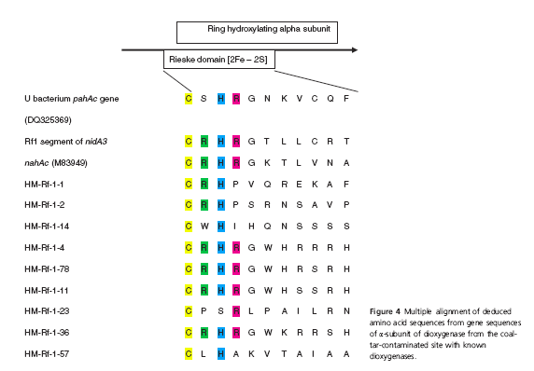
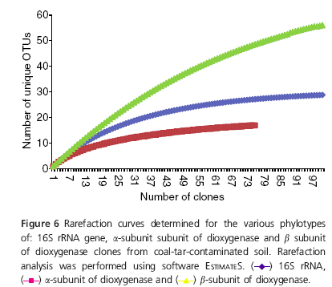
Recovered diversity of ribosomal and dioxygenase genes
16S rRNA and dioxygenase subunits diversity
Alignment of predicted proteins

Slide 14
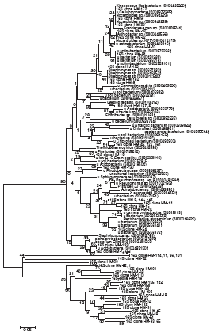
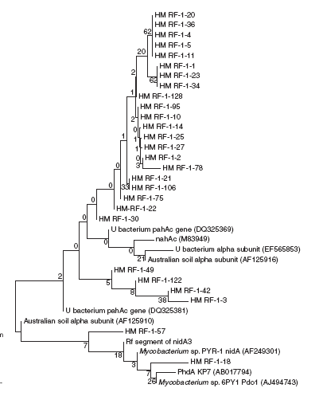
16S rRNA tree α subunit tree

Slide 15
Clone libraries summary
Can obtain sequence information to do phylogenetic analysis and OTU analysis
PCR bias
Primer bias
Cloning bias. Some genes interfere with host
Does not sample whole community
Expensive
Time consuming

Slide 16
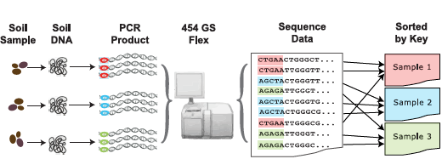
Multiplex pyrosequencing (Pyrotags)
400,000 - 500 000 sequences
$1400
80 samples
5000-6250 seq./ sample
$175 per sample
Image modified from Ribosomal Database Project poster from Michigan-ASM 2008 meeting

Slide 17
Pyrotags summary
Obtains sequence information
Massive information can be used to create profile of community
No cloning bias
Cheap ($0.08/kB)
Still in development
Only samples community, thought it some cases is enough
PCR bias
Primer bias

Slide 18
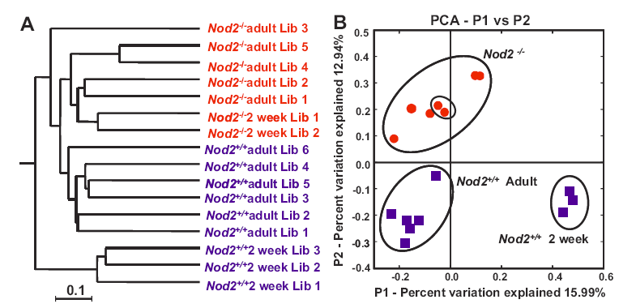
Influence of nod2 mutation on microbial gut communities
nod2 is essential for bacterial cell wall detection by host
nod2-mutated individuals present early onset of Chron’s disease
nod2-deficient mice display altered microbial communities
Image from Rehman A et al. Gut doi:10.1136/gut.2010.216259

Slide 19
Genomic fingerprinting
Amplify naturally occurring interspersed repetitive elements in bacteria using PCR
Repetitive extragenic palindromic elements (REP)
Enterogenic repetitive intergenic consensus (ERIC) sequences
Inverted repeated box elements

Slide 20
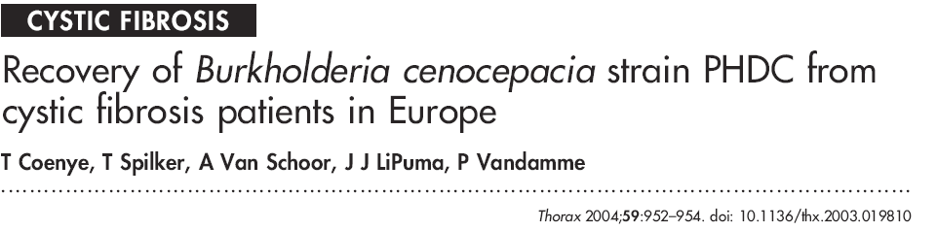
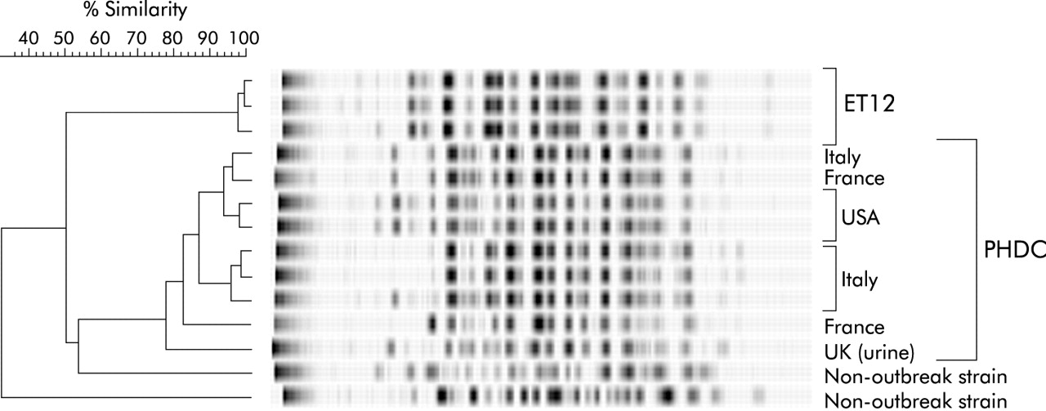
BOX-PCR can differentiate Burkholderia cenocepacia strains

Slide 21
Fingerprinting summary
Extra sensitive
Fast
Cheap
Limited resolution at upper levels of taxonomy

Slide 22
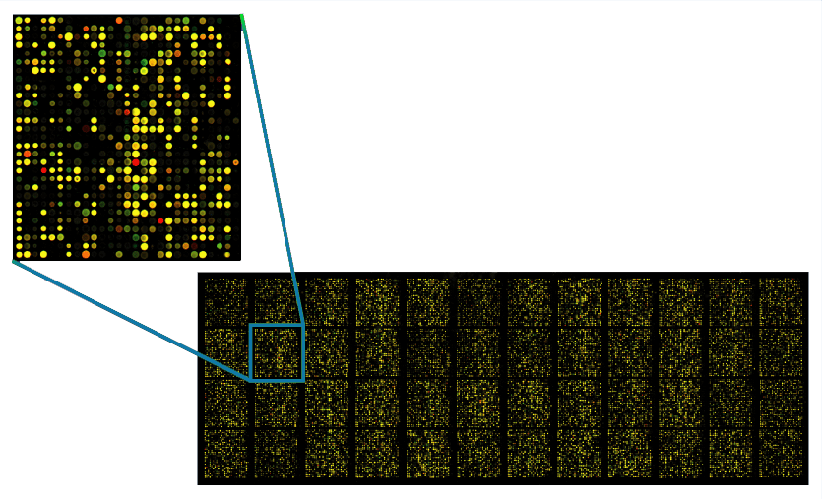
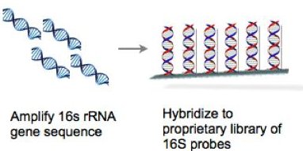
Phylogenetic arrays
Microarrays technology using 16S rRNA probes
Detect thousand of genes at the time
Phylochip ~8000
High throughput
High specificity
High sensitivity
Image from http://www.mobio.com/blog/wp-content/uploads/2011/01/phylochip.jpg

Slide 23
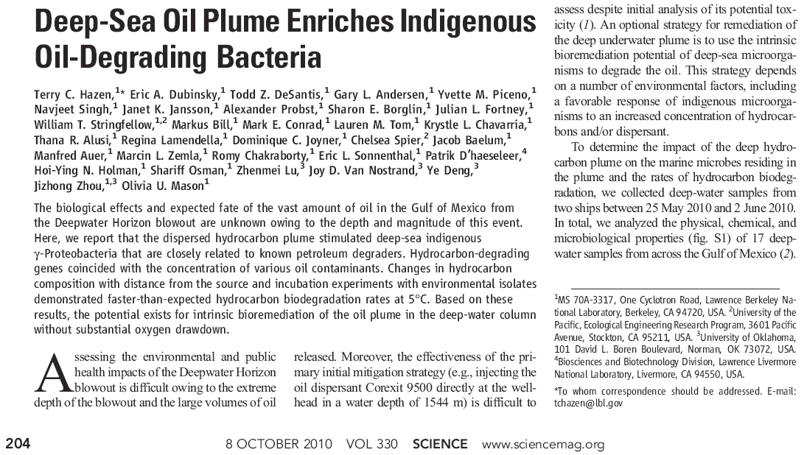

Phylochip was used in the Deepwater Horizon oil spill

Slide 24
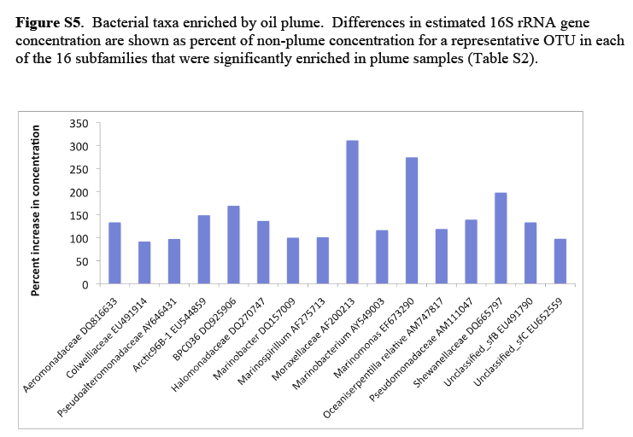

Slide 25
Phylogenetic microarrays
Detect thousand of microorganisms at the time
High specificity
Sensitive
Semiquantitative
Diversity obtained is limited by probe design
Not good for discovery
Requires specialized equipment
Expensive
Requires large amounts of DNA (micrograms)

Slide 26
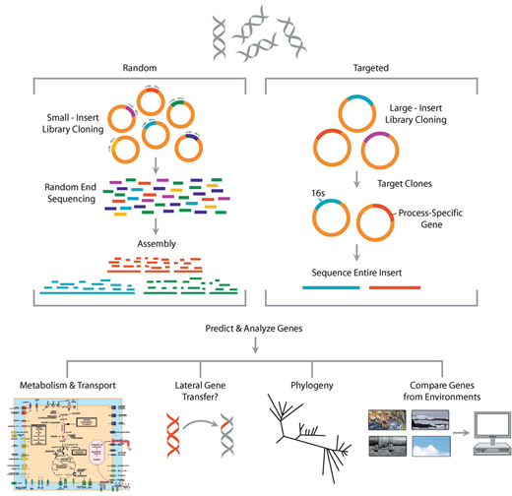
Metagenomics
Sequencing and analysis of DNA of microorganisms recovered from an environment, without the need for culturing them

Slide 27
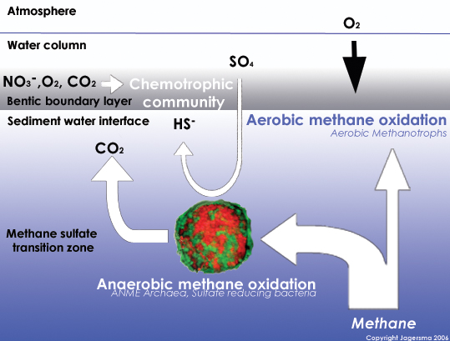
Anaerobic methane oxidation
Consortia of Archaea and sulfate reducing bacteria
Image from http://www.amethox.com/, © Jagersma 2006

Slide 28
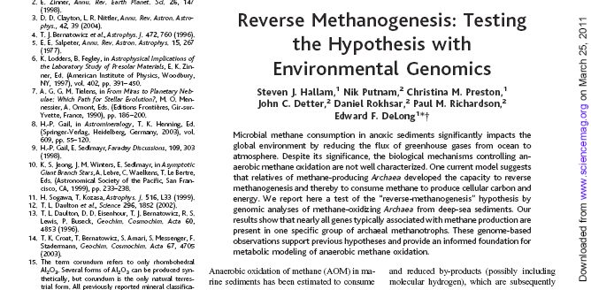
Science. 2004 Sep 3;305(5689):1457-62

Slide 29
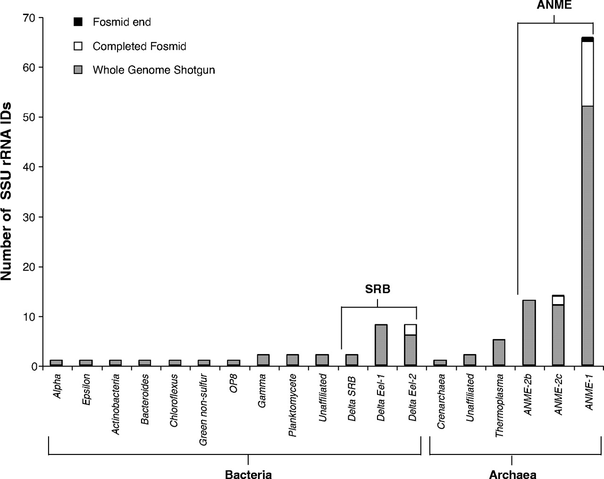
Taxonomic distribution of SSU rRNA sequences identified in whole-genome shotgun sequencing (n = 114) and fosmid DNA libraries (n = 18).

Slide 30
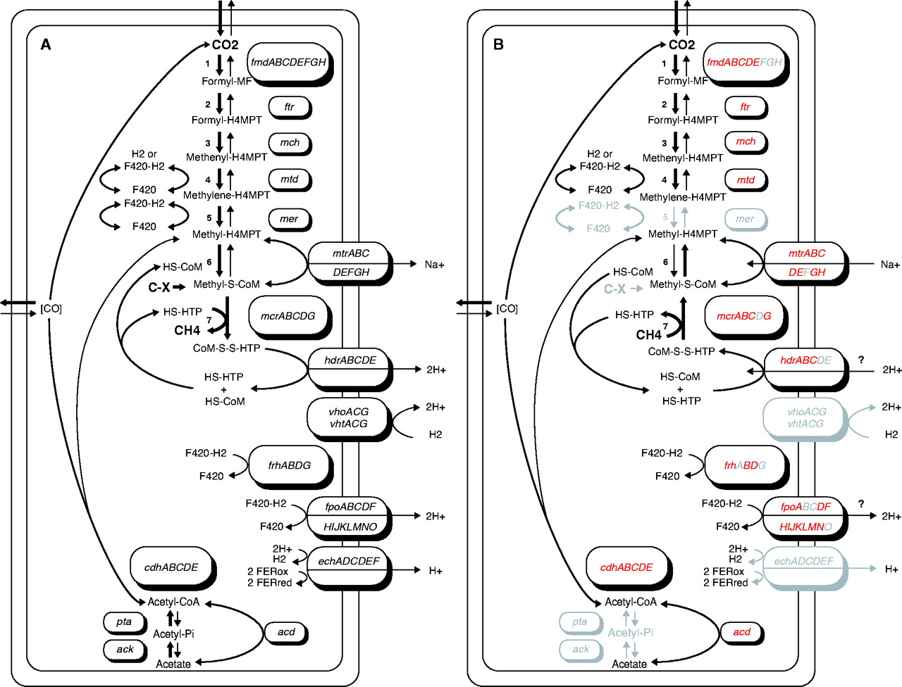
Hypothetical model for reverse methanogenesis in ANME-1.

Slide 31
Metagenomics balance
Can provide phylogenetic and functional information
Can discover novel genes, genes clusters, and pathways
Can recover partial genomes
Assembly strongly depends on evenness
Computationally challenging
May suffer from cloning bias
Depends on good gene finders and annotation tools

Slide 32
Levels of resolution
Metagenomes
10000
Phylogenetic arrays
Pyrotags
1000
Throughput
100
Clone libraries
T-RFLP
DGGE + sequencing
10
DGGE
1
Fingerprinting
Phyla Order Class Family Genus Species Subspecies
Resolution

Slide 33
Summary
Best method is the one that works for you
For simple systems fingerprinting is good enough
Try one method, change if needed

Slide 34
Other
Length-heterogeneity PCR
Targets variable regions of 16S rRNA gene
Uses fluorescent primers
Detect fluorescent bands of different sizes
Easy, rapid, reproducible
Uses databases of known bacteria
ARISA
Amplifies region between 16S and 23S
Regions vary between 140 and 1500 bp.

