Slide 1
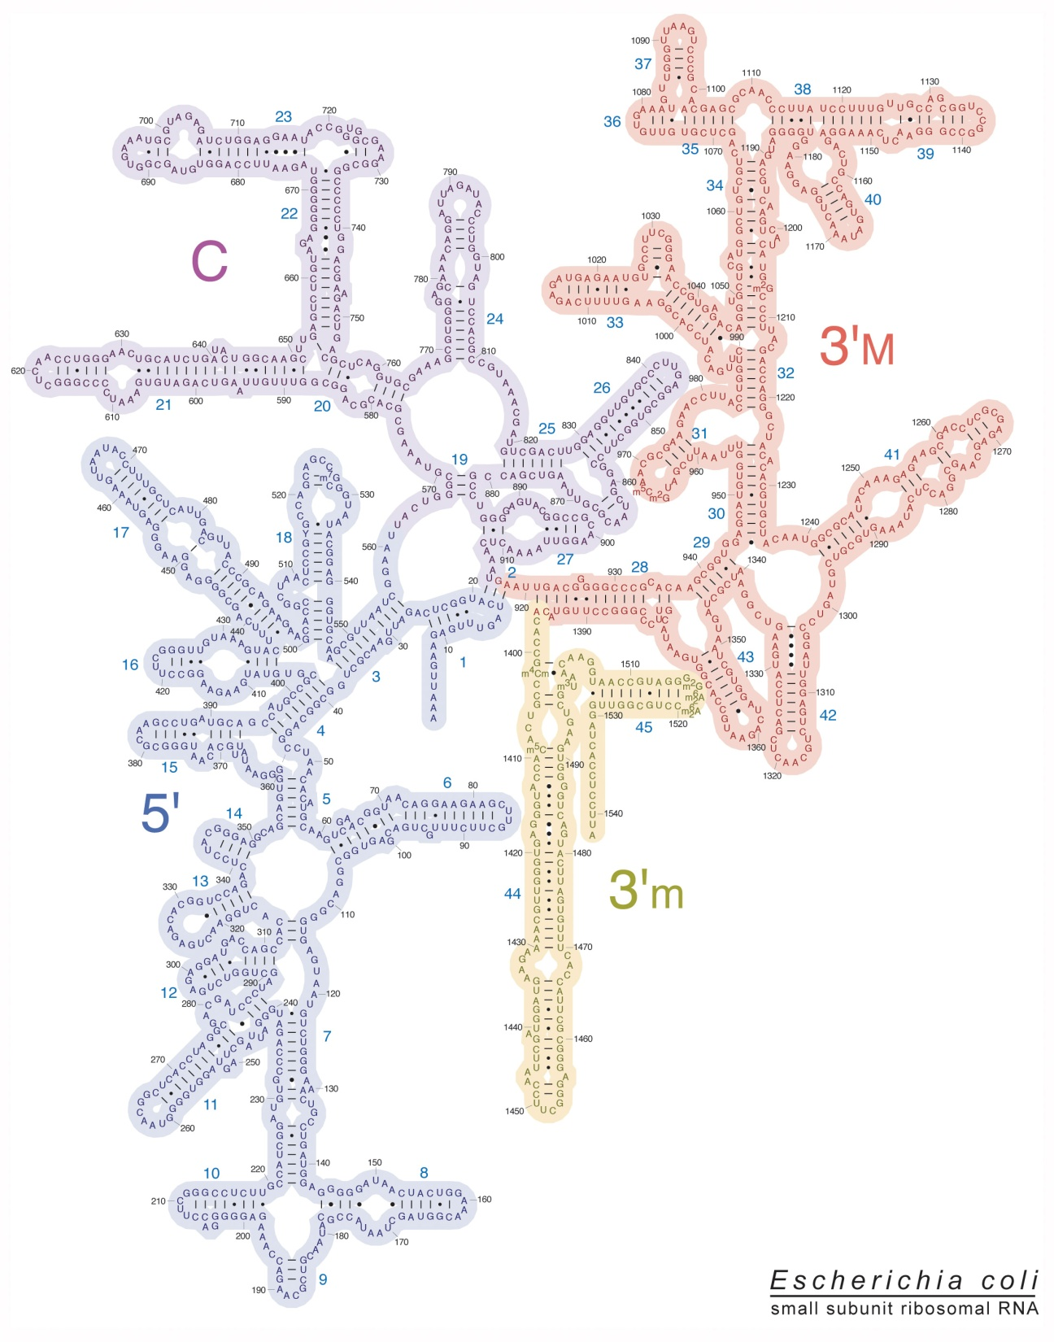
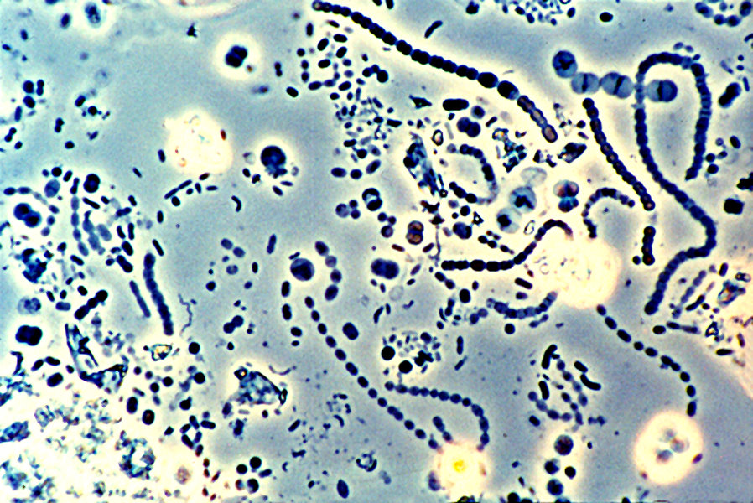
Microbial community analysis by
16S rRNA gene sequencing

Slide 2
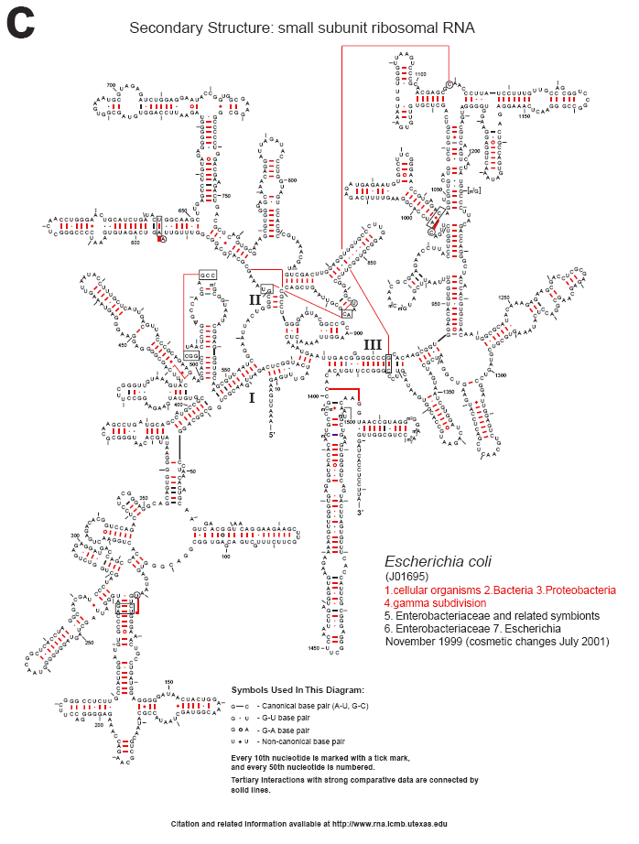
rRNA background
Essential function in ribosomes
Highly conserved at sequence and secondary structure level
Not laterally transferred (few exceptions)
Preferred phylogenetic marker
Cannone ,2002. BMC Bioinformatics. 3:2

Slide 3
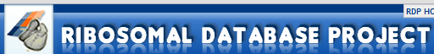

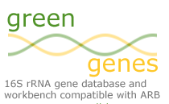
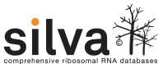
Genbank RNA Databases
All genes
Not all 16S rRNA are placed in taxonomy (>50%)
Unaligned
Contains chimeric sequences
General tools
Only 16S rRNA (some 23S)
Secondary structure based aligner
Curated for chimeras
Specialized analysis tools
Explorable taxonomy

Slide 4
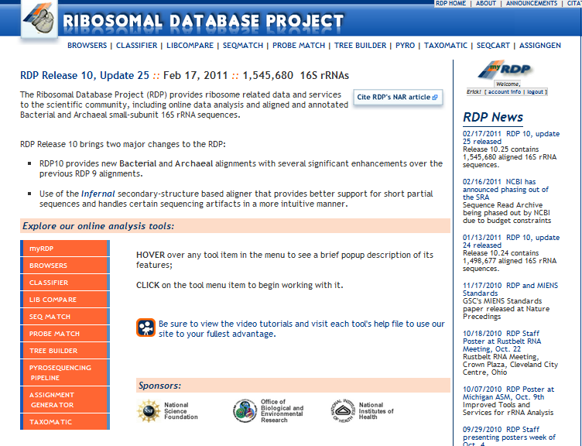
Weapon of choice: RDP (rdp.cme.msu.edu)

Slide 5
Phylogenetic and community analysis
Who is there?
How do my sequences fit in the taxonomy?
How represented are my sequences in the database?
Can we reconstruct the evolutionary history of the sequences?
How is the community formed?
Richness
Evenness
How similar are the communities among samples?
How are specific groups distributed among samples?
What is the coverage of my 16S rRNA primers/probes?
What is the known 16S diversity for a given group?

Slide 6
Who is there?
Phylogenetic reconstruction
Needs alignment and reference sequences
Limited number of queries
Slow
Classification
Need taxonomy
Alignment-independent
Fast

Slide 7
RDP uses a naïve Bayesian classifier
Bayesian theory incorporates a priori probability to calculate that after seeing the evidence E the a priori hypothesis H is true
Likehood evidence
Priori probability inferred before evidence was observed
P(H|E) = P(E|H)P(H)
P(E)
A priori probability of observing E

Slide 8
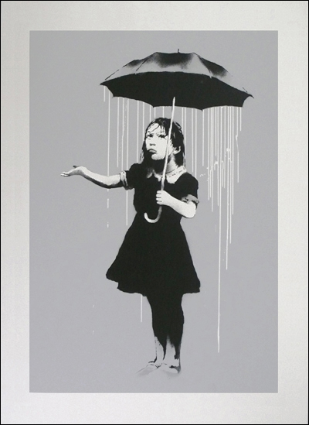
Bayesian theory
E.g. MMG faculty, 25% women, 75% men. On rainy days, women use umbrellas 100% of time, men use umbrellas 50% of time.
If you see a person wearing a umbrella, what are the chances it is a men? (Clue: it is not 37.5%)
P(E|H): man wears an umbrella on rainy days = 0.5
P (H) : person is a men = 0.75
P (E) random person using umbrella = (0.75*50)+(0.25x100) =0.625
P(H|E)= (0.5 x 0.75 )/ 0.625 = 0.6
P(H|E) = P(E|H)P(H)
P(E)

Slide 9
Bayesian spam filters, a Bayesian naïve classifier
For each word train system to tell if word is part of spam or not
Calculate probability that a email containing a given word is spam
Combine probabilities for each individual word to classify email as spam.
1: Viagra = Frequency in Spam 90%. Frequency in Normal email 1%
2. P(S|V) = P(V/S)P(S) (1)
P(V/S).P(S)+P(V/N).P(N)
P(S|V) = P(V/S) (2)
P(V/S) +P(V/N)
P(S|V) = 0.9 = 0.989
0.9+0.01

Slide 10
A naïve classifier assumes independence of frequencies
3.Combine probabilities for each individual word to classify email as spam
P= ____________p1 . p2. p3…pn________
p1p2p3…pn +(1-p1)(1-p2) (1-p3)…(1-pn)
Uses naïve assumption that probabilities for each word is independent

Slide 11
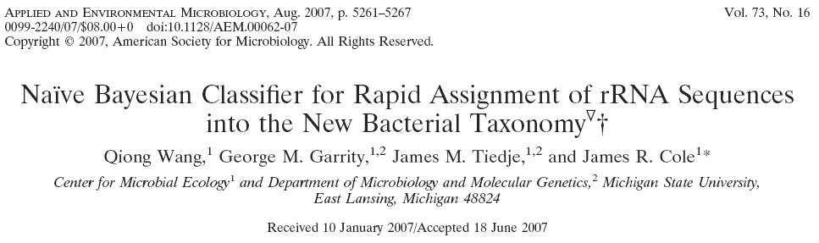
Assigns sequences into taxa according to the frequency of 8-mer words
Naive assumptions that all word frequencies are independent
Assumes that all genera are equally probable
Calculates probability that a sequence belong to a given genus using all 8-mer words. Reports genus with highest probability
Repeats process with a subset (1/8th)of words and gives bootstrap confidence values
Fast, accurate

Slide 12
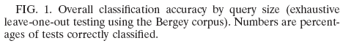
Accuracy depends on sequence’s size
Wang Q, Garrity GM, Tiedje JM, Cole JR.
Appl Environ Microbiol. 2007 Aug;73(16):5261-7. Epub 2007 Jun 22.

Slide 13
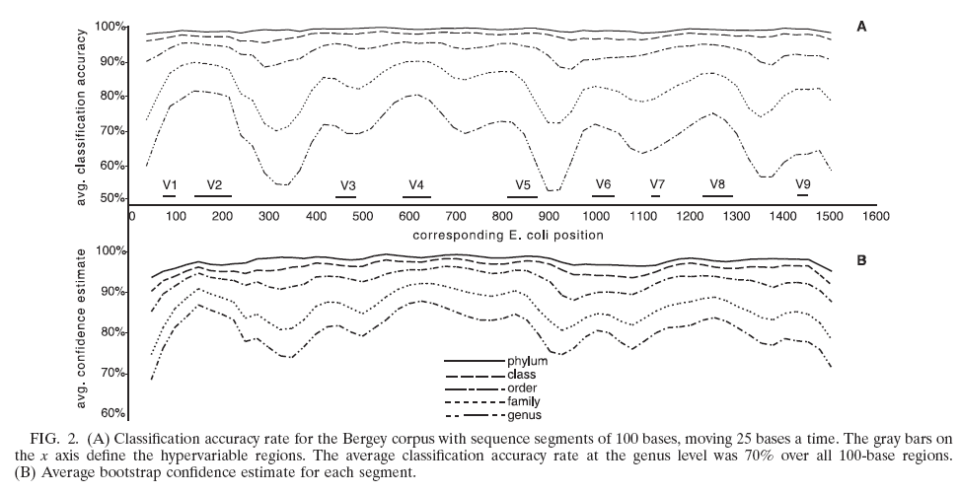
Accuracy depends on region targeted
Wang Q, Garrity GM, Tiedje JM, Cole JR.
Appl Environ Microbiol. 2007 Aug;73(16):5261-7. Epub 2007 Jun 22.

Slide 14
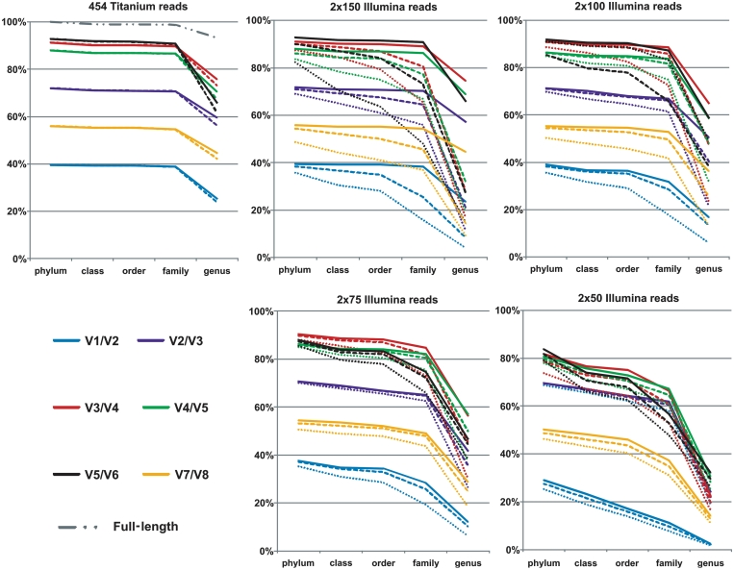
Error rates varies with platform
Classification accuracy
Claesson, 2010. Nucleic Acids Res. Dec 1;38(22):e200. Epub 2010 Sep 29.

Slide 15
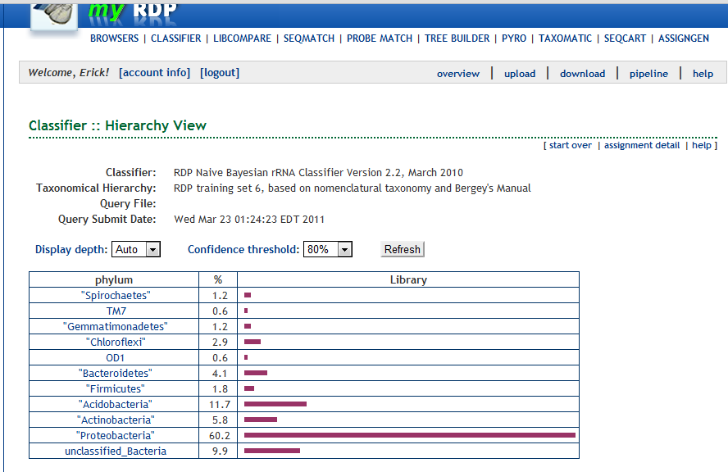
Classifier output – Hierarchy based

Slide 16
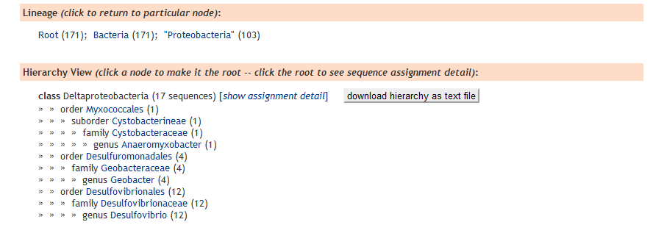
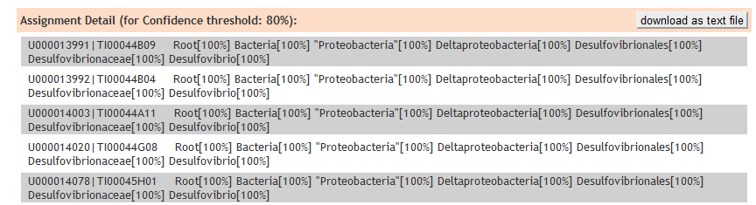
Classifier – Sequence centric result

Slide 17
Other RDP Classifier tricks
Source code is freely available (Java)
Can be run locally in command line to classify multiple libraries at the time
Can use different taxonomies

Slide 18
Library Compare
Classifies two samples into the taxonomy
Makes statistical test for significance at each taxonomy level
Fast way to tell where significant differences are located
Can only compare two libraries at the time

Slide 19
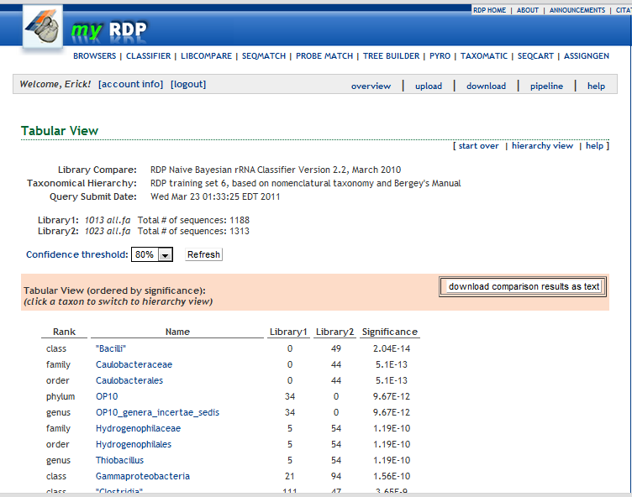
Library Compare hierarchy-based results

Slide 20
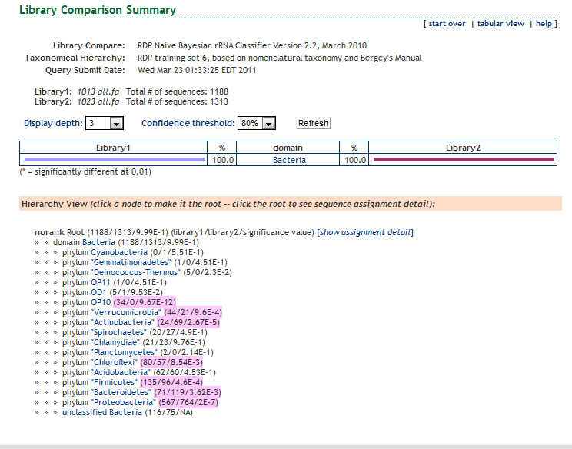
Library Compare summary

Slide 21
How represented in my sequence in database?
Seqmatch
Transforms query into 7-bases words
Ranks matches according to SeqMatch score
Best N matches “vote” for classification of query (n:1-20). If no unanimous vote is reached vote goes to upper taxon level
a
b
Unique words in query
c
Unique words in reference
Sab = c/ min(a+c , c+b)

Slide 22
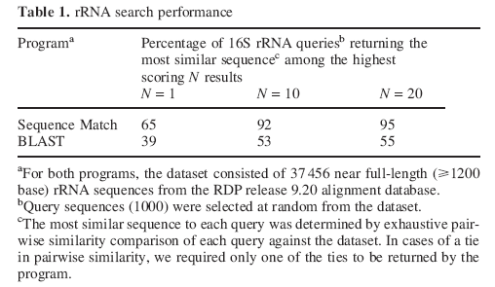
SeqMatch is better in finding close relatives than BLAST
Table from :Cole et al. 2005. Nucleic Acids Res. Jan 1;33(Database issue):D294-6.
See also: Koski 2001 The Closest BLAST Hit Is Often Not the Nearest Neighbor. J Mol Evol (2001) 52:540–542

Slide 23
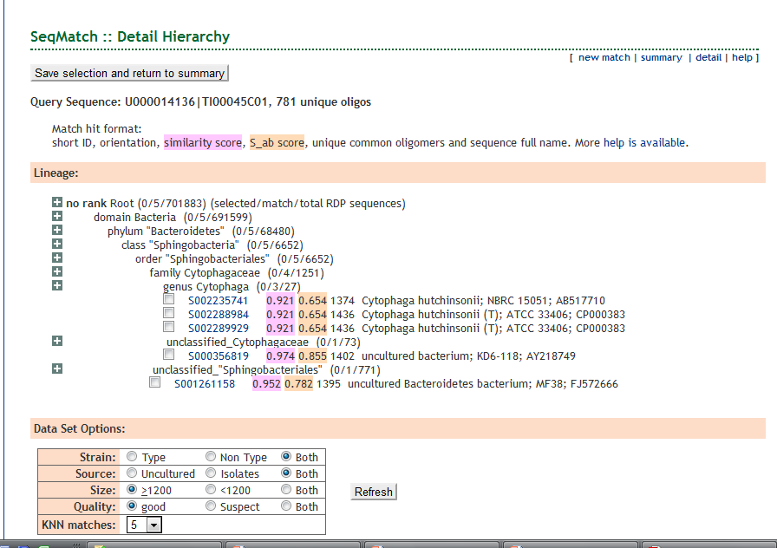
SeqMatch result
Classification is based on consensus of relatives
Choose dataset to compare and number of relatives (KNN)

Slide 24
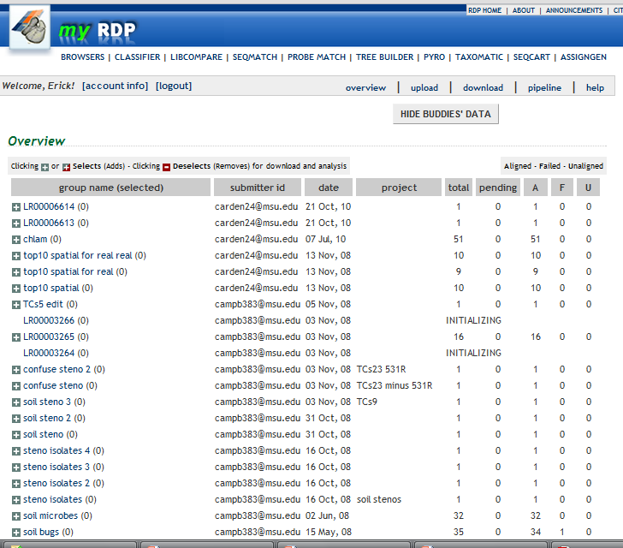
myRDP
RDP Private working space
Do not need to upload sequences to public databases
Sequences will be aligned with RDP model
SeqMatch will report also sequence similarity
Sequences can be used for phylogenetic trees (TreeMaker)
Distance matrices can be created and exported
Sequences can be shared with collaborators

Slide 25
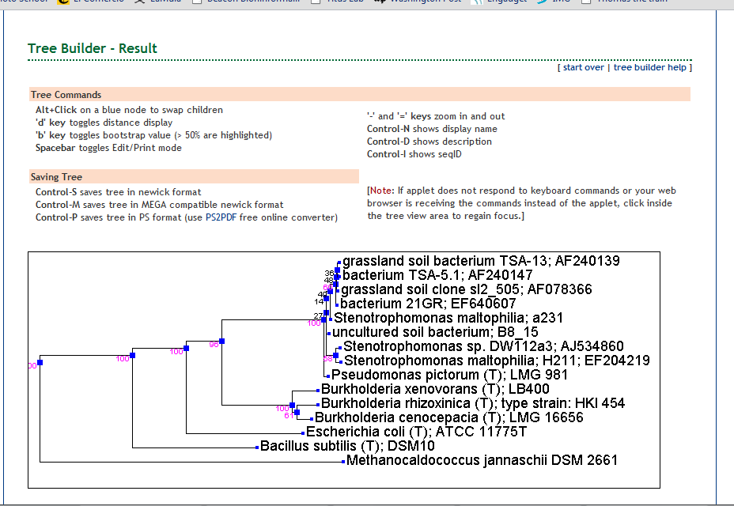
myRDP sequences can be used for trees

Slide 26
OTU-based analysis
Since we do not know what species the sequence corresponds we assign it to a operational taxonomy unit based on its similarity
Commonly used threshold for species =97% similarity for whole gene
Distance matrix
Complete linkage clustering
Sequences
Aligned sequences
Sites by species table

Slide 27
RDP aligner
Uses infernal aligner ¹
Builds consensus RNA profiles
Incorporates secondary structure information
As it fits sequences into model they get aligned
Fast, does not require all pairwise comparisons
1. Nawrocki et al 2009. Bioinformatics. May 15;25(10):1335-7. Epub 2009 Mar 23.

Slide 28
Distance matrix
Complete linkage clustering
Aligned sequences

Slide 29
Distance matrix
Complete linkage clustering
Aligned sequences

Slide 30
Distance matrix
Complete linkage clustering
Aligned sequences

Slide 31
Distance matrix
Complete linkage clustering
Aligned sequences

Slide 32
Distance matrix
Complete linkage clustering
Aligned sequences

Slide 33
Distance matrix
Complete linkage clustering
Aligned sequences

Slide 34
Distance matrix
Complete linkage clustering
Aligned sequences
Guarantees intra-cluster distance
Can have artifacts
Number of OTUs will depend on number of sequences compared
Many singletons can have closely related relatives

Slide 35
Species x sites table or OTU x Samples
 | OTU1 | OTU2 | OTU3 | OTU4 | OTU5
Sample1 | 20 | 15 | 50 | 10 | 0
Sample2 | 15 | 30 | 35 | 20 | 0
Sample3 | 0 | 12 | 0 | 100 | 0
Sample4 | 0 | 10 | 100 | 0 | 1

Slide 36
Species x sites table or OTU x Samples
 | OTU1 | OTU2 | OTU3 | OTU4 | OTU5
Sample1 | 20 | 15 | 50 | 10 | 0
Sample2 | 15 | 30 | 35 | 20 | 0
Sample3 | 0 | 12 | 0 | 100 | 0
Sample4 | 0 | 10 | 100 | 0 | 1
Shannon
0.518666
0.57982
0.147877
0.153431
Alpha diversity components
Richness
Eveness
Estimators of coverage
Rarefaction
Alpha diversity estimators
Chao1
Shannon
Simpson

Slide 37
Species x sites table or OTU x Samples
 | OTU1 | OTU2 | OTU3 | OTU4 | OTU5
Sample1 | 20 | 15 | 50 | 10 | 0
Sample2 | 15 | 30 | 35 | 20 | 0
Sample3 | 0 | 12 | 0 | 100 | 0
Sample4 | 0 | 10 | 100 | 0 | 1
Richness
4
4
2
3

Slide 38
Species x sites table or OTU x Samples
 | OTU1 | OTU2 | OTU3 | OTU4 | OTU5
Sample1 | 20 | 15 | 50 | 10 | 0
Sample2 | 15 | 30 | 35 | 20 | 0
Sample3 | 0 | 12 | 0 | 100 | 0
Sample4 | 0 | 10 | 100 | 0 | 1
Beta diversity
Jaccard distance
Sorensen distance
0.6
0.4
Sample3
Sample1 Sample2 Sample3
Sample2 0.00
Sample3 0.73 0.50
Sample4 0.32 0.35 0.94
0.2
0.0
Cluster Dendrogram
Sample4
Sample1
Sample2

Slide 39
Species x sites table or OTU x Samples
 | OTU1 | OTU2 | OTU3 | OTU4 | OTU5
Sample1 | 20 | 15 | 50 | 10 | 0
Sample2 | 15 | 30 | 35 | 20 | 0
Sample3 | 0 | 12 | 0 | 100 | 0
Sample4 | 0 | 10 | 100 | 0 | 1
Third party outputs
Spade format
Mothur format
Distance matrix with option of Jukes-Cantor correction

Slide 40
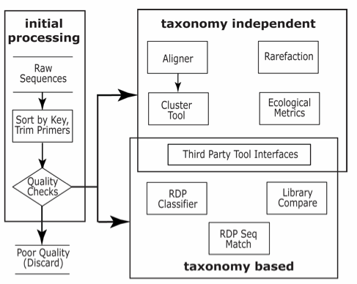
OTU diversity
OTU distribution among samples
Similarity of samples
How represented are my sequences in the database?
How do my sequences fit in the taxonomy?
Modified from ASM 2009 presentation, available at : http://rdp.cme.msu.edu/misc/presentations/RDP-HTPweb.html

Slide 41
Other RDP tools
Probe Match: Finds coverage of probes or primers to the sequences in the database
RDP pipeline: Specialized tools for analysis of clone libraries
RDP Pyro Pipeline: Tools for analysis of pyrosequencing data of rRNA
Taxomatic: Heatmap of distance matrix. Visualize clustering groups and anomalies in taxonomy.

Slide 42
Questions?

