Slide 1
RDP pyrosequencing pipeline
Erick Cardenas Ph. D.

Slide 2
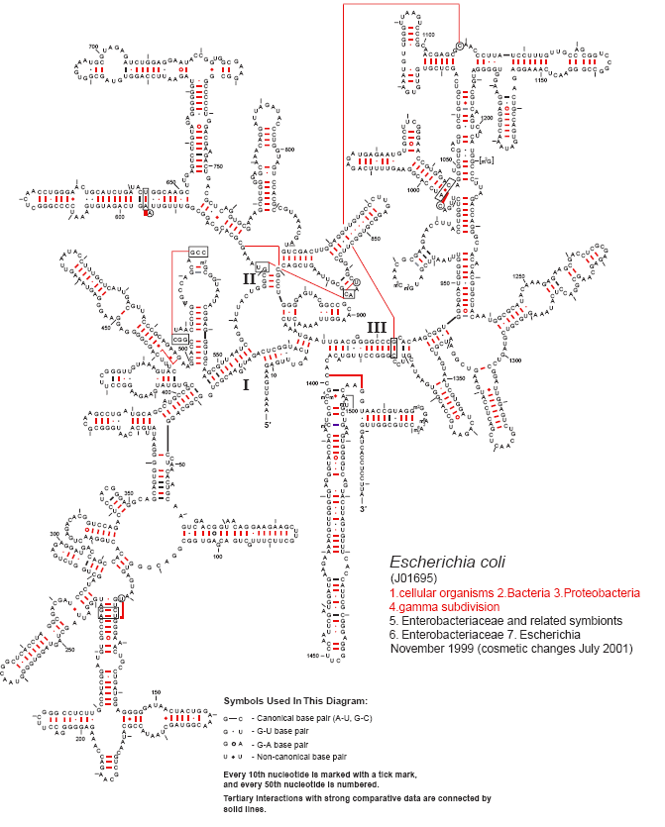
Background
Ribosomal RNA is the most common phylogenetic marker for bacteria
Sequencing information is desirable for classification and phylogenetic reconstructions

Slide 3
Newer technologies provide cheaper and bigger throughput
 | Clone libraries | 454 whole plate | Pyrotag
Output per samples | 196 | 1000000 | 6250
(sequence)
Read length (bp) | 1000 | 400 | 400
Output (Mb) | 0.196 | 400 | 2.5
Total cost $ | 980 | 14000 | 87.5
Cost per Mb $ | 5000 | 35 | 35

Slide 4
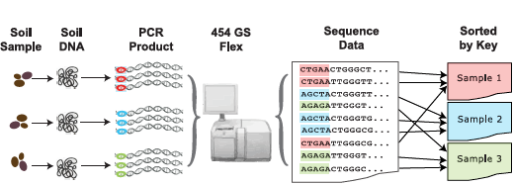
Multiplex pyrosequencing provide a good compromise between price and coverage
400,000 - 500 000 sequences
80 samples mixed in equal proportions
5000-6250 seq./ sample
Image modified from Ribosomal Database Project poster from Michigan-ASM 2008 meeting

Slide 5
Multiplex primers require special configuration
Primer1
ADAPTORBARCODEPRIMERF
Primer2
ADAPTORPRIMERR
Barcodes need to be separated at least by two changes.
i.e. There has to be some room for error in primer region so samples do not get mixed
For list of possible tags go to:
http://pyro.cme.msu.edu/pyro/help.jsp

Slide 6
Challenge Solution
Short sequences
Not good enough for phylogeny
Massive outputs
Alignment is slow
Files are hard to manipulate
Mixed sequences
Short sequences
Use classification methods
Massive outputs
Use a model aligner
Work with pipeline
Use specialized programs for manipulation
Mixed sequences
Sequences sorter

Slide 7
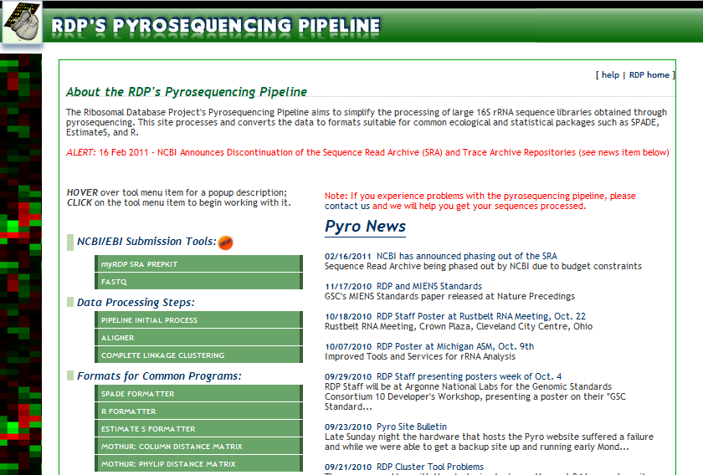
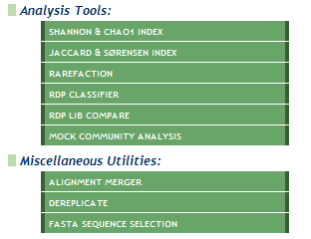
http://pyro.cme.msu.edu/

Slide 8
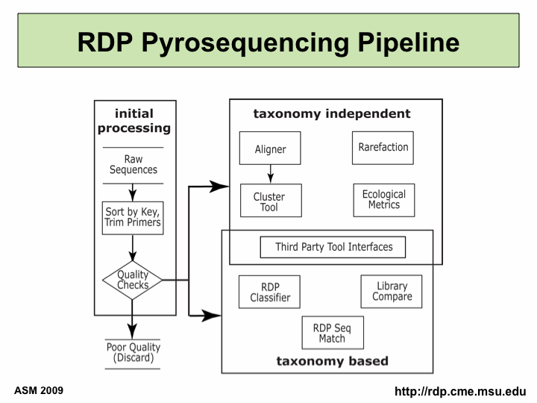
Pyrosequencing pipeline workflow
OTU diversity
OTU distribution among samples
Similarity of samples
Relatives of my sequences
How do my sequences fit in the taxonomy?
Modified from ASM 2009 presentation, available at : http://rdp.cme.msu.edu/misc/presentations/RDP-HTPweb.html

Slide 9
Preprocess
Sorts sequences into samples according to barcodes
Filters
Size filter
Quality filter
Trimming
Global filter
Primers
Remove sequences if too many errors in primers
Remover primers

Slide 10
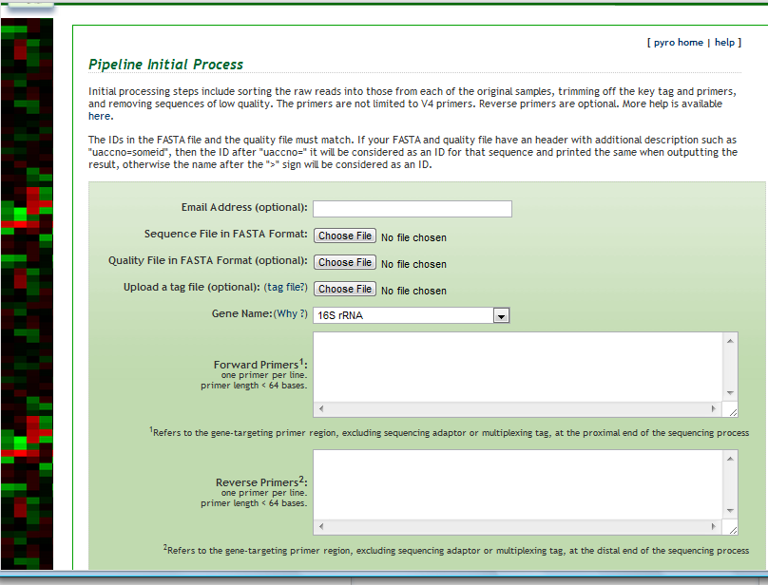
General options
ATGCTG FUSION26
AGAGAG FUSION27
AGATGC FUSION28
AGCATG FUSION29
ADAPTORBARCODEPRIMERSEQUENCE

Slide 11
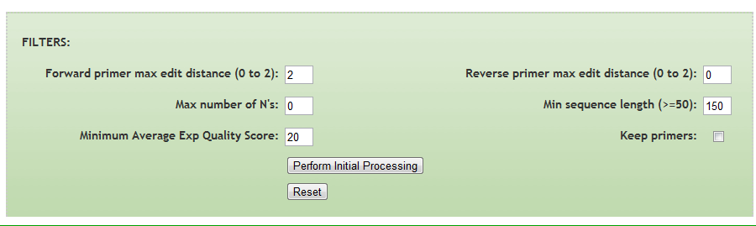
Filter for pre-processing
Length filter can get rid of primer dimers
Empirical evidence suggest that if sequences have too many error in primer regions, read is bad
Since primers are degenerate is recommended to remove them before analysis
If sequence turns too small for alignment keep primers

Slide 12
Alignment-independent analysis
Classifier works fine
Library compare works fine
SeqMatch is slower but can be done
Recommended to run on representative sequences

Slide 13
OTU analysis requires aligners
Infernal aligner
Model aligner that incorporates secondary structure
Faster than any pairwise aligner (fewer comparison)
Better than NAST or any local neighbor aligner
Sequences
Aligned sequences
Cluster file
Dereplication
Format

Slide 14
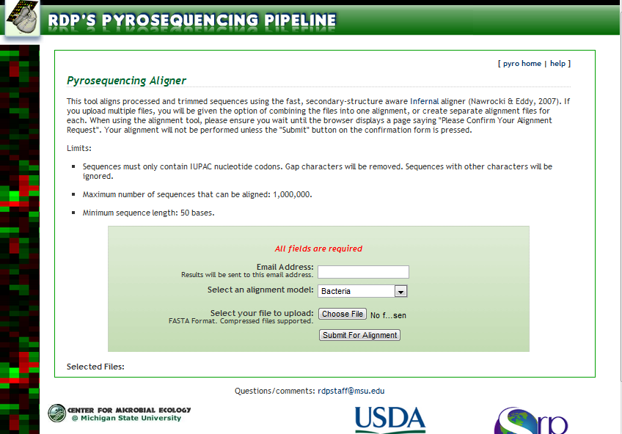
Submitting files to aligner
1. Archaeal and Bacteria aligners can be selected
2. Compressed files can be submitted. They can contain multiple libraries

Slide 15
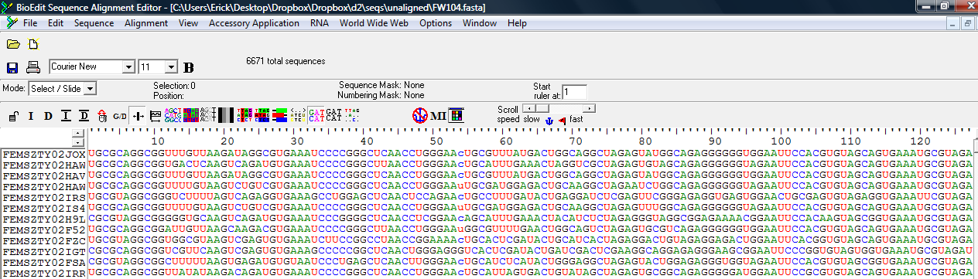
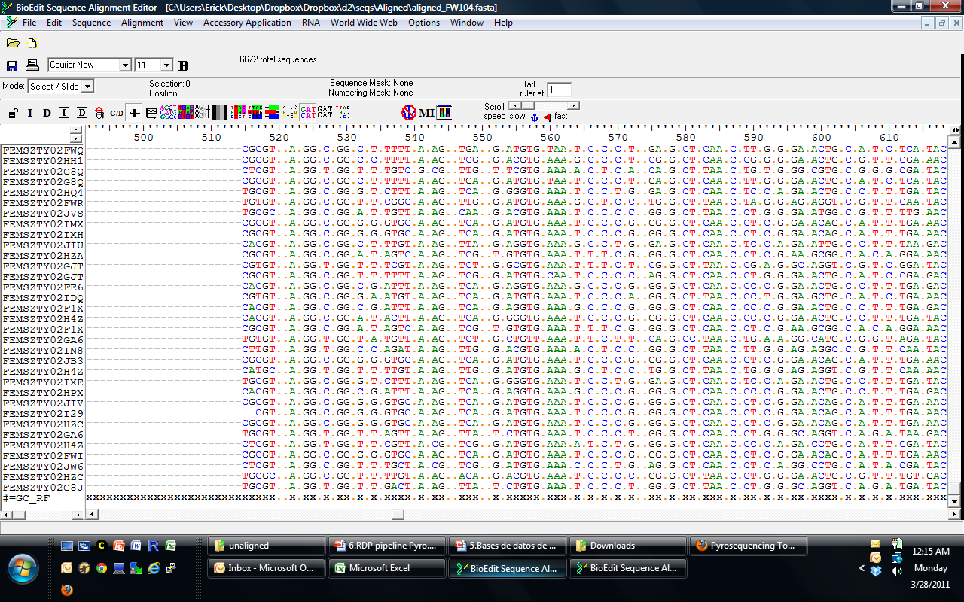

Slide 16
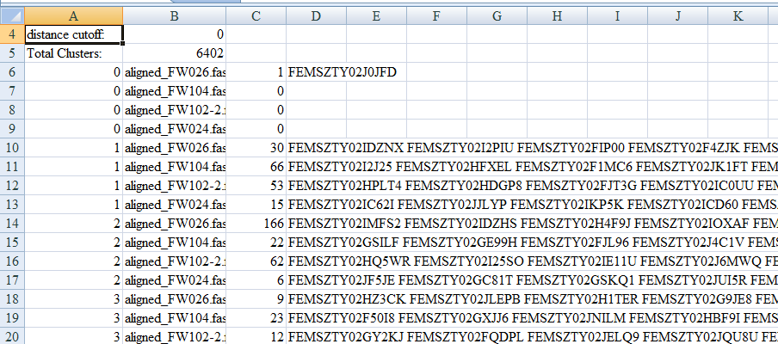
Clustering file (cluster.clust)
OTU1
OTU2
OTU2
List of all sequences
Sample
name
# Seqs. in this otu
!!! One file can contain information for multiple tresholds

Slide 17
Sub selection of sequences
Great when studying specific groups
Inputs: List of ids and fasta file
Output: Fasta file with selected sequences

Slide 18
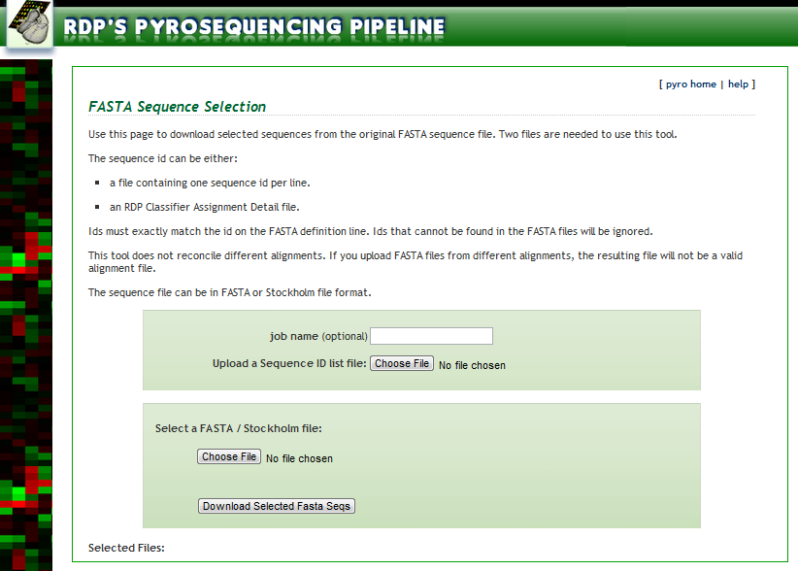
Notes:
Fasta selection

Slide 19
Selecting representative sequences
Also called dereplication
The representative minimizes the sum of square distances to all members of the cluster
Do computer-intensive analysis with representatives
E.g Phylogenetic trees, SeqMatch

Slide 20
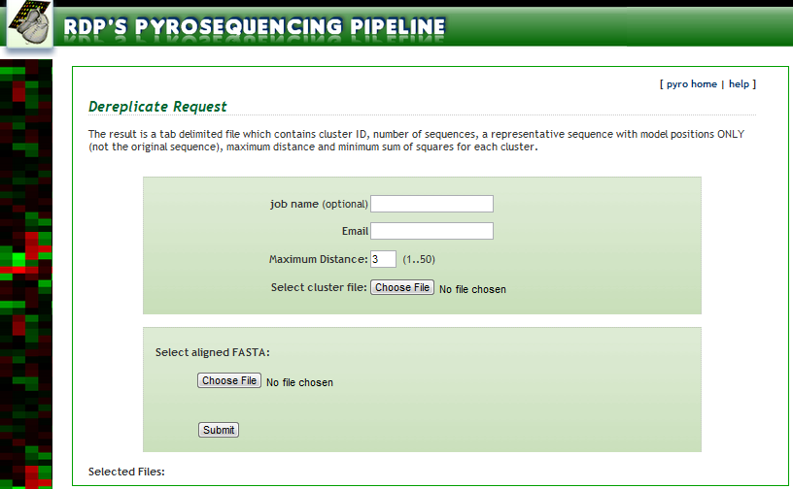
Dereplication request

Slide 21
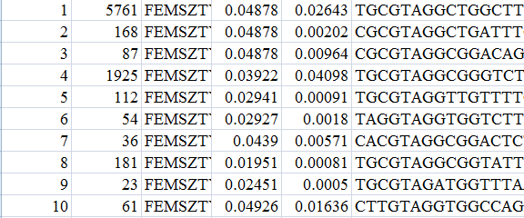
Dereplication result
OTU
#Seqs
Representative ID
Representative Sequence
minimum sum of squares
maximum distance
Sequence only contain model positions (those used for rRNA trees)
For running Seqmatch, save IDS and used Fasta selection

Slide 22
Useful formats
Distance matrix
Used as input in program MOTHUR
Can include Jukes-Cantor correction
EstimateS format
Easily converted to a sample x sites table
EstimateS Output for cluster of X samples with Y OTUs
NAME
#OTU #SAMPLES
S1.O1 S2.O1 … SX.O1
S1.O2 S2.O2 … SX.O2
S1.O3 S2.O3 … SX.O3
… … … …
S1.OY S2.OY … SX.OY
S1.O1 S2.O1 … SX.O1
S1.O2 S2.O2 … SX.O2
S1.O3 S2.O3 … SX.O3
… … … …
S1.OY S2.OY … SX.OY

Slide 23
Questions, comments, complaints?

