Slide 1
Functional Gene Database/ Repository
Fungene

Slide 2
Challenge
Working with proteins is difficult
Conservations is at amino acid level at secondary and tertiary structure
Databases are big and messy
Short or partial sequences
Similar proteins in superfamilies
Common motifs can give false positives
Alignment has to be done each time a new sequence is found

Slide 3
Solution: Build a protein model
Protein model is made one time
Model is used to search databases for new members
As sequences are put into the model they can be easily aligned without actually comparing them
Most common program to generate protein model is HMMR, using a Hidden Markov Model

Slide 4

Fungene is the solution!, maybe
Database of functional proteins that uses Hidden Markov Models
Model are used to get new sequences after each NCBI update
http://fungene.cme.msu.edu
Contains tools for analysis, alignment and processing of pyrosequencing data
Model can be custom made
Maintained by RDP

Slide 5
Outline
Hidden Markov model
Features of the Functional gene database
Pipeline for working with functional genes and pyrosequencing

Slide 6
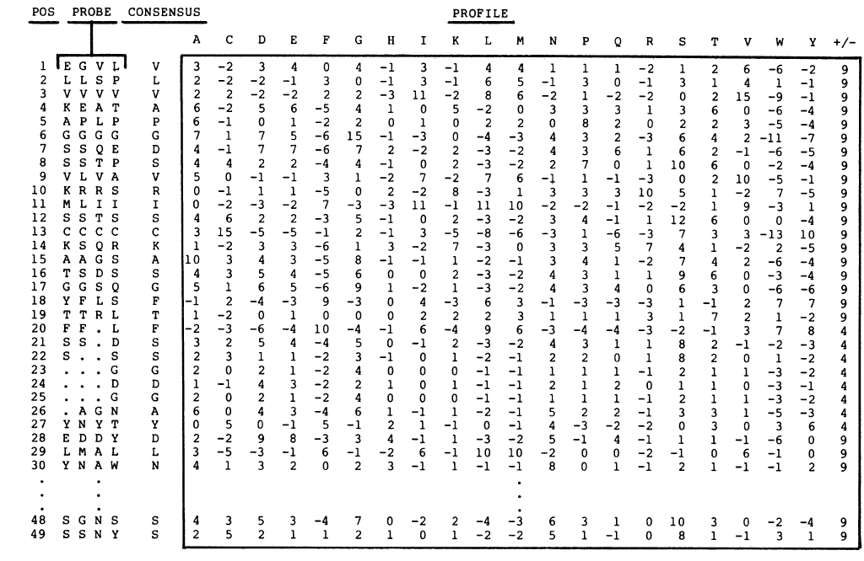
Hidden Markov Models are like PSI BLAST
From Gribskov, 1989. Profile analysis: detection of distantly related proteins. PNAS. 84(13): 4355–4358

Slide 7
PSI-BLAST HMM
Uses the frequency of amino acid at each position to create a substitution matrix for the corresponding positions
Uses the frequency of amino acids at each position to create model that describes the probability of going from one state to the other
State can be an amino acid or a gap

Slide 8
Working with HMM
Select training set
(User)
Create model
(Program HMMR)
Compare sequences to model
(HMMR)
Create database
(HMMR)

Slide 9
HMM are built with training sets
Sequences belong to groups a priori decided
Building successfult HMM
Long length
Partial sequences can have common domains but not same function
Low error rate
Known functions
Model is as good as the training set

Slide 10
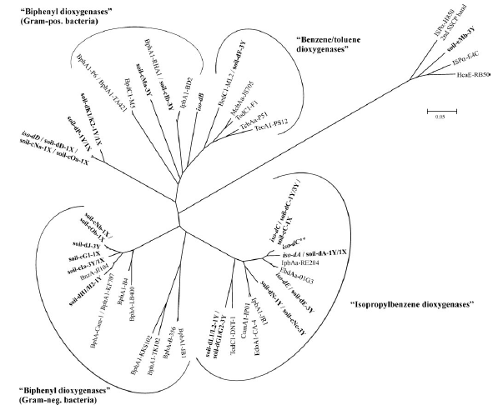
Tips
Do not trust annotation too much
Some genes are not monophyletic
E.g. Convergent evolution for substrate in dioxygenases
Homology does not means same functions
In general information from sequenced genomes is more accurate

Slide 11
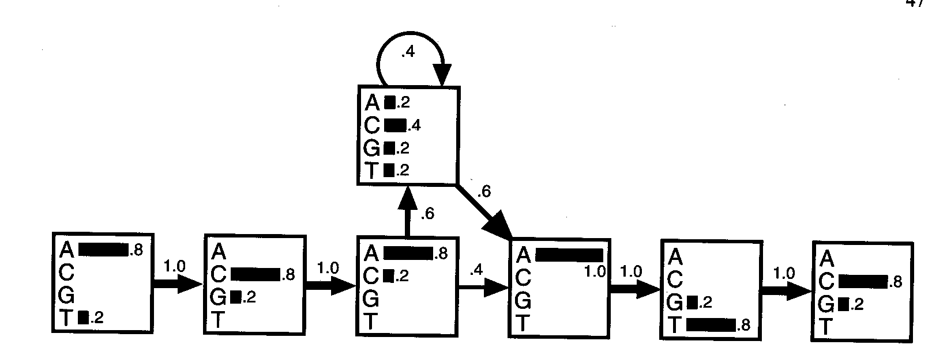
Building a model with a alignments
ACA - - - ATG
TCA ACT ATC
ACA C - - AGC
AGA - - - ATC
ACC G - - ATC
Alignment
Output probability
→Transition probabilities
Model

Slide 12
Comparing sequencing with model
What is the probability that my sequences belong fit that model?
Adds output probabilities and transitions
Given ACACATC
P(ACACATC)=0.8x1x 0.8x1 x 0.8x0.6 x 0.4x0.6 x 1x1 x 0.8x1 x 0.8
= 4.7 x 10 ⁻²

Slide 13
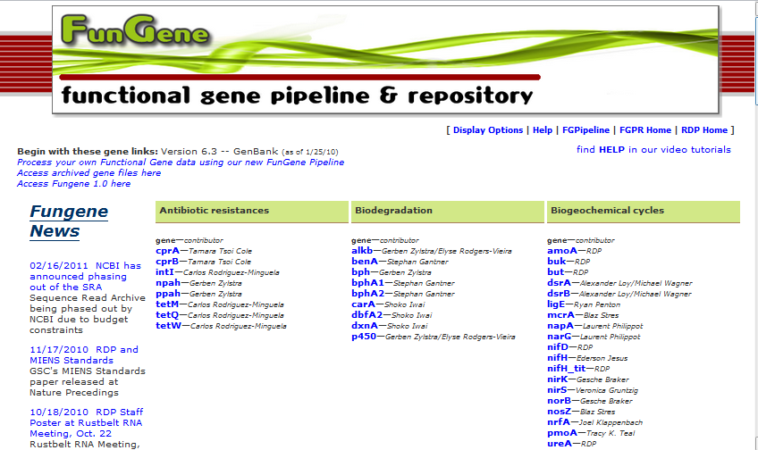
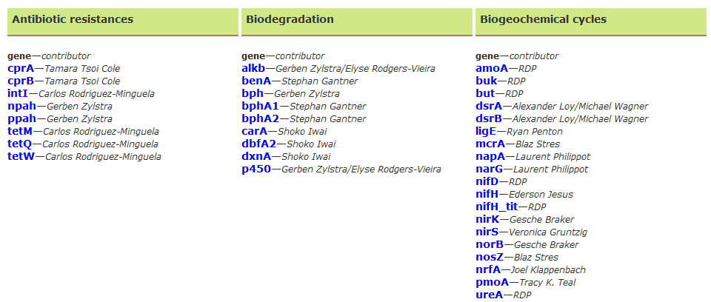
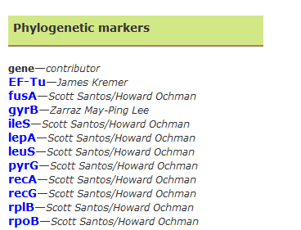
http://fungene.cme.msu.edu/index.spr

Slide 14
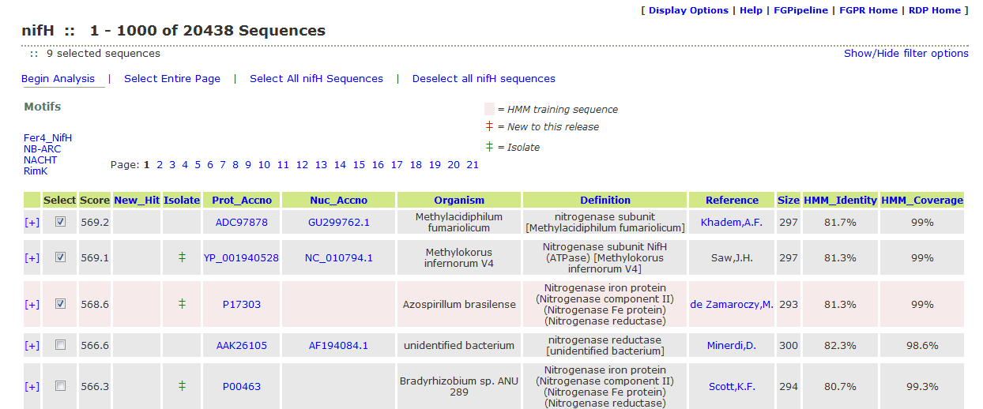
Exploring a gene database
List of high scoring sequences to the HMM
Sequences used for building HMM appear in orange
Accession information, not complete for all sequences
Source of microorganism

Slide 15
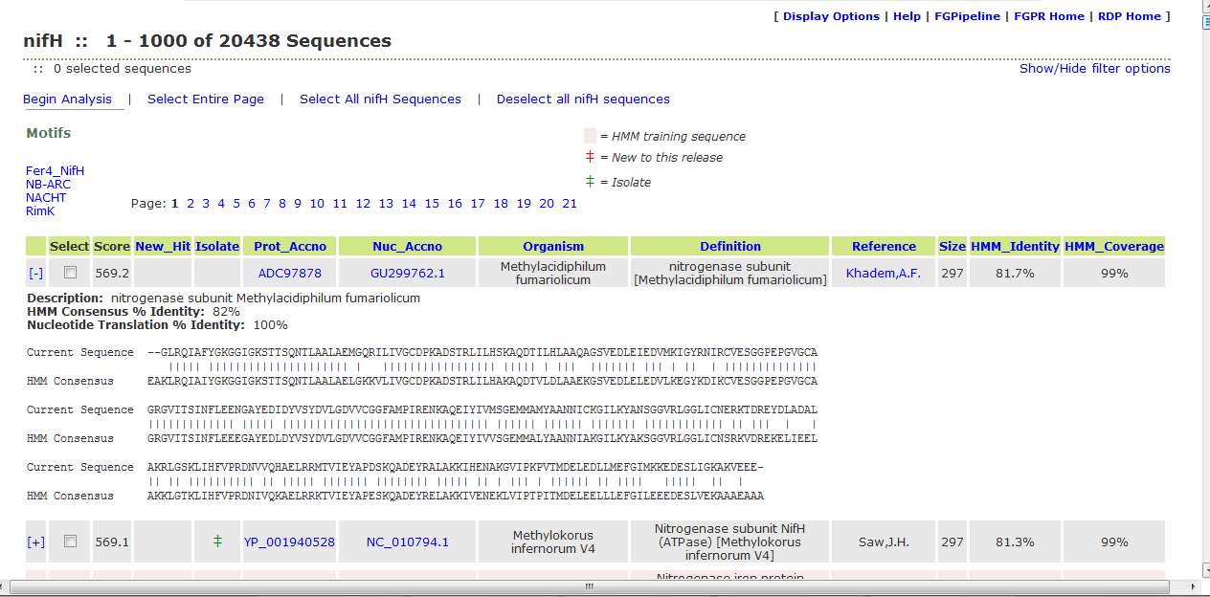
We can get additional information for each gene
How god is the alignment to the model
Global alignment with model

Slide 16
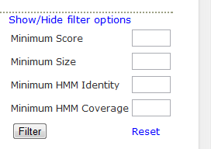
Filter can be used remove poor matches

Slide 17
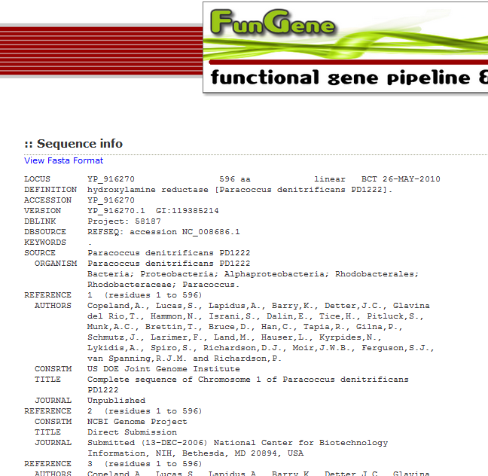
We can go directly to the accessions or related publications

Slide 18
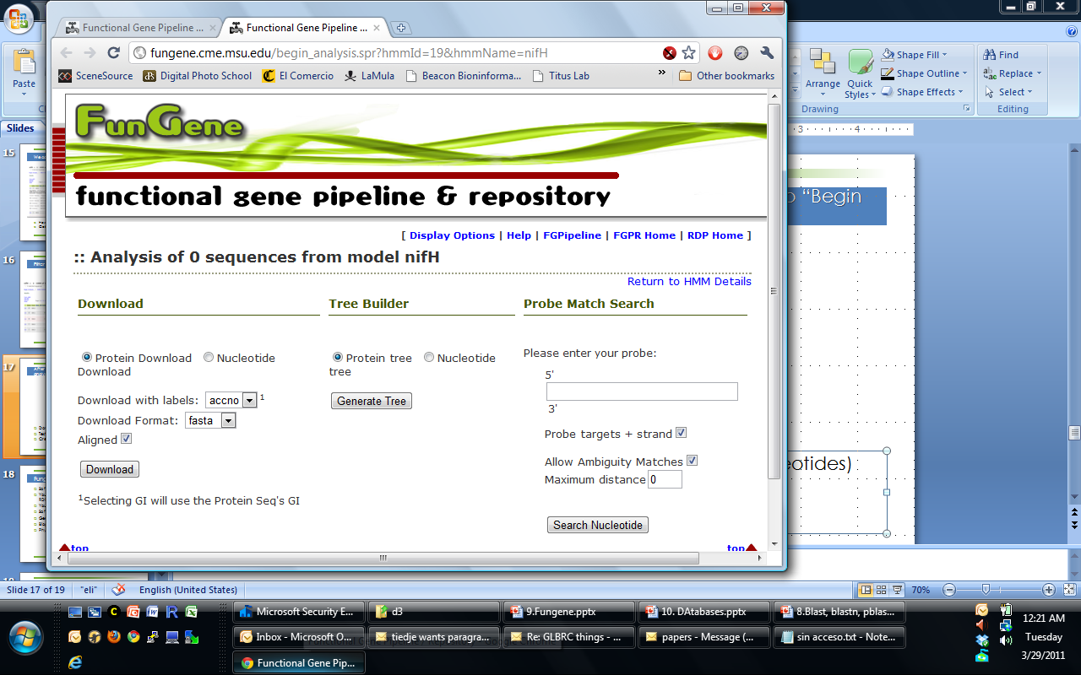
After selecting sequences on interest go to “Begin analysis”
Download sequences (proteins or Nucleotides), aligned or unaligned.
Test primers or probes for specificity
Create tree

Slide 19
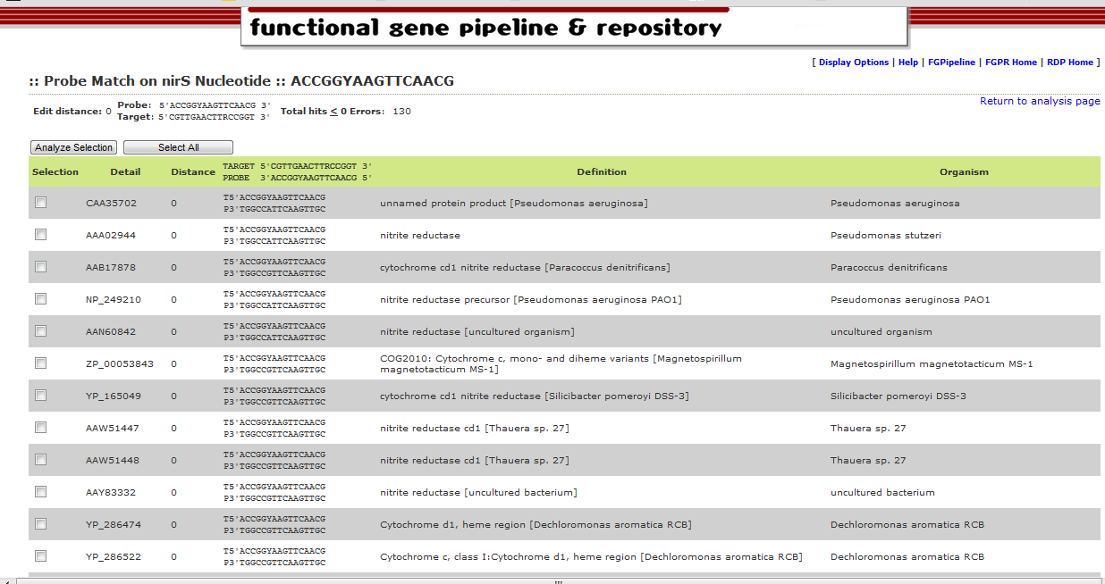
Testing nirS primers with Fungene (5930 sequences)
Number of hits with no mismatches
You can refine your selection and work only with the selected sequences

Slide 20
How do I create my own Fungene database?
Create your training set
PSI BLAST can be a good guide
Email RDP (rdpstaff@msu.edu)
One of RDP goal is user support (as written in grant) so do not be shy

Slide 21
Fungene Pyrosequencing Pipeline
RDP Pyro cousing

Slide 22
Challlenge
Solution
Study the diversity of functional proteins using pyrosequencing
Massive sequencing
Alignment need
Clustering needs
Errors in pyrosequencing can create frameshifts
Pipeline for processing and separate sequences
Control quality
HMM Aligner
Clustering tool
Frameshift correction

Slide 23
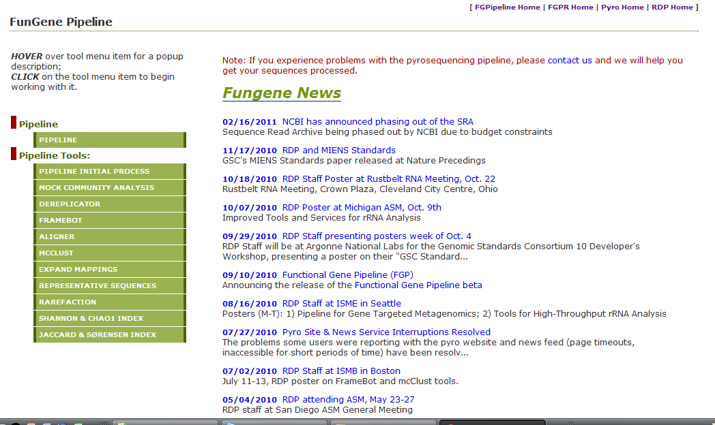
http://fungene.cme.msu.edu/FunGenePipeline/
Similar design to Pyrosequencing page at RDP

Slide 24
http://fungene.cme.msu.edu/FunGenePipeline/
Pre-processing

Slide 25
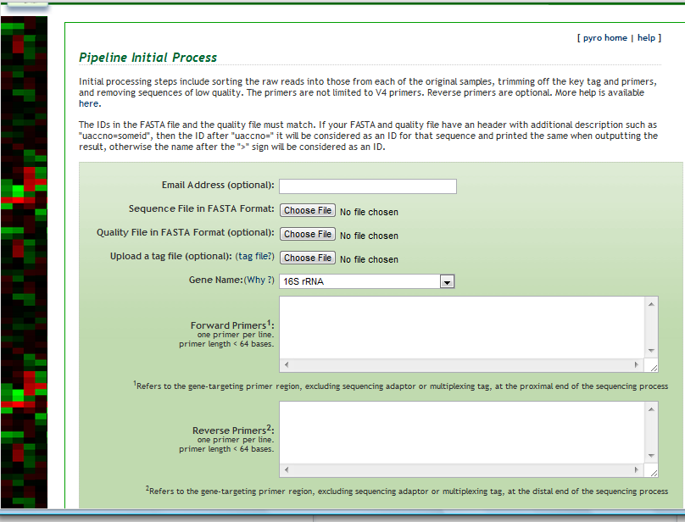
Pre-procesing
If sequence is 16S, orientation will be check and reversed complemented if needed

Slide 26
http://fungene.cme.msu.edu/FunGenePipeline/
Dereplicator

Slide 27
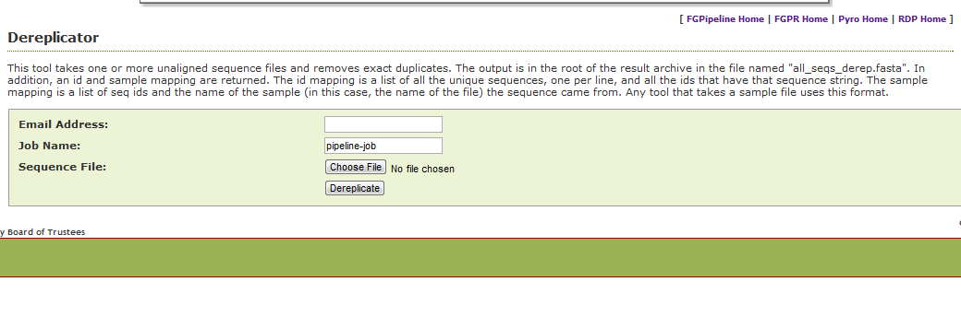
Dereplicator removes identical sequences
Dereplicator is used to reduce computational complexity. Does not work at OTU level
Will give you a file with information of where identical sequences were removed

Slide 28
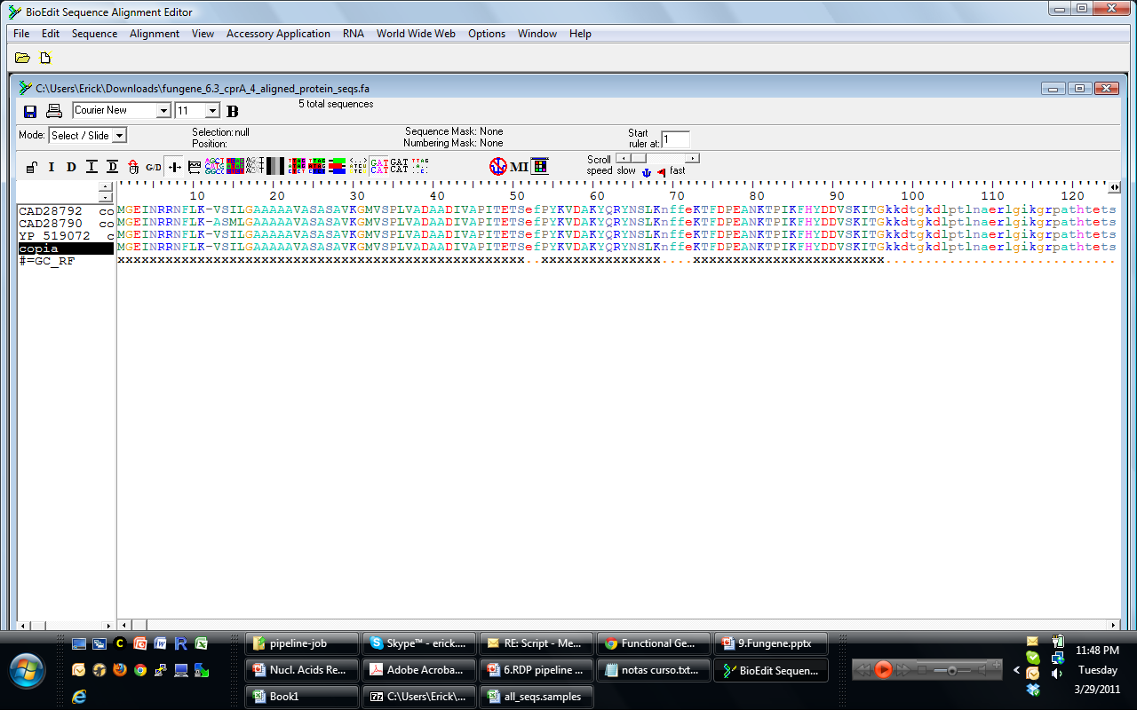
Dereplicator
0 CAD28792
1 CAD28790
2 YP_519072,COPIA
copia Muesta1.fa CAD28790 Muesta1.fa CAD28792 Muesta1.fa YP_519072 Muesta1.fa
Fasta file
ID LIST
Sample mapping

Slide 29
http://fungene.cme.msu.edu/FunGenePipeline/
Framebot = Frame shift correction

Slide 30
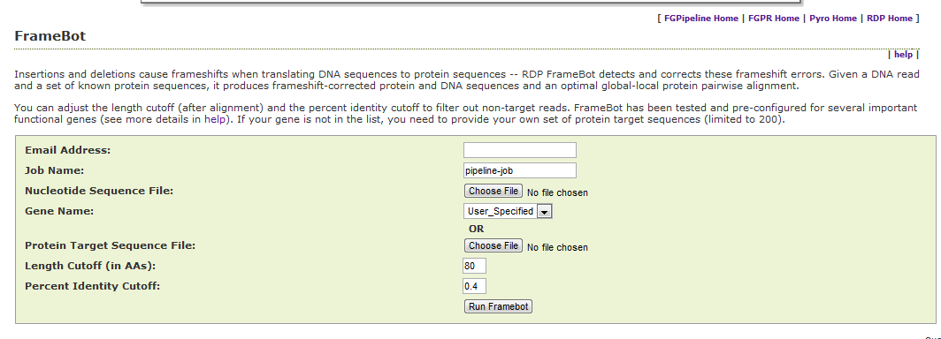
Framebot finds and corrects frameshifts
Requires a protein model as guide
Select some models from Fungene
Input own protein alignment as guide
Sequence is check in forward and reverse directions in query DNA
Returns corrected protein and DNA sequence

Slide 31
http://fungene.cme.msu.edu/FunGenePipeline/
Aligner

Slide 32
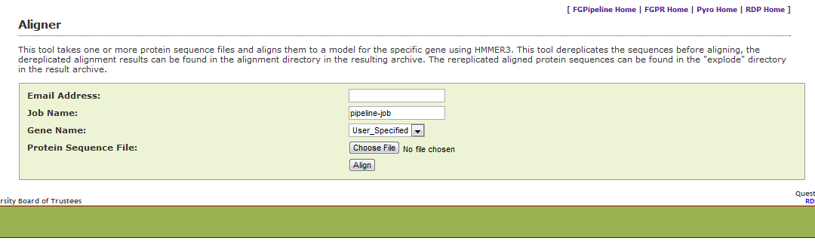
HMMR aligners are available for selected genes
nifH, but, buk, p450,alkB, bphA,dxnA, carA, dbFA2
Tool dereplicates sequences first (will let you know what it did)

Slide 33
http://fungene.cme.msu.edu/FunGenePipeline/
MCCLUST is a clustering tool

Slide 34
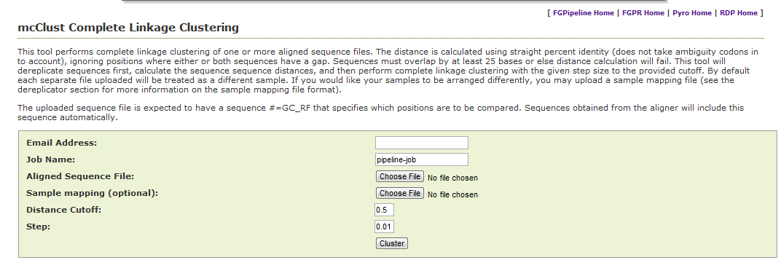
Clustering by MCCLUST
Same principle as with Pyro tool
Can use mapping file from Dereplicator

Slide 35
http://fungene.cme.msu.edu/FunGenePipeline/
Expand mappings reverse the dereplicator
Sequences with replicates
Sequences with no replicates
ID List
Sample mapping

Slide 36
http://fungene.cme.msu.edu/FunGenePipeline/
Representative (as in Pyro)
Diversity indices

Slide 37
http://fungene.cme.msu.edu/FunGenePipeline/
Analysis express

Slide 38
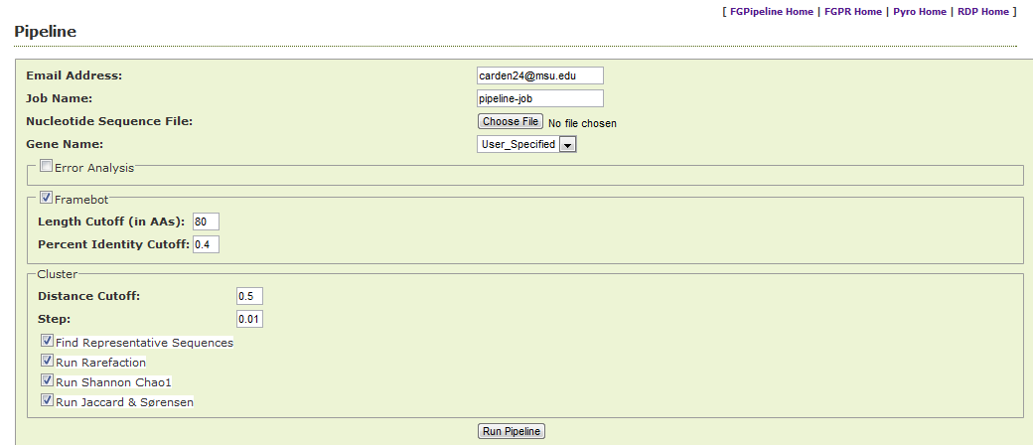
All analysis at once

Slide 39
Tips
Not all genes are easy to target with pyrosequencing (400 bp)
Be sure to include conserved regions to build a good model
Training set is essential for the HMM

Slide 40
Summary
Fungene is a fast way to build HMM for proteins and create an frequently update database
Alignment and probe search tools are available
Pyrosequencing tools for functional genes are also available
Write RDP if you want another gene or aligner

