Slide 1
Bioinformatics databases

Slide 2
What is a biological database?
Library of life sciences information, collected from scientific experiments, published literature, high-throughput experiment technology, and computational analyses.
Can contain information from research areas including genomics, proteomics, metabolomics, microarray gene expression, and phylogenetics.

Slide 3
Biological databases: why?
Need for storing and communicating large datasets has grown
Make biological data available to scientists
To make biological data available in computer-readable form
Databases can be searched by programs

Slide 4
Use of databases
Homology searching:
Use of knowledge from other often more well described organisms such as the model organisms Mouse, Drosophila, Fugu, C.Elegans etc..
Sequence level – position, annotation
Structural level – proteins, RNA
Evolutionary analyses:
Phylogenetics
Population genetics
Molecular evolution of genetic elements
Genome evolution
Primer design
Microarray design
Drug design
Many more……
Notes:
( definition of homology: shared evolutionary history)
structure homology among protein families and folds

Slide 5
General types of databases
Primary
Raw and non-processed data
E.g. Genbank
Secondary
Curated – data chosen from criteria
If you have a choice work with them
E.g. RDP
Tertiary
Data processed
HMM profile
E.g. PFAM , Fungene
Notes:
An arbitrariry calssification by me

Slide 6
Different classifications of databases
Type of data
nucleotide sequences
protein sequences
proteins sequence patterns or motifs
macromolecular 3D structure
gene expression data
metabolic pathways
Microarray
Whole genomes
Papers and books
Variation of human genes

Slide 7
Nucleotide sequence databases
GenBank www.ncbi.nlm.nih.gov/Genbank
EMBL www.ebi.ac.uk/embl
DDBJ www.ddbj.nig.ac.jp
Notes:
These three all have the same content as they are synchronised every day

Slide 8
Molecular interaction databases
General
Biomolecular Interaction Network Database http://bioinfo.mshri.on.ca/cgi-bin/bind/dataman
Molecular interactions Database (MINT) http://cbm.bio.uniroma2.it/mint/
Protein-Protein interactions
Database of interacting proteins http://dip.doe-mbi.ucla.edu/
Biochemical pathways
KEGG Metabolic Pathways http://www.genome.ad.jp/kegg/metabolism.html

Slide 9
Genome databases
Entrez genomes www.ncbi.nlm.nih.gov/entrez/query.fcgi?db=Genome
Ensemble genomes http://www.ensembl.org/
HIV Sequence Database
http://hiv-web.lanl.gov/content/hiv-db/mainpage.html
FlyBase http://flybase.bio.indiana.edu/
COGs www.ncbi.nlm.nih.gov/COG
Notes:
Clusters of Orthologous Groups of proteins (COGs) were delineated by comparing protein sequences encoded in 43 complete genomes, representing 30 major phylogenetic lineages. Each COG consists of individual proteins or groups of paralogs from at least 3 lineages and thus corresponds to an ancient conserved domain. Proteins from two eukaryotic genomes (Drosophila melanogaster and Caenorhabditis elegans) were assigned to COGs and can be reached from each individual COG page.

Slide 10
Integrated databases
Increasing the value of information
InterPro www.ebi.ac.uk/interpro
Sequence retrieval system (SRS) www.expasy.ch/srs5
Entrez www.ncbi.nlm.nih.gov/Entrez
Notes:
Off course the information is not worth much without the ability to put it into a context or a link to existing knowledge.
Many of the databases attempt to addres this through linking to other databases, bus some databases as NCBI#s Entrez also truly try to build integrated databases
Where several types of information is cross referenced and readily accessible
Interpro combines informatio from a number of member databases that encompass information from protein sequences concerning sequence data, possible motifs, domains
HMM of domains structure etc
SRS is a meta-query tool which searches several databases for information and combines this for the user
Entrez is a retrieval system for searching several linked databases. It provides access to: PubMed: The biomedical literature (PubMed) Nucleotide sequence database (Genbank) Protein sequence database Structure: three-dimensional macromolecular structures Genome: complete genome assemblies PopSet: population study data setsOMIM: Online Mendelian Inheritance in Man Taxonomy: organisms in GenBank Books: online books ProbeSet: gene expression and microarray datasets3D Domains: domains from Entrez StructureUniSTS: markers and mapping dataSNP: single nucleotide polymorphisms CDD: conserved domains Journals: journals in Entrez UniGene: gene-oriented clusters of transcript sequences PMC: full-text digital archive of life sciences journal literature

Slide 11
Proteomics databases
Yeast Proteome Database http://www.incyte.com/sequence/proteome/databases/YPD.shtml
SWISS-2DPAGE
http://us.expasy.org/ch2d/
TMIG-2DPAGE
http://proteome.tmig.or.jp/2D/
Notes:
SWISS-2DPAGE Two-dimensional polyacrylamide gel electrophoresis database
TMIG-2DPAGE Two-dimensional protein gels for a normal human diploid fibroblast line (TIG-3)
The Yeast Proteome Database (YPD) is a comprehensive knowledge resource that contains information on all the characterized proteins of the well-studied yeast Saccharomyces cerevisiae.

Slide 12
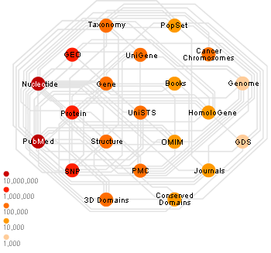
NCBI , the most popular database
over 30 databases including GenBank, PubMed, OMIM, and GEO
Access all NCBI resources via Entrez (www.ncbi.nlm.nih.gov/Entrez/)

Slide 13
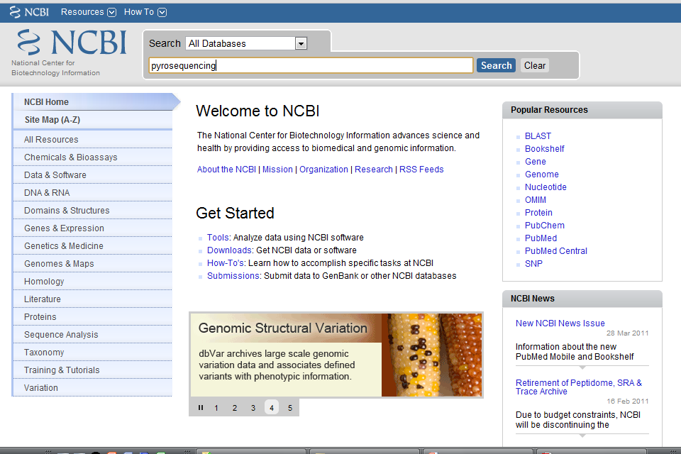

Slide 14
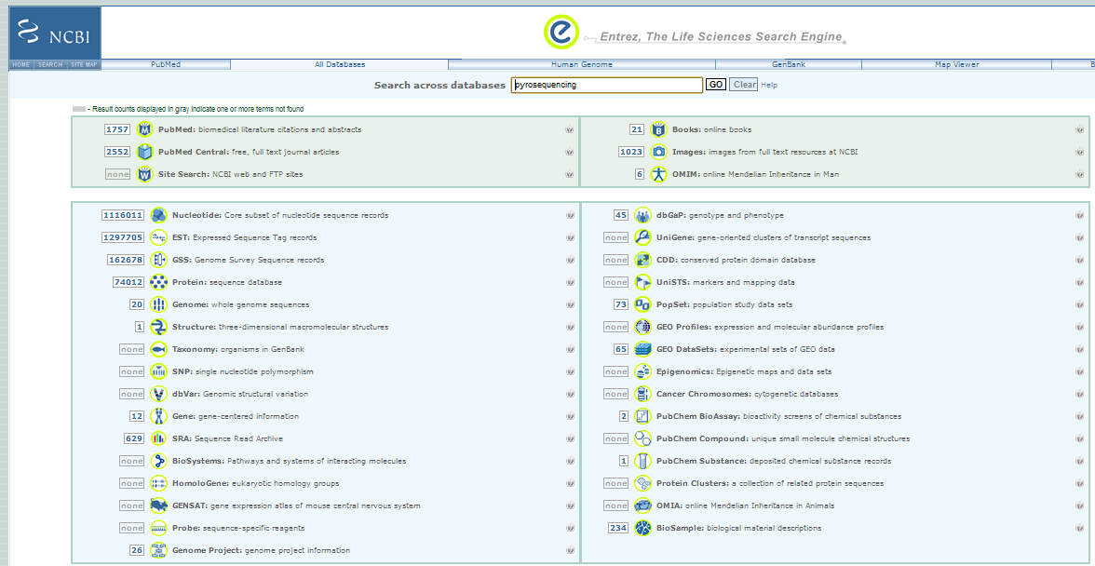

Slide 15
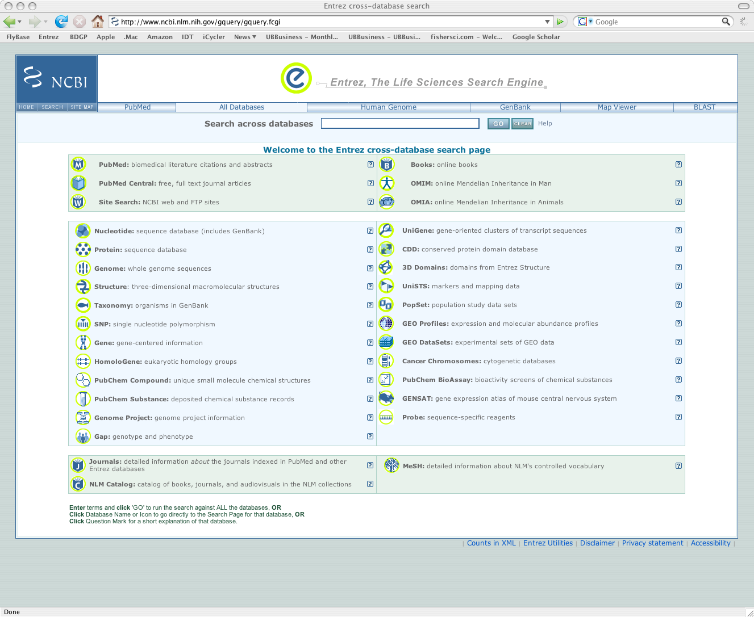

Slide 16
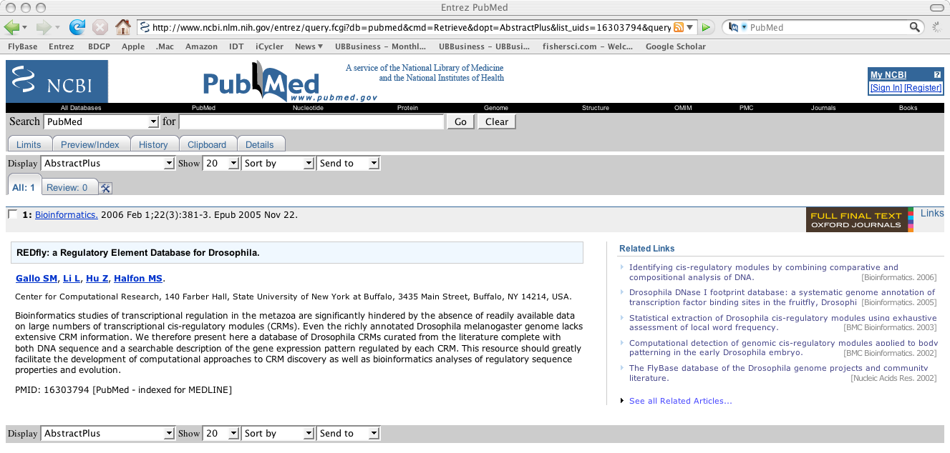

Slide 17
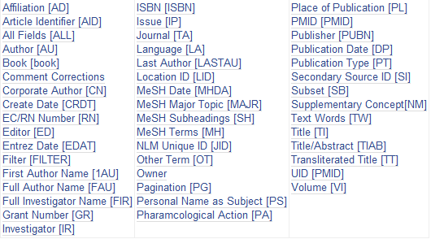
Pubmed field search
E.g. pyrosequencing[TIAB] Review[PT] 2010[DP]

Slide 18
Tips for free papers
All paper from the American Society for Microbiology are free after 6 months of publication
App. Env. Microbiol., J.Bacteriol. , etc,
Try open access journals
PLOS
BMC
Papers supported by NIH have to be open access
Email authors, they are vain

Slide 19
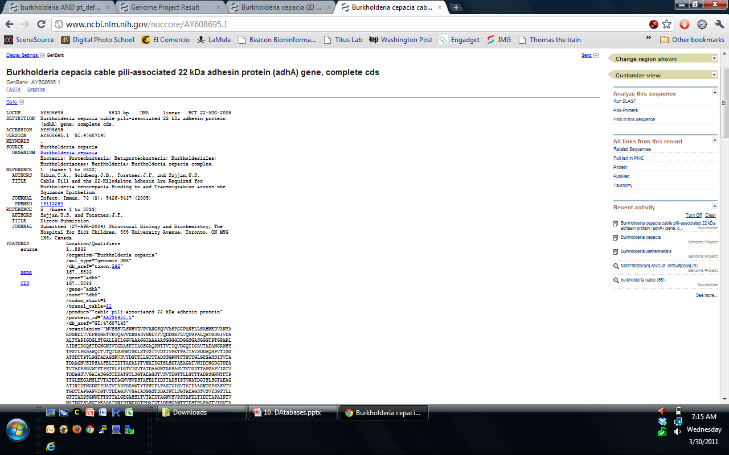
GenBank

Slide 20
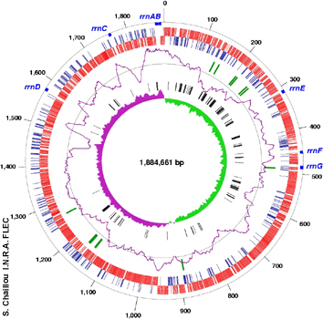
Genome
Basic statistics
Size
GC %
Download
Whole chromosome
Individual genes
Annotation

Slide 21
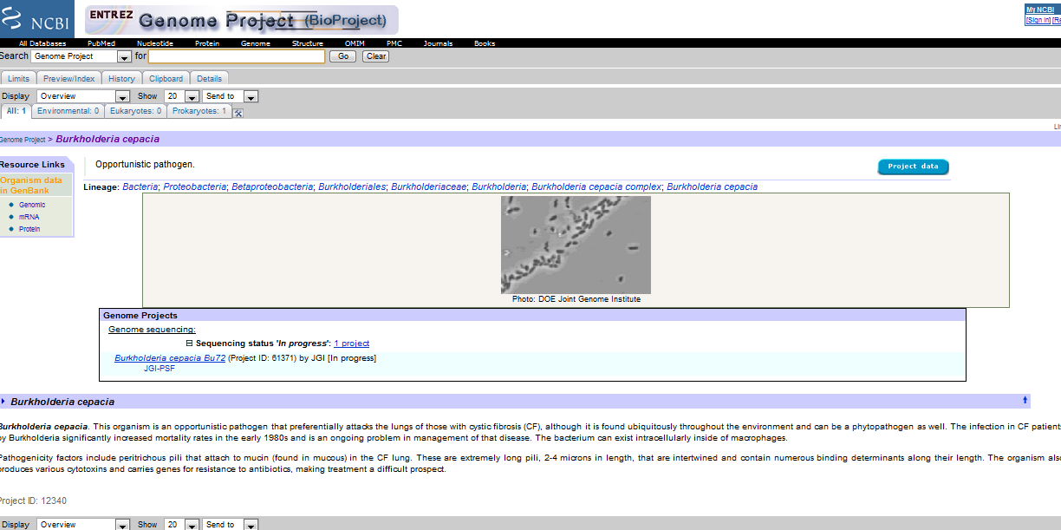
Burkholderia vietnamiensis genome project

Slide 22
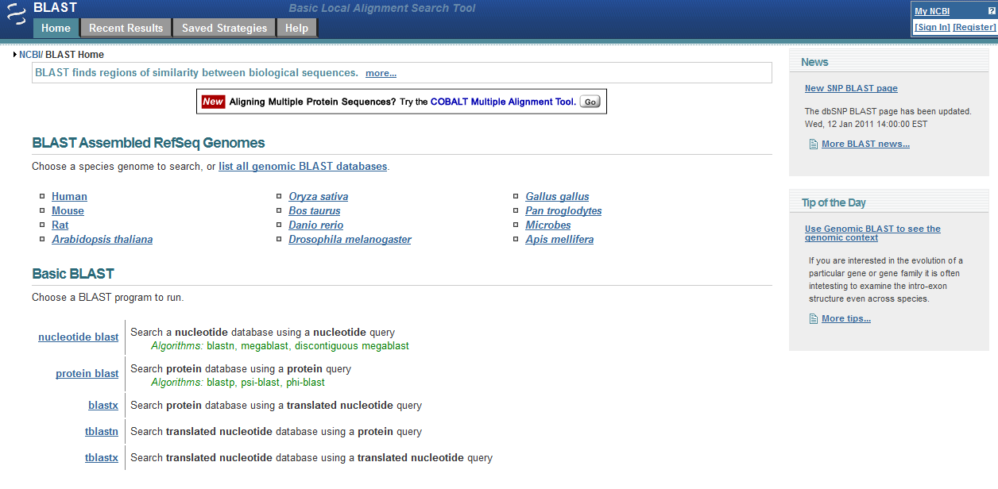
BLAST

Slide 24
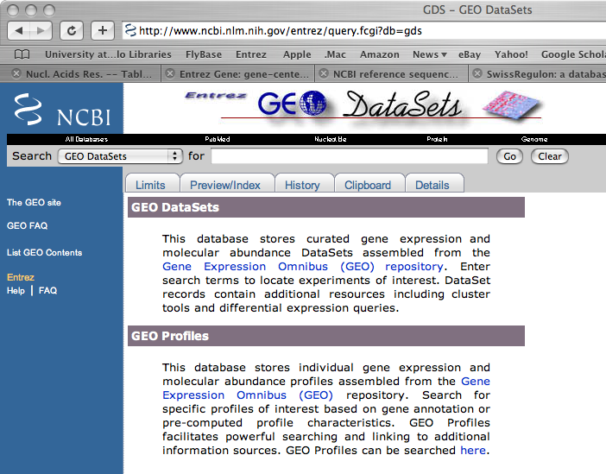
Microarray data are stored in GEO (NCBI) and ArrayExpress (EBI)

Slide 25
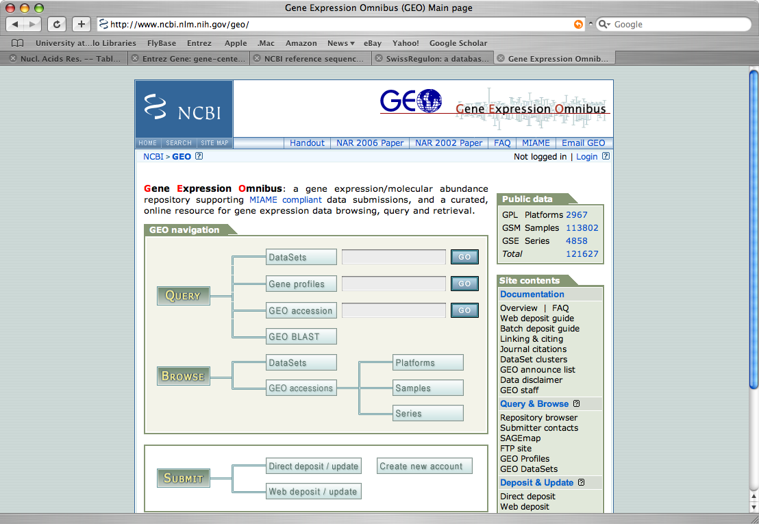
Microarray data are stored in GEO (NCBI) and ArrayExpress (EBI)

Slide 26
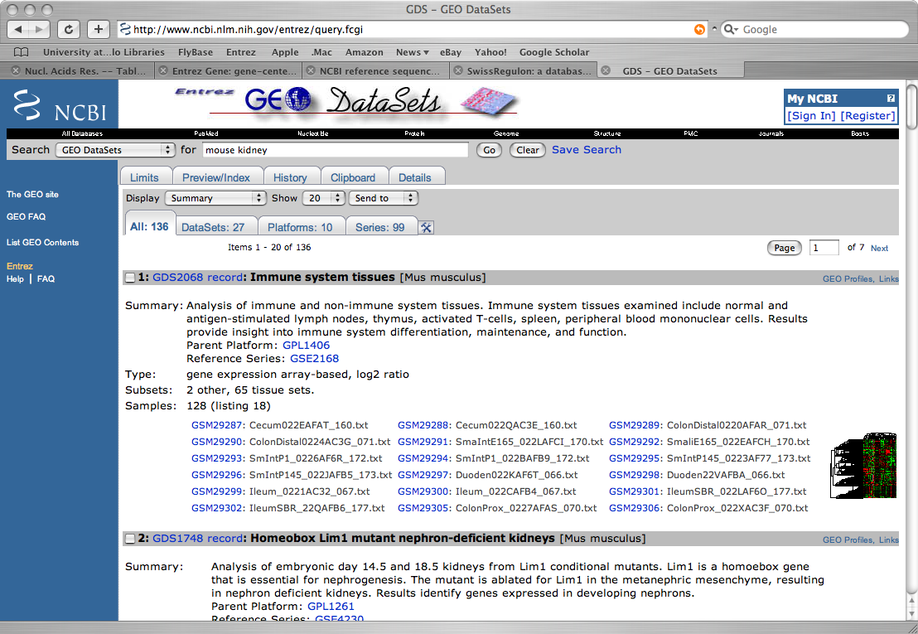
Microarray data are stored in GEO (NCBI) and ArrayExpress (EBI)

Slide 27
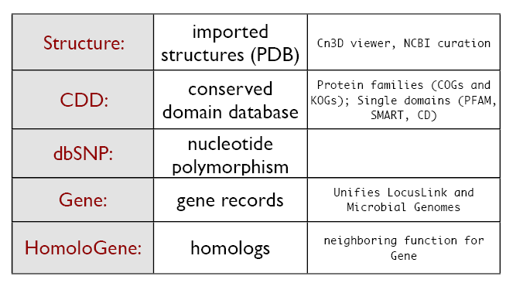
Other NCBI database

Slide 28
SWISSPROT
http://www.ebi.ac.uk/swissprot/
European/Swiss Bioinformatics Institute 1986
Contains 254609 genes from 10766 species
Highly accurate, hand curated resource
Aims:
Have a high level of annotation
Often by the people who have been working with the gene
Have a low level of redundancy
Have a high level of integration with other databases

Slide 29
TREMBL
http://www.ebi.ac.uk/trembl/
SWISSPROT’s Big Brother
All genes which have been left out of SWISSPROT
Computer annotated rather than human annotated
SP-TrEMBL
Those sequences which will eventually make it in
REM-TrEMBL
Those sequences they don’t want to include
3633676 protein sequences so far
Major resource which is often first port of call

Slide 30
PROSITE
http://ca.expasy.org/prosite/
Families of proteins
Can search using regular expressions
Similar to unix commands using wildcards, etc.
E.g., [AC]-x-V-x(4)-{ED}
Interpretted as:
[Ala or Cys]-any-Val-any-any-any-any-{any but Glu or Asp}
Families exhibit these patterns
So we can search over families
1465 documents about 1327 different patterns

Slide 31
PFAM
http://www.sanger.ac.uk/Software/Pfam/
Maintained by the Sanger Centre (Cambridge)
Protein families aligned using HMMs
Hidden Markov Models (see later lecture)
Given a new sequence
Find families which the sequence might fit into
Sequence Coverage
8957 families
74% of protein sequences have at least one match to Pfam
Split into Pfam-A (high quality) and Pfam-B (low quality)

Slide 32
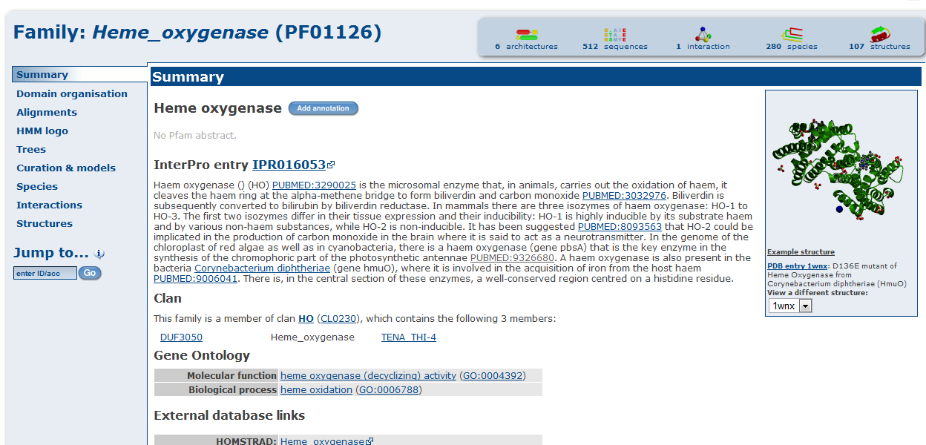
PFAM

Slide 33
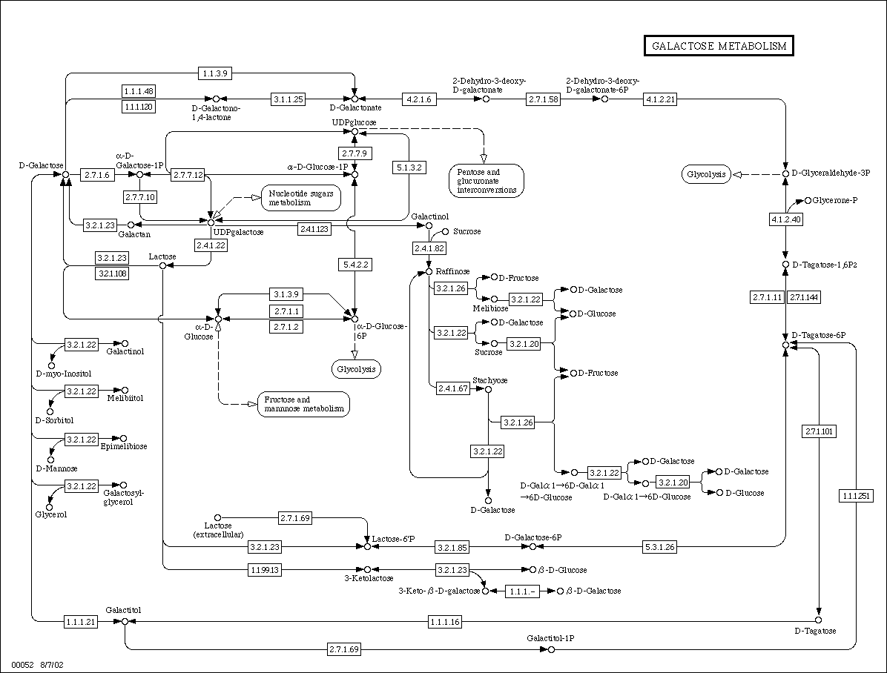
KEGG (Kyoto Encyclopedia of Genes and Genomes)
Metabolic pathways
Encoded as GIF files
http://www.genome.jp/kegg/
Can be used to infer metabolism capacity from genome information

Slide 34
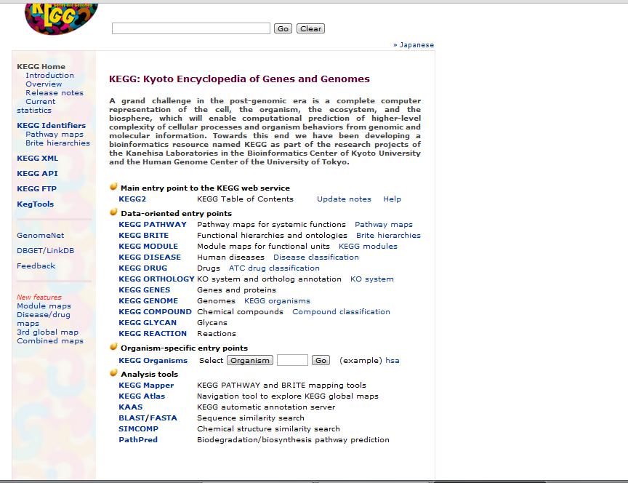

Slide 35
Gene Ontology
http://www.geneontology.org/
Ontology is a hierarchical database
Where concepts are linked by
isa (one concept is a specialisation of another)
partof (one concept is part of another)
Each concept has a number of genes
i.e., each gene is annotated by some concepts
Split into three main branches
Process, function, cellular component
Currently
13257 process, 7526 function and 1863 component terms

Slide 36
COG (Cluster of orthologous groups of proteins)
Information storage and processing
J | Translation, ribosomal structure and biogenesis
A | RNA processing and modification
K | Transcription
L | Replication, recombination and repair
B | Chromatin structure and dynamics
Cellular processes and signaling
D | Cell cycle control, cell division, chromosome partitioning
Y | Nuclear structure
V | Defense mechanisms
T | Signal transduction mechanisms
M | Cell wall/membrane/envelope biogenesis
N | Cell motility
Z | Cytoskeleton
W | Extracellular structures
U | Intracellular trafficking, secretion, and vesicular transport
O | Posttranslational modification, protein turnover, chaperones
Metabolism
C | Energy production and conversion
G | Carbohydrate transport and metabolism
E | Amino acid transport and metabolism
F | Nucleotide transport and metabolism
H | Coenzyme transport and metabolism
I | Lipid transport and metabolism
P | Inorganic ion transport and metabolism
Q | Secondary metabolites biosynthesis, transport and catabolism
Poorly characterized
R | General function prediction only
S | Function unknown
Groups of well studied or highly conserved genes
Has not been updated in years, people still use them

Slide 37
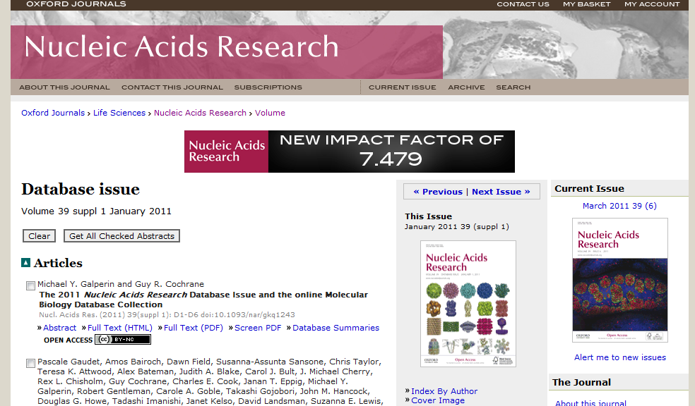
List of Bioinformatic Databases

Slide 38
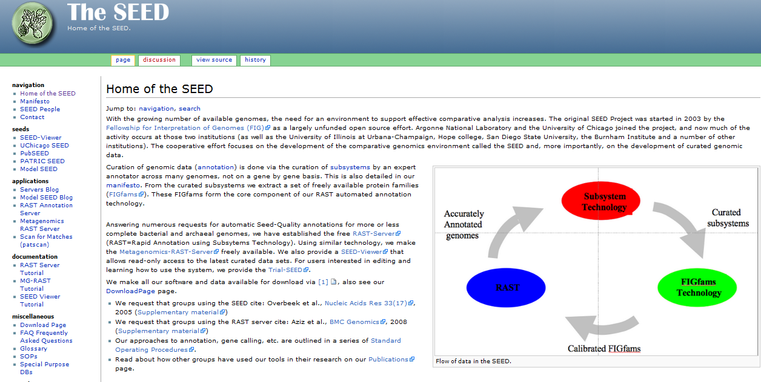
Organize genes according to the process they are involved
Curated and update

Slide 39
TIPS: Database searching tips
Look for links to Help or Examples
Try Boolean searches (AND, OR, NOT)
Some of the databases can be downloaded and analyzed off site
E.g. Local BLAST

Slide 40
Summary
There are many, many databases
Updated databases and curated databases are highly desirable
There are many free resources

