Slide 1

Android & Firebase
Working firebase Example of the following Firebase methods:
- child()
- getRef()
- getRoot()
- getParent()
- setValue()
- updateChildren()
- addValueEventListener()
- removeEventListener()

Slide 2
Create Project
Create a new Android Studio Project
Empty Activity
API 16 or greater

Slide 3
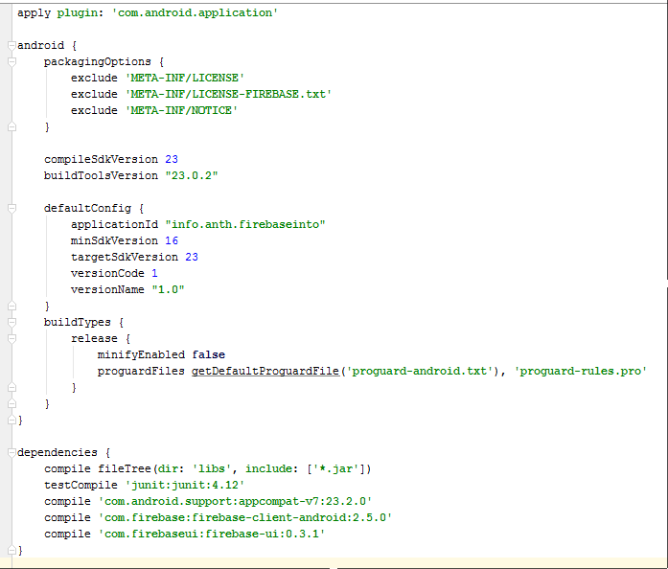

build.gradle
Update build.gradle for Firebase dependencies
Add packaging options to avoid licensing errors
Sync now

Slide 4
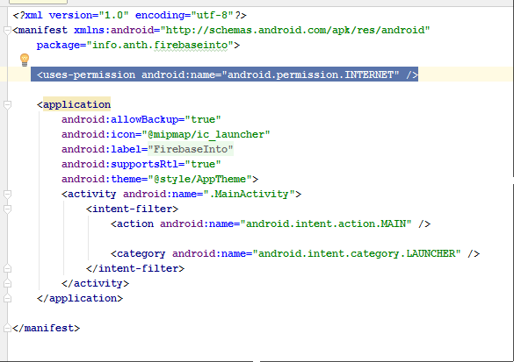
AndroidManifest
Add user permissions

Slide 5
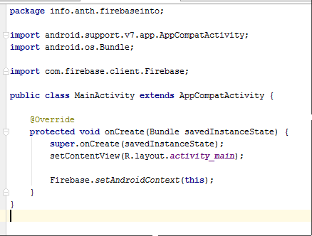
MainActivity.java
Add Firebase Android Context
Check for import file
Run to emulator or phone

Slide 6

Create Firebase Account
Create / Login to Firebase.com
.com

Slide 7
Firebase
YOUR_DATABASE_NAME
Example
Countries
Canada
Hierarchical – tree structure– similar to a file system.
Life expectancy: 81.24
Population: 35.16
United States
Life expectancy: 78.74
Population: 318.9
States
. . .

Slide 8
Firebase Vocabulary – Root
YOUR_DATABASE_NAME
Example
Countries
Canada
aka: base reference
The start of the tree, you database in URL format.
Life expectancy: 81.24
Population: 35.16
United States
Life expectancy: 78.74
Population: 318.9
States
Example: https://hudsonvalleygdg.firebaseio.com
FIREBASE Command: reference.getRoot()
Firebase mRef = new
Firebase("https://hudsonvalleygdg.firebaseio.com");

Slide 9
Firebase Vocabulary – Reference
YOUR_DATABASE_NAME
Example
Countries
Canada
Position within the hierarchy – tree structure
(aka node)
Life expectancy: 81.24
Population: 35.16
United States
Life expectancy: 78.74
Population: 318.9
States
Example:
https://hudsonvalleygdg.firebaseio.com
https://hudsonvalleygdg.firebaseio.com/Example/Countries/Canada
FIREBASE Command: mRef.getRef()

Slide 10
Firebase Vocabulary – Child
YOUR_DATABASE_NAME
Example
Countries
Canada
Any sub-level item from the root
(Parent – the parent of the reference)
Life expectancy: 81.24
Population: 35.16
United States
Life expectancy: 78.74
Population: 318.9
States
Example: How to navigate from base reference to Canada
mRef.child(“Example”).child(“Countries”).child(“Canada”)
FIREBASE Command: mRef.child()
(parent: mRef.getParent() – returns the parent reference

Slide 11
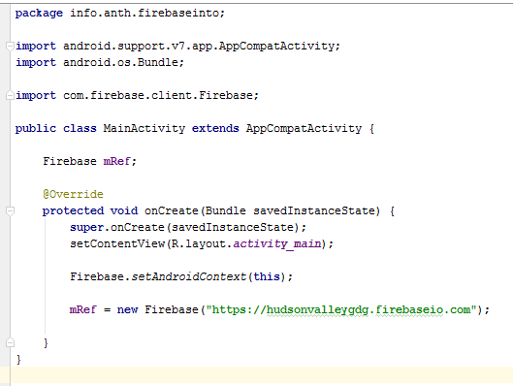
MainActivity.java
Add global mRef, reference to your firebase database.
REPLACE hudsonvalleygdg with YOUR database name.

Slide 12
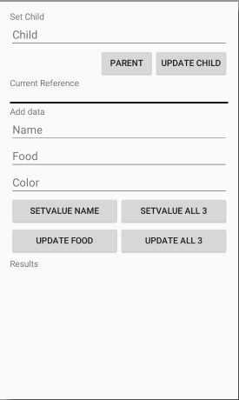
activity_main.xml
Replace code with the code provided.
Screen should look like the one to the right.

Slide 13
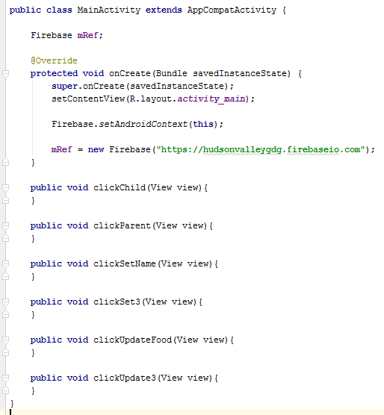
MainActivity.java
Add empty button methods to the MainActivity class.

Slide 14
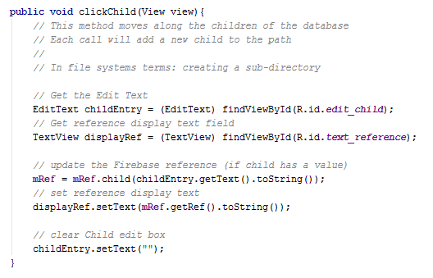
MainActivity.java Adding Children
YOUR_DATABASE_NAME
Example
Countries
Canada
Life expectancy: 81.24
Population: 35.16
Update the clickChild method
child() method
getRef() method

Slide 15
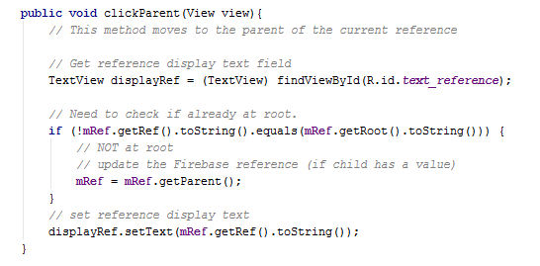
MainActivity.java Parent
YOUR_DATABASE_NAME
Example
Countries
Canada
Life expectancy: 81.24
Population: 35.16
Update the clickParent method.
getRef() method
getRoot() method
getParent() method

Slide 16
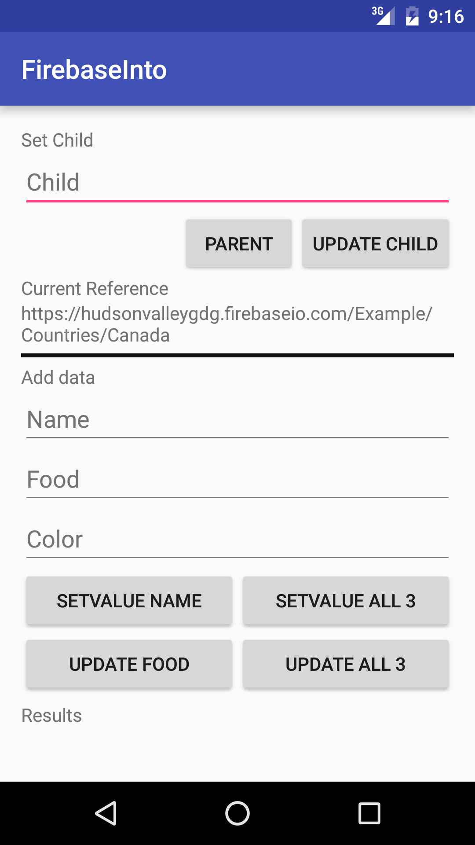
Run Program
Review how adding children and moving back to parent impacts the current reference.

Slide 17
Saving Data
Two different methods
setValue()
updateChildren()
Two ways to provide the values
Navigate to the child element that you want updated (using .child()) – only works with setValue()
Using a Hash Map – setValue() and updateChildren()

Slide 18
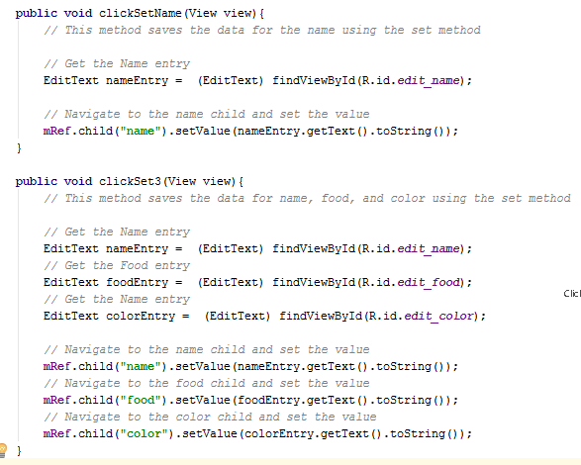
MainActivity.java clickSetName & cilckSet3
Update the clickSetName and cilckSet3 methods with the code provided.
child() method
setValue() method

Slide 19
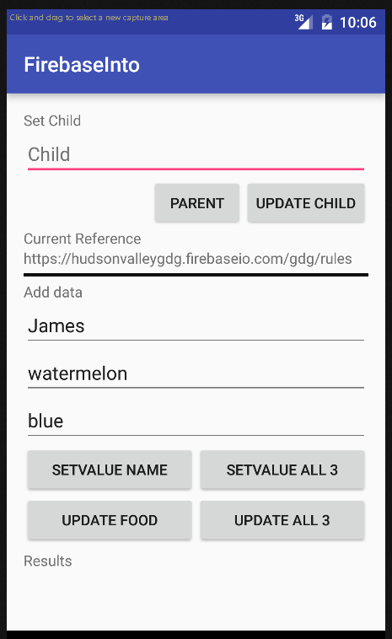
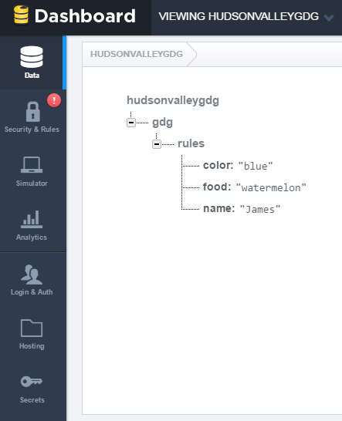
Run Program
https://YOUR-DATABASE-NAME.firebaseio.com
Add values for name, food, and color and see how they are saved into the database.
Use the Firebase dashboard to see the changes.
Add child references and move back to parent click the SETVALUE buttons to see the impact on where the data is saved.

Slide 20
Hash Map
Direct Navigation
A data structure used to map keys to values
String, Object format
Process many fields at once
// Navigate to the name child and set the value mRef.child("name").setValue(nameEntry.getText().toString());
Hash Map
Map<String, Object> updateMap = new HashMap<>(); updateMap.put("name", nameEntry.getText().toString()); mRef.setValue(updateMap);

Slide 21
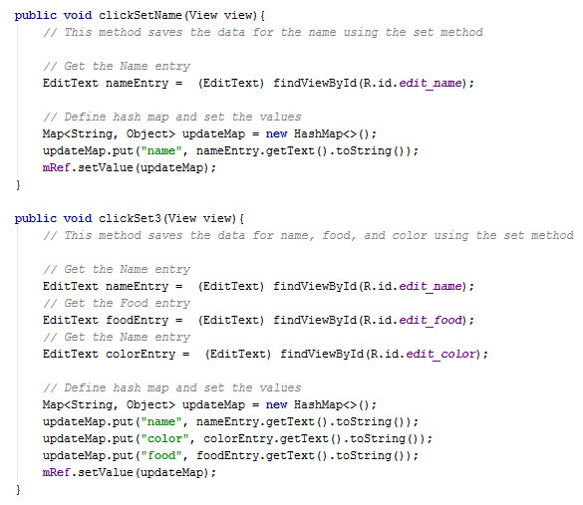
MainActivity.java clickSetName & cilckSet3 HASH MAP
Update the clickSetName and cilckSet3 methods with the Hash Map code provided.
setValue() method

Slide 22
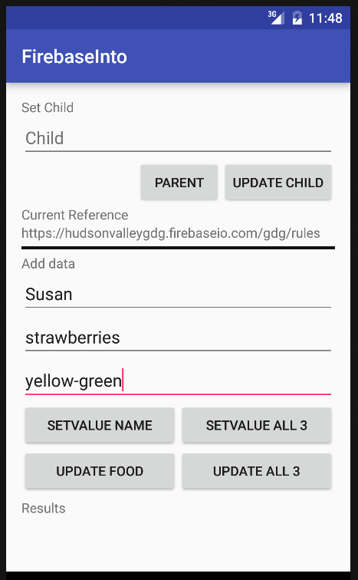
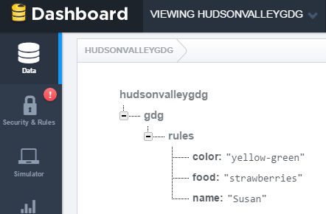
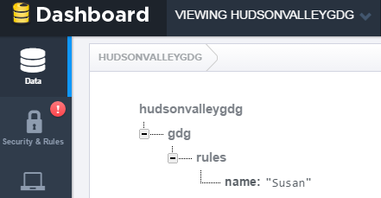
Run Program
https://YOUR-DATABASE-NAME.firebaseio.com
Add values for name, food, and color and see how they are saved into the database.
Use the Firebase dashboard to see the changes.
See how SETVALUE all 3 works different then SETVALUE Name.

Slide 23
Firebase Vocabulary – setValue()
For the given reference, it deletes all children of the reference and creates the value passed in.

Slide 24
Firebase Vocabulary – updateChildren ()
For the given reference, it updates the children mentioned in the Hash Map with the values of the Map. If the child does not exist, it will create it.

Slide 25
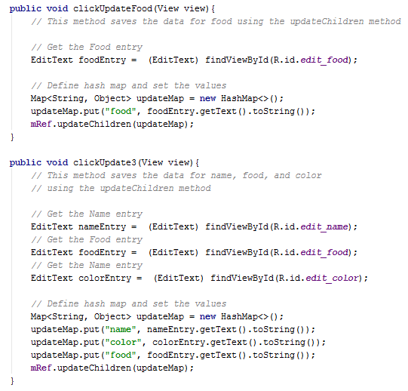
MainActivity.java clickUpdateFood & cilckUpdate3
Update the clickUpdateFood and cilckUpdate3 methods with the code provided.
updateChildren() method

Slide 26
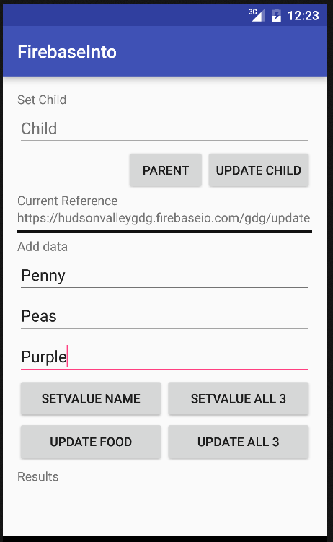
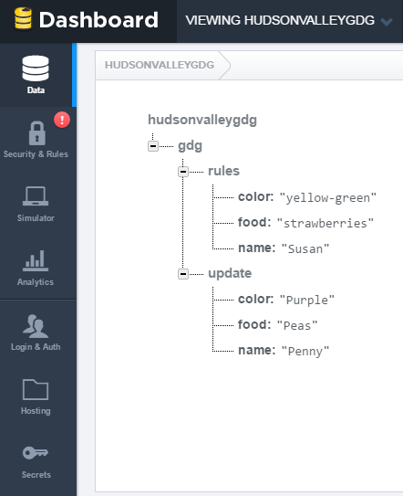
Run Program
https://YOUR-DATABASE-NAME.firebaseio.com
Add values for name, food, and color and see how they are saved into the database.
Use the Firebase dashboard to see the changes.
Add child references and move back to parent click the “UPDATE” buttons to see the impact on where the data is saved.

Slide 27
Retrieving Data
Receiving
X
You do not go out and get the data …
Asynchronous in nature
It is sent to you
… you just have to listen for it.

Slide 28
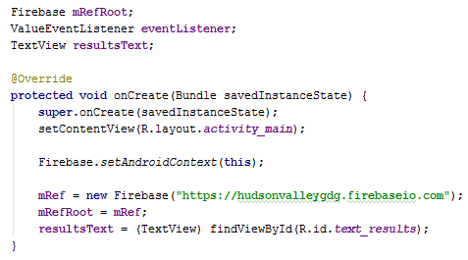
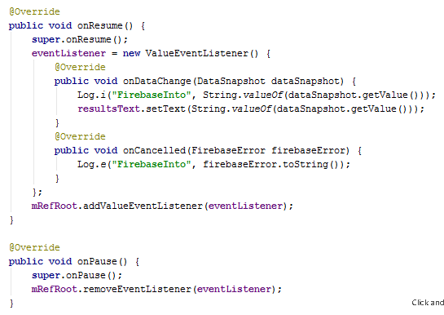
MainActivity.java Setup Listener
Setup a listener at the base reference level of the database. Show in the results section of screen.
Add variables, store results TextView
Override onResume / onPause

Slide 29
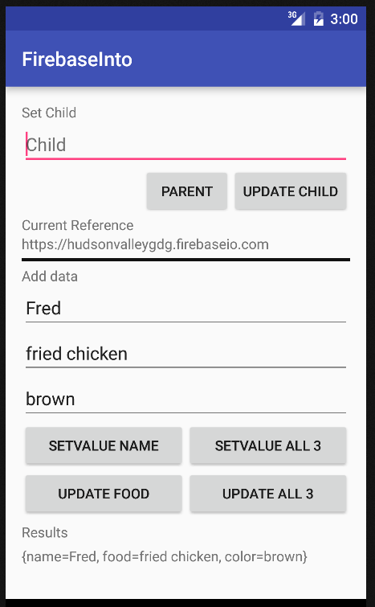
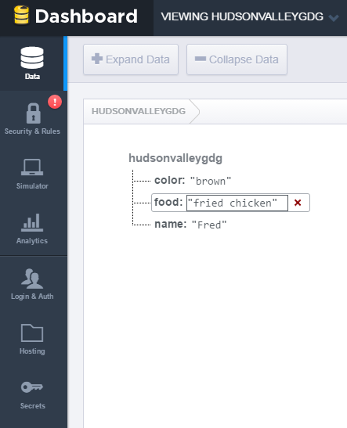
Run Program
https://YOUR-DATABASE-NAME.firebaseio.com
Add values for name, food, and color and see how they are saved into the database.
Use the Firebase dashboard to see the changes.
Delete a value using the Dashboard and see how Results area changes.

