Slide 1
Classroom Rocket Scientist
Advanced (KS3) version

Slide 2



1. Pick satellite type
Select your type of satellite
Navigation Satellite
Help people find their way
Communication Satellite
Help people communication with each other
Navigation arrow
Earth Observation Satellite
Monitor the Earth
Colour coded (changeable pallets for colour-blind etc.?)
Title
Brief description
Icon

Slide 3

2a. Pick a goal/objective (Nav)
Select the purpose of your satellite
Title
Brief description
Budget
Size
Photo?
Navigation arrow
Navigation arrow
Satellite Navigation System
Tell people their location
Budget: ₴100
Size: small
Map-making
Map the surface of the Earth
Budget: ₴200
Size: medium
Use “credits” units for currency by default (always < ₴1000)
Perhaps photos of example satellites?

Slide 4
2b. Pick a goal/objective (Comms)
Select the purpose of your satellite
Same as above (different colour?)
Same as above (different colour?)
Satellite telephone system
Let people talk over the phone using satellites
Budget: ₴100
Size: small
Satellite internet
Connect to the internet using satellites
Budget: ₴200
Size: medium
Satellite TV
Provide satellite TV
Budget: ₴500
Size: large

Slide 5
2c. Pick a goal/objective (Earth Obs)
Select the purpose of your satellite
Same as above (different colour?)
Weather forecasting
Monitor the weather
Budget: ₴200
Size: medium
Vegetation mapping
Map the plants over the surface of the Earth
Budget: ₴200
Size: medium
Build
Natural Disaster monitoring
Study areas of natural disasters
Budget: ₴500
Size: medium
Surface mapping
Measure the height of land over the surface
Budget: ₴500
Size: large
Build
Perhaps photos of example satellites?

Slide 6

3. Satellite size
Choose the size of your satellite
Budget: ₴500
Nano
Small
L
L
Medium
S
S
S
S
L
S
S
Large
S
S
Cost, base power requirement, mass allowance
L
L
S
S
S
S
L
S
S
L
S
S
L

Slide 7



4. Orbit
Select the orbit for your satellite
Possible orbits
Low Earth orbit
Altitude: 400 km
+
Title, Altitude
Medium Earth orbit
Altitude: 20000 km
Orbital period: 12 hours
Can typically see
+
Similar to Design a Space Telescope image
Requirements
See the whole planet
Show/hide more info
Sun-synchronous orbit
Altitude: 600 km
Requirements relating to orbit
+

Slide 8
5. Select your instruments
Arrow shows breakdown of budget and mass, but not total
Only show if over budget
Title depends on selected type
Build your navigation satellite
Graphical schematic of the satellite (size & slots dictated by mission)
“Blocks” for instruments
Spaces for radio dishes etc.
Budget: ₴500 Mass: 500 kg
L
Available instruments
S
Camera
Cost: ₴40 Size: S
Mass: 5 kg
+
S
Icon, Title, Cost, Size, Mass
Navigation only shows if all requirements met
Large Radio dish
Cost: ₴10 Size: L
Mass: 10 kg
Allows communication with the ground.
+
Slots available: Large: 1/2 ; Small: 2/4
Restart
Power
Requirements
Take pictures of the Earth
Radio dish to communicate
Requirement 3…
Show/hide more info
No check boxes in secondary mode
Video camera
Cost: ₴50 Size: S
Mass: 10 kg
+
Requirements not met
Warning visible when requirements not met.
Instrument Warnings

Slide 9


6. Select power
More complicated in “Intermediate” view, with batteries etc.
Add your solar panels
Budget: ₴500 Mass: 500 kg
L
Slots available: Large: 1/2 ; Small: 2/4
S
S
Deployable
solar panels
Available power devices
Fixed
solar panels
Selection box
Deployable not available for all satellite sizes
Small Battery
Cost: ₴40 Size: S
Power: 50 W Mass: 5 kg
+
Only shows if all requirements met
Solar panels:
None/ Fixed/ Deployable
Build
Number:
4
+
RTG
Cost: ₴200 Size: L
Power: 300 W
Provides power
Rocket
+
Cost: ₴100
-
If fixed, area is fixed by satellite size
Power available: 1100 W
Required power: 1200 W
Icon, Title, Cost, Size, Power
Not enough power. Add solar panels or remove instruments
Error message

Slide 10

7. Select rocket
Build your rocket
Budget: ₴500 Mass: 500 kg
Carousels for each stage
Payload Bay
Your rocket
Medium
Large
Extra Large
Satellite in payload bay
Required
thrust
Second stage
Small
Medium
Large
Power
Bar changes colour when over limit
Launch!
Schematic of chosen stages
(spaceplane may complicate it!
First stage
Spaceplane
Small
Medium
Error message (if applicable)
Navigation only shows if launch is possible
Payload bay too big for 2nd stage
2nd stage too big for 1st stage

Slide 11
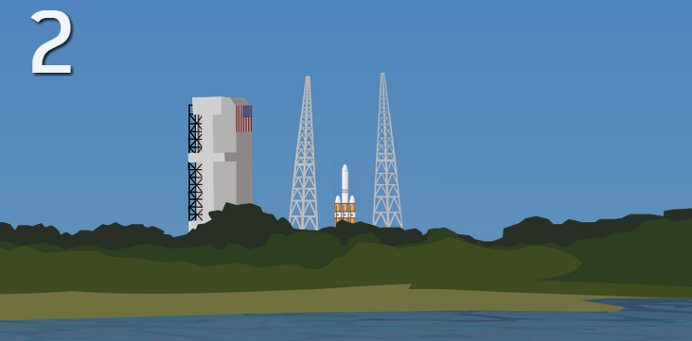
8. Launch
Launch!
Animation of launch. With stages dropping off?
Congratulations! Your satellite is now successfully providing an internet service to Europe!

