Slide 1
RmdEx3
test

Slide 2
R Markdown
This is an R Markdown presentation. Markdown is a simple formatting syntax for authoring HTML, PDF, and MS Word documents. For more details on using R Markdown see http://rmarkdown.rstudio.com.
When you click the Knit button a document will be generated that includes both content as well as the output of any embedded R code chunks within the document.

Slide 3
Slide with Bullets
Bullet 1
Bullet 2
Bullet 3

Slide 4
Slide with R Output
summary(cars)
## speed dist ## Min. : 4.0 Min. : 2.00 ## 1st Qu.:12.0 1st Qu.: 26.00 ## Median :15.0 Median : 36.00 ## Mean :15.4 Mean : 42.98 ## 3rd Qu.:19.0 3rd Qu.: 56.00 ## Max. :25.0 Max. :120.00

Slide 5
Data
rowname | mpg | cyl | disp | hp | drat | wt | qsec | vs | am | gear | carb
Mazda RX4 | 21.00 | 6.00 | 160.00 | 110.00 | 3.90 | 2.62 | 16.46 | 0.00 | 1.00 | 4.00 | 4.00
Mazda RX4 Wag | 21.00 | 6.00 | 160.00 | 110.00 | 3.90 | 2.88 | 17.02 | 0.00 | 1.00 | 4.00 | 4.00
Datsun 710 | 22.80 | 4.00 | 108.00 | 93.00 | 3.85 | 2.32 | 18.61 | 1.00 | 1.00 | 4.00 | 1.00
Hornet 4 Drive | 21.40 | 6.00 | 258.00 | 110.00 | 3.08 | 3.21 | 19.44 | 1.00 | 0.00 | 3.00 | 1.00
Hornet Sportabout | 18.70 | 8.00 | 360.00 | 175.00 | 3.15 | 3.44 | 17.02 | 0.00 | 0.00 | 3.00 | 2.00
Valiant | 18.10 | 6.00 | 225.00 | 105.00 | 2.76 | 3.46 | 20.22 | 1.00 | 0.00 | 3.00 | 1.00

Slide 6
Regression Analysis
rowname | Estimate | Std. Error | t value | Pr(>|t|)
(Intercept) | 29.5314 | 2.6221 | 11.26 | < 0.0001
wt | -3.5013 | 0.6915 | -5.06 | < 0.0001
factor(vs)1 | 11.7667 | 3.7638 | 3.13 | 0.0041
wt:factor(vs)1 | -2.9097 | 1.2157 | -2.39 | 0.0236
Call: lm(formula = mpg ~ wt * factor(vs), data = mtcars)

Slide 7
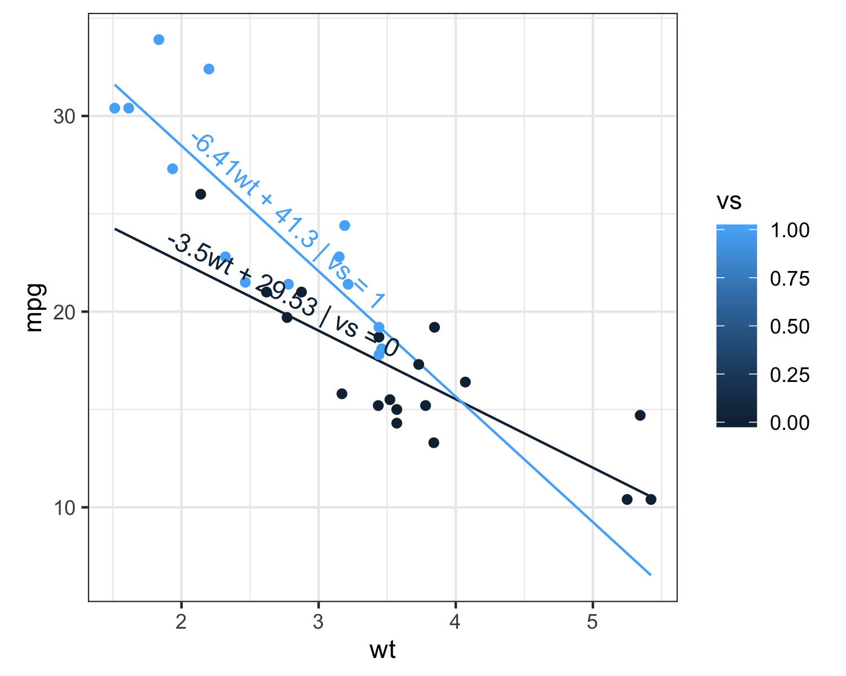
Slide with Plot

