Slide 1
Review of some
Tentative Experiments
on the DDPG
Jiang Xiaohan
2019.9.16

Slide 2
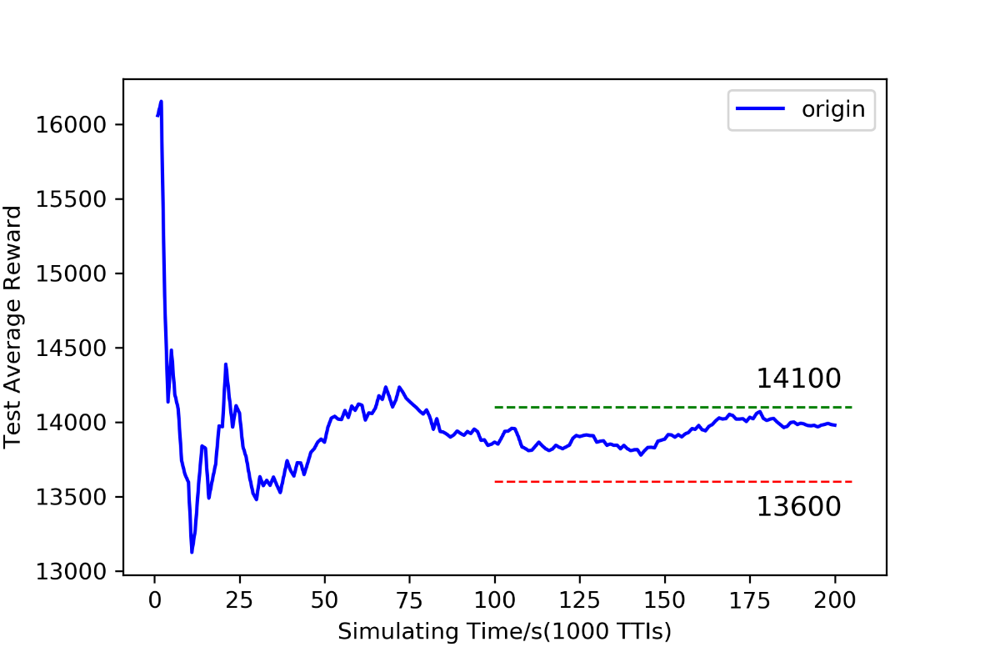
Performance of the very original version
Basically, after sufficient
times of experiments, the
results show that the
average reward of testing
process is between 13600
and 14100, while the
quality of service is not
that satisfyingly stable,
Frequently with intermittent intervals whose QoS are
absolute 0.0.

Slide 3
Four Attempts
Adding dynamic factors to MCS state
Enlarging the dimensions of RBG state
Employing EMF (Exponential Moving Filter)
Exploiting MMF (Median Moving Filter)

Slide 4
1. Modifications on MCS state
Notice that the reward of MCS allocation to a certain user at certain simulating time is mainly depending on the following three
factors:
SNR
static but decisive
Sum RBG scheduled
dynamic but secondary
Buffer
dynamic but secondary
So here I tried to employing these three
together to update as the next MCS state
instead of the randomly-generated one.

Slide 5
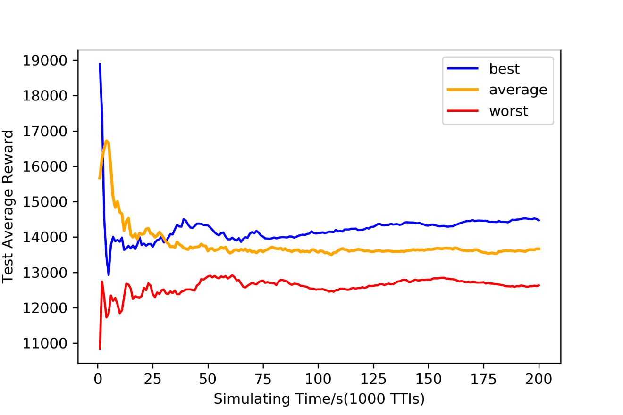
1. Modifications on MCS state
The performance is displayed on the left
side.
Generally speaking, this attempt leads to even less stability on the average reward of the testing process, apparent differences are shown among disparate groups.

Slide 6
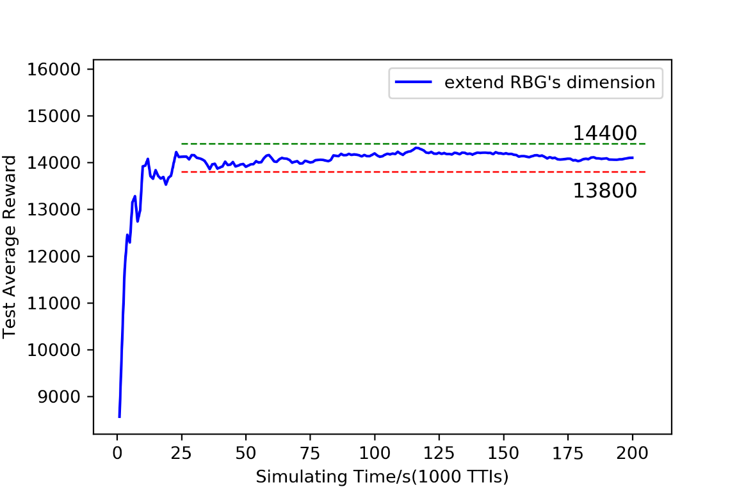
2. Alterations on RBG state
Notice that in a particular TTI, all the users’ RBG rewards are the same while RBG states are not, so I tried to
concatenate all of them to an overall (global?) RBG
state with the dimension of 4*RBG_NUM*RBG_NUM.
The median result is
presented on the right.
Despondently, there aren’t
obvious improvements
unearthed after more
tests are carried out.
On the contrary, the
expansion on the dimensions directly causes obvious
increments on the training
duration.

Slide 7

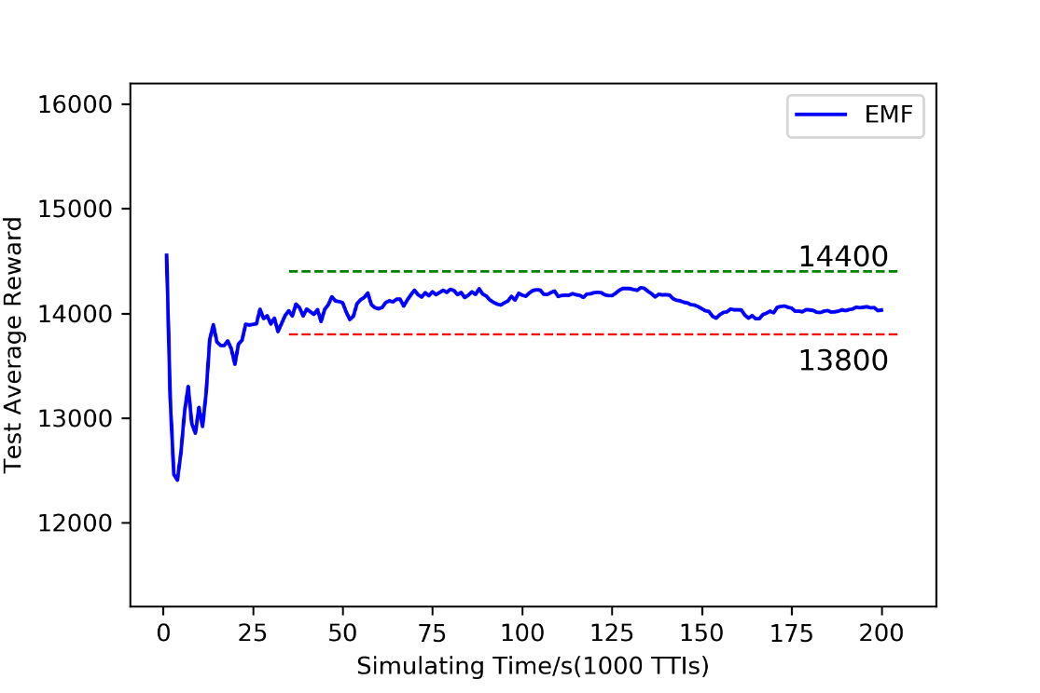
3. EMF
I then employ EMF to
calculate the throughput of user as the formula is illustrated on the right
with Beta denoting
forgetting factor.
Here I just
arbitrarily choose
one of the results
to display.
It is approximately
as similar as the
second version
(modification on
RBG state) .

Slide 8
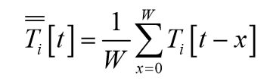

4. MMF
Subsequently, I tried to exploit MMF when computing user’s
throughput.
There are two representatives of MMF.
One is using a fixed window
size as the formula is listed
on the upper right.
Another is using a windowing
Factor denoted by Rho to
dynamically adjust the window
size. The formula is listed on the downer right.

Slide 9
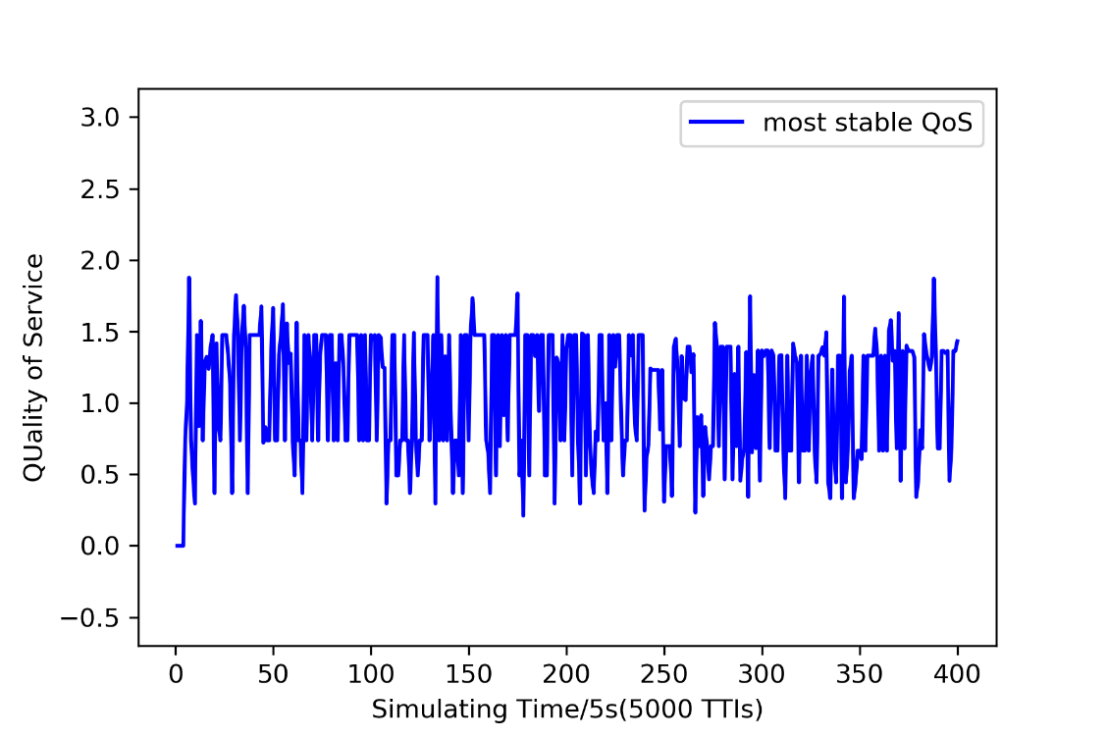
4. MMF
4.1 Fixed window size
Here I attempted to set the
window size with the values 3,5,7 and 9.
Also, no obvious and stable
Improvements are revealed.
But there’s indeed something
interesting when setting the
size 3, here I gain a result
with unexpectedly good
performance of QoS just as
showed on the left side.
In this test, the rate that the
QoS is greater than 0.5
surpasses 82%, while the
proportion that QoS is greater than 0.0 even reaches 97%.

Slide 10
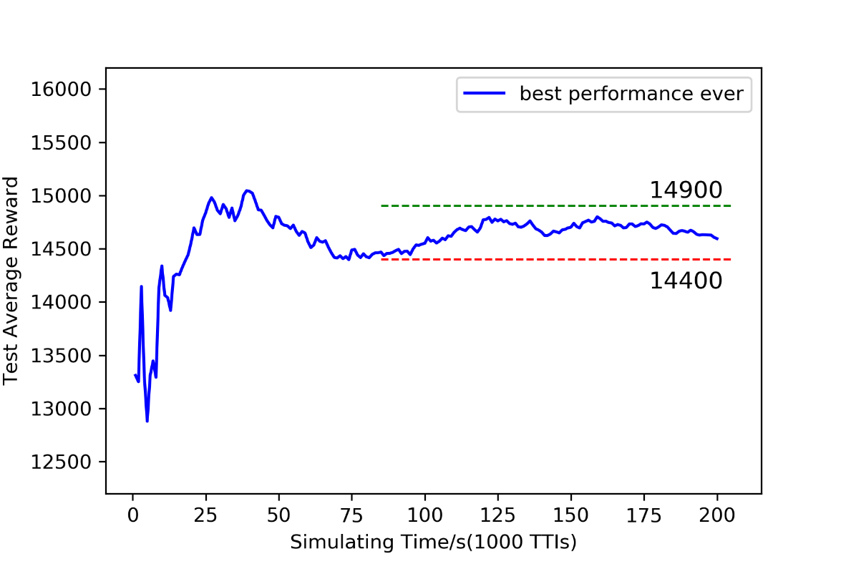
4. MMF
4.2 Windowing factor
Here I attempted to set the
windowing factor with the
value 17,26,34,43 and 51.
As usual, the performances
are basically as similar as the
fixed window size.
As well, I occasionally come
across something exciting
when setting the factor 43 —— a result with unparalleled high
average reward as displayed
on the right side.

Slide 11
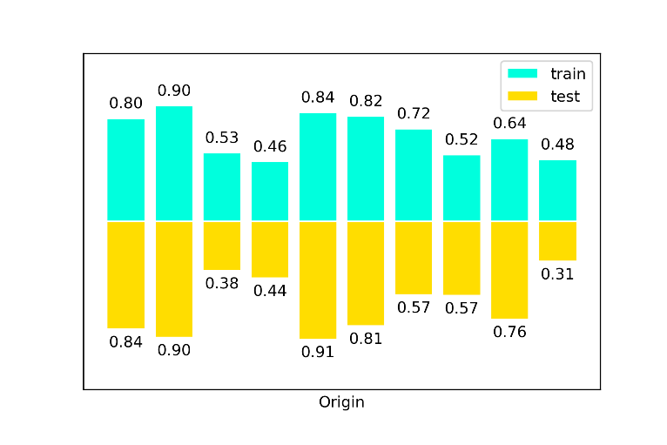
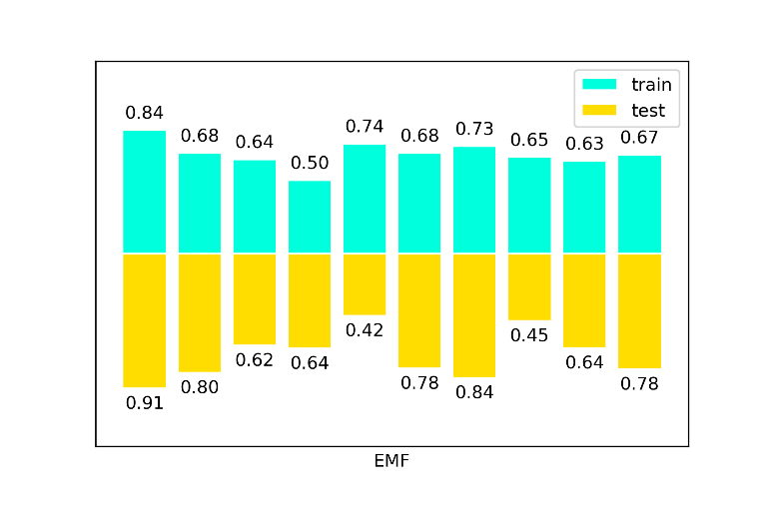
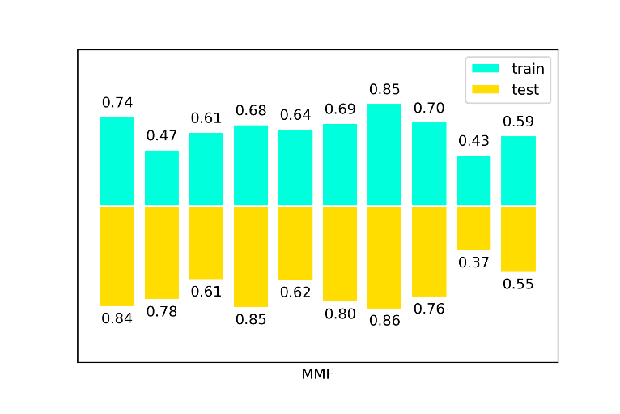
5. Throughput qualified rate
At last, I’d like to show something about the rate that user’s throughput is greater than the baseline (10000).
I simply record several groups: origin, EMF and MMF.
And the results with moving filters
seem slightly a little bit more stable?
Maybe it’s just my illusion.

