Slide 1
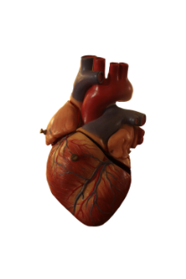
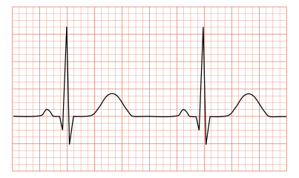
Biosignal Processing – EEEE 5286 Detection of Atrial Fibrillation from ECG Signals
Lecture by
Prasanth Ganesan
PhD Student, Electrical Engineering

Slide 2
Atrial Fibrillation Review
Irregular beating of atria
2.7 million Americans and 30 million worldwide affected every year
Normal heart beat
Atrial fibrillation

Slide 3
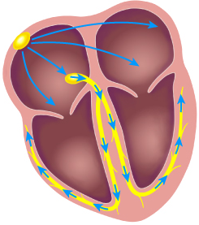
Causes of Atrial Fibrillation
Re-entry – Signals enters back to the atrium without leaving the chamber.
Single fibrillatory reentry
Multiple randomly propagating reentries
Abnormal focal activity

Slide 4
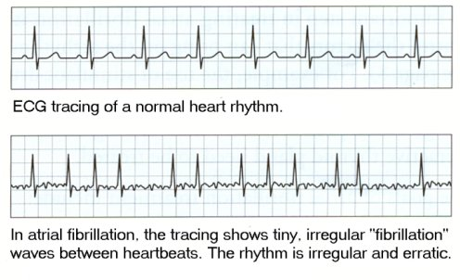
AF Signal Characteristics
Normal ECG – PQRST
AF ECG:
No p-waves
Random QRS waves
No isoelectric line
High “heart rate”
Fibrillatory waves

Slide 5
Methods of Detection
Time domain methods
R-R interval
Heart rate variability features such as mean heart rate, mean R-R intervals, standard deviation of the intervals etc.
Frequency domain methods
FFT of ECG
Frequency features in different bands
Time-frequency Analysis
Spectrogram:
Stridh, Martin, et al. "Characterization of atrial fibrillation using the surface ECG: time-dependent spectral properties." IEEE transactions on Biomedical Engineering 48.1 (2001): 19-27.

Slide 6
Methods of Detection
Linear and Non-linear analysis
Regression based methods
Bayesian decision methods
Non-stationary data analysis
Machine learning methods
Train a classifier based on training features
Ladavich, Steven, and Behnaz Ghoraani. "Rate-independent detection of atrial fibrillation by statistical modeling of atrial activity." Biomedical Signal Processing and Control 18 (2015): 274-281.
Li, Qiao, Cadathur Rajagopalan, and Gari D. Clifford. "Ventricular fibrillation and tachycardia classification using a machine learning approach." IEEE Transactions on Biomedical Engineering 61.6 (2014): 1607-1613.
Hybrid methods
Huang, Z., Y. Chen, and M. Pan. "Time-frequency characterization of atrial fibrillation from surface ECG based on Hilbert-Huang transform." Journal of medical engineering & technology 31.5 (2007): 381-389.
Arafat, Muhammad Abdullah, Jubair Sieed, and Md Kamrul Hasan. "Detection of ventricular fibrillation using empirical mode decomposition and Bayes decision theory." Computers in Biology and Medicine 39.11 (2009): 1051-1057.
Review of some methods
Ganesan, Prasanth, et al. "Computer-Aided Clinical Decision Support Systems for Atrial Fibrillation." Computer-aided Technologies-Applications in Engineering and Medicine. InTech, 2016.

Slide 7
Today’s Topic of Discussion
AF detection by feature extraction in EMD domain using IMFs:
Maji, U., M. Mitra, and S. Pal. "Automatic detection of atrial fibrillation using empirical mode decomposition and statistical approach." Procedia Technology 10 (2013): 45-52.
Paper URL: http://www.sciencedirect.com/science/article/pii/S2212017313004891

Slide 8
Method Used In The Article
Input filtered NSR ECG
Choose one cycle
Apply EMD
Get all the IMFs
Compute statistics of IMFs and compare the statistics
Find the best IMF that distinguishes AF signals
Repeat for filtered AF signal

Slide 9
Matlab Example - Physiobank
Physiobank afib database - https://physionet.org/physiobank/database/afdb/
Import the ECGs
Preprocessing for noise removal
Butterworth band pass filter of pass band frequency 0.5Hz to 45Hz
102 different cycles of NSR signals
63 different cycles for AF signals

Slide 10
Matlab Code Sections
Import ECGs
Preprocessing
Choose cycles
Annotate based on visual thresholds
Choose R-R cycle
Apply EMD
Compute statistics of IMFs
Compare the statistics of AF vs NSR

Slide 11
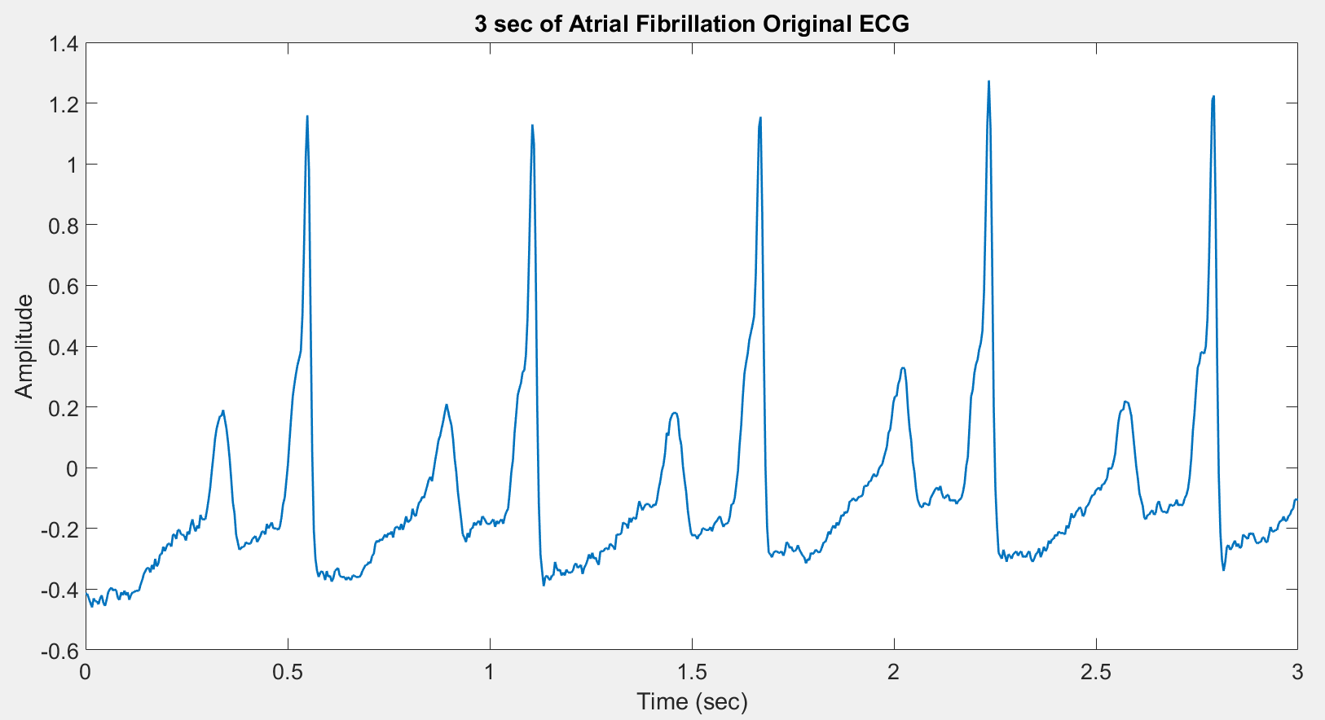
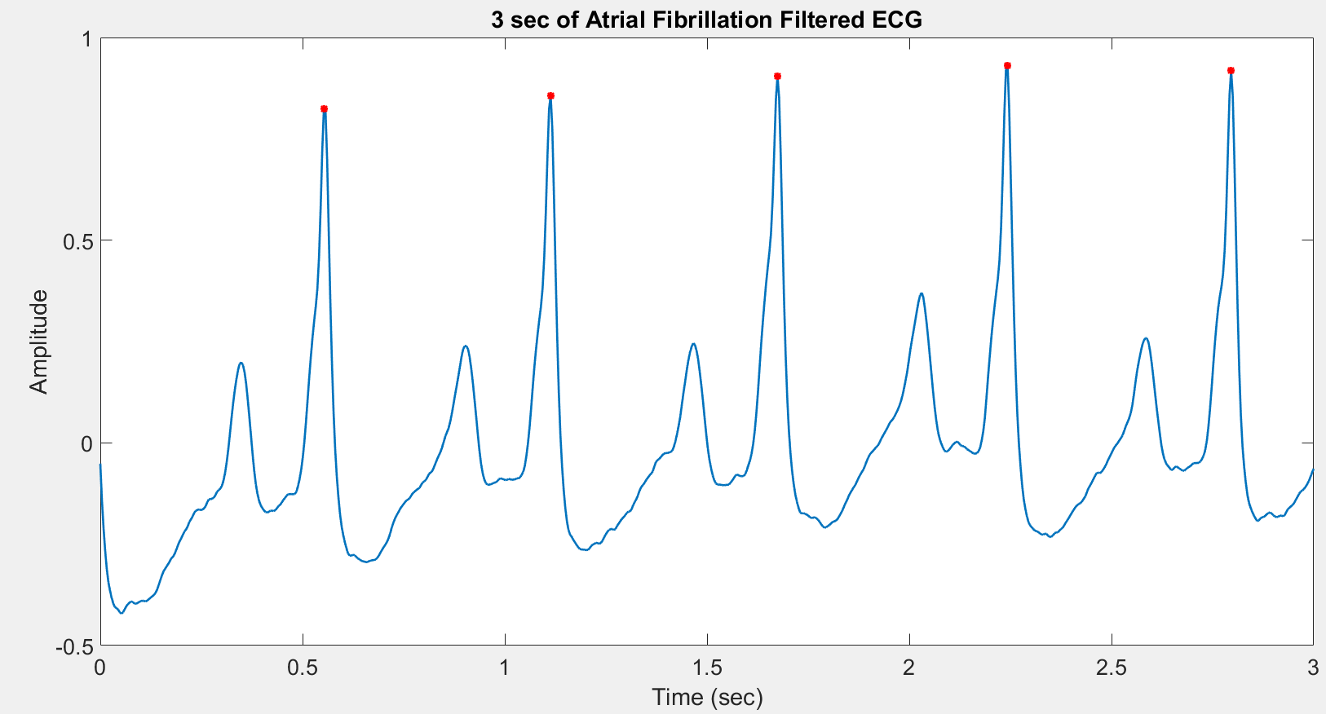
AF ECG before and after filtering

Slide 12
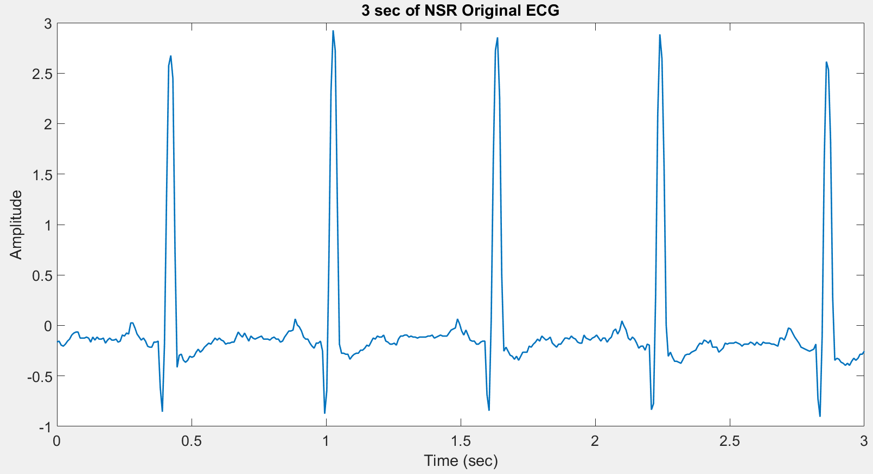
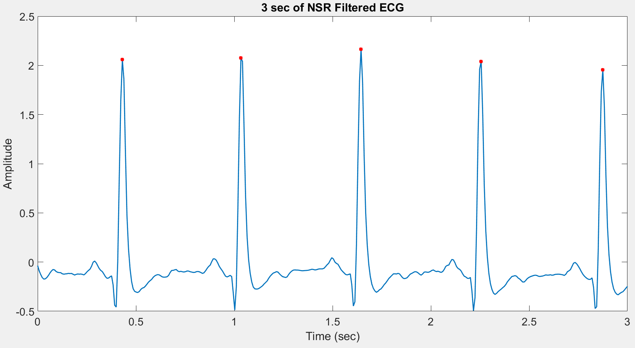
NSR ECG before and after filtering

Slide 13
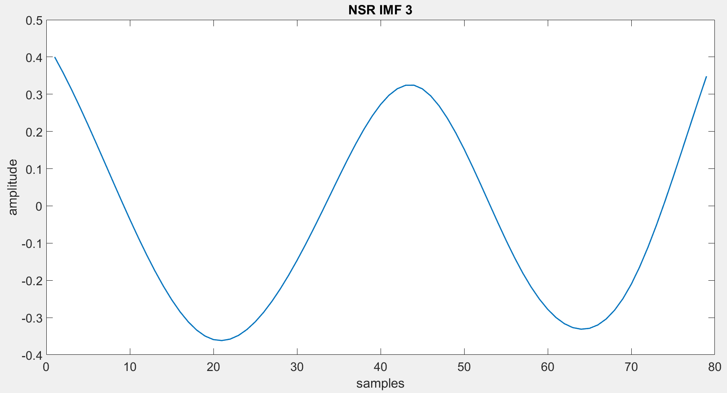
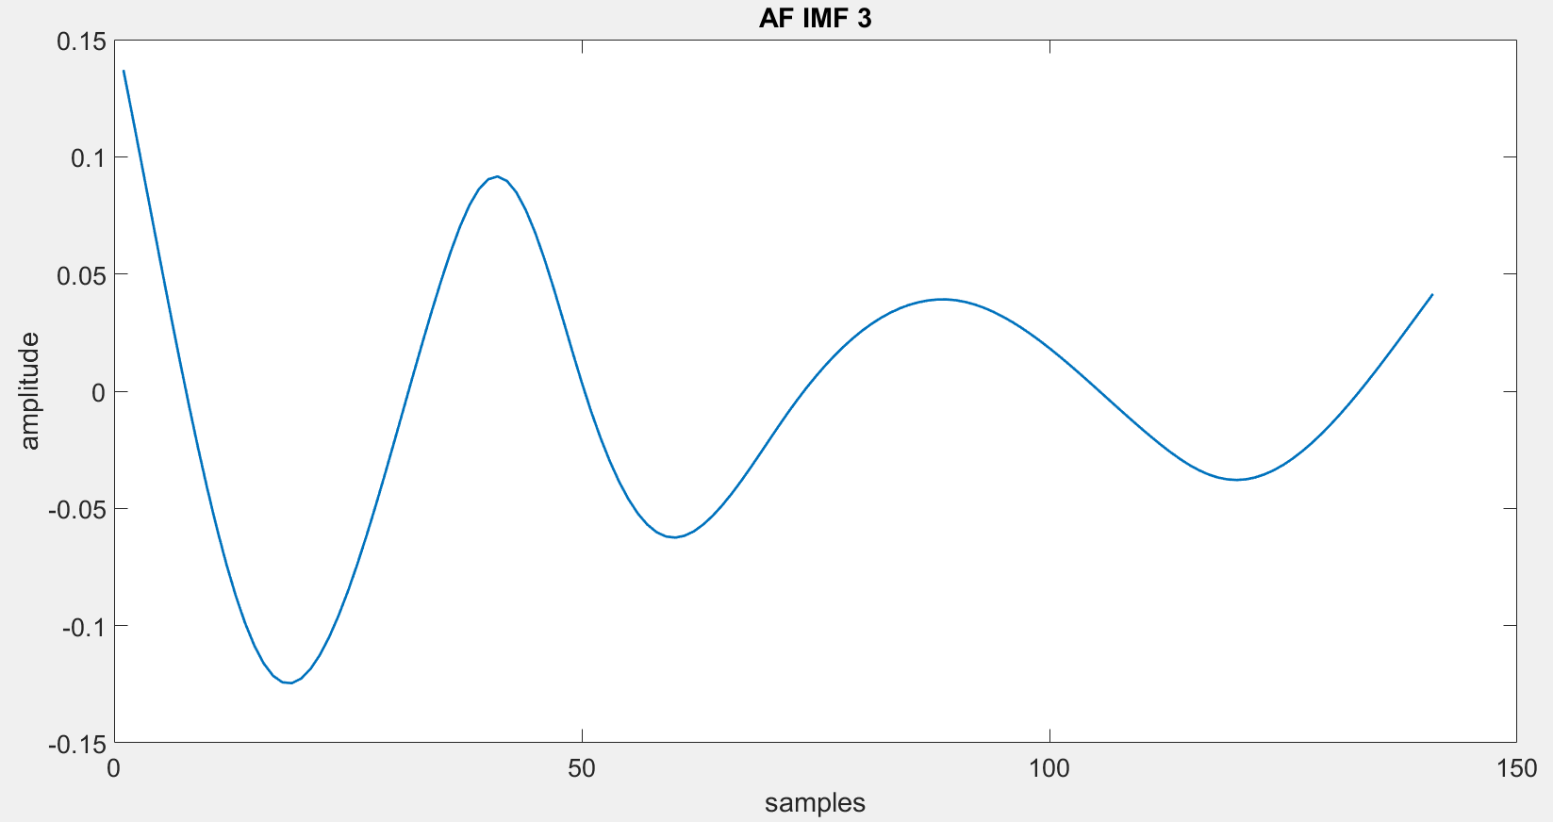
IMF 3 of NSR vs AF – Note the decreasing amplitude of AF

Slide 14
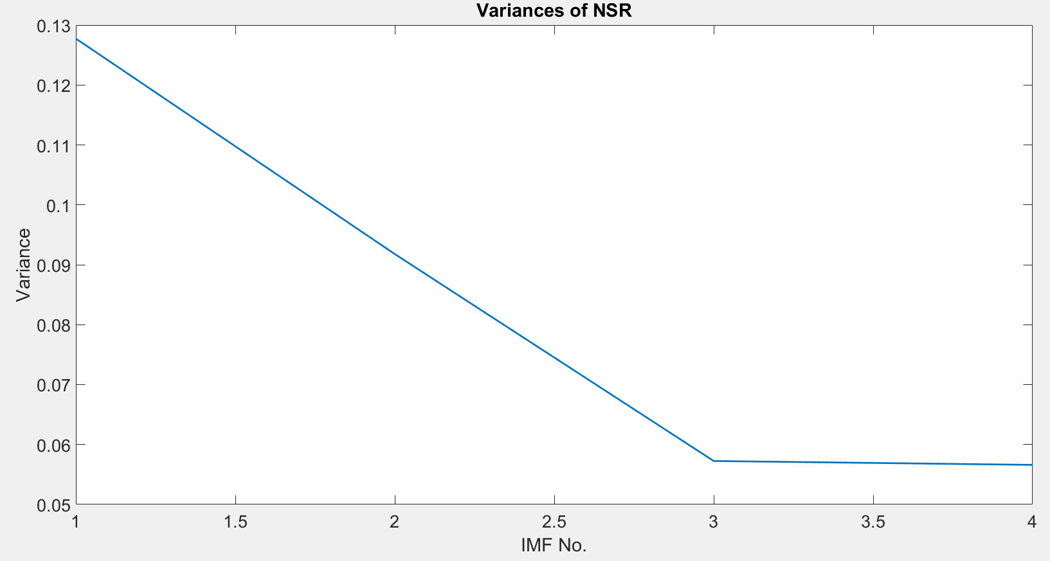
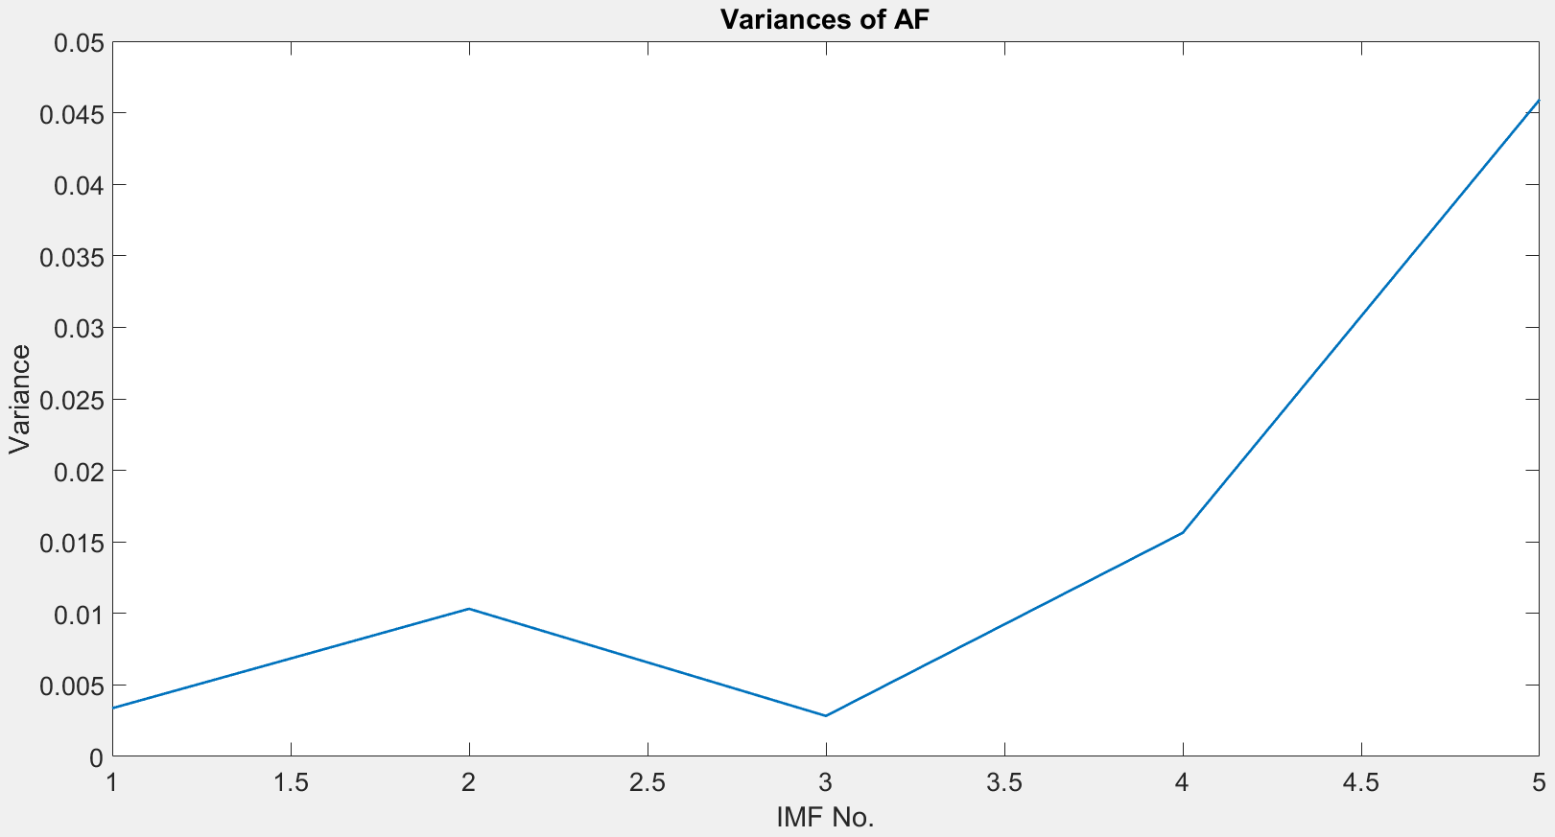
Variances of NSR IMFs vs AF IMFs
Variances of NSR decreases with increasing IMF, whereas it increases for AF.

Slide 15
Final Detection Steps
Compute different statistics
These are your features
Provide these features to train a classifier – could be linear regression, non-linear classifiers, semi-supervised classifiers etc.
AF detection percentage success can be compared using test data

Slide 16
Conclusion
IMFs are highly useful for feature extraction
EMD domain analysis is a notable domain to explore just as the Fourier domain and others
They are helpful in detection of abnormal rhythms.

