Slide 1
Project title Internship Project On Manual Calculator Using Visual Studio Python GUI (Project-1) PRESENTED BY MOHAN KUMAR JHA Internship organization Next Hikes IT Solutions Ongoing training on Digi Crome Academy

Slide 2
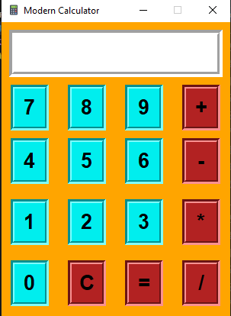
Calculator GUI Desired
Project Requirements
Required Title Field
Required Entry Field
Required Clickable Buttons arranged in Rows and Columns
Required Operator Buttons like ‘+’, ‘-’, ‘*’, ‘/’ to perform mathematical operations
Required Clear Button C to Clear all the entries in the Entry Field
Required Equal To Button (=) to evaluate the result and show it in the Entry Field

Slide 3
Calculator GUI Desired
Project Requirements
Displaying “Invalid Entry” when Invalid Entry is done
In Case of Division when division by ‘0’ display “Error”
Whenever any Button is pressed its Entry displayed in the EntryField
Operator Buttons like ‘+’, ‘-’, ‘*’, ‘/’ to perform real mathematical operations
Providing Calculator Logo
Calculator shape not changeble

Slide 4

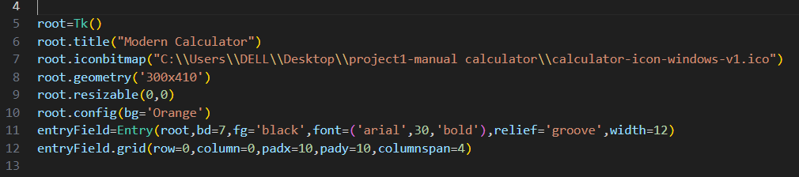
Project Execution
Here we are using Visual Basic Studio and at first importing all the necessary Libraries
Here we are creating an Object root and assigned the Tk Class to it.
Then we have created a title for our Calculator which will show at the top area
Fixed one Logo by using icon.ico in iconbitmap method
Sized our Calculator as 300x410 and made it not resizeable
Configured the background colour of our calculator as Orange
Created an EntryField and placed it in row=0 and column=0 and assigned font and foreground colour

Slide 5
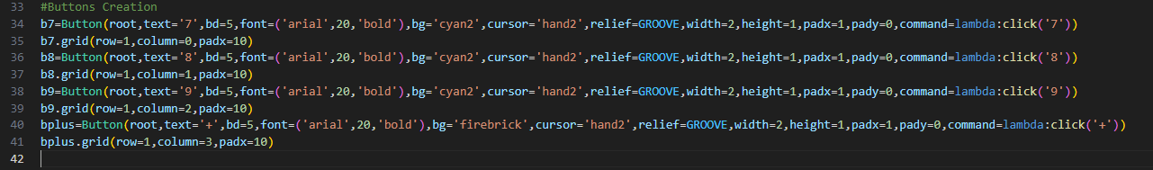

Project Execution
Here we are creating the Buttons in the 1st row i.e. Buttons 7,8,9,+
Placed those buttons at positions respectively row1, column0, row1, column1, row 1 column2 and row1 column3.
Provided font as arial, size 20 and and bold.
Provided buttons background colour and cyan2, depth of buttons as bd=5
Provided cursor symbol a shand2 when ever user places his cursor to the buttons.
Sizing done with width, height, padx and pady.
Made the buttons clikable with command method and defining a function click in the GUI Operational Part

Slide 6
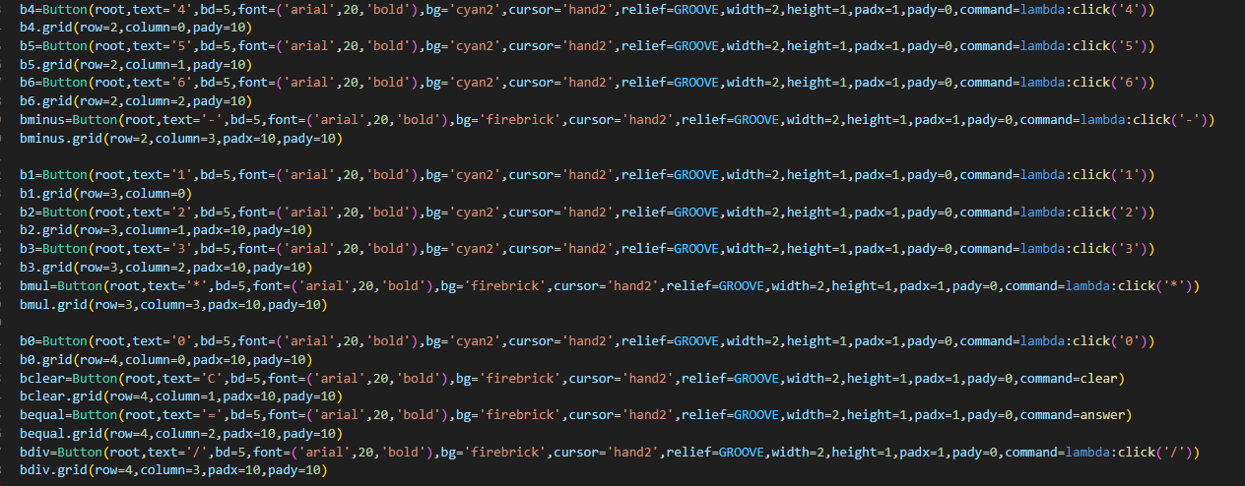
Project Execution
Similarly created the Buttons in the 2st row i.e. Buttons 4,5,6,-
Buttons 1,2,3,* in 3rd row and 0, Clear (C), =, Div (/) in 4th row

Slide 7
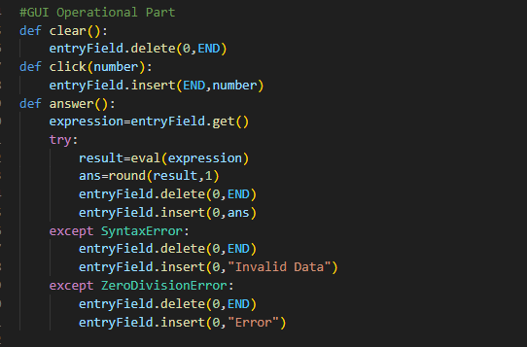
Project Execution
Defined functions Clear, Click, answer in the GUI Operational part.
For Clear function- When pressed whatever will get deleted at end.
For Click Function- When any number button or operator button pressed it will get inserted in the entry field at the end point.
For Equal (=)Button: Defined answer function to evaluate the expression. Here took one variable expression which is getting the data from the entryField what the operator enters. Then if it is not syntax error or zerodivision error then it will go to the loop through try method. Storing eval(expression) in result, rounding up the result to 1 decimal place as ans=round(result,1)
First deleting whatever is in the entryfield and then inserting the ans over there as entryField.insert(0,ans).
For Syntax Error it will Print “Invalid Data”
For Zero Division Eroor will Print “Error”

Slide 8
Project Outcomes
Learnt about tkinter, Visual Studio Basic
Learnt about process of creating GUI application
Learnt about decorating our project with different methods
Learnt about widgets

Slide 9
Some Methods and Definations
1. Tk: To create a main window, tkinter offers a method ‘Tk’
2. mainloop(): There is a method known by the name mainloop() is used when your application is ready to run. mainloop() is an infinite loop used to run the application, wait for an event to occur and process the event as long as the window is not closed.
Tk.mainloop()
widgets are added in between Tk and mainloop
3. pack() method:It organizes the widgets in blocks before placing in the parent widget.
4. grid() method:It organizes the widgets in grid (table-like structure) before placing in the parent widget.
5. place() method:It organizes the widgets by placing them on specific positions directed by the programmer.
6.Button:To add a button in your application, this widget is used. The general syntax is:
w=Button(master, option=value)
There are number of options which are used to change the format of the Buttons. Number of options can be passed as parameters separated by commas. Some of them are listed below.
activebackground: to set the background color when button is under the cursor.
activeforeground: to set the foreground color when button is under the cursor.
bg: to set the normal background color.
command: to call a function.
font: to set the font on the button label.
image: to set the image on the button.
width: to set the width of the button.
height: to set the height of the button.

Slide 10
Some Methods and Definations
Title: To set the title of the widget.
activebackground: to set the background color when widget is under the cursor.
activeforeground: to set the foreground color when widget is under the cursor.
bg: to set the normal background color.
command: to call a function.
font: to set the font on the button label.
Entry:It is used to input the single line text entry from the user.. For multi-line text input, Text widget is used. The general syntax is:
w=Entry(master, option=value)
Learning Outcome:
1. Core Python
2. tkinter Library
3 Visual Studio Code[IDE]
4. GitHub 5. Application development using Python programming language

Slide 11
Thank You

