Slide 1
Networking

Slide 2
Protocols

Slide 3
Communications Protocols
Communications Protocol is a set of rules that allows communication devices to send and receive data.
Just like humans need to speak a common language for communication, computing devices need to have a common protocol ot communicate with each other.
The protocol defines the rules, syntax, semantics and synchronization of communication and possible error recovery methods.
Protocols may be implemented by hardware, software, or a combination of both.
Ex: TCP/IP, HTTP

Slide 4
Communications Protocols (contd)
Communication systems need to agree upon the protocol they are using. A protocol that is generally agreed upon for a certain type of communication becomes a Technical Standard
Protocols are to Communication what Algorithms are to programming language. The implementation way change but the underlying principles remain the same.
Multiple protocols often describe different aspects of a single communication. A group of protocols designed to work together are known as a protocol suite; when implemented in software they are a protocol stack.

Slide 5
OSI Model

Slide 6
OSI
Open Systems Interconnection reference model (OSI) is a framework to design standard frameworks for various layers of communication.
In the OSI model, communicating systems are assumed to be connected by an underlying physical medium providing a basic (and unspecified) transmission mechanism.
The layers above it are numbered (from one to seven); the nth layer is referred to as (n)-layer. Each layer provides service to the layer above it, using the services of the layer immediately below it.

Slide 7
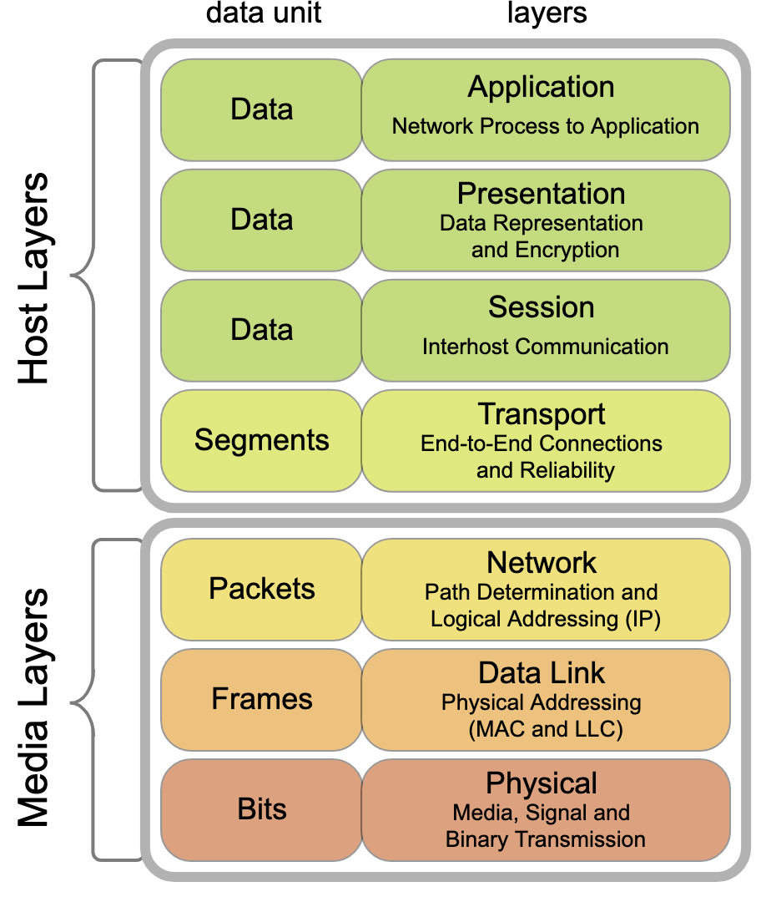

Slide 8
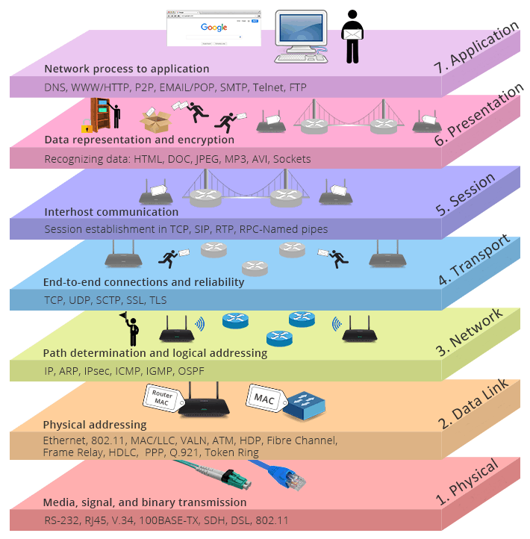

Slide 9
TCP/IP Model

Slide 10
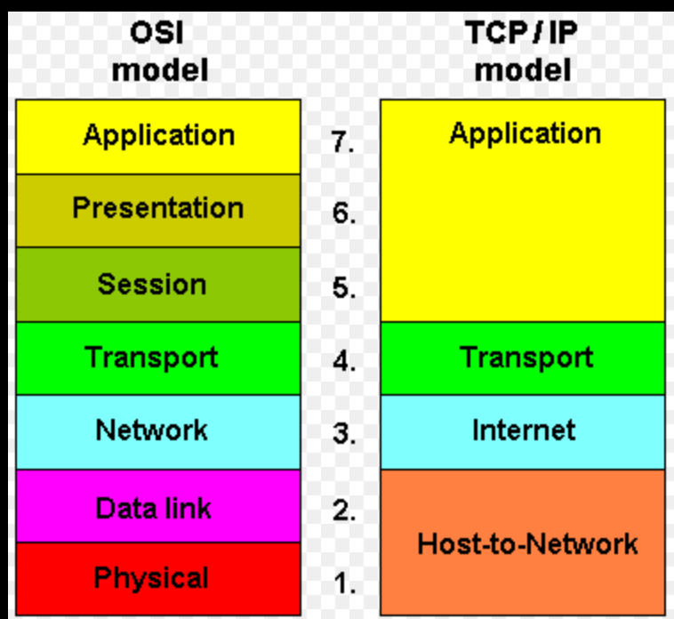

Slide 11
IP
Internet Protocol is the key protocol that enables communication between various communication devices.
The Internet Protocol is responsible for addressing host interfaces, encapsulating data into datagrams (including fragmentation and reassembly) and routing datagrams from a source host interface to a destination host interface across one or more IP networks.
IP uses IP addresses for inter host communication.
The first major version of Internet Protocol is IPv4. IPv6 is the latest version and is still in the process of being adopted.

Slide 12
Networks

Slide 13
Computer Networks
A Network is a group of interconnected devices. Network allows communication among the nodes (Computers, routers, switches).
An internetwork is the connection of multiple computer networks via a common routing technology using routers.
Internet is the most well-known and biggest internetwork.

Slide 14
IP Addresses
Every NIC has a physical address (MAC) and a logical address.
An address fulfills the functions of identifying the host and locating it on the network. The most common network addressing architecture is Internet Protocol version 4 (IPv4)
While MAC address is fixed, the logical address is assigned and re-assigned. The logical address is known as IP address.
Every computing device viz., Computers, routers, switches, firewalls have at least one IP address
IPv4 uses a 32-bit address space, which limits the number of unique hosts to 4,294,967,296 (232), but large blocks are reserved for special networking methods.

Slide 15
IP - Network and Host bits.
IP addresses are described as consisting of two groups of bits in the address: the most significant bits are the network prefix, which identifies a whole network or subnet, and the least significant set forms the host identifier, which specifies a particular interface of a host on that network. This division is used as the basis of traffic routing between IP networks and for address allocation policies.
In the Classful network design IPv4 addresses are divided into chunks of 8 bits, resulting in the formation of Class A, Class B and Class C.

Slide 16
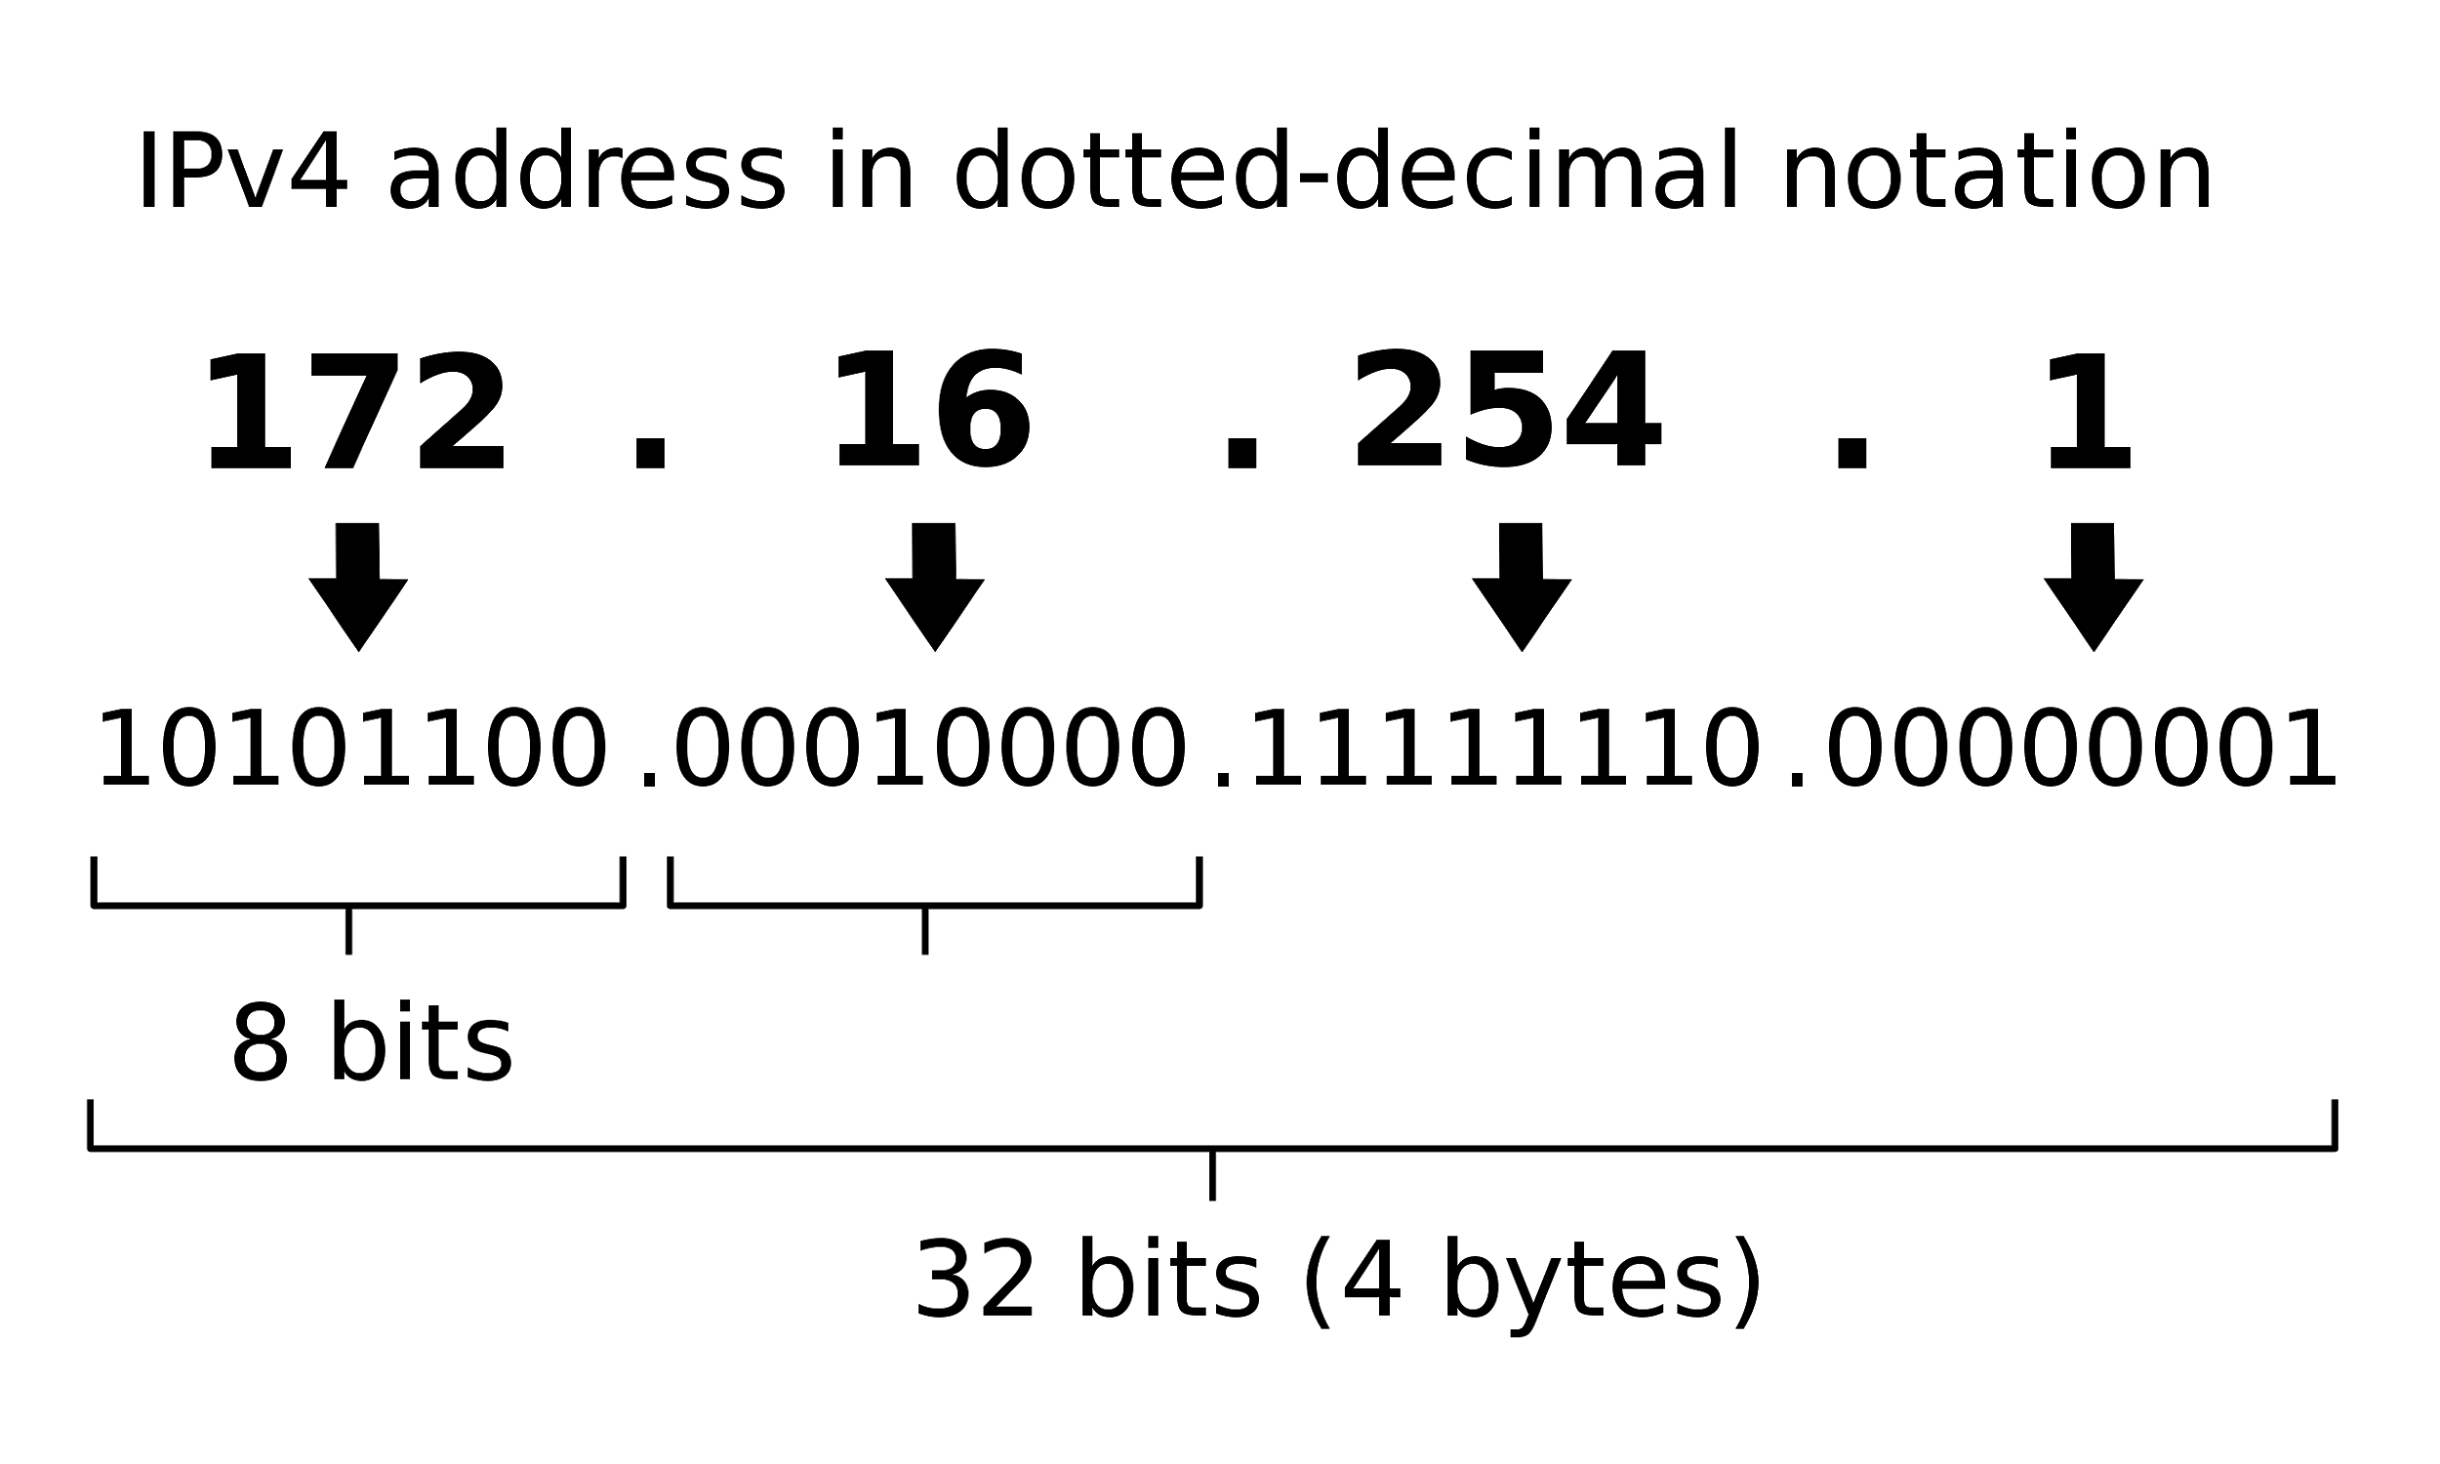
Understanding IPs

Slide 17
IP - Private vs Public
Of the 4 Billion IPs available with IPv4 format, about 18 million are reserved as Private IPs.
A Private IP is local to one’s network, meaning it is only understood within that network and devices in other network cannot communicate using Private IP.
Every device has a Private IP. A public IP is assigned to a device, if it needs to communicate over the Internet.
A device with Private IP may communicate with devices in other networks using a process called Network Address Translation.

Slide 18
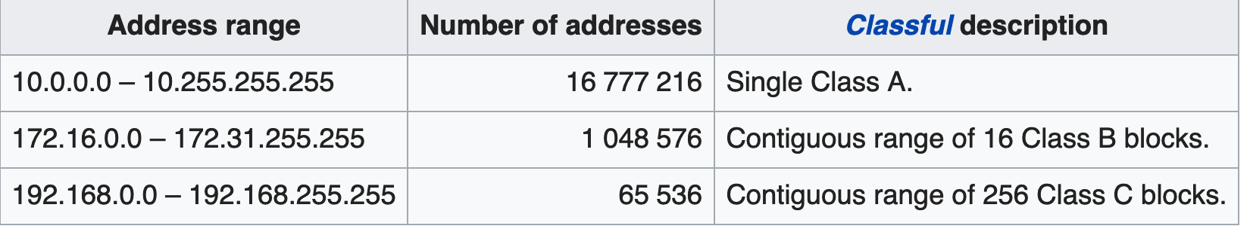
IP - Private Addresses

Slide 19
Network Interface Controller (NIC)
The NIC allows computers to communicate over a computer network, either by using cables or wirelessly. The NIC is both a physical layer and data link layer device.
Every Computing device has at least one NIC embedded or attached to it.
Every NIC has a MAC address and an IP address

Slide 20
Subnets

Slide 21
Subnets
A subnetwork or a subnet is a logical subdivision of the network.
The process of dividing a network into subnets is known as subnetting.
Computers that belong to a subnet are addressed with an identical most-significant bit-group in their IP addresses. This results in the logical division of an IP address into two fields, the network number or routing prefix and the rest field or host identifier. The rest field is an identifier for a specific host or network interface.

Slide 22
Network
192.168.0.0
192.168.0.1
……………
……………
…………...
192.168.0.31
192.168.0.32
192.168.0.33
192.168.0.34
……………
……………
……………
192.168.0.63
192.168.0.64
Subnet1
Subnet2

Slide 23
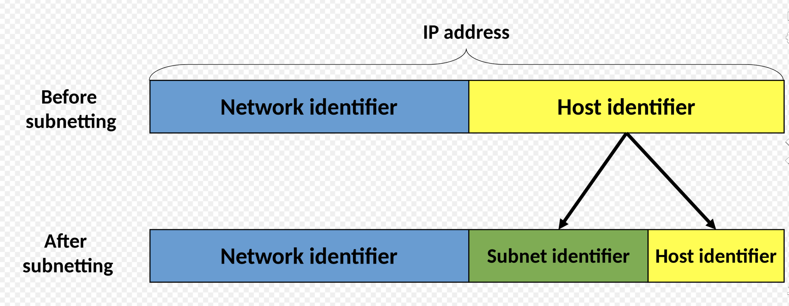

Slide 24
Subnetting - subnet masks
The process of dividing a network in to subnetworks is called subnetting.
A subnet is represented by a subnet Mask, which determines the number of Network bits and host bits.
A Network is represented by a I.P address and a Subnet mask
IP address: 10.0.0.0
Subnet Mask: 255.0.0.0

Slide 25
CIDR
CIDR - Classless Inter Domain Routing is a system of allocating IP addresses and routing.
CIDR has been introduced to address the limitations within the classful network design.
CIDR uses the variable-length subnet masking (VLSM) technique, which allows the specification of arbitrary-length prefixes. CIDR introduced a new method of representation for IP addresses - CIDR notation, in which an address or routing prefix is written with a suffix indicating the number of bits of the prefix, such as 192.0.2.0/24 for IPv4

Slide 26
Network Port
A network port is a process-specific or an application-specific software construct serving as a communication endpoint.
Ports are identified for each protocol and address combination by numbers, commonly known as the port number.
A port number is always associated with an IP address of a host and the protocol type of the communication. It completes the destination or origination network address of a message. Specific port numbers are commonly reserved to identify specific services, so that an arriving packet can be easily forwarded to a running application.

