Slide 1


GNU/Linux

Slide 2
Linux or GNU/Linux is a family of Operating Systems.
Linux is the Kernel on top of which GNU/BSD applications run and together they form the Operating System

Slide 3
Distribution
A Linux distribution ( distro for short) is an operating system made from a software collection that is based upon the Linux kernel and, often, a package management system. Linux users usually obtain their operating system by downloading one of the Linux distros.
A typical Linux distro comprises a Linux kernel, GNU tools & libraries, additional software, documentation, a window system, a window manager, and a desktop environment.
Linux distros are available for a wide variety of systems ranging from:
Embedded devices: OpenWrt
Personal computers: Debian, Ubuntu, Linux Mint, Fedora.
Powerful supercomputers: Rocks Cluster Distribution.

Slide 4
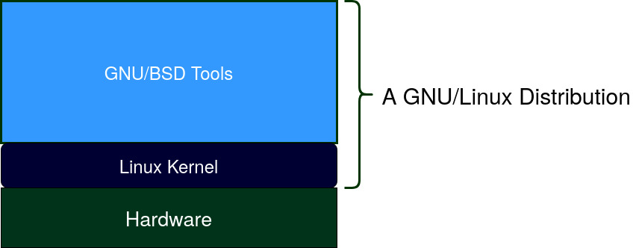

Slide 5
Linux vs Unix
Are Linux and Unix the same?

Slide 6
Unix and Linux are two families of Operating Systems.
Since they follow similar design philosophy and have so many utilities in common, Linux and Unix are referred to as nix-like Operating System.
Linux and Unix have so much in common, yet they are completely different.

Slide 7
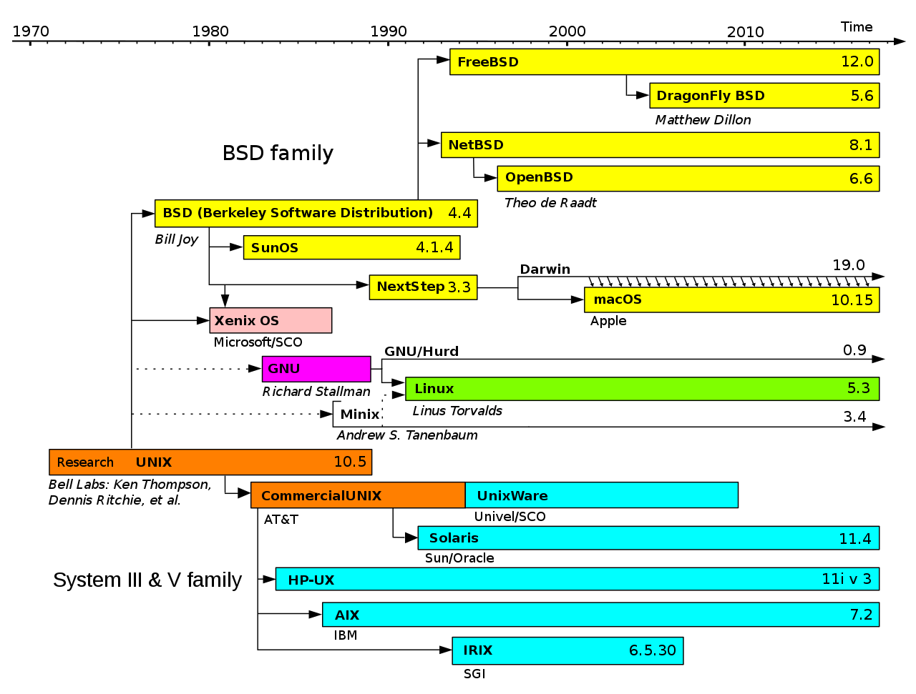

Slide 8


Unix
Linux
History | Originally developed by Dennis Ritchie & Ken Thompson at Bell Laboratories. | Linux kernel was originally developed by Linus Torvalds
 | AT&T released a proprietary version of Unix as System V | GNU project was founded by Richard Stallman as a Free & Open Source alternative to Unix
 | BSD was a spin-off of Unix created by University of Berkley and later a Fress & Open Source Version version known as FreeBSD was released | Ian Murdock created Debian in the year 1993, since then there have been 10s of 10s of Linux distros(OSs)
License | Some Versions are Proprietary, others are free & open-source | GPL v2 (Free & Open Source)
Variants | System V | Debian
 | HP UX | Fedora
 | Solaris by Sun Microsystems | Slackware
 | MacOs | Android
Current Status | Many variants of a Unix are widely used in Data centers and embedded machines | Linux Operating systems are predominantly used in Enterprise IT
 | MacOs is the second most used Operating System after Windows on Desktop computers | Linux desktop market is quite low.
 | iOS is the second most used Mobile Operating System | Android is the most used Mobile Operating system
 | Unix has good presence in embeded systems like POS systems | Linux is the predominant choice for embedded devices such as Set top boxes, Smart TVs etc

Slide 9
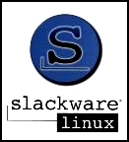


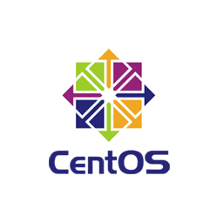








Linux Operating Systems
Vector Linux
Tiny Linux

Slide 10
What’s the difference?
All the GNU/Linux Operating Systems are built on Linux Kernel and use almost the same GNU tools and in some cases BSD tools as well. What differentiates one family/branch of the Operating System from other is the Package Management used. Each distro have their own release cycle and often dependent on the upstream distro.

Slide 11
Directory Structure

Slide 12
