Slide 1

Let us connect the DOTS (NGOs, Govts, Donors and the Needy)
OCMS
Online Portal for Charity
An initiative by

Slide 2
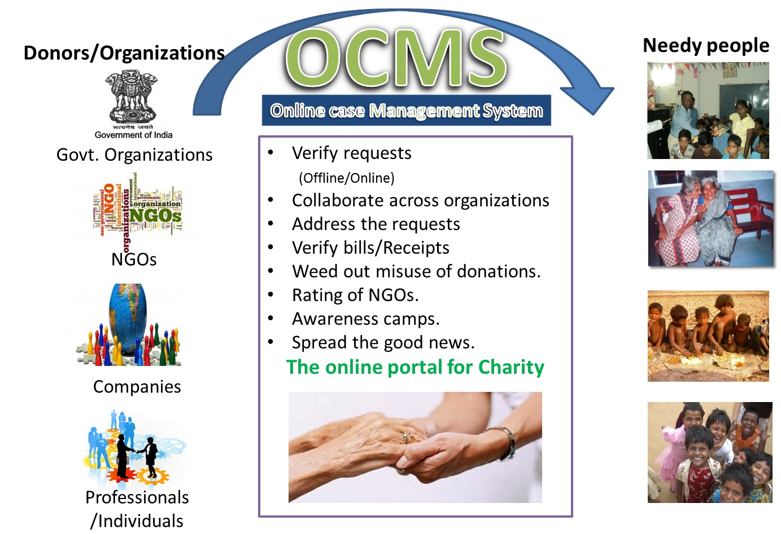

Slide 3
What is OCMS?
OCMS is the product/Platform that is being built for unifying access and integrating various stake holders in the service/charity sector. There are countless needy people and there are many kind hearted people who are ready to help. There are many organizations that are also interested.
There is a need for a platform which is transparent and integrates everyone under one umbrella. The NGOs, Govt organizations, companies and individual donors with the actual needy requirements.
History
With close to *7 years of association with various NGO organizations like To Make A Difference(TMAD), The realization is all the NGO organizations need similar online and offline infrastructure for what ever is the cause they have chosen to work with.
* Careerscale founder Mr. Harinath has been associated with TMAD and is currently Its Present.

Slide 4
The Team
Harinath Mallepally
Mahender Singh
Rishi
Prasanthi

Slide 5
Phase 1 basic functionality – Target date 1St July 2013
Get feedback from NGO community and Users.
Phase 2 - 1st January 2014
automate case work flow fully
Integrate SMS functionality.
Implement user feedback from phase 1
Announce it to the world.
Plan for future releases

Slide 6

Phase 1 plan
Iteration 1 /Release 1
Target date : April 6th
The following functionality need to be achieved for this release :Registration, login./Harinath
Open Id integration and corresponding db changes. Mahender/Harinath
Back office screens.Rishi/Praveen
Emailing functionality.
Demo hosting with free/cheaper solutions
Testing frameworks/Guidelines for automation - Pankaj
Status: On time
Iteration 2 /Release 2
Target date : May 11th
The following functionality need to be achieved for May relase.
Feedback incorporation from release 1.
Case lifecycle. Harinath/Mahender
Role base access for back office screens - Rishi/Praveen
Automated testing with JUnit and for web layer as well.
Jenkins local configuration for CI.
Iteration 3 /Release 3
Target date : June 29th
The following are part of this final release for Phase 1.
UI changes / Look and Feel as per the initial iterations. Target is to make it usuable web site.
All phase 1 use cases to be ready with QA done.
Automation in place for each of the page/module.
Central jenkins CI configuration in place.

Slide 7
Tech stack
Java tech stack. Everything latest, Lot Exciting
Spring MVC
Hibernate with JPA
Tomcat 7
Jenkins for CI (yet to be done).
Redhat Openshift cloud deployment for alpha testing

Slide 8
Want to Contribute?
Mail to info@careerscale.in
Developers:
Upgrade your skills, we provide guidance.
Testers:
Automate UT and FT
SME(Volunteers/NGOs):
Review the functionality
Provide early feedback

Slide 9
Thank you
Come join hands with us.
Let us work towards making a world a lot better.

