Slide 1
MAC: Metadata Acceleration for Sustainable Performance in Big-Data Systems with CXL DRAM
Dusol Lee, †Yan Sun, †Houxiang Ji, †Vinit Gupta, †Austin Antony Cruz, Inhyuk Choi, †Nam Sung Kim, and Jihong Kim
Seoul National University, †University of Illinois Urbana-Champaign

Slide 2


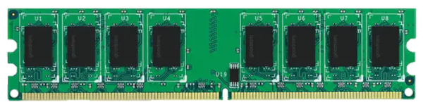

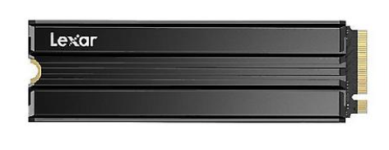
Rising Memory Demands and Memory-Expansion Challenges
Databases (e.g., SQL, No-SQL, ..)
Graph processing engines
…
What if we add more DDR5 DRAM?
More DDR5 DRAMs?
1. limited DIMM slots
2. cost ↑
...
PCIe lanes
Data created/consumed (zettabytes)
SSD
Year
Big Data Statistics [1]
[1] Big Data Statistics 2026, Demandsage

Slide 3

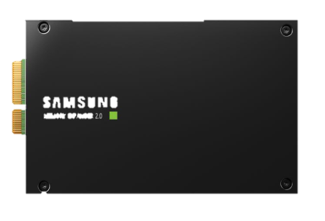
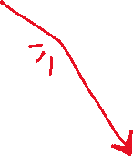
Alternative: Memory Expansion with CXL DRAM
1. Enables 2x - 4x memory capacity expansion
However, system data (e.g., metadata for memory mgmt.) can fallback to CXL DRAM
2. 50% ↓ cost at DDR DRAM : CXL DRAM = 1:4
DIMM
2. Reuse legacy DDR DRAM
CXL decouple memory expansion from the DDR interface generation
Application
data
Metadata
(9G)
full!
Local DRAM (64GiB)
PCIe lanes
..
1. abundant PCIe lanes
..
CXL
CXL
Metadata
(10G)
CXL DRAM (512GiB)

Slide 4



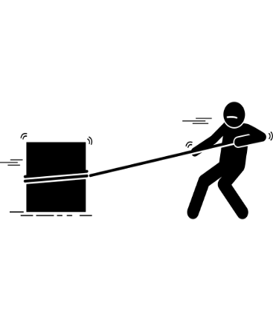
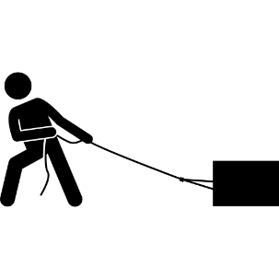
Observations: Excessive Metadata and Latency Spikes
Metadata is too large to fit entirely in DDR-DRAM
As CXL DRAM and file size ↑, Metadata size ↑
Up to 20-30% of DDR DRAM (DDR:CXL = 1:4 or 1:8)
Spill over to CXL DRAM
Remote access during memory reclamation → Latency spikes!
Latency spikes!
App
Kernel
70%
Local DRAM
CXL DRAM
99.9 tail latency (ms)
memory
reclaimer
250ns
spill over!
kernel medata
100ns
App’s tail latency (LMDB with GET benchmark)
Metadata spill over!

Slide 5
Outline
Introduction
The Rise of CXL DRAM Systems and Their Challenges
Background & Motivation:
Memory reclamation slowdown and latency spikes in CXL DRAM systems
MAC Design & Challenges
Experimental Evaluations

Slide 6




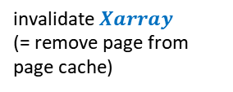
How Does Latency Spikes Occur Under Memory Pressure?
Background reclaimer (Kswapd) accesses metadata iteratively
Free page descriptor and invalidate Xarray indexing
Application
32 Victims for eviction
32 Victims for eviction
LRU list
LRU list
ptr
..
..
offset
select victim page $Page descriptor$
offset
offset
Free space
offset
Low!
offset
...
invalidate$Xarray$
(= remove page from page cache)
tail latency
Memory
i
file0
i
i
file1
file2
Kswapd0
(background reclaim)
Application pause & Reclaim
(foreground reclaim)
Kswapd1
(background reclaim)
DDR DRAM
CXL DRAM

Slide 7
How Does Latency Spikes Occur Under Memory Pressure? (Cont.)
If Metadata Spills Over..
Kswapd0/1
Reclaim efficiency ↓
250ns
Kswapd0/1 reclamation breakdown
100ns
only-DDR
system
Free space
Memory
page descriptors for Local
page descriptors for CXL DRAM
Low!
DDR DRAM
CXL DRAM
DDR+CXL
system
Xarray (file0)
Xarray (file1)
Xarray (file2)
pause app!
Reduced background reclamation efficiency due to remote memory access → Trigger foreground page reclamations

Slide 8
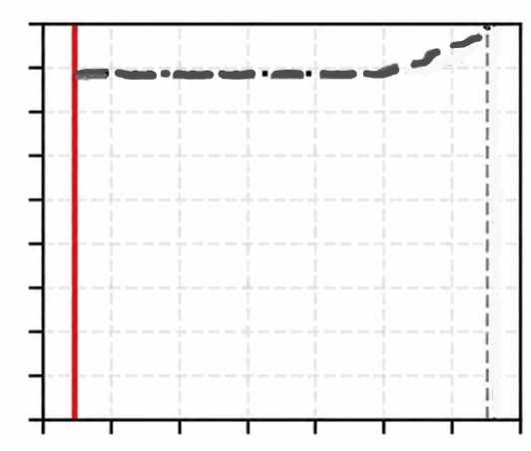


Application Latency Spikes Due to Foreground Reclamation
Application pause & reclamation
250ns
100ns
Memory
page descriptors for Local
page descriptors for CXL DRAM
DDR DRAM
CXL DRAM
Latency CDF (${99.9}^{th}$ - ${99.99}^{th})$
.9999
.9998
.9997
CDF
only-DDR
system
...
To avoid latency spikes,
background reclamation must keep up memory pressure!
4x application latency ▲
DDR+CXL
system
.9990
796
2107
...
6900
8120
application overhead breakdown (us)
Latency (X ${10}^{2} us)$

Slide 9




Requirement for Fast Memory Reclamation and Opportunities
Key requirement:
Repeated metadata traversals must be fast.
Observations:
1. Operations are simple
Reclaimable?
Need writeback?
Activated?
…
...
...
page descriptors
page descriptors
Local DRAM
reclaim efficeincy
Only shift/bitwise operations on flags
+ PCIe PHY
+ controller
...
...
i
i
entry[2]
$${node}_{1}$$
CXL DRAM
Xarray0
Xarray1
entry[3] = entry[2] – 2
i
Xarray0
…
entry[3]
$${node}_{3}$$
…
entry[3] = SHADOW_VALUE
An NMP-based solution is needed on the CXL DRAM side where metadata resides
Only arithmetic/store operations
2. Operations on each metadata objects are independent
e.g., Each XArray traversal can be performed in parallel

Slide 10
Outline
Introduction
The Rise of CXL DRAM Systems and Their Challenges
Background & Motivation:
Memory reclamation slowdown and latency spikes in CXL DRAM systems
MAC Design & Challenges
Experimental Evaluations

Slide 11








MAC: Metadata Acceleration inside the CXL DRAM
Place metadata (page descriptor and Xarray) on CXL DRAM and offload page reclamation to NMP accelerators.
1. Allocate metadata in the less-contended CXL DRAM
page descriptors
$${page}_{0}$$
...
2. Offload page reclamation to accelerators in CXL DRAM
parallel
processing
$${page}_{31}$$
Xarrays
accelerator
...
$$Xarray0$$
$$…$$
3. get results (free pages, stats)
$Xarray$31
DDR DRAM
CXL-DRAM

Slide 12



Challenge1: How the accelerator process metadata?
Only shift/bitwise needed in the kernel address area for address translation and processing
32 victim pointers
Reclaimable?
Need writeback? (exclude from victim)
Many processes referencing? (exclude ..)
Activated? (exclude ..)
Pinned?
…
ptr
?? out of 32 pages is reclaimable!
Page descriptors
LRU list
PA =
VA - PAGE_OFFSET
Only Shift/bitwise operations on flags
Page descriptor
Xarray
entry[63]
$${node}_{0}$$
VA(entry[2]) = VA(entry[63]) – 2
PA(entry[2]) = VA(entry[2]) - PAGE_OFFSET
entry[2]
$${node}_{1}$$
…
entry[3]
$${node}_{3}$$
…

Slide 13




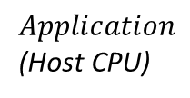

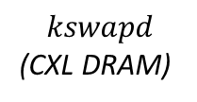



Challenge2: Cache Coherency Overhead
Case1: Host CPU (application) updated the Xarray
When new file page is read by the application, the updated Xarray’s entry is only in the CPU cache
$${node}_{0}$$
…
Need to flush cacheline
entry[4]
NULL
yet
entry[4] = 0x12 (new)
$${node}_{1}$$
CPU Cache
Xarray
CXL DRAM
Observation: No need for immediate synchronization.
$$Application$$
(Host CPU)
$$kswapd$$
(CXL DRAM)
❶ while the lock is hold, nobody can modify Xarray
$$lock$$
$$entry\left[4\right]=0x12$$
$$unlock$$
❷ kswapd don’t choose entry[4] as a victim even after the lock is released

Slide 14
Challenge2: Cache Coherency Overhead
Case1: Host CPU (application) updated the Xarray
When new file page is read by the application, the updated Xarray’s entry is only in the CPU cache
$${node}_{0}$$
…
Need to flush cacheline
entry[4]
NULL
yet
entry[4] = 0x12 (new)
$${node}_{1}$$
CPU Cache
CXL DRAM
Solution: Asynchronous clwb (cache line writeback)
negligible
Overhead breakdown of query (us)

Slide 15




Challenge2: Cache Coherency Overhead (Cont.)
Case2: CXL-DRAM update the Xarray
Kswapd (CXL-DRAM)
$$lock$$
Host DRAM
CXL DRAM
$${node}_{0}$$
…
Need to invalidate
entry[3]
invalid
entry[3]
$${node}_{1}$$
CPU Cache
$$unlock$$
Solution: Utilize BISnp (Back Invalidation Snoop protocol)
2 us
$${node}_{0}$$
300 - 500ns
500 – 700ns
2. BISnp (CXL 3.0)
…
...
Xarr0 walk
BISnpBlk0
3. Snoop
(invalidation)
...
BISnpBlk1
entry[3]
entry[3]
$${node}_{3}$$
Xarr31 walk
BISnpBlk2
4. Response
BISnpBlk3
CPU
Cache
1. update
CXL DRAM
Pipelined BISnp

Slide 16
Outline
Introduction
The Rise of CXL DRAM Systems and Their Challenges
Background & Motivation:
Memory reclamation slowdown and latency spikes in CXL DRAM systems
MAC Design & Challenges
Experimental Evaluations

Slide 17

Experimental Setup
CXL-EMULATION SYSTEM
NODE 0 (CPU0 (cores 0-63))
NODE1 (CPU1 (cores 64-96))
Evaluation Platform
Applications
offload
NDP
controller
(core64)
offloader
BISnp
model
Linux Server (Kernel 6.14)
Intel Xeon 6th 128 cores
256 GiB DRAM, 8-TiB NVMe SSD
UPI frequency is controlled
to emulate CXL-DRAM
kswapds
cores 0-63
UPI link
(controlled)
accelerator
(core65)
...
accelerator
(core96)
NDP info. (tager file idx, ..)
$${MAC}_{buf}$$
Page Descripts., Xarrays
DRAM
DRAM
Host
CXL DRAM
Workloads
Databases: PostgreSQL, RocksDB, LMDB (key-value store), and Neo4j
Workloads: YCSB (read/write intensive), pgbench, mmap-based GET, and Interactive Short/Complex Queries
Comparison Schemes
Baseline: Default kernel (preferentially allocate metadata on DDR, but spill over under DDR pressure)
MAC: +NMP-based page reclamation

Slide 18

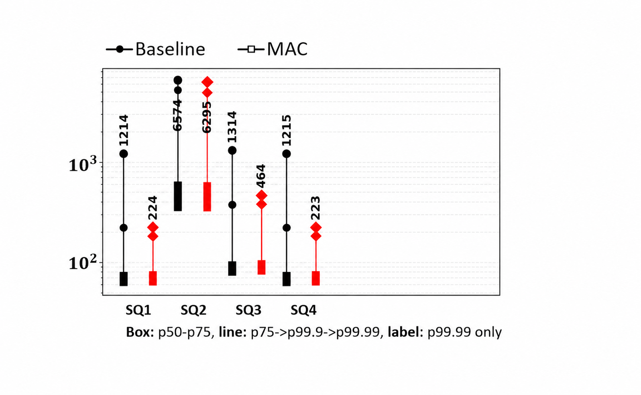
Experiment 1: Evaluating Tail-Latency Reduction for Database Application
Interactive Short (IS) workload on Neo4j
Workload: 400K ops with 200 threads
DDR : CXL = 64 GiB : 128 GiB
p99.99
82% ▼
Latency (ms)
p99.9
p99.99
p99.9
p75-p99 tail
Parallel NMP inside CXL-DRAM reduces tail latency by 82%

Slide 19
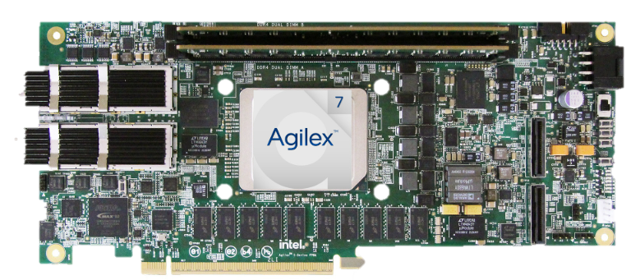
Experiment 2: Real Overhead Measurement Using FPGA
Intel Agilex 7 I-series FPGA
2 x 8 GiB DDR4-2666
Intel Xeon 6538Y
❸
❶- ❷
❹
Base
30%
MAC
❶ MMIO write
(send info)
s
❷ Fetch info
Overhead breakdown (us) of kswapd
accelerator
Shared buffer
❹ Host poll for
completion
❸ Xarray walk
and return

Slide 20
Conclusions
Introduced the metadata overhead problem in the CXL DRAM systems.
Proposed MAC, a HW/SW co-designed near-memory metadata acceleration architecture.
Substantially reduced latency spikes.
NMP-based parallel metadata processing (▼ number of foreground reclamations)
Light-weight consistency optimizations (▼ consistency overhead)
Evaluated on a two-NUMA-node emulation platform and an FPGA prototype.
Reduced the p99.99 latency by up to 98% across four data-intensive applications.
Validated a 30% reduction in page reclamation overhead using an FPGA prototype.

Slide 21
Thank You
Q/A

