Slide 1


Composable Software, Collaborative Development, and the CareWeb Framework
Doug Martin, MD

Slide 2
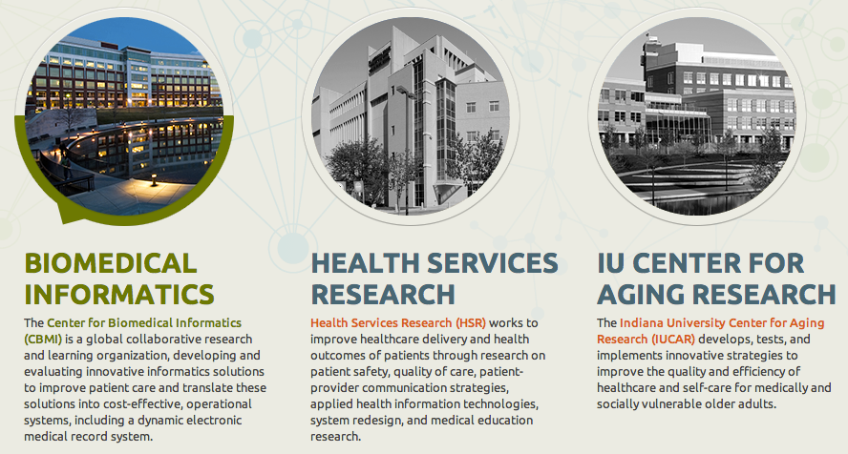
Regenstrief Institute www.regenstrief.org

Slide 3
Regenstrief Institute
Non-profit organization
Founded in 1969
Healthcare research focus
Primarily grant funded
Core funding from the Regenstrief Foundation
Affiliated with Indiana University
Collaborations with academic, government, and private sector entities

Slide 4
CareWeb Framework
What It Does
Provides a foundation for building component-based applications
Leverages existing open source technologies
Is highly extensible through plugin modules
Supports composable UI layouts
Coordinates shared functions (events, contexts)
Promotes collaborative development

Slide 5
The Road to CWF
1998 Consortium of VA Hospitals fund VistAtion project
Integrate commercial note authoring tool into CPRS
Monolithic, closed → open, modular, extensible architecture
Monopolistic → collaborative development culture
Needed a supporting framework (VistAtion Framework)
Modularize CPRS → VistAtion components
1999 VistAtion pilot commences at Atlanta VAMC
2000 VA rejects VistAtion concept as “too open”
2001 VistAtion re-engineered as VueCentric Framework
2002 VueCentric-based EHR piloted at Crow Indian Hospital
2004 IHS adopts RPMS-EHR as its official EMR
2008 RPMS-EHR deployed in over 120 IHS sites
2009 VueCentric inspires CareWeb Framework (CWF)
2010 CWF-based clinical data viewer deployed across Indiana HIE
2011 Gopher CPOE system re-engineered as Gopher³
2012 Ports developed for OpenMRS, VistA, RPMS
2013 Open Source (MPL 2.0)
2014 Added support for FHIR

Slide 6
Design Objectives
Technology convergence
Web-based
Leverage open source technologies
Extensible architecture
Modular design
Composable user interface
Emphasis on component re-use
Ease of development
Minimal configuration
Domain agnostic

Slide 7
What We Already Knew
Component-based frameworks work
Given the proper tools, users will innovate
Don’t design to perceived workflows
Let users adapt software to workflow
Ability to share custom layouts is huge
Deployment can be a pain (lots of moving parts)
Notes:
Say something about re-engineering ➔ preserve functions

Slide 8
Challenges
Speed, speed, speed
Scalability
Cross browser support
UI richness
UI consistency
Session interference
Dependency management
Versioning
Workflow support
Notes:
Speed, speed, speed (translated into our new platform)
Web-based application wins/challenges
Components wins/losses
SOA wins/losses
What would we do differently if we started over
Compare to our goals – did we achieve them?

Slide 9
Key Technologies
Spring Framework
Spring Security*
ZK Framework
JQuery
Apache ActiveMQ Server*
Apache Tomcat*
Apache Maven
*not required

Slide 10
Architecture
User
Interface
Order
Entry
Flowsheet
User Preferences
SMART
Plug-in
Chart Search
Plug-in
Widgets
Electronic
Signature
Patient
Selection
User
Authentication
SMART Adaptor
Plug-in
Services
Layout
Manager
Layout
Designer
Framework
Services
Internal
Services
Electronic
Signature
Patient
Context
User
Context
SMART
API Registry
Plug-in
Services
Context
Management
Event
Management
Component
Registration
Help
Subsystem
Theme
Support
Framework
Services
External
Services
Data
Access
Security
Services
Messaging
Services
Web
Services
Solr Search Engine
Core
Services

Slide 11
Key Services
Context Management
Event Management
Plugin Registration and Discovery
Layout Design and Management

Slide 12
Composability
XML-based UI layouts
Integrated layout designer
Layout import and export
Layout linking and embedding
Context-sensitive layouts

Slide 13
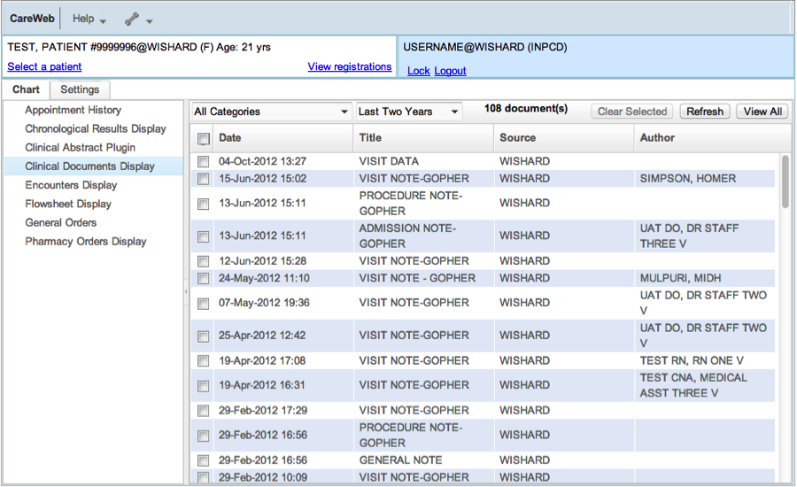

Slide 14
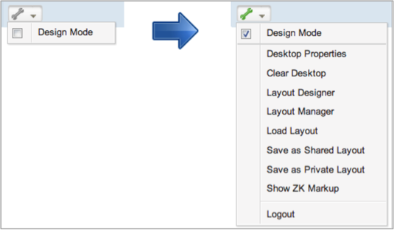

Slide 15
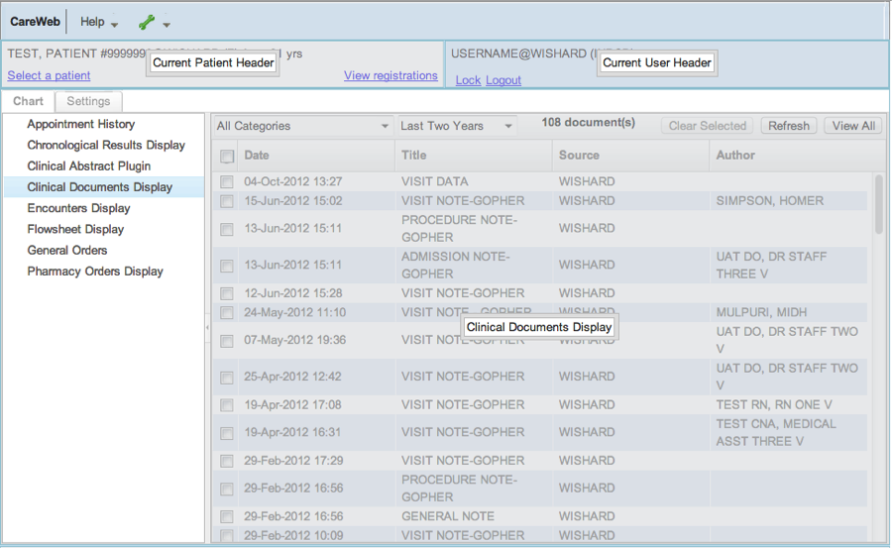

Slide 16
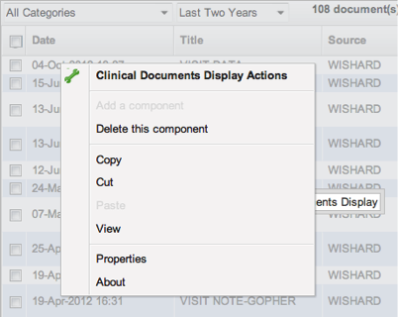

Slide 17
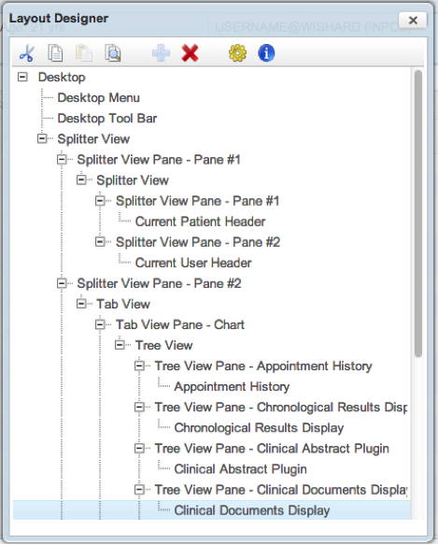

Slide 18
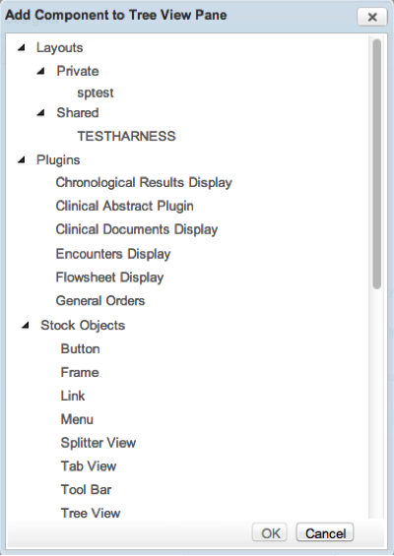

Slide 19
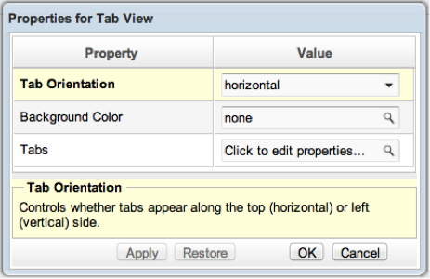

Slide 20
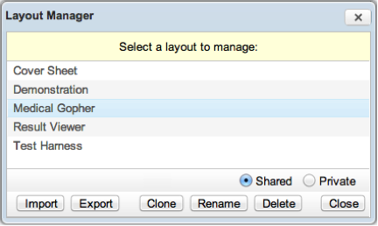

Slide 21
Extensibility
Plugins follow a standard specification
Plugins are self describing
Plugins are self registering
Plugins may discover other plugins
Plugins may be services or UI widgets or both
Plugin access can be constrained

Slide 22
Clinical Abstraction Layer
Adaptation of CWF for clinical use
Translational layer between underlying EMR implementation and CWF
Allows creation of interoperable clinical plugins
Based on the HL7 FHIR specification
Mixed clinical domain models supported

Slide 23
EMR Ports
RMRS (Regenstrief Institute)
VistA (Veterans Health Administration)
RPMS (Indian Health Service)
OpenMRS

Slide 24
RMRS Port Feature Inventory
Results display
Recent results
Flowsheet
Clinical abstract
Clinical documents
Encounter display
Order summary
Appointment history
Patient dashboard
Medication summary
Chart search
Data capture
Order entry
Note writing
Observations
Patient letters
Document uploader
Electronic signature
Problem list management
Allergy management
Order sets
Natural language processing
Communication
Secure chat
Clinical Decision support
Alert display
InfoPanel
Rule authoring
Relevance Adjustment Module
FDB integration
Administrative Tools
User management
Remote troubleshooting
Property management
Concept mapping
Disaster aid support
System integration
McKesson portal
Relay Health portal
Docs4Docs integration
Research
Randomization
Medication adherence
Medication reconciliation
Med profile visualization
ResNet study recruitment
SMART plug-ins
Notes:
Switch to demo – show plugins, help content, about box, design mode.

Slide 25
VistA Port
Uses Medsphere RPC Broker for authentication, event and messaging services
Existing RPC Calls supported
Serialization Support (JSON)
FHIR API (XML)
SMART API (RDF)

Slide 26
www.carewebframework.org
Wiki
Documentation
Blog
Source Code (MPL 2.0)

Slide 27
Github Repositories
carewebframework-core
carewebframework-icons
carewebframework-ohj
carewebframework-highcharts
carewebframework-smart
carewebframework-fhir
carewebframework-cal
carewebframework-openmrs
carewebframework-vista
carewebframework-rpms

Slide 28

Questions?
dkmartin@regenstrief.org

