Slide 1


The CareWeb Framework
Douglas K. Martin, MD
dkmartin@regenstrief.org
Regenstrief Center for Biomedical Informatics
Indiana University School of Medicine

Slide 2
CareWeb Framework (CWF)
Provides a foundation for building modular applications
Leverages existing open source technologies
Java on server; pure HTML / JavaScript on client
Is highly extensible through plugin modules
Has a composable user interface (UI layouts)
Coordinates shared functions (events, contexts)
Integrates help content (indexed, context-sensitive)
Heavily promotes code re-use / sharing
Facilitates collaborative development

Slide 3
CWF Foundational Technologies
Spring Framework
Spring Security
ZK Framework*
JQuery
Bootstrap
Lucene
Maven
All Open Source!

Slide 4
Architecture
User
Interface
Order
Entry
Flowsheet
User Preferences
SMART
Plug-in
Chart
Search
Plug-in
Widgets
Electronic
Signature
Patient
Selection
User
Authentication
SMART
Adaptor
Plug-in
Services
Layout
Manager
Layout
Designer
Framework
Services
Internal
Services
User
Context
Patient
Context
Electronic
Signature
SMART
API Registry
Plug-in
Services
Context
Management
Messaging
Services
Component
Discovery
Help Content
Integration
Theme
Support
Framework
Services
External
Services
Data
Access
Security
Services
Messaging
Services
Web
Services
Solr Search Engine
Host
Services

Slide 5
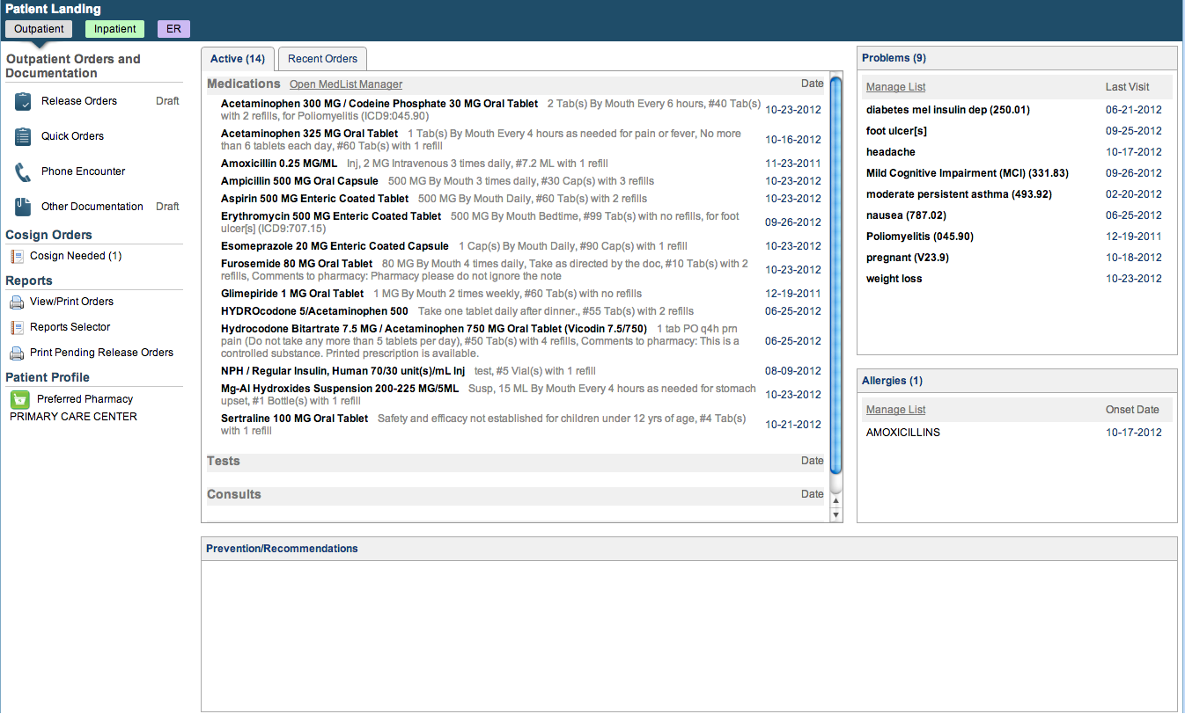
The Medical Gopher

Slide 6
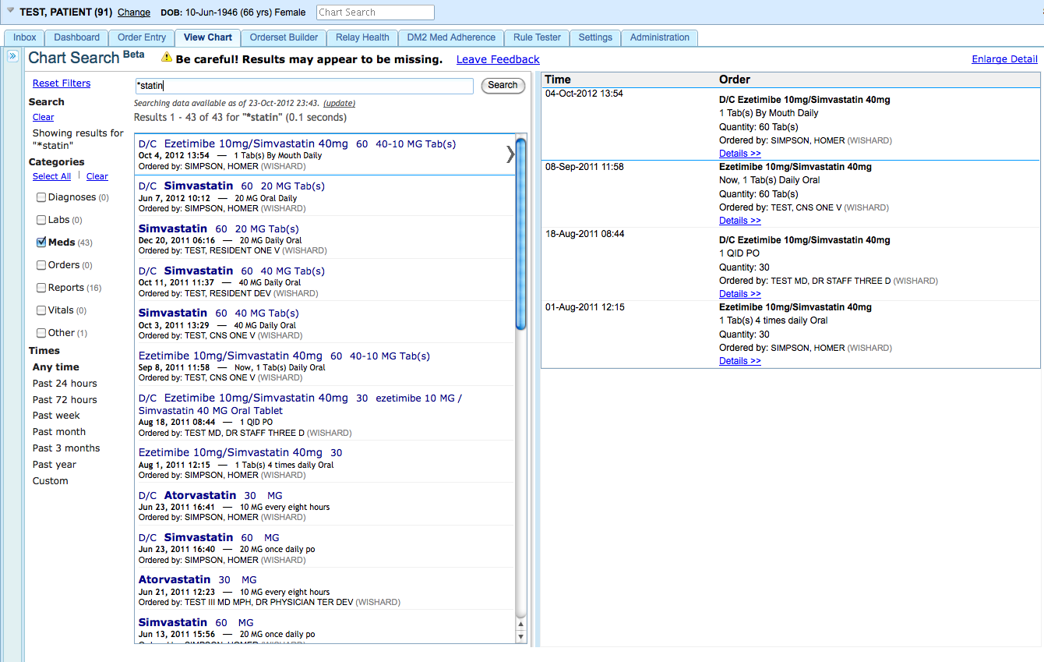
Chart Search

Slide 7
Indiana HIE

Slide 8
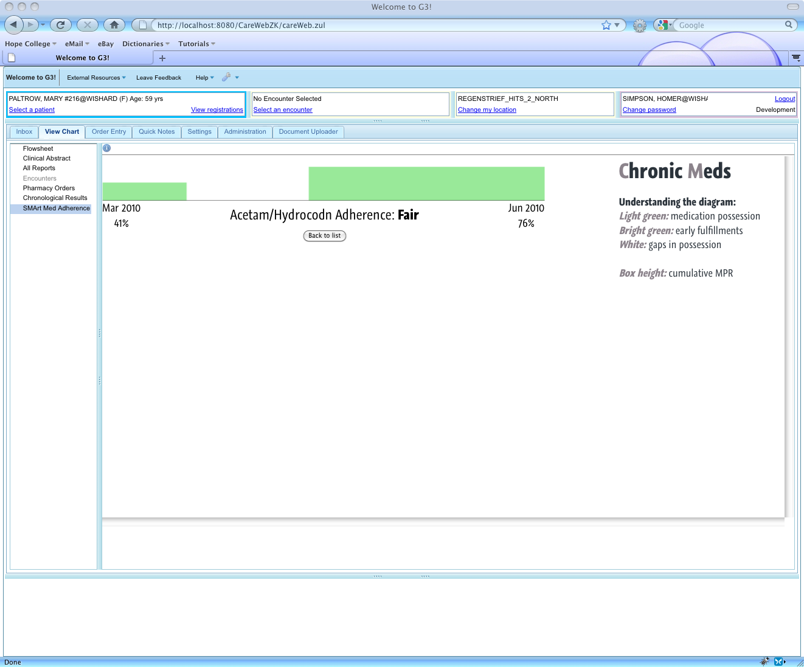
SMART Support
Notes:
CareWeb: the first SMArt-enabled EMR!!

Slide 9
VA Innovation Project
Demonstrate CWF running atop VistA
Port selected plugins from RPMS EHR
Chief Complaint
Patient Goals
Family History
Immunizations

Slide 14
Healthcare Services Platform Consortium (HSPC)
Establish platform for building truly interoperable clinical applications
Partnership of academic, federal, commercial stakeholders
Leverage and evolve existing standards
FHIR
SMART on FHIR
CIMI
Other (EPS, UCS, CDS)
Build toolkits for testing services
www.hspconsortium.org

Slide 15
HSPC Collaboration
CareWeb as basis for reference EMR to showcase interoperability capabilities
modular
collaborative
extensible
Common data model (FHIR vs CIMI vs ?)
Standards-based
100% open source

Slide 17
New Developments
MPL → Apache license
Redesigned messaging services
ZK → CWF web framework

Slide 18
Why Abandon ZK?
Atypical open source license
Community version lacks key capabilities
Product / community stagnating
Not a mainstream technology
Difficult to integrate 3rd party libraries
Proprietary approach to key functions

Slide 19
A ZK Replacement
Leverage existing open source technologies (client- and server-side)
Avoid framework lock-in on client
Build around web socket I/O for better responsiveness
Keep the stuff we like about ZK (server-centric approach)
Make it easier to extend

Slide 20
CWF Web Framework
Server-side
Spring Framework
Spring MVC
Servlet support
Internationalization support
Minification/compression support
Spring Web Sockets
Spring Expression Language
Webjar Support
Convenient packaging of client-side artifacts
Dependency/version management via Maven
RequireJS, Bower, NPM formats supported

Slide 21
CWF Web Framework
Client-side
SystemJS
JQuery
JQuery-UI
Bootstrap
Websocket (native)
Lightweight widget framework

Slide 22
Features
Similarities to ZK
Java component model → Javascript widget model
Imperative and/or declarative
Annotation-based component and event bindings
Annotation-based component definitions
Extensible scripting support (JRuby, Groovy)
Heavy use of HTML5/CSS3 features

Slide 23
Current State
Still alpha
Mostly feature-complete
66 out-of-the-box components
Migrating existing codebase
Lot of CSS tweaks still needed

Slide 24

Questions?
Douglas K. Martin, MD
dkmartin@regenstrief.org
Regenstrief Center for Biomedical Informatics
Indiana University School of Medicine

