Slide 1


The CareWeb Framework
Douglas K. Martin, MD
dkmartin@regenstrief.org
Regenstrief Center for Biomedical Informatics
Indiana University School of Medicine

Slide 2
CareWeb Framework (CWF)
Provides a foundation for building modular applications
Leverages existing open source technologies
Java on server; pure HTML / JavaScript on client
Is highly extensible through plugin modules
Has a composable user interface (UI layouts)
Coordinates shared functions (events, contexts)
Integrates help content (indexed, context-sensitive)
Heavily promotes code re-use / sharing
Facilitates collaborative development

Slide 3
CWF Foundational Technologies
Spring Framework
Spring Security
ZK Framework
JQuery
Bootstrap
Lucene
Maven
All Open Source!

Slide 4
Architecture
User
Interface
Order
Entry
Flowsheet
User Preferences
SMART
Plug-in
Chart
Search
Plug-in
Widgets
Electronic
Signature
Patient
Selection
User
Authentication
SMART
Adaptor
Plug-in
Services
Layout
Manager
Layout
Designer
Framework
Services
Internal
Services
User
Context
Patient
Context
Electronic
Signature
SMART
API Registry
Plug-in
Services
Context
Management
Event
Services
Component
Discovery
Help
Integration
Theme
Support
Framework
Services
External
Services
Data
Access
Security
Services
Messaging
Services
Web
Services
Solr Search Engine
Host
Services

Slide 5
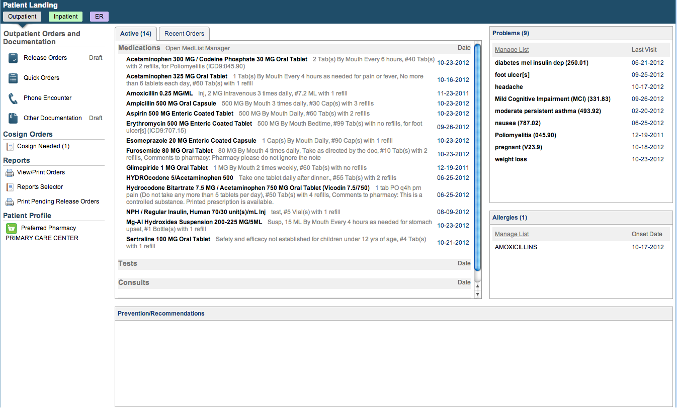
The Medical Gopher

Slide 6
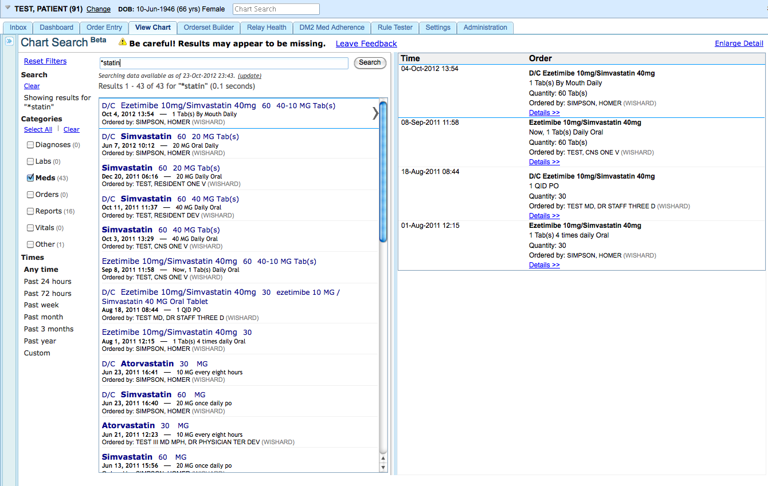
Indiana HIE

Slide 7
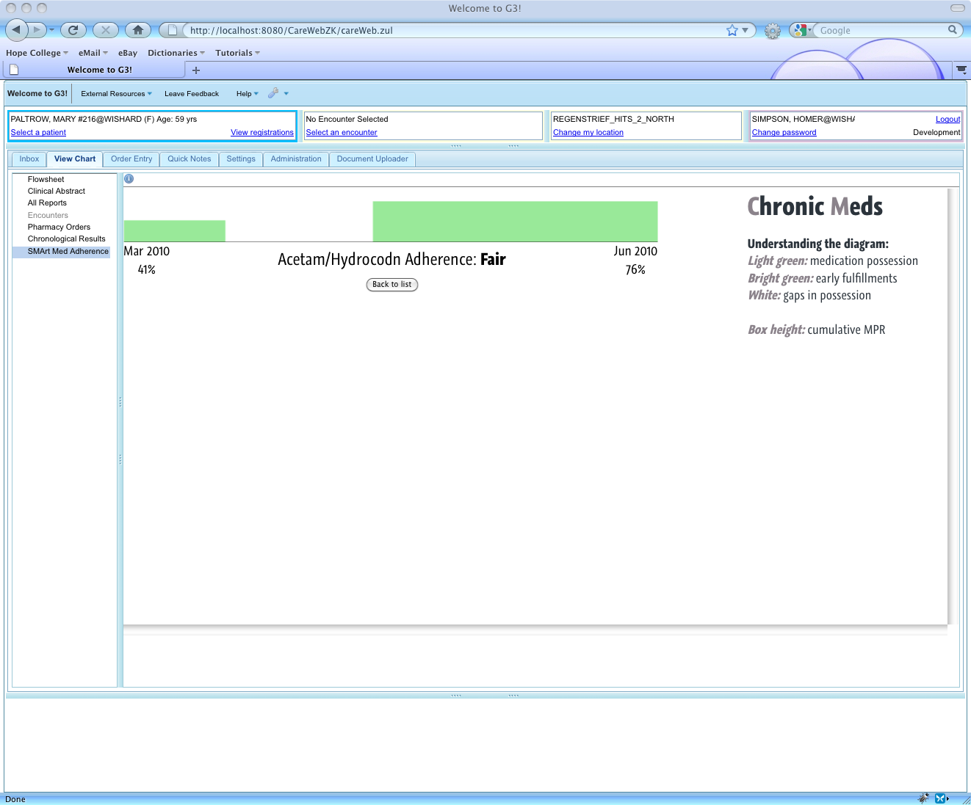
SMART Support
Notes:
CareWeb: the first SMArt-enabled EMR!!

Slide 8
The Present
User
Interface
Document
Viewer
Plug-in
Widgets
Patient Selection
Plug-in
Services
Layout
Manager
Layout
Designer
Framework
Services
Internal
Services
Patient
Context
Plug-in
Services
Context
Management
Event
Services
Component
Discovery
Help
Integration
Theme
Support
Framework
Services
External
Services
Data
Access
Host
Services
RMRS OpenMRS VistA/RPMS

Slide 9
Clinical Abstraction Layer
HAPI-FHIR client library
FHIR resource model
FHIR-based plugins
EHR platform agnostic
Truly interoperable plugins
Build once, run anywhere

Slide 10
The Future?
User
Interface
Document
Viewer
Plug-in
Widgets
Patient Selection
Plug-in
Services
Layout
Manager
Layout
Designer
Framework
Services
Internal
Services
Patient
Context
FHIR
Client
Plug-in
Services
Context
Management
Event
Services
Component
Discovery
Help
Integration
Theme
Support
Framework
Services
External
Services
FHIR
Endpoint
Host
Services
−−−−−−−−−−−−−−−−−−−−−−−−− FHIR −−−−−−−−−−−−−−−−−−−−−−−−−
RMRS OpenMRS VistA/RPMS

Slide 11
Demo

Slide 12

Where does this fit?
Douglas K. Martin, MD
dkmartin@regenstrief.org
Regenstrief Center for Biomedical Informatics
Indiana University School of Medicine

Slide 13
Resources
http://www.carewebframework.org
http://github.com/carewebframework

