Slide 1


The CareWeb Framework An Update
Doug Martin MD

Slide 2
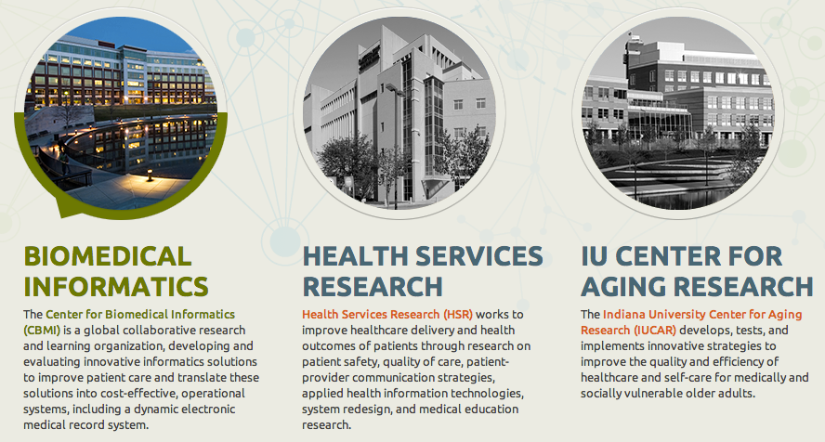
Regenstrief Institute www.regenstrief.org

Slide 3
Regenstrief Institute
Non-profit
Indiana University Affiliate
Founded in 1969
Healthcare research
Funding sources
Grants (primary)
Regenstrief Foundation
Industry Partnerships
Not a vendor!

Slide 4
Why a Collaborative Platform?
CPRS is monolithic
It is difficult to extend
Has rudimentary extension points
Difficult to share innovations
Sound familiar?
Notes:
Say something about re-engineering ➔ preserve functions

Slide 5
The Road to CWF
1998 Consortium of VA Hospitals fund VistAtion project
Integrate commercial note authoring tool into CPRS
Monolithic, closed → open, modular, extensible architecture
Monopolistic → collaborative development culture
Needed a supporting framework (VistAtion Framework)
Modularize CPRS → VistAtion components
1999 VistAtion pilot commences at Atlanta VAMC
2000 VA rejects VistAtion concept as “too open”
2000 Clinical Informatics Associates incorporates
2001 VistAtion re-engineered as VueCentric
2002 VueCentric-based EHR piloted at Crow Indian Hospital
2004 IHS adopts RPMS-EHR as its official EMR
2006 Medsphere acquires CIA
2008 RPMS-EHR deployed in over 120 IHS sites
2008 Return to Regenstrief
2009 VueCentric re-engineered as CareWeb Framework
2010 CareWeb viewer deployed across Indiana HIE
2011 Gopher re-engineered as Gopher³
2012 Ports for OpenMRS, VistA, RPMS
2013 Open Source (MPL 2.0)

Slide 6
What We Know
Component-based frameworks work
Given the proper tools, users will innovate
Don’t design to perceived workflows
Let users adapt software to workflow
Ability to share custom layouts is huge
Deployment can be a pain (lots of moving parts)
Notes:
Say something about re-engineering ➔ preserve functions

Slide 7
CareWeb Framework Today
Third generation framework
Web-based
100% open source (MPL 2.0)
Not just VistA anymore
Notes:
Say something about re-engineering ➔ preserve functions

Slide 8
CareWeb Framework Features
Provides a foundation for building modular applications
Leverages existing open source technologies
Is highly extensible through plugin modules
Supports flexible UI layouts
Coordinates shared functions (events, contexts)
Heavily promotes code re-use / sharing
Facilitates collaborative development

Slide 9
Foundational Technologies
Spring Framework
Spring Security
ZK Framework
JQuery
Bootstrap
Apache Maven
All Open Source!

Slide 10
Architecture
User
Interface
Order
Entry
Flowsheet
User Preferences
SMART
Plug-in
Chart Search
Plug-in
Widgets
Electronic
Signature
Patient
Selection
User
Authentication
SMART Adaptor
Plug-in
Services
Layout
Manager
Layout
Designer
Framework
Services
Internal
Services
Electronic
Signature
Patient
Context
User
Context
SMART
API Registry
Plug-in
Services
Context
Management
Event
Management
Component
Registration
Help
Subsystem
Theme
Support
Framework
Services
External
Services
Data
Access
Security
Services
Messaging
Services
Web
Services
Solr Search Engine
Core
Services

Slide 11
CareWeb Framework is not just for VistA
Regenstrief Medical Record System (RMRS)
OpenMRS
RPMS
VistA
FHIR-compliant EMR’s (future)

Slide 12
Fast Healthcare Interoperability Resources (FHIR)
Emerging HL7 standard
DSTU v2
Wire format for resource exchange
CRUDS operations
REST interface
Common data model
Industry-wide uptake
Still immature and evolving

Slide 13
VistA Port
RPC broker (Java client, CIA server)
Authentication (Spring Security)
Asynchronous RPC’s
Event propagation
Communication is server-to-server, not client
HttpClient implementation
Resource serialization framework
FHIR resources (user, patient, encounter, etc.)
Non-FHIR resources (parameter definitions)

Slide 14
VistA Port
Patient selection (FHIR)
Patient lists
Patient photo (VistA Imaging via FHIR)
Encounter selection (mostly FHIR, incomplete)
Secure chat
Notifications (from RPMS)
User/patient/encounter headers
Cover sheet components
Vitals display/graph
CWAD
TIU document viewer (FHIR and non-FHIR)
Settings editor
SMART adaptor (thanks to George Lilly)
Lots more to do

Slide 15
www.carewebframework.org
Wiki
Documentation
Blog
Source Code (MPL 2.0)

Slide 16
Github Repositories
carewebframework-core
carewebframework-icons
carewebframework-themes
carewebframework-cal
carewebframework-fhir
carewebframework-smart
carewebframework-ohj
carewebframework-highcharts
carewebframework-openmrs
carewebframework-vista
carewebframework-rpms

Slide 17

Questions?
dkmartin@regenstrief.org

