Slide 1


The CareWeb Framework A Platform for Collaboration and Innovation
Doug Martin MD

Slide 2
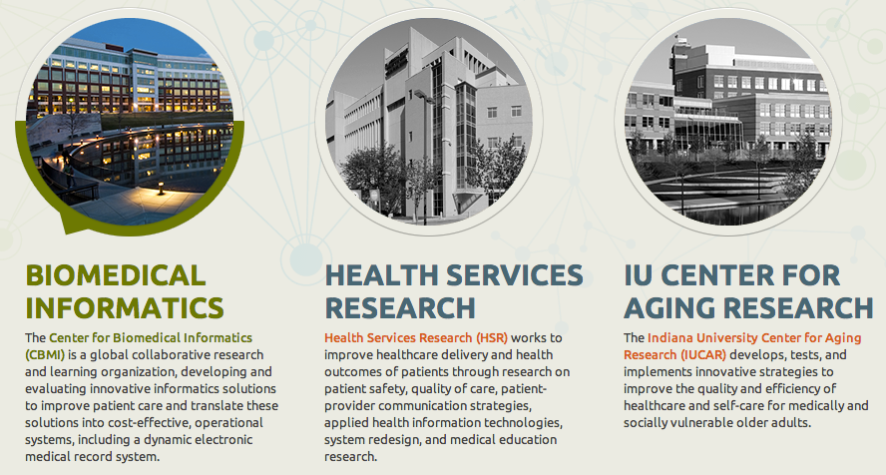
Regenstrief Institute www.regenstrief.org

Slide 3
Regenstrief Institute
Non-profit
Founded in 1969
Healthcare research
Primarily grant funded
Regenstrief Foundation
Affiliated with Indiana University
Multiple partnerships

Slide 4
CareWeb Framework
What It Does
Provides a foundation for building component-based applications
Leverages existing open source technologies
Is highly extensible through plugin modules
Supports flexible UI layouts
Coordinates shared functions (events, contexts)
Facilitates collaborative development

Slide 5
CareWeb Framework
What It Is Not
A standalone application
Specific to healthcare (not an EMR)
Dependent upon a specific domain model

Slide 6
The Road to CWF
1998 Consortium of VA Hospitals fund VistAtion project
Integrate commercial note authoring tool into CPRS
Monolithic, closed → open, modular, extensible architecture
Monopolistic → collaborative development culture
Needed a supporting framework (VistAtion Framework)
Modularize CPRS → VistAtion components
1999 VistAtion pilot commences at Atlanta VAMC
2000 VA rejects VistAtion concept as “too open”
2000 Clinical Informatics Associates incorporates
2001 VistAtion re-engineered as VueCentric
2002 VueCentric-based EHR piloted at Crow Indian Hospital
2004 IHS adopts RPMS-EHR as its official EMR
2006 Medsphere acquires CIA
2008 RPMS-EHR deployed in over 120 IHS sites
2008 Return to Regenstrief
2009 VueCentric re-engineered as CareWeb Framework
2010 CareWeb viewer deployed across Indiana HIE
2011 Gopher re-engineered as Gopher³
2012 Ports for OpenMRS, VistA, RPMS
2013 Open Source (MPL 2.0)

Slide 7
Rationale for Re-engineering
Software platform reaching end of life
Systems reaching limits of extensibility
Difficulty recruiting engineers with relevant experience
Diminishing compatibility with evolving infrastructure
Limited ability to leverage contemporary tools
Complexity of maintaining multiple systems
Notes:
Say something about re-engineering ➔ preserve functions

Slide 8
Goals of New Platform
Technology convergence
Web-based
Built on open source technologies
Extensible architecture
Modular design
Emphasis on component re-use
Ease of development
Minimal configuration
Support our research mission!

Slide 9
What We Already Knew
Component-based frameworks work
Given the proper tools, users will innovate
Don’t design to perceived workflows
Let users adapt software to workflow
Ability to share custom layouts is huge
Deployment can be a pain (lots of moving parts)
Notes:
Say something about re-engineering ➔ preserve functions

Slide 10
Challenges
Speed, speed, speed
Scalability
Cross browser support
UI richness
UI consistency
Session interference
Dependency management
Versioning
Workflow support
Notes:
Speed, speed, speed (translated into our new platform)
Web-based application wins/challenges
Components wins/losses
SOA wins/losses
What would we do differently if we started over
Compare to our goals – did we achieve them?

Slide 11
Key Technologies
Spring Framework
Spring Security
ZK Framework
JQuery
Apache ActiveMQ Server
Apache Tomcat
Apache Maven

Slide 12
Architecture
User
Interface
Order
Entry
Flowsheet
User Preferences
SMART
Plug-in
Chart Search
Plug-in
Widgets
Electronic
Signature
Patient
Selection
User
Authentication
SMART Adaptor
Plug-in
Services
Layout
Manager
Layout
Designer
Framework
Services
Internal
Services
Electronic
Signature
Patient
Context
User
Context
SMART
API Registry
Plug-in
Services
Context
Management
Event
Management
Component
Registration
Help
Subsystem
Theme
Support
Framework
Services
External
Services
Data
Access
Security
Services
Messaging
Services
Web
Services
Solr Search Engine
Core
Services

Slide 13
Feature Inventory
Results display
Recent results
Flowsheet
Clinical abstract
Clinical documents
Encounter display
Order summary
Appointment history
Patient dashboard
Medication summary
Chart search
Data capture
Order entry
Note writing
Observations
Patient letters
Document uploader
Electronic signature
Problem list management
Allergy management
Order sets
Natural language processing
Clinical Decision support
Alert display
InfoPanel
Rule authoring
Relevance Adjustment Module
FDB integration
Administrative Tools
User management
Remote troubleshooting
Property management
Concept mapping
Disaster aid support
System integration
McKesson portal
Relay Health portal
Docs4Docs integration
Research
Randomization
Medication adherence
Medication reconciliation
Med profile visualization
ResNet study recruitment
SMART plug-ins
Communication
Secure chat
Notes:
Switch to demo – show plugins, help content, about box, design mode.

Slide 14
www.carewebframework.org
Wiki
Documentation
Blog
Source Code (MPL 2.0)

Slide 15
Github Repositories
carewebframework-core
carewebframework-icons
carewebframework-ohj
carewebframework-highcharts
carewebframework-smart
carewebframework-cal
carewebframework-openmrs
carewebframework-vista
carewebframework-rpms

Slide 16
Demos
VistA port
The Medical Gopher Order Entry System

Slide 17

Questions?
dkmartin@regenstrief.org

