Slide 1
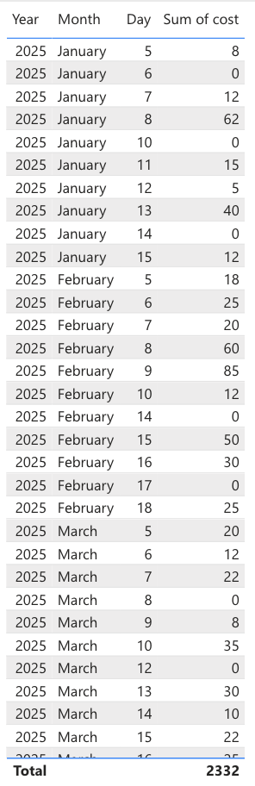
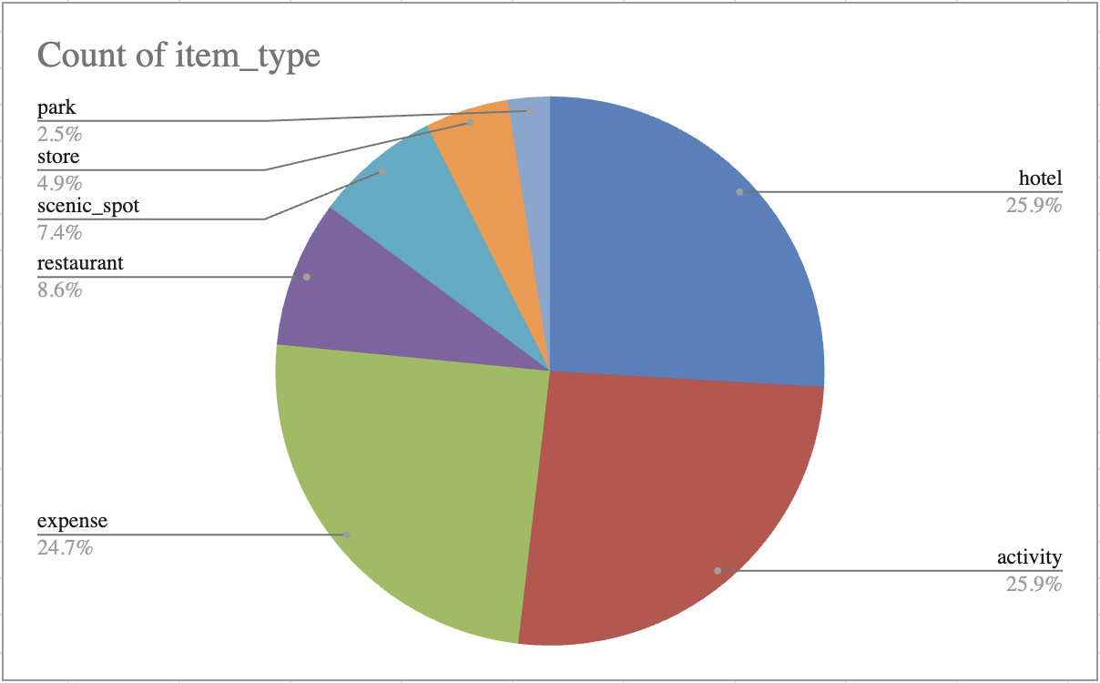
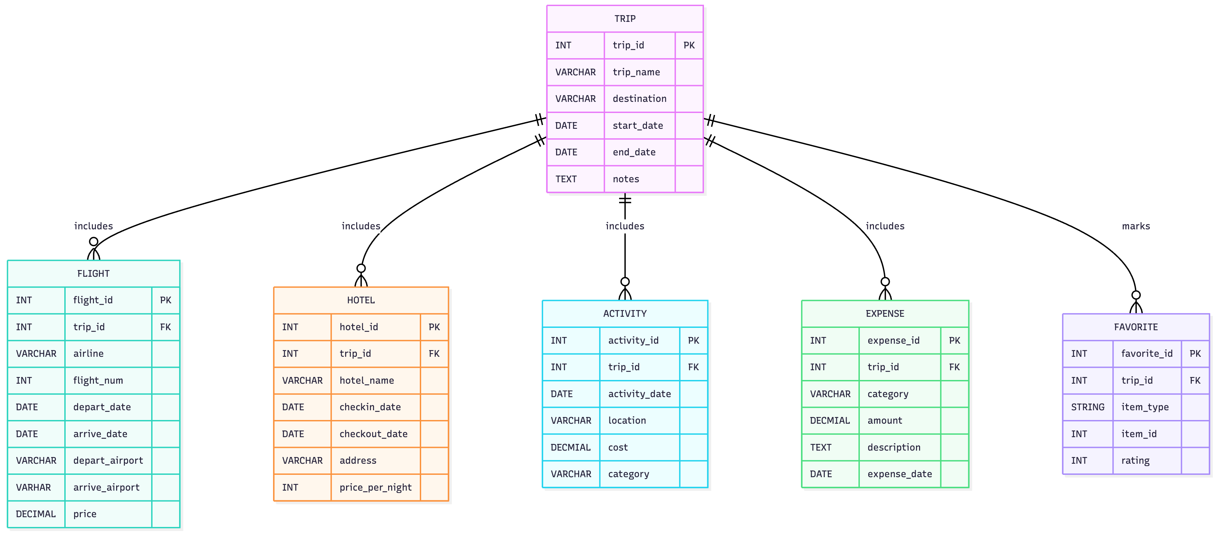
Travel Database
Caroline Smith | Huntington University | CS 415 Database Management – Fall 2025 - Final Project
Overview
Data
Reports
Database will be used for organization of travel information and efficiency of planning future trips
Multiple tables will be used in helping organize different aspects of trip-planning
TRIP (trip_name, destination, start_date, end_date, notes)
FLIGHT (trip_id, airline, flight_num, depart_date, arrive_date, depart_airport, arrive_airport, price)
HOTEL (trip_id, hotel_name, checkin_date, checkout_date, address, price_per_night)
ACTIVITY (trip_id, activity_date, location, cost, category)
EXPENSE (trip_id, category, amount, description, expense_date)
FAVORITE (trip_id, item_type, item_id, rating)
Design
6 tables:
  Trip (parent table)
  Flight
  Hotel
  Activity
  Expense
  Favorite
  Each child table has a one-to-many relationship, keeping 3rd Normal Form
ER Model
Queries
Query 1: Shows all trips and sorts them by start date and then by name.
Query 2: Shows expenses for trip 1 and calculates each amount with 10% tax.
Query 3: Shows New York trips and the month number of their start dates.
Query 4: Shows total expenses per trip, only for trips costing more than 100.
Query 5: Joins trips, hotels, and expenses to show each trip, its hotel, and total spending.
Query 6: Shows trip 3 with any matching favorite items (or none if they don’t exist).
Query 7: Checks a hotel’s price, updates it, and confirms the new price.
Query 8: Shows an expense, deletes it, and verifies it’s gone.
Query 9: Creates a view summarizing each trip and then displays it.
Query 10: Changes hotel prices in a transaction, views the changes, then rolls them back.

