Slide 1
Monoracle
Fully decentralised on-chain Oracle
based on game theory

Slide 2
Monoracle
A decentralized price Oracle
Permissionless price oracle quotation and feed creation
Verified on-chain and agentic native
More secure price oracle

Slide 3
Current Design
Centralised therefore vulnerable
Price is heavily delayed
Essentially it is just data uploading without verification
Notes:
Chainlink is controlled by 20+ entries
Price is time-delayed
price is upload but not verified.

Slide 4
Price market tested with skin-in-the-game
On chain settle, dual asset stake
AI Agent friendly
Monoracle
Notes:
Permissless no need oracle token not need have server or it team
We have two type users price provider provide price... the skin-in-the-game not only to the oracle token but also the asset the price is pricing
but have incentive and with the price they are providing
Verifier have incentive to correct price

Slide 5
Quote a price
Also staking assets
  Good price, take rewards
  mispriced got punished
Price Provider

Slide 6
Verifying prices
  Good price, do nothing
  Bad price, veto, arb ( and profit!)
Verifier

Slide 7
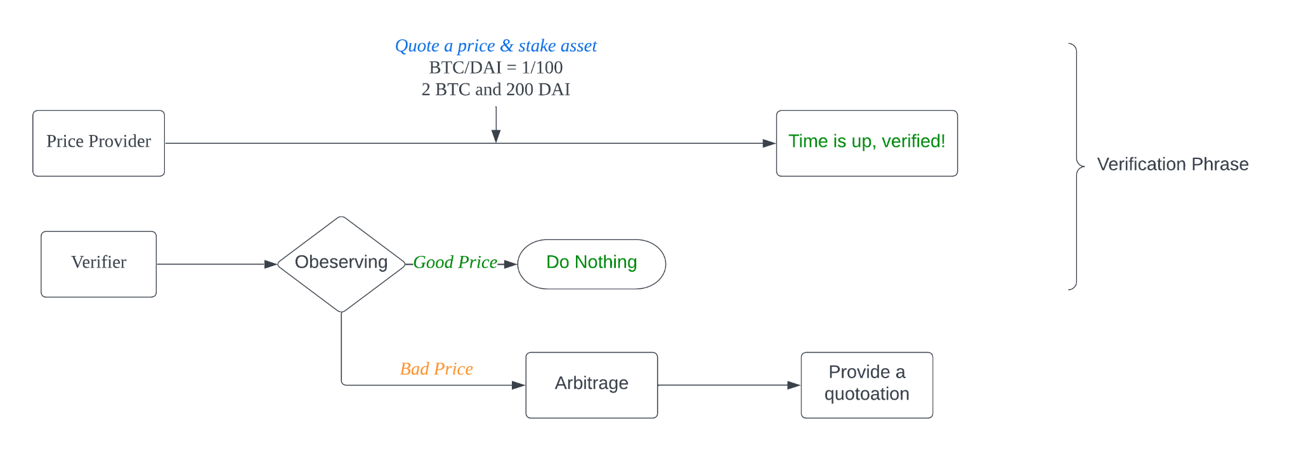
Price quotation Flow
Notes:
Todo add deposit asset

Slide 8
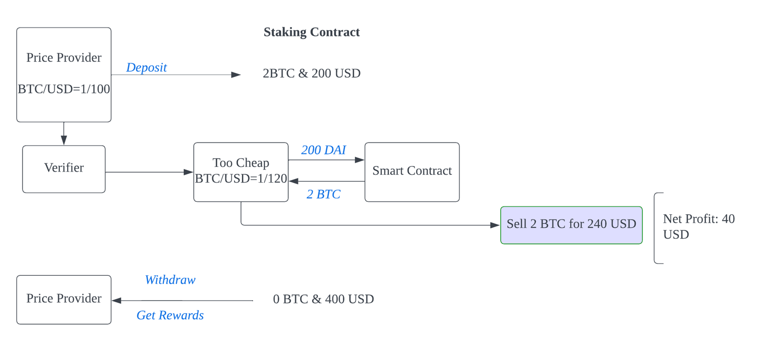
Misprice Flow

Slide 9
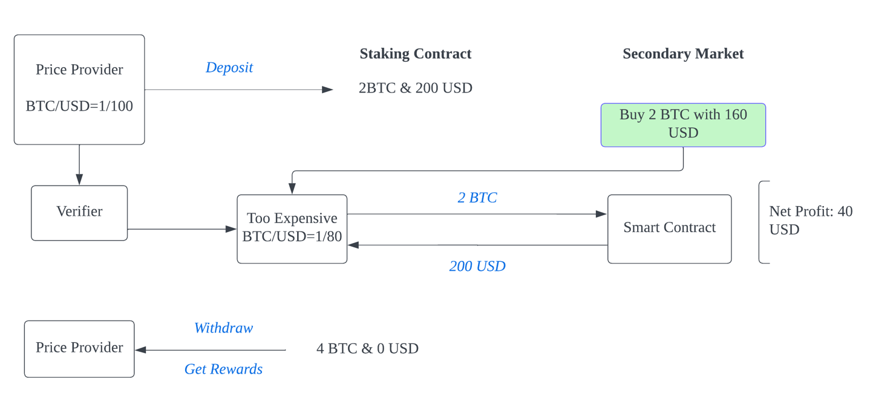
Misprice Flow

Slide 10
Why built on a faster blockchain
Faster finality
Low gas fee
Async/parallel/anti-MEV culture
Notes:
A bit technical content, architect content here Solana has almost deterministic finality
So how does it work?

Slide 11
Demo

Slide 12
Questions?

