Slide 1
RUNNERS AND RACES

Slide 2
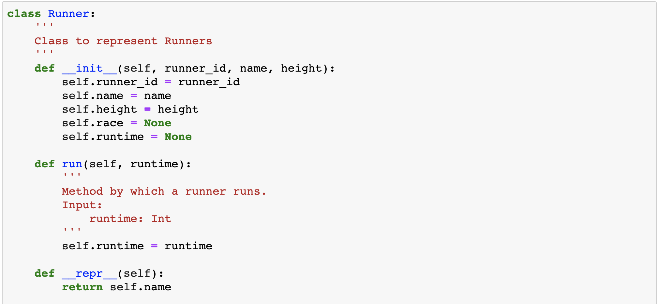
RUNNERS

Slide 3
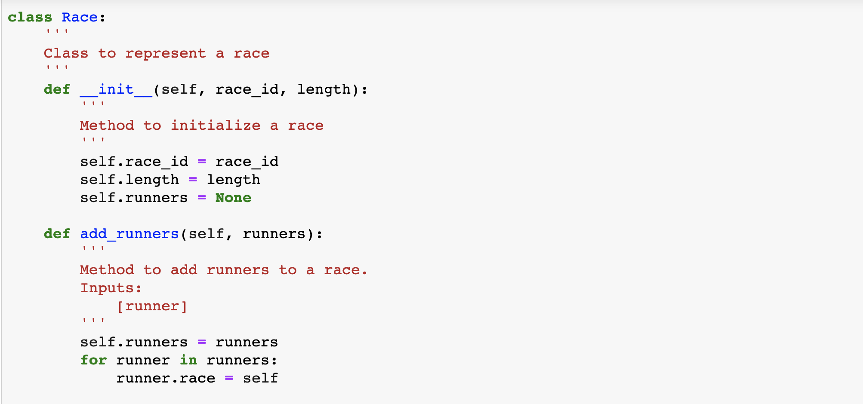
RACE

Slide 4
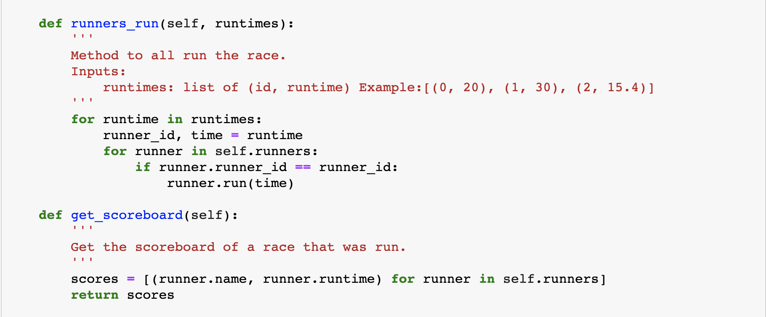
RACE

