Slide 1

Smart Stepper
WITH BIOFEEDBACK FOR TOE-WALKERS
2023 - 2024 OIT Wilsonville Junior Project designed by:
Ismael Hernandez-Hernandez Zachary Elliott Ian Gaffney Cari Blaker

Slide 2

WHAT IS TOE-WALKING?
Problematic gait
Causes further health issues
Affects 5% of the population
Physical therapy doesn't help
Surgery ineffective
The world needs a solution!

Slide 3
SOLUTION REQUIREMENTS
Shoe senses gait
Feedback for improvement
Stealthy; medical capability disguised
Encouragement to heel strike (for kids!)
Shareable with parents & medical professionals

Slide 4
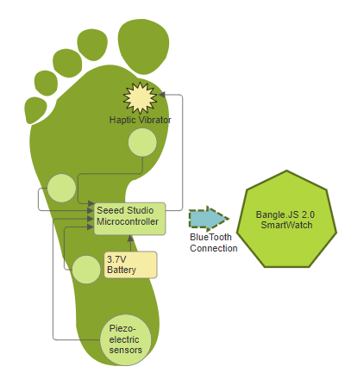
Smart stepper solution
The Smart Stepper is a shoe featuring:
4 embedded piezoelectric sensors
Embedded haptic vibrator (live feedback)
Smart watch connection with a week of data feedback/display

Slide 5
HARDWARE
PER SHOE
PER PROJECT
Seeed Studio Microcontroller: - small enough to be encapsulated by shoe comfortably - supports analog input (with enough pins) from piezoelectric sensors - supports BLE connection - internal battery, plus external battery & its charging support - plenty of on-chip and on-board memory
Four Piezoelectric sensors:
provide feedback voltage
save on power
3.7V battery
Haptic Vibrator : provides live feedback by vibrating on toe strikes
Bangle.JS 2.0 Smart Watch - BLE capability
- fully programmable

Slide 6
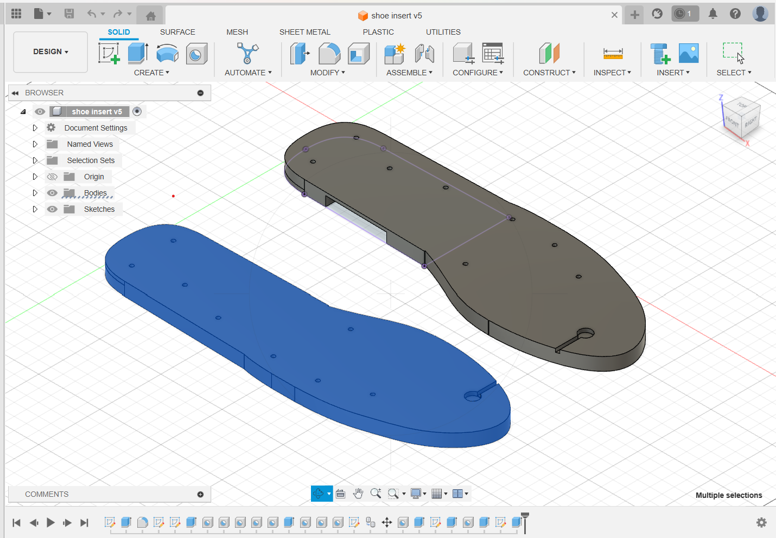
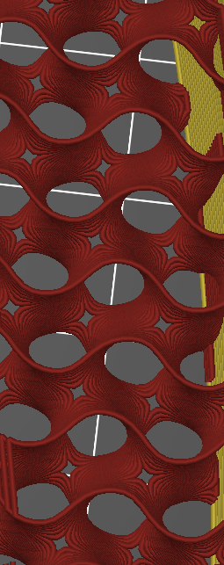
HARDWARE Encasement
3D Printing
Thermoplastic Polyurethane (TPU) Filament
12% Infill
182 grams used

Slide 7
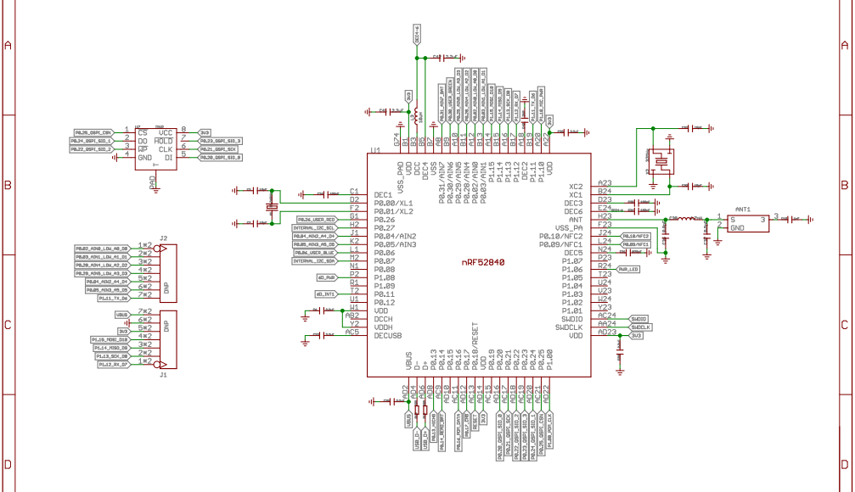
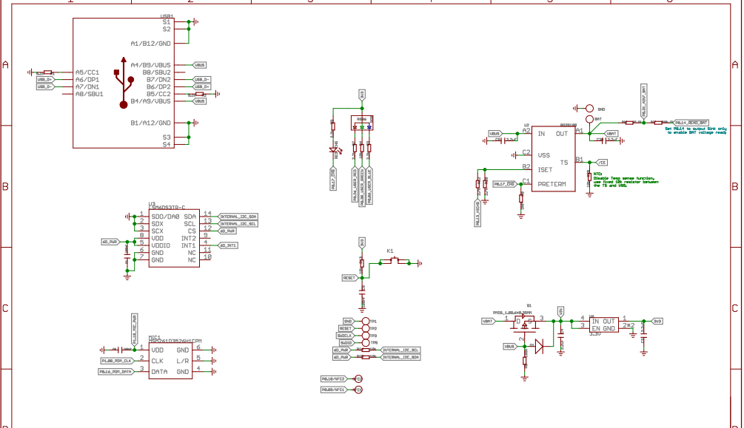
SEEED BOARD
KiCad EDA
jlcpcb
FLEX

Slide 8
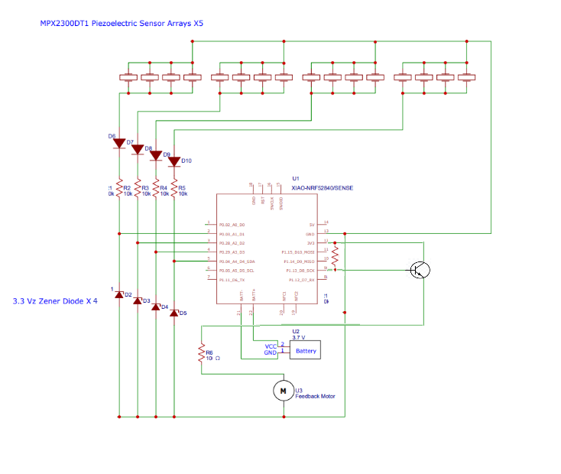
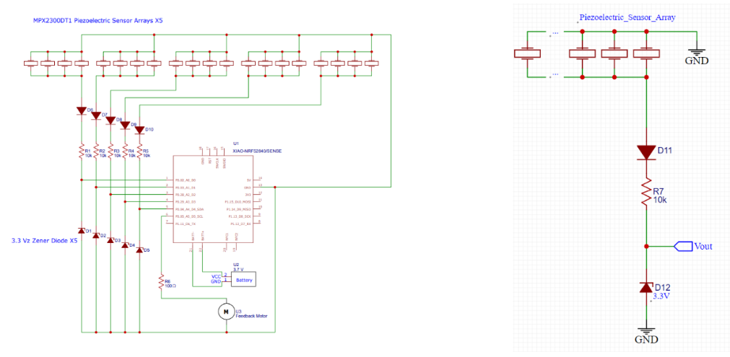
CIRCUIT bOARD

Slide 9
SOFTWARE
Device | IDE | Language
Fusion 360 | CAD | N/A
Prusa Printer | PrusaSlicer | Gcode
Seeed studio microcontroller | Arduino IDE | Arduino
Bangle.JS 2.0 | Espruino's Web IDE | JavaScript
KiCad EDA | s-expression schematic | N/A

Slide 10
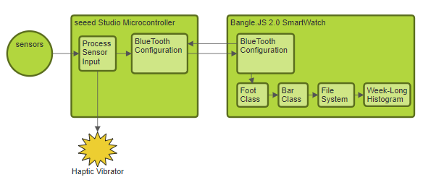
SOFTWARE

Slide 11
Graph Display
Foot Class
+good +bad +total +bottom_steps +top_steps +bottom_color +top_color +x_start +x_finish +y_bottom_start +y_top_start +y_bottom_finish +y_top_finish +update(good, bad)
Bar Class
+day +date +day_relation +file_contents +left foot +right foot +highest_total +parse_file(contents) +update()

Slide 12
costs
Product | Units | Price Per | Cost Per Project
Bangle.JS 2 Smart Watch | 1 | $93.22 | $93.22
Seeed Studio Microcontroller | 2 | $15.99 | $31.98
3.7V Lithium Ion Battery | 2 | $14.95 | $29.90
Piezo Electric Sensor | 10 | $0.79 | $6.32
Haptic Vibrator | 2 | $1.20 | $2.40
Shoes (pair) | 1 | $60.00 | $60.00
Filament TPU Roll (0.75 Kg) | 1 | $29.99 | $14.99
Total Physical Cost |  |  | $238.81

Slide 13
schedule
This term:
Read/Write data
Bluetooth Connection
Data histogram display
Board Creation
3D Insoles printed
Testing
Spring term:
Idea Fest preparation
PCB board order
Rigorous testing and refining
Game creation
Insole changes—waterproofing!
Phone app
Game
BLE completion
Adding sensor arrays for accuracy

Slide 14
Are you ready for a demonstration?!

Slide 15
Thank you

