Slide 1
CO1111/51 Computing Skills a.k.a. The Four Week Challenge
Google’s Android App Inventor
A Gentle Introduction
Dr Nick Mitchell (Room CM226)
email: npmitchell@uclan.ac.uk

Slide 2
Your Team Challenge For Week 1…
…Build a Quiz app, that will form the basis of your future Treasure Hunt, to be demonstrated on Friday.
Today, you will be learning the basics of how to use App Inventor, on an un-related example.
  By the end of the day, you should, INDIVIDUALLY, be competent to build a simple app and deploy it to a mobile phone emulator.
Tomorrow, we will start looking at the features you will need to build the Quiz, and how to put them together.

Slide 3
What is App Inventor?
A simple development environment which allows you to write programs (apps) without “programming” by using a graphical Blocks language
  You don’t have to learn a difficult syntax (like with C++)
  So there are no* mysterious compiler errors or warnings
  You choose blocks of code from a set of options
It works in a 3-step process:
  Design the appearance of the app by dragging components onto a viewer representing your phone’s screen area;
  Design the behaviour of the app by dragging blocks of functionality together like doing a jigsaw;
  Test the app by running it in an emulator or on a phone.
* In the words of the Captain of the Pinafore, hardly ever!

Slide 4
Component Designer
The Component Designer allows you to design what your app will look look like (and a few other things)
Runs in any web browser…
  A “cloud” application
    All your data is stores on Google’s servers, so you can edit and deploy your app from anywhere
Allows you to select components and ‘place’ them in your app
  Simple components like buttons and labels
  Advanced components which access the sensors and actuators on the phone like the accelerometer or camera
  Some are visible like buttons, but some do not appear as part of the app’s user interface, like the accelerometer

Slide 5
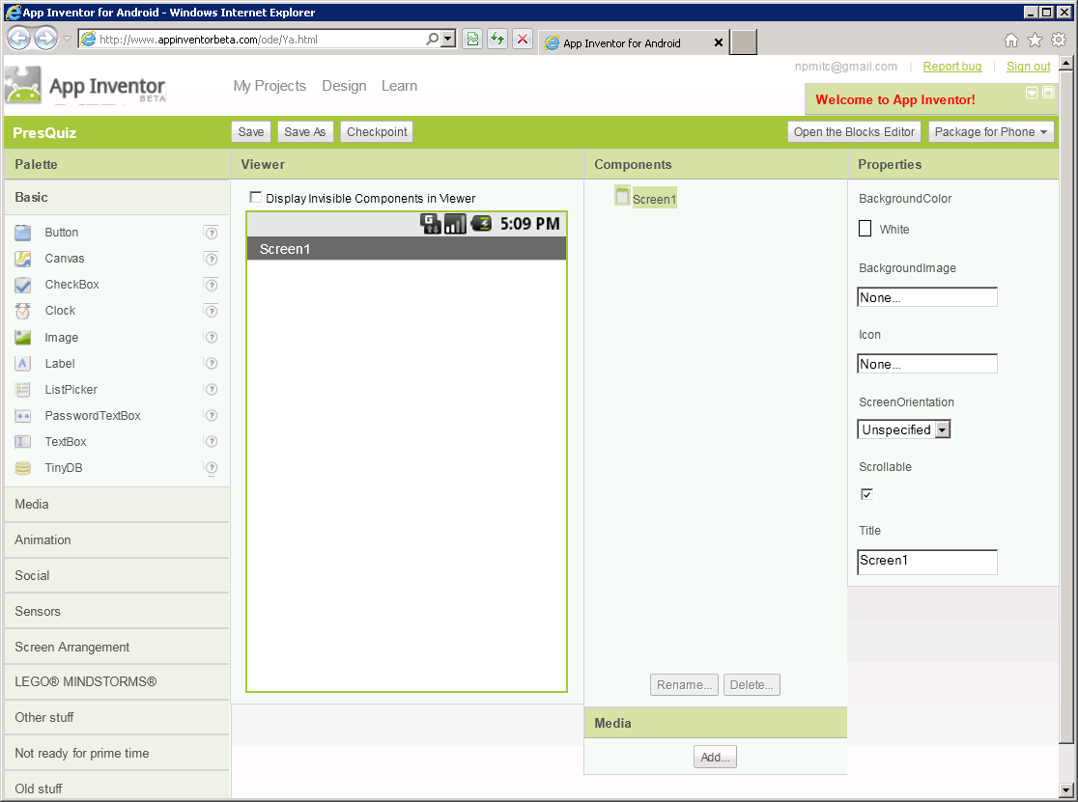
Component Designer
Palette of components to choose from
Viewer representing the phone’s screen
List of components (visible and invisible)
Properties of currently selected component

Slide 6
Components
Two things you need to know about components
  They have properties which you can investigate and change
    E.g. a button component will have properties relating to what color and size it is, and what (if any) text is written on it.
    Some properties you will set when you design the appearance of your app
    Some properties will be used or changed by your program
  They have a set of associated events – things which can happen to them – which you can respond to
    E.g. a button component can be clicked

Slide 7
Events
Some events are triggered by the user interacting with interface components on the phone’s touch screen or one of its other input sensors.
Some events may be generated from inside your program:
  E.g. a timer component has reached the end of its countdown.
Other events may come from outside your program:
  E.g. a text message being received by the phone.
Your App can listen for specific events, and perform some behaviour according to what has happened

Slide 8
Blocks Editor
Runs as a Java web start application
  You may encounter some protest from your firewall
Gives you a set of standard building blocks for programming arranged in “drawers” by category for easy access.
  E.g. program control structures, mathematical operators, text and numbers, etc.
Also building blocks to access the properties and events of every component you have placed in your app.
Code blocks are like jigsaw pieces
  You drag them onto the canvas and fit them together to build behaviour…
    Only pieces that work together will fit together

Slide 9
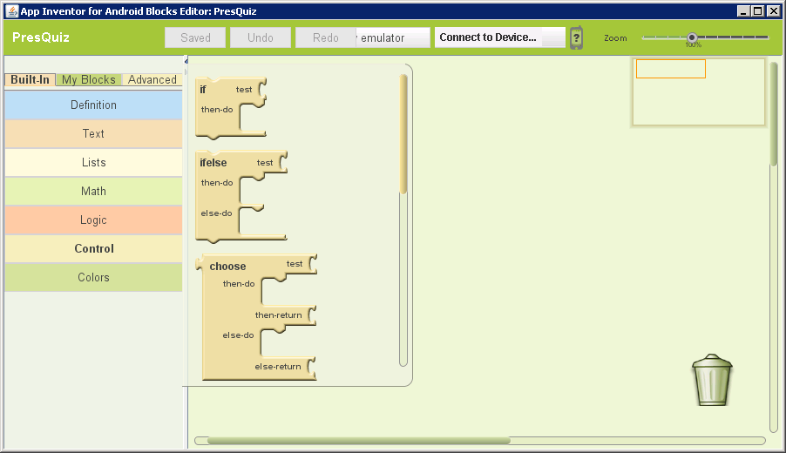
Blocks Editor
“Drawers” containing categories of ready made code blocks
“Contents of the control drawer

Slide 10
Testing your App
There are two ways of testing your app
  Live testing allows you to be running the app either on a phone or on a phone emulator while you are programming
    As you change the behaviour in the blocks editor, the behaviour changes on the phone in real time
    The app is not installed on your phone
  Packaging the app allows you to download it either on to your computer (to share with others) or directly on to your phone, where you can install and run it like any other app

Slide 11
Let’s Build and Test a simple App
We will build a very simple app where the user presses a button to change the colour of a text label…

Slide 12
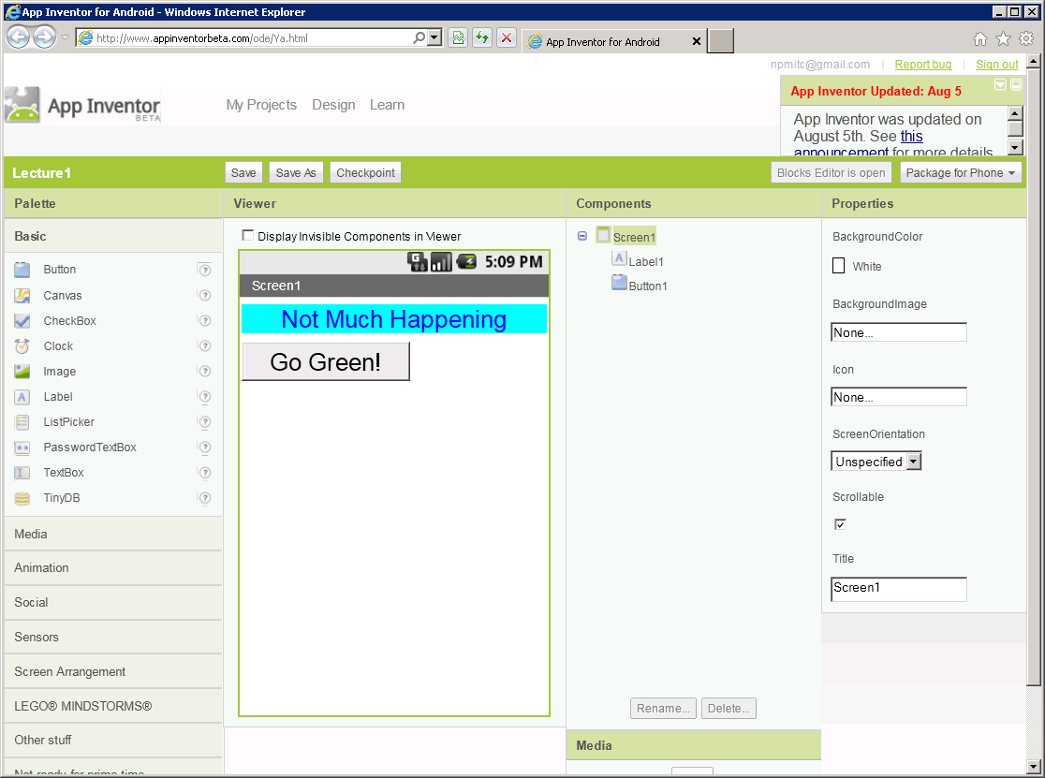
Demo
We dragged a label component and a button component onto the viewer, and set their initial properties

Slide 13
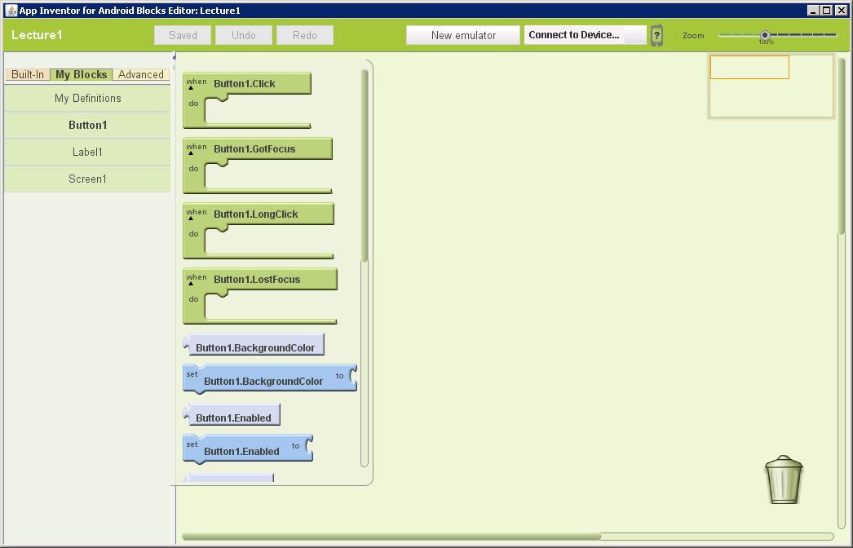
Demo
In the Blocks Editor, drawers for Button1 and Label1 had appeared under MyBlocks
We could select the event handler for clicking the button

Slide 14
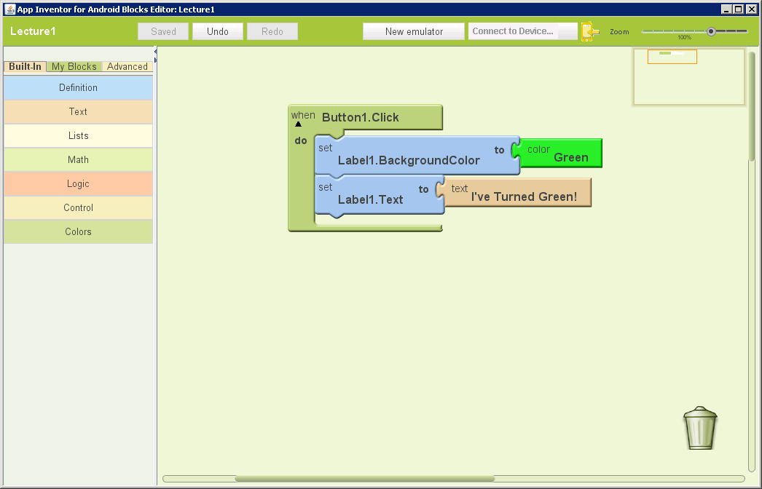
Demo
We built a simple program to change the colour and text of the label when the button is clicked.
Now to test it out…

Slide 15
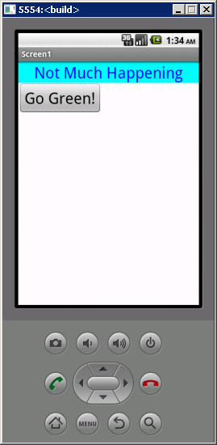
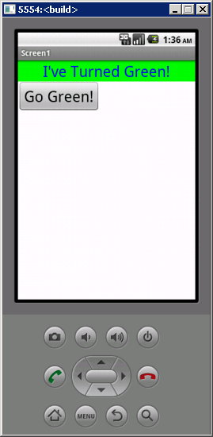
Demo
We launched the emulator and pressed the button…

