Slide 1
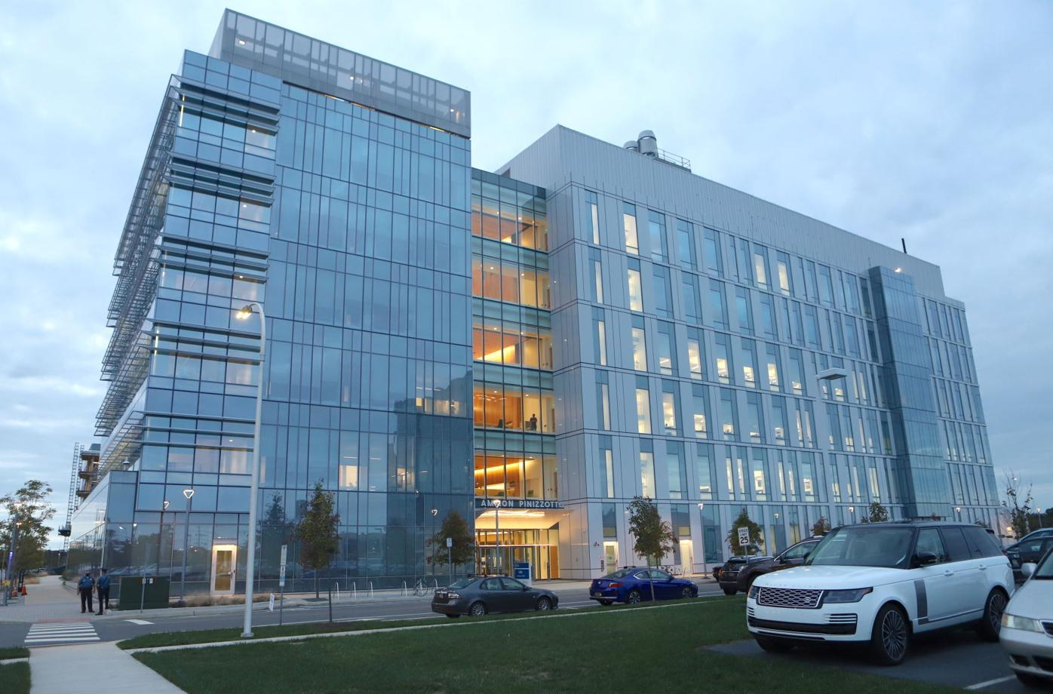


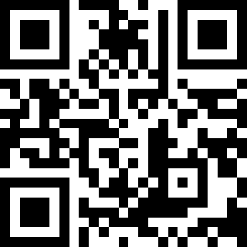
The Chemistry Biology Interface and the Bioinformatics Core present:
Practical AI/ML for Computational Biology and Chemistry Workshop
June 13 - 17, 2022
1:00pm – 5:00pm
Seats are limited, register ASAP using the attached Google form.
Registration is limited to UD students, faculty, and staff. Participants will be contacted later if they have been accepted. Priority will be given to CBI students.
Questions should be directed to:
workshop@bioinformatics.udel.edu
We are excited to announce "Practical AI/ML for Computational Biology and Chemistry" Workshop. This workshop will provide participants with a conceptual understanding of various Artificial Intelligence and Machine Learning (AI/ML) approaches, practical
applications of AI/ML in computational biology and chemistry, and hands-on exercises that emphasize the
importance of data preparation and readiness for AI/ML.
We will give participants opportunity with first-hand experiences on the issues in dealing with data that is not well-prepared. We will cover various data formats, processing and wrangling techniques to get the data into a form where it can be utilized by AI/ML algorithms. We will also teach different visualization techniques to better understand the data at hand. Basic Python programming is recommended but not required. The skills covered in the Data Carpentry Bootcamp that will be held in May 2022 meet this requirement. If you are concerned about this requirement, please contact us.
The workshop will be held in-person on June 13 to 17 from 1:00pm to 5:00pm (see Syllabus) in the Ammon Pinizzotto Biopharmaceutical Innovation Center conference room 140 on STAR Campus.
Register: Google form

