Slide 1
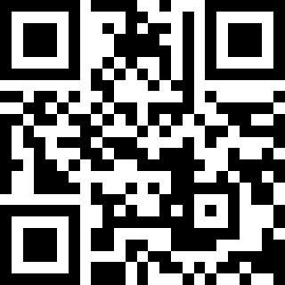
Practical AI/ML for Computational Biology and Chemistry
(Day 1)
Chuming Chen
chenc@udel.edu
Research Associate Professor
Computer and Information Sciences
Center for Bioinformatics and Computational Biology
Data Science Institute
Slides and notebooks: https://github.com/udel-cbcb/al_ml_workshop
June 13, 2022

Slide 2
Introduction to Workshop

Slide 3
Welcome and Roundtable Introduction
Instructors
Chuming Chen
Hongzhan Huang
TAs
Qinghua Wang
Julie Cowart
Manju Anandakrish
Participants

Slide 4
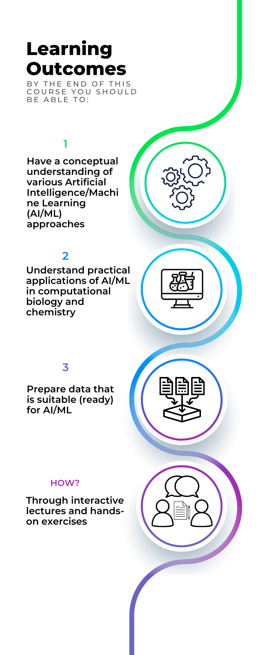
Workshop Outcome and agenda
Day 1: Introduction to AI/ML and Python ML ecosystem, AI/ML applications in computational biology and chemistry
Day 2: Data collection and data preparation, data readiness for AI/ML checklist
Day 3: Feature selection, feature engineering and feature scaling
Day 4: ML model, from its selection to its training, evaluation and tuning
Day 5: Introduction to deep learning
Notes:
This is alternative slide combining slide 4 and 6

Slide 5
Workshop Logistics
June 13 - 17, 2022, 1:00pm – 5:00pm
Ammon Pinizzotto Biopharmaceutical Innovation Center conference room 140
Daily Activities:
Lectures
Live demos (Google Colaboratory)
Hands-on exercises (Google Colaboratory)

Slide 6
Acknowledgement
Cathy Wu
Shawn Polson
Cecilia Arighi
Amelia Harrison
Rita Hayford
Yuqi Wang

