Slide 1
Practical AI/ML for Computational Biology and Chemistry
(Day 2)
Chuming Chen
chenc@udel.edu
Research Associate Professor
Computer and Information Sciences
Center for Bioinformatics and Computational Biology
Data Science Institute
Slides and notebooks: https://github.com/udel-cbcb/al_ml_workshop
June 14, 2022

Slide 2

Lecture outline
Review of Day 1
Data Collection
Data Preparation
Data Readiness for AI/ML Checklist

Slide 3
Review of Day 1
Introduction to AI/ML
Overview of Artificial Intelligence and Machine Learning
Key concepts in AI/ML
Python AI/ML Ecosystem
AI/ML Applications in Biology and Chemistry
Comparison of different AI/ML algorithms
Recommendations for the use of AI/ML strategies for different data types
Multi-omics Data Analysis
Protein structure prediction with AlphaFold
Live Demo
Introduction to Google Colab, NumPy and Pandas
Exercise

Slide 4
Lecture outline
Review of Day 1
Data Collection
Data Preparation
Data Readiness for AI/ML Checklist

Slide 5
Data Collection and Data Preparation

Slide 6
Common Steps of Machine Learning Process
Define the problem
Learning enough about the project to select the framing or framings of the prediction task.
Prepare the data
Transforming the raw data into a form that can be used in modeling
Evaluate the models
Evaluating machine learning models on your dataset.
Finalize the model
Selecting and deploying the final model

Slide 7
What is data?
Refers to examples or cases from the domain that characterize the problem we want to solve.
In supervised learning, data consists of examples where each example has an input that will be provided to the model and an output or target that the model is going to predict.
Output data: a label (classification), a number (regression)
Input data: usually is tabular or structured data (spreadsheet, database table, CSV, TSV)
Row: a single example from the domain, also called an instance, an example or a case.
Column: a single property observed about that example, also called a variable, a predictor or feature.
Input variables: columns in the dataset provided to the model to make a prediction
Output variables: column in the dataset to be predicted by the model

Slide 8
Data Collection
Data collection is where everything begins. Though listed as a step that comes post business understanding and problem definition, data collection often happens in parallel. Of course, data collection takes a formal and better form once the problem statement is defined and the project gets underway.
Data is at the center of everything around us, which is a tremendous opportunity. However, we should realize that data can be present in different formats, shapes, and sizes and exists in systems such as legacy machines (say mainframes), web (say web sites and web applications), databases, flat files, sensors, mobile devices, and so on.

Slide 9
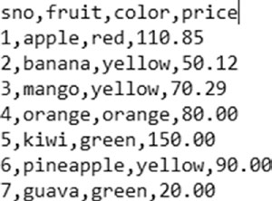
Comma Separated Values (CSV)
A CSV data file is one of the most widely available formats of data. It is also one of the oldest formats still used and preferred by different systems across domains.
Comma Separated Values (CSV) are data files that contain data with each of its attributes delimited by a “,” (a comma). Store tabular data, i.e., data in the form of rows and columns.
A CSV may contain an optional header row (as shown in the example below).
CSVs may also optionally enclose each of the attributes in single or double quotes.
CSVs are usually used to store tabular data, i.e., data in the form of rows and columns.
CSVs come in different variations and just changing the delimiter to a tab makes one a TSV (or a tab separated values) file.

Slide 10
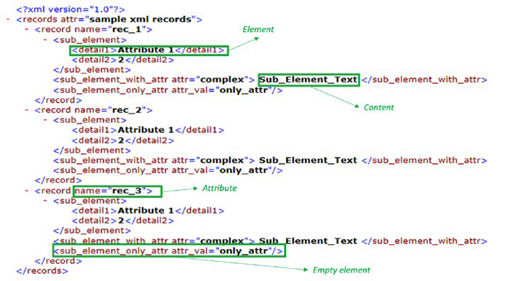
eXtensible Markup Language (XML)
XML is a markup language that defines rules for encoding data/documents to be shared across the Internet.
XML defines rules for encoding data/documents to be shared across the Internet. More details on key concepts and details can be browsed at https://www.w3schools.com/xml/.
XML is a text format that is human readable. Its design goals involved strong support for various human languages (via Unicode), platform independence, and simplicity.
XMLs are widely used as configuration formats by different systems, metadata, and data representation format for services like RSS, SOAP, and many more.

Slide 11
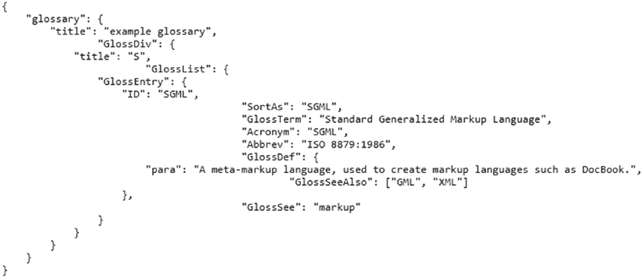
Java Script Object Notation (JSON)
One of the most widely used data interchange formats across the digital realm.
A lightweight alternative to legacy formats like XML.
A text format that is language independent with certain defined conventions.
A human-readable format that is easy/simple to parse in most programming/scripting languages.
A JSON file/object is simply a collection of name(key)-value pairs. Such key-value pair structures have corresponding data structures available in programming languages in the form of dictionaries (Python dict), struct, object, record, keyed lists, and so on. More details are available at http://www.json.org/.

Slide 12
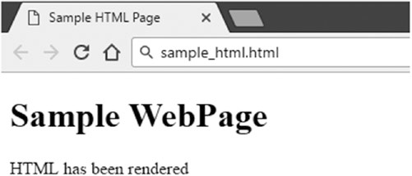
Hyper Text Markup Language (HTML)
A markup language similar to XML. Mainly used by web browsers and similar applications to render web pages for consumption.
Defines rules and structure to describe web pages using markup.
Browsers use markup tags to understand special instructions like text formatting, positioning,
hyperlinks, and so on but only renders the content for the end user to see.
<!DOCTYPE html>
<html>
<head>
<title>Sample HTML Page</title>
</head>
<body>
<h1>Sample WebPage</h1>
<p>HTML has been rendered</p>
</body>
</html>

Slide 13
Web Crawling and Scraping
A technique to scrape or extract data from the web, particularly from web pages.
A typical web scraping flow can be summarized as follows:
Crawl: A bot or a web crawler is designed to query a web server using the required set of URLs to fetch the web pages. A crawler may employ sophisticated techniques to fetch information from pages linked from the URLs in question and even parse information to a certain extent.
Scrape: Once the raw web page has been fetched, the next task is to extract information from it. The task of scraping involves utilizing techniques like regular expressions, extraction based on XPath, or specific tags and so on to narrow down to the required information on the page.

Slide 14
Structured Query Language (SQL)
Data available in the form of tables in databases, or to be more specific, relational databases, comprise of another format of structured data that we encounter when working on different use cases, most of them conforming to the SQL standard.
The most common way used while working on data science and related use cases is to access data using SQL queries directly. To access data using SQL queries, powerful libraries like sqlalchemy and pyodbc provide convenient interfaces to connect, extract, and manipulate data from a variety of relational databases like MS SQL Server, Oracle and so on.
The second way of interacting with databases is the ORM or the Object Relational Mapper method. This method is synonymous to the object oriented model of data, i.e., relational data is mapped in terms of objects and classes. Sqlalchemy provides a high-level interface to interact with databases in the ORM fashion.

Slide 15
Lecture outline
Review of Day 1
Data Collection
Data Preparation
Data Readiness for AI/ML Checklist

Slide 16
Data Description (Types)
Numeric
This is simplest of the data types available. It is also the type that is directly usable and understood by most algorithms.
Numeric data represents scalar information about entities being observed.
Numeric values also form the basis of vector features, where each dimension is represented by a scalar value. The scale, range, and distribution of numeric data has an implicit effect on the algorithm and/or the overall workflow.
Categorical
Categorical variables refer to categories of entities being observed.
Nominal: define only the category of the data point without any ordering possible. e.g., hair color can be black, brown, blonde, etc.
Ordinal: define category but can also be ordered based on rules on the context. e.g., people categorized by economic status of low, medium, or high.

Slide 17
Why raw data needs to be prepared?
Raw data: data in the form provided from the domain
ML algorithms expect numbers
Statistical noise and errors in the data need to be corrected
ML algorithms have specific requirements or expectations
Model performance also depends on the data

Slide 18
Machine Learning is mostly data preparation
Most ML algorithms are well understood and well parameterized and there are standard definitions and implementations
Each ML project is empirically rather than theoretical and require systematic experimentation on data
One thing that changes from project to project is the specific data used in the project

Slide 19
What is data preparation?
Data preparation
A step in predictive modeling project where the raw data must be pre-processed before being use to fit and evaluate a machine learning model.
The goal is to discover how to best expose the underlying structure of the problem to the learning algorithms.
The tasks of data preparation:
Data cleaning: identifying and correcting mistakes or errors in the data
Data transformation: changing the scale or distribution of the input variables
Feature selection: identifying those input variables that are most relevant to the task
Feature engineering: deriving new variables from available data
Dimensionality reduction: creating compact projections of the data

Slide 20
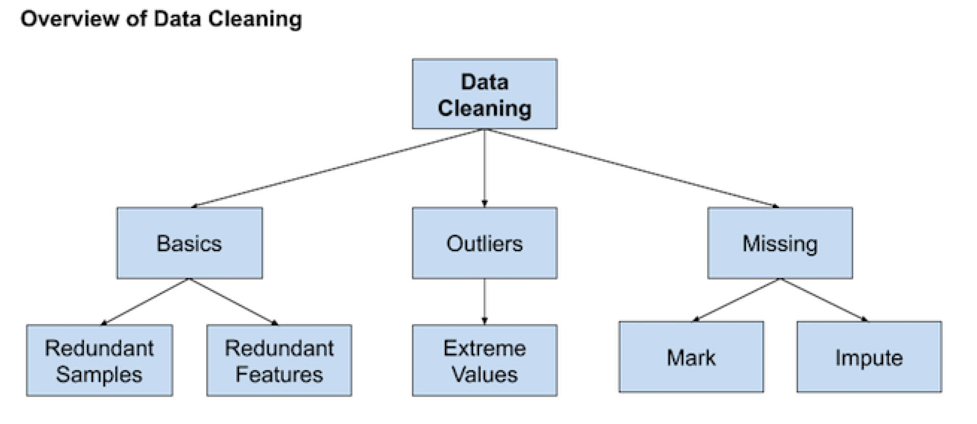
Data Cleaning
Involves fixing systematic problems or errors in messy data.
Involves deep domain expertise.
involve identifying and addressing specific observations that may be incorrect.
(Brownlee, 2020)

Slide 21
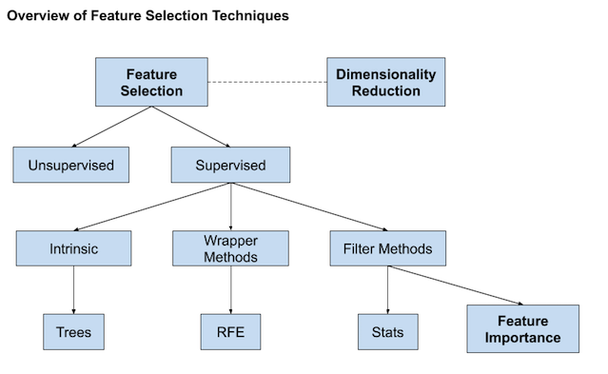
Feature Selection
Techniques for selecting a subset of input features that are most relevant to the target variable that is being predicted.
Irrelevant and redundant input variables can distract or mislead learning algorithms possibly resulting in lower predictive performance.
The goal is to favor the simplest possible well performing model.
(Brownlee, 2020)
Notes:
Feature selection techniques may generally grouped into those that use the target variable
(supervised) and those that do not (unsupervised). Additionally, the supervised techniques
can be further divided into models that automatically select features as part of fitting the
model (intrinsic), those that explicitly choose features that result in the best performing model
(wrapper) and those that score each input feature and allow a subset to be selected (filter).

Slide 22
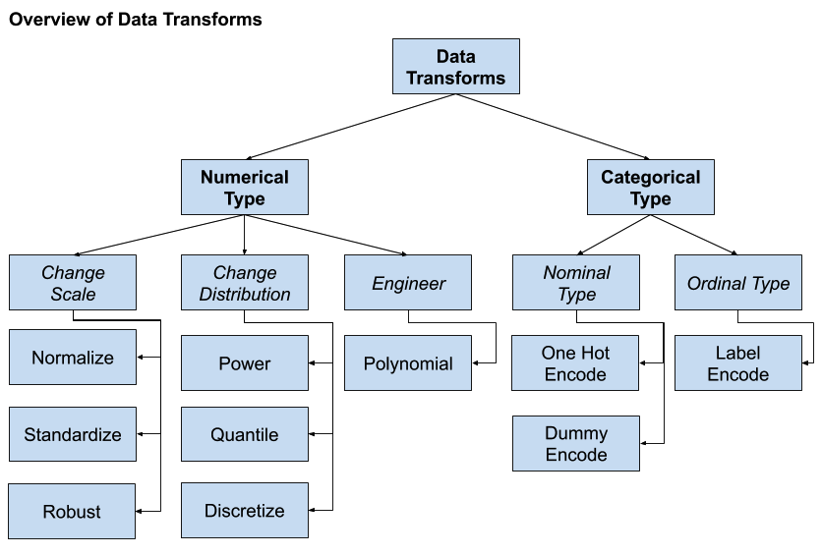
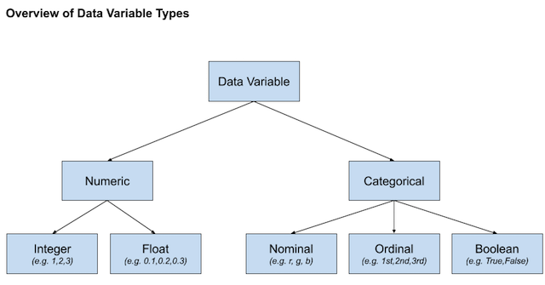
Data Transformation
Change the type or distribution of data variables.
Operations are generally performed separately for each variable.
(Brownlee, 2020)

Slide 23

Feature Engineering
The process of creating new input variables from the available data.
Usually require the collaboration of a subject matter expert to help identify new features.
To add broader context to a single observation or decompose a complex variable in order to provide more straightforward perspectives on the input data.
Popular techniques:
Adding a boolean flag variable for some state.
Adding a group or global summary statistic, such as mean.
Adding new variables for each component of a compound variable, such as a date-time.
Creating copies of numerical input variables that have been changed with a simple mathematical operation.
(Koehrsen, 2018)

Slide 24
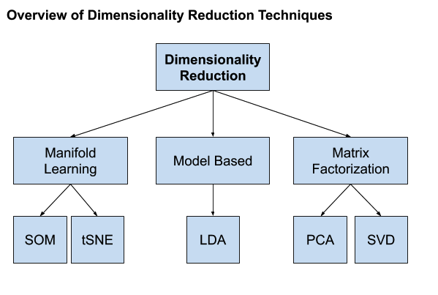
Dimensionality Reduction
The curse of dimensionality: The problem is, the more dimensions (e.g. the more input variables) the dataset has, the more likely it is that the dataset represents a very sparse and likely unrepresentative sampling space.
This motivates creating a projection of the data into a lower-dimensional space that still preserves the most important properties of the original data.
(Brownlee, 2020)

Slide 25
Quiz
How can we handle missing or corrupted dataset?
Drop missing rows or columns
Assign a unique category to missing values
Replace missing values with mean/median/mode
All of the above
✔
Which of the following is not a data transformation method?
Normalization
Imputation
Quantization
One-hot encoding
✔
Which of the following is considered data preparation for AI/ML?
Data cleansing and transformation
Feature engineering and selection
Dimension reduction
All of the above
✔

Slide 26
References
Will Koehrsen. Feature Engineering: What Powers Machine Learning. Nov 12, 2018.
(https://towardsdatascience.com/feature-engineering-what-powers-machine-learning-93ab191bcc2d)
Jason Brownlee. 2020. Data Preparation for Machine Learning. (https://machinelearningmastery.com/data-preparation-for-machine-learning/)
Chirag Goyal. Data Leakage And Its Effect On The Performance of An ML Model. July 23, 2021 (https://www.analyticsvidhya.com/blog/2021/07/data-leakage-and-its-effect-on-the-performance-of-an-ml-model/)

Slide 27
Lecture outline
Review of Day 1
Data Collection
Data Preparation
Data Readiness for AI/ML Checklist

