Slide 1
Practical AI/ML for Computational Biology and Chemistry
(Day 3)
Chuming Chen
chenc@udel.edu
Research Associate Professor
Computer and Information Sciences
Center for Bioinformatics and Computational Biology
Data Science Institute
Slides and notebooks: https://github.com/udel-cbcb/al_ml_workshop
June 15, 2022

Slide 2
Feature Engineering, Scaling, and Selection

Slide 3

Lecture Outline
Review of Day 2
Data, Dataset, Features
Feature Engineering
Feature Scaling
Feature Selection

Slide 4
Review of Day 2
Data Collection
Data formats (e.g., CSV/TSV, XML, JSON, HTML/Web Scraping, SQL)
Data Preparation for ML
Data cleaning
Feature selection
Data transformation
Dimensionality reduction
Data Readiness for AI/ML Checklist
Essential checks, Additional checks, Data preparation
Live Demos
Basic data cleaning
Marking and removal of missing data
Outlier identification and removal
Missing data imputation
Exercise

Slide 5
Lecture Outline
Review of Day 2
Data, Dataset, Features
Feature Engineering
Feature Scaling
Feature Selection

Slide 6
Data and Dataset
Data
a collection or set of qualitative and/or quantitative variables containing values based on observations.
Usually collected in its raw form which can then be processed further and analyzed as required.
structured having definite rows and columns indicating observations and attributes or unstructured like free textual data.
Dataset
A collection of data in the form of flat files like CSV, Excel, relational database tables or views etc.
Popular datasets for ML can be found in scikit-learn package, UC Irvine Machine Learning repository, Kaggle

Slide 7
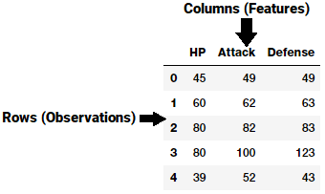
Features
Each feature is an individual measurable attribute, depicted as a column in a 2D dataset
Each observation is a row and each feature will have a specific value for an observation
Each row typically indicates a feature vector and entire set of features across all the observations is called a feature set.
Inherent raw features are obtained directly from the dataset without data manipulation or engineering.
Derived features are usually obtained from feature engineering from existing data attributes.
(Sarkar et al. 2018)

Slide 8
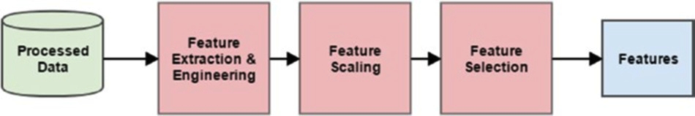
How to handle data features?
Major essential steps:
Feature extraction and engineering
Feature scaling
Feature selection
(Sarkar et al. 2018)

Slide 9
Lecture Outline
Review of Day 2
Data, Dataset, Features
Feature Engineering
Feature Scaling
Feature Selection

Slide 10
What is feature engineering?
“Feature engineering is the process of transforming raw data into features that better
represent the underlying problem to the predictive models, resulting in improved model accuracy on unseen data.” - Dr. Jason Brownlee
Raw data: data in its native form after data retrieval from source. Typically, some data processing and wrangling is also done.
Features: specific representations of raw data after the process of feature engineering
The underlying problem:The problem we want to solve or the ML task we want to perform.
The predictive models: the ML models that learn about the data.
Model accuracy: model performance metrics that are used to evaluate the model.
Unseen data: new data not used previously to build or train the model. The model is expected to learn and generalize well from unseen data using good quality features.

Slide 11
Why do we need to do feature engineering?
Better representation of data can be better understood by the ML algorithms.
In general if you have the right feature set, even a simple model will perform well.
Raw data cannot be used to build ML models. Feature engineering is essential for model building and evaluation.
Feature engineering helps us build models on diverse data types therefore enables us to work on complex unstructured data.
Feature engineering enables data scientists to take a step back and try to understand the domain and the business problem better by taking inputs from domain experts.

Slide 12

How to engineer features?
It involves using a combination of domain knowledge and business constraints, hand-crafted transformations and mathematical transformations to transform the raw data into desired features.
Different data types need different techniques for feature extraction
Numeric, Categorical, Text, Temporal, Audio/Video/Image data
Recently, auto feature generation becomes popular. It uses Deep Learning to make the machine detect patterns and extract useful data representations from the raw data directly and use them as features.
Convolutional neural networks (CNNs)
Recurrent neural networks (RNNs)
Long Short Term Memory networks (LSTMs)
(Koehrsen, 2018)

Slide 13
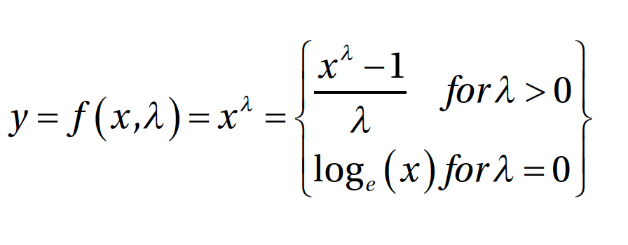
Feature engineering on numeric data
Raw measures
Values: average, standard deviation, quartiles
Counts: frequencies and occurrences of specific attributes
Binarization: binary feature is preferred as opposed to a count base measure.
Rounding: round off high precision percentages into numeric integers
Interactions: capture the interactions between feature variables as a part of the input feature set
Binning: also called quantization. It is the operation to transform continuous numeric values into discrete ones.
Fixed-Width Binning: use pre-defined fixed widths for each bin
Adaptive Binning: use data distribution itself (Quantile) to decide the appropriate bins.
Statistical or Mathematical Transformation
Log Transformation
Box-Cox Transformation

Slide 14
Feature engineering on categorical data
Nominal Features: Nominal categorical features usually have a finite set of distinct discrete values without ordering among the values
Ordinal Features: Ordinal features are similar to nominal features except that order matters.
Encoding Categorical Features: The ML models will directly interpret transformed numeric representations of categorical features as raw numeric features and their magnitude will be wrongly interpreted.
One Hot Encoding: Encode a feature with m distinct labels into m binary features. Each observation is converted into a vector of size m with only one of the values of 1.
Dummy Encoding: Encoe a feature with m distinct labels to get m-1 binary features, such that each value gets converted into a vector of size m-1. 0th or m-1th feature will be all 0s.
Effect Coding: Similar to Dummy Encoding, all 0s is replaced with -1s.
Bin-Counting: useful for dealing with categorical variables with many categories. We use probability based statistical information instead of using the actual label values for encoding.
Feature Hashing: a hash function is typically used with the number of encoded features pre-set (as a vector of pre-defined length) such that the hashed values of the features are used as indices in this pre-defined vector and values are updated accordingly.

Slide 15
Feature engineering on text data
Text Pre-Processing: Text tokenization, special characters removal, contraction expansion, stopwords removal, spelling correction, stemming, lemmatization
Bag of Words Model: convert text documents into numeric vectors.
Bag of N-Grams Model: Take into account phrases or collection of words
TF-IDF Model: uses a combination of term frequency (tf) and inverse document frequency (idf) as scaling or normalization factor on frequently occurring terms
Document Similarity:
Search engines, document clustering, information retrieval
cosine distance/similarity, BM25 distance, jaccard distance
Topic Models: use summarization techniques to extract key themes or concepts from documents as topics
Latent Semantic Indexing (LSI) uses matrix decomposition like SVD
Latent Dirichlet Allocation (LDA) uses generative probabilistic models
Word Embeddings: word2vec (NN-based, Bag of Words and Skip-Grams)

Slide 16
Feature engineering on temporal data
Datasets that most attributes are time based and changed over time
Date-Based Features:
Each temporal value has a date component that can be used to extract useful information and features related to the date.
Time-Based Features:
Each temporal value has a time component that can be used to extract useful information and features related to the time.

Slide 17
Feature engineering on Image data
Image Metadata Features (EXIF)
Raw Image and Channel Pixels
Grayscale Image Pixels
Binning Image Intensity Distribution
Image Aggregation Statistics
Edge Detection
Object Detection
Localized Feature Extraction
Visual Bag of Words Model
Automated Feature Engineering with Deep Learning

Slide 18
Lecture Outline
Review of Day 2
Data, Dataset, Features
Feature Engineering
Feature Scaling
Feature Selection

Slide 19
Feature Scaling
When dealing with numeric features, we have specific attributes which may be completely unbounded in nature, like view counts of a video or web page hits.
Using the raw values as input features might make models biased toward features having really high magnitude of values.
Models such linear or logistic regression are typically sensitive to the magnitude or scale of features.
Tree based models can still work without feature scaling. However it is still recommended to normalize and scale down the features with feature scaling, especially if you want to try out multiple Machine Learning algorithms on input features.

Slide 20
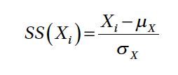
Standardized Scaling
The standard scaler tries to standardize each value in a feature column by removing the mean and scaling the variance to be 1 from the values. This is also known as centering and can be denoted mathematically as
where each value in feature X is subtracted by the mean μ_{X} and the resultant is divided by the standard deviation σ_{X}. This is also popularly known as Z-score scaling. You can also divide the resultant by the variance instead of the standard deviation if needed.

Slide 21
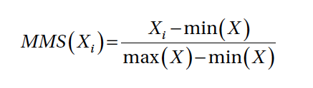
Min-Max Scaling
With min-max scaling, we can transform and scale our feature values such that each value is within the range of [0, 1]. However the MinMaxScaler class in scikit-learn also allows you to specify your own upper and lower bound in the scaled value range using the feature_range variable. Mathematically we can represent this scaler as
where we scale each value in the feature X by subtracting it from the minimum value in the feature min(X) and dividing the resultant by the difference between the maximum and minimum values in the feature max(X) - min (X).

Slide 22

Robust Scaling
The disadvantage of min-max scaling is that often the presence of outliers affects the scaled values for any feature. Robust scaling tries to use specific statistical measures to scale features without being affected by outliers. Mathematically this scaler can be represented as
where we scale each value of feature X by subtracting the median of X and dividing the resultant by the IQR also known as the Inter-Quartile Range of X which is the range (difference) between the first quartile (25th %ile) and the third quartile (75th %ile).

Slide 23
Lecture Outline
Review of Day 2
Data, Dataset, Features
Feature Engineering
Feature Scaling
Feature Selection

Slide 24
Feature Selection
Dealing with a large number of features bring us to the concept of the curse of dimensionality. More features tend to make models more complex and difficult to interpret. Besides this, it can often lead to models over-fitting on the training data. The ultimate objective is to select an optimal number of features to train and build models that generalize very well on the data and prevent overfitting.
Feature selection strategies:
Filter methods:
Select features based on metrics such as correlation, mutual information etc.
Threshold based and statistical tests methods
Wrapper methods:
Capture interactions between multiple features using a recursive modeling with subset of features and select the best subset features give the best performing model
Backward selecting and forward elimination methods
Embedded methods:
Combine the benefits of the above two methods by using ML models themselves to rank and score features variables based on their importance.
Decision trees and random forests methods.

Slide 25
Threshold Based Feature Selection
This is a filter based feature selection strategy, where you can use some form of cut-off or thresholding for limiting the total number of features during feature selection.
Thresholds can be of various forms. Some of them can be used during the feature engineering process itself, where you can specify threshold parameters.
A simple example of this would be to limit feature terms in the Bag of Words model, which we used for text based feature engineering.
Another way of using thresholds is to use variance based thresholding where features having low variance (below a user-specified threshold) are removed. This signifies that we want to remove features that have values that are more or less constant across all the observations in our datasets.

Slide 26
Statistical Based Feature Selection
Another widely used filter based feature selection method, which is slightly more sophisticated, is to select features based on univariate statistical tests.
You can use several statistical tests for regression and classification based models including mutual information, ANOVA (analysis of variance) and chi-square tests.
Based on scores obtained from these statistical tests, you can select the best features on the basis of their score.

Slide 27
Recursive Feature Elimination
You can also rank and score features with the help of a Machine Learning based model estimator such that you recursively keep eliminating lower scored features till you arrive at the specific feature subset count.
Recursive Feature Elimination, also known as RFE, is a popular wrapper based feature selection technique, which allows you to use this strategy.
The basic idea is to start off with a specific Machine Learning estimator like the Logistic Regression algorithm. Next we take the entire feature set and the corresponding response class variables. RFE aims to assign weights to these features based on the model fit. Features with the smallest weights are pruned out and then a model is fit again on the remaining features to obtain the new weights or scores.
This process is recursively carried out multiple times and each time features with the lowest scores/weights are eliminated, until the pruned feature subset contains the desired number of features that the user wanted to select (this is taken as an input parameter at the start). This strategy is also popularly known as backward elimination.

Slide 28
Model Based Feature Selection
Tree based models like decision trees and ensemble models like random forests (ensemble of trees) can be utilized not just for modeling alone but for feature selection.
These models can be used to compute feature importances when building the model that can in turn be used for selecting the best features and discarding irrelevant features with lower scores.
Random forest is an ensemble model. This can be used as an embedded feature selection method, where each decision tree model in the ensemble is built by taking a training sample of data from the entire dataset.
This sample is a bootstrap sample (sample taken with replacement). Splits at any node are taken by choosing the best split from a random subset of the features rather than taking all the features into account. This randomness tends to reduce the variance of the model at the cost of slightly increasing the bias. Overall this produces a better and more generalized model.

Slide 29
Quiz
Which of the following is not feature scaling method?
Standardized
Min-Max
Robust
Binning
✔
Which of the following is feature engineering method?
Rounding
Dummy encoding
Quantization
Feature hashing
✔
Which of the following are feature selection strategies?
Filter method
Wrapper method
Embedded method
All of the above
✔

Slide 30
References
Dipanjan Sarkar, Raghav Bali and Tushar Sharma. 2018. Practical Machine Learning with Python. A Problem-Solver's Guide to Building Real-World Intelligent Systems. Apress. (https://doi.org/10.1007/978-1-4842-3207-1), Chapter 4.

