Slide 1
DASM-AFP: Computer-based Document Archiving and Security Management for Armed Forces of the Philippines
Angelo Kyle S. Pinlac
Cherish Love A. Faeldin
Dominic Anthony M. Rabano
May Ann R. Villadar
DASM-AFP: Computer-based Document Archiving and Security Management for Armed Forces of the Philippines

Slide 2
PROJECT CONTEXT
The AFP handles massive volumes of sensitive records daily, including personnel files, medical histories, and operational documents.
Current Challenges
  Most records are maintained through traditional manual filing methods using physical folders and filing cabinets.
DASM-AFP: Computer-based Document Archiving and Security Management for Armed Forces of the Philippines

Slide 3
Operational Vulnerabilities
  Paper-based records are fragile and vulnerable to humidity, heat, water damage, misplacement, and permanent loss.
Administrative Inefficiencies
  Manual searching through paper files is time-consuming, slows productivity, and creates workflow bottlenecks.
DASM-AFP: Computer-based Document Archiving and Security Management for Armed Forces of the Philippines

Slide 4
Security Concerns
  Physical filing systems lack proper monitoring, audit trails, and robust access control for classified information.
Proposed Solution
  Develop a Document Scanning and Access Control Management System to digitize, secure, and centralize AFP records.
DASM-AFP: Computer-based Document Archiving and Security Management for Armed Forces of the Philippines

Slide 5
Why the Study is Important?
Importance to AFP
  Protect sensitive military records
  Improve office efficiency
  Modernize record management
  Strengthen information security
Expected Benefits
  Faster retrieval of files
  Secure centralized storage
  Better monitoring of document access
  Reduced paperwork
DASM-AFP: Computer-based Document Archiving and Security Management for Armed Forces of the Philippines

Slide 6
OBJECTIVES
General Objective
To develop a secure Document Scanning and Access Control Management System for AFP.
Specific Objectives
Digitize physical documents
Provide centralized storage
Implement role-based access control
Enable quick document retrieval
Reduce paperwork and improve efficiency
DASM-AFP: Computer-based Document Archiving and Security Management for Armed Forces of the Philippines

Slide 7
SCOPE AND LIMITATIONS
Scope:
The system can:
  Scan and upload documents
  Store files digitally
  Organize records by category/department
  Allow authorized access
  Search and retrieve documents quickly
  Operate within the AFP local network
DASM-AFP: Computer-based Document Archiving and Security Management for Armed Forces of the Philippines

Slide 8
SCOPE AND LIMITATIONS
Limitations:
  No internet or cloud access
  No mobile accessibility
  Manual document scanning only
  No OCR feature
  Requires stable hardware and electricity
  System depends on administrator maintenance
DASM-AFP: Computer-based Document Archiving and Security Management for Armed Forces of the Philippines

Slide 9
RELATED LITERATURE
Foreign Literature and Studies
Document Archiving Systems
  According to Document Logistix (2024):
    Digital archiving improves long-term document preservation
    Organized indexing improves retrieval efficiency
    Supports legal and audit requirements
Data Security in Archiving
  MES Hybrid Document Systems (2024):
    Encryption enhances data security
    Role-based access prevents unauthorized access
    Digital systems reduce security risks
DASM-AFP: Computer-based Document Archiving and Security Management for Armed Forces of the Philippines

Slide 10
RELATED LITERATURE
Local Literature and Studies
RA 9470 Compliance
  National Archives Act emphasizes:
    Proper records management
    Preservation of government documents
Local Archiving Issues
  Gamba et al. (2024):
    Manual filing causes document degradation
    Humidity and environmental factors damage records
DASM-AFP: Computer-based Document Archiving and Security Management for Armed Forces of the Philippines

Slide 11
RELATED LITERATURE
Synthesis
Foreign Studies Contributed:
  Security standards
  Digital archiving practices
  Role-based access control
Local Studies Contributed:
  Need for modernization
  Legal compliance requirements
  Protection against environmental damage
DASM-AFP: Computer-based Document Archiving and Security Management for Armed Forces of the Philippines

Slide 12
RELATED LITERATURE
Research Gap
  Existing systems:
    Lacks localized AFP-focused implementation,
    has limited access control,
    and is not designed for secure military document handling
Contribution of the Proposed System
  The study provides:
    centralized document management,
    secure access control,
    organized digital archiving,
    and AFP-focused implementation
DASM-AFP: Computer-based Document Archiving and Security Management for Armed Forces of the Philippines

Slide 13
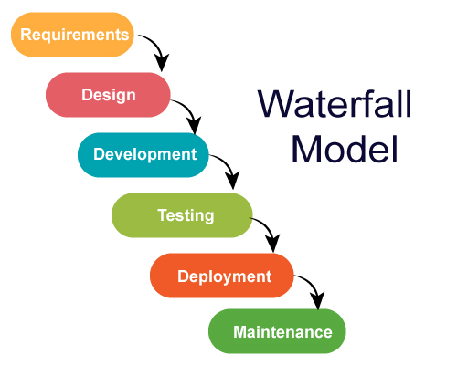
METHODOLOGY
DASM-AFP: Computer-based Document Archiving and Security Management for Armed Forces of the Philippines

Slide 14
METHODOLOGY
Waterfall Model
The study uses the Waterfall Model as the software development methodology.
Reason for Choosing Waterfall
  Requirements are clearly defined
  Structured and sequential process
  Suitable for secure system development
  Easier monitoring and documentation
DASM-AFP: Computer-based Document Archiving and Security Management for Armed Forces of the Philippines

Slide 15
WATERFALL MODEL PHASES
Phases of Development
Requirements Analysis
  Gather system requirements
  Analyze the document handling process
  Identify security requirements
2. System Design
  Design database structure
  Create system architecture
  Design user interface
3. Implementation
  Develop system features
  Integrate scanning and access control
DASM-AFP: Computer-based Document Archiving and Security Management for Armed Forces of the Philippines

Slide 16
WATERFALL MODEL PHASES
Phases of Development
4. Testing
  Verify functionality and security
  Detect and fix errors
5. Deployment
  Install the system in the local network
6. Maintenance
  Monitor system performance
  Apply updates and fixes
DASM-AFP: Computer-based Document Archiving and Security Management for Armed Forces of the Philippines

Slide 17
OVERVIEW OF CURRENT TECHNOLOGIES TO BE USED
Frontend Technologies.
  NET MAUI Blazor
Backend and Database
  Microsoft SQL Server
Security Features
  User Authentication
  Role-Based Access Control
Environment
  Local Area Network (LAN)
DASM-AFP: Computer-based Document Archiving and Security Management for Armed Forces of the Philippines

Slide 18
Development Tools and Functions
Technology | Purpose
.NET MAUI Blazor | Cross-platform application development and User interface development
Microsoft SQL Server | Database management
LAN Environment | Secure local deployment
DASM-AFP: Computer-based Document Archiving and Security Management for Armed Forces of the Philippines

Slide 19
SYSTEM SECURITY IMPLEMENTATION
Security Implementation
  Authentication
    Secure login system
    Username and password verification
  Access Control
    Role-based permissions
    View/Edit restrictions
DASM-AFP: Computer-based Document Archiving and Security Management for Armed Forces of the Philippines

Slide 20
SYSTEM SECURITY IMPLEMENTATION
Security Implementation
  Data Protection
    Centralized document storage
    Controlled access management
  Audit and Accountability
    User activity monitoring
DASM-AFP: Computer-based Document Archiving and Security Management for Armed Forces of the Philippines

Slide 21
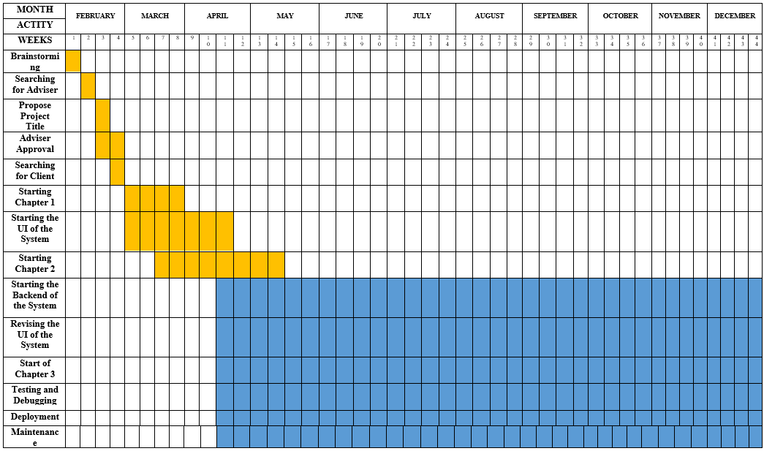
CALENDAR OF ACTIVITIES (GANTT CHART)
DASM-AFP: Computer-based Document Archiving and Security Management for Armed Forces of the Philippines

Slide 22
RESOURCES (SOFTWARE)
Software/Tool | Purpose
.NET MAUI | Cross-platform application development
Blazor Framework | Interactive user interface
Microsoft SQL Server | Database management
Visual Studio IDE | Coding and debugging
Windows OS | Development environment
Microsoft Office | Documentation
Figma | UI/UX prototyping
DASM-AFP: Computer-based Document Archiving and Security Management for Armed Forces of the Philippines

Slide 23
DESIGN OF SOFTWARE, SYSTEM, PRODUCT, AND/OR PROCESSES
DASM-AFP: Computer-based Document Archiving and Security Management for Armed Forces of the Philippines

Slide 24
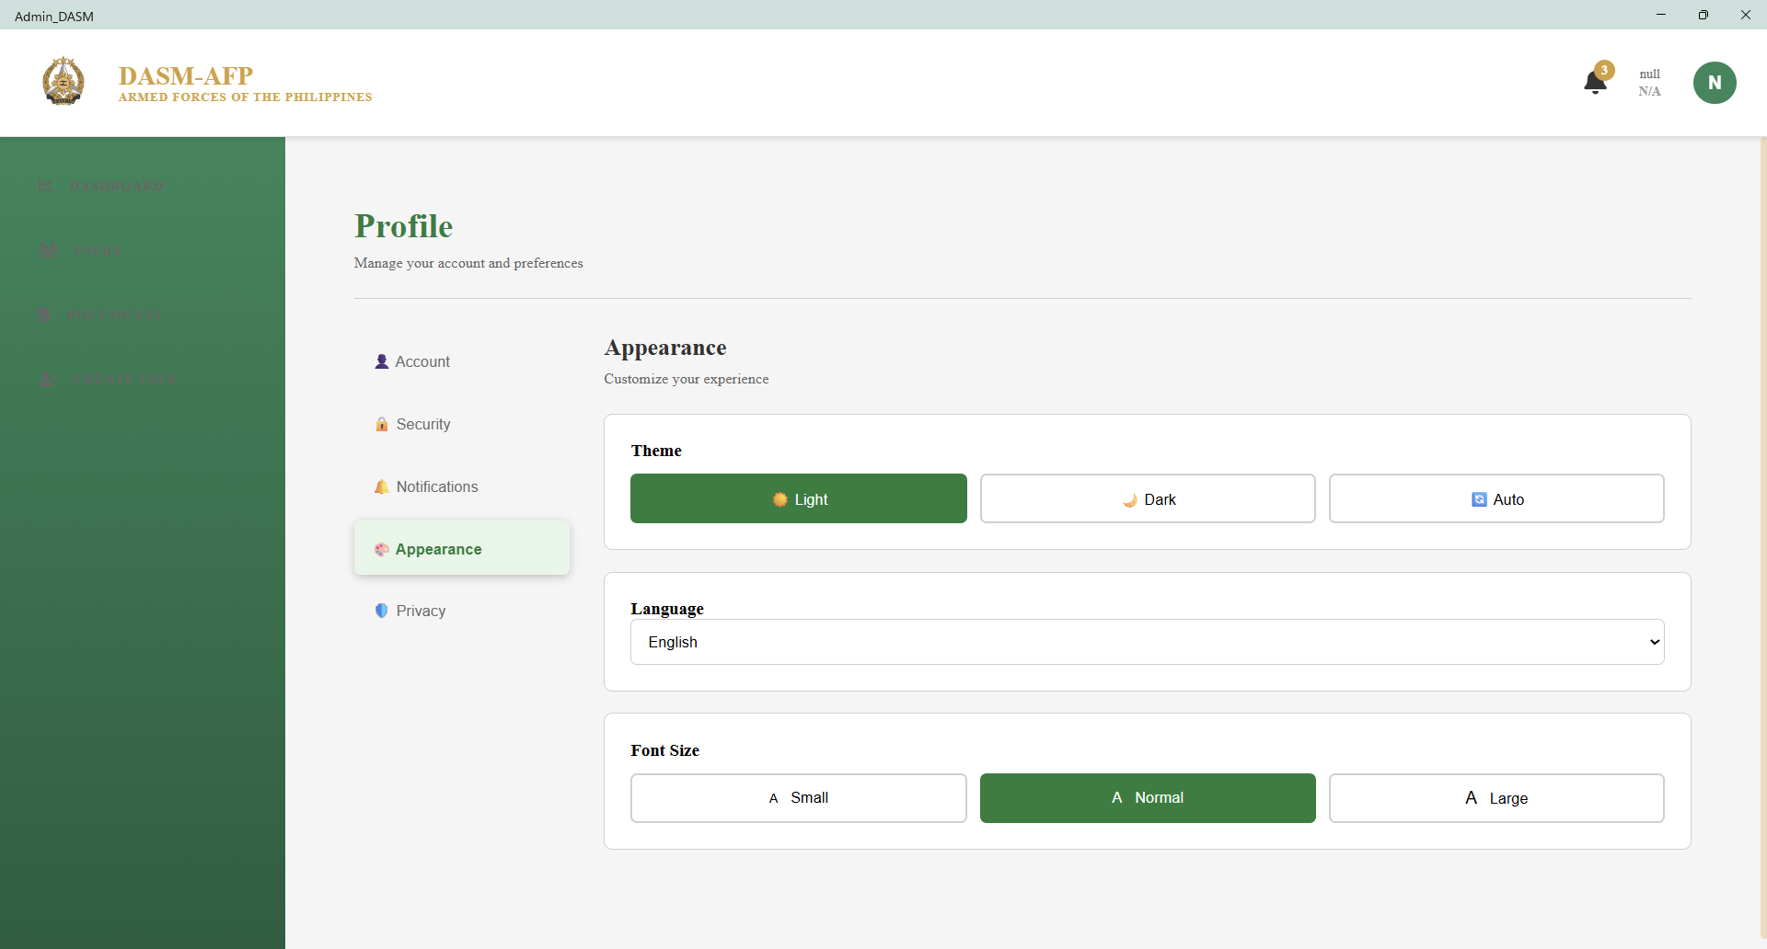
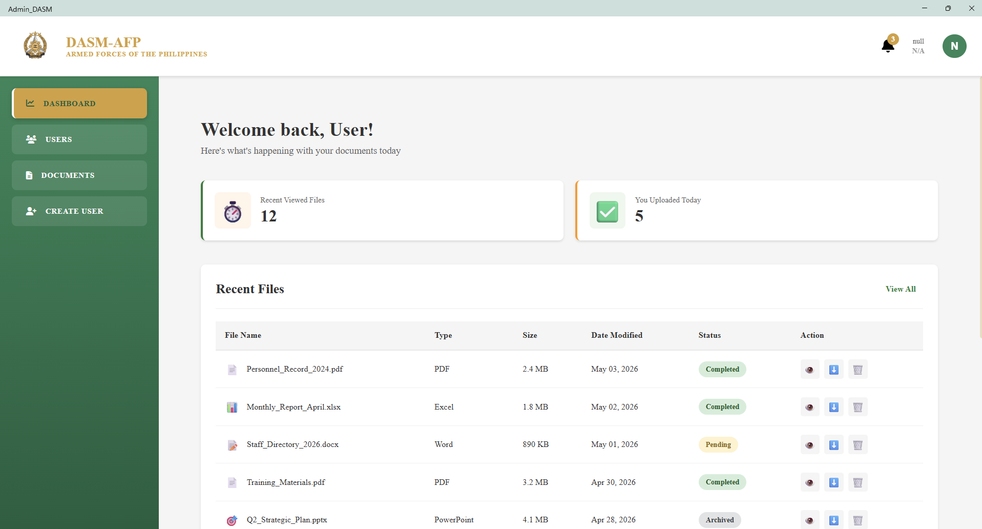
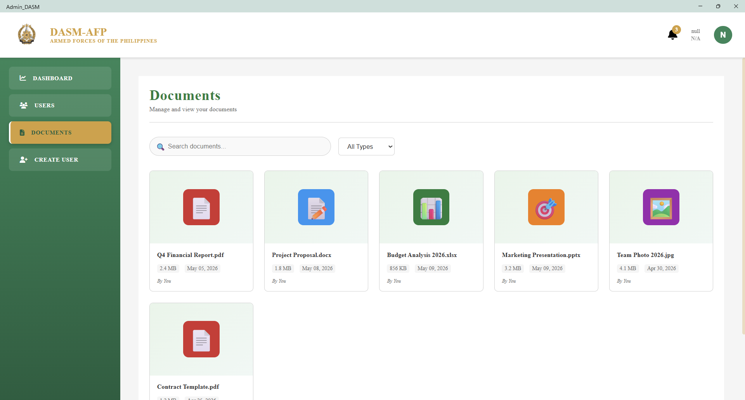
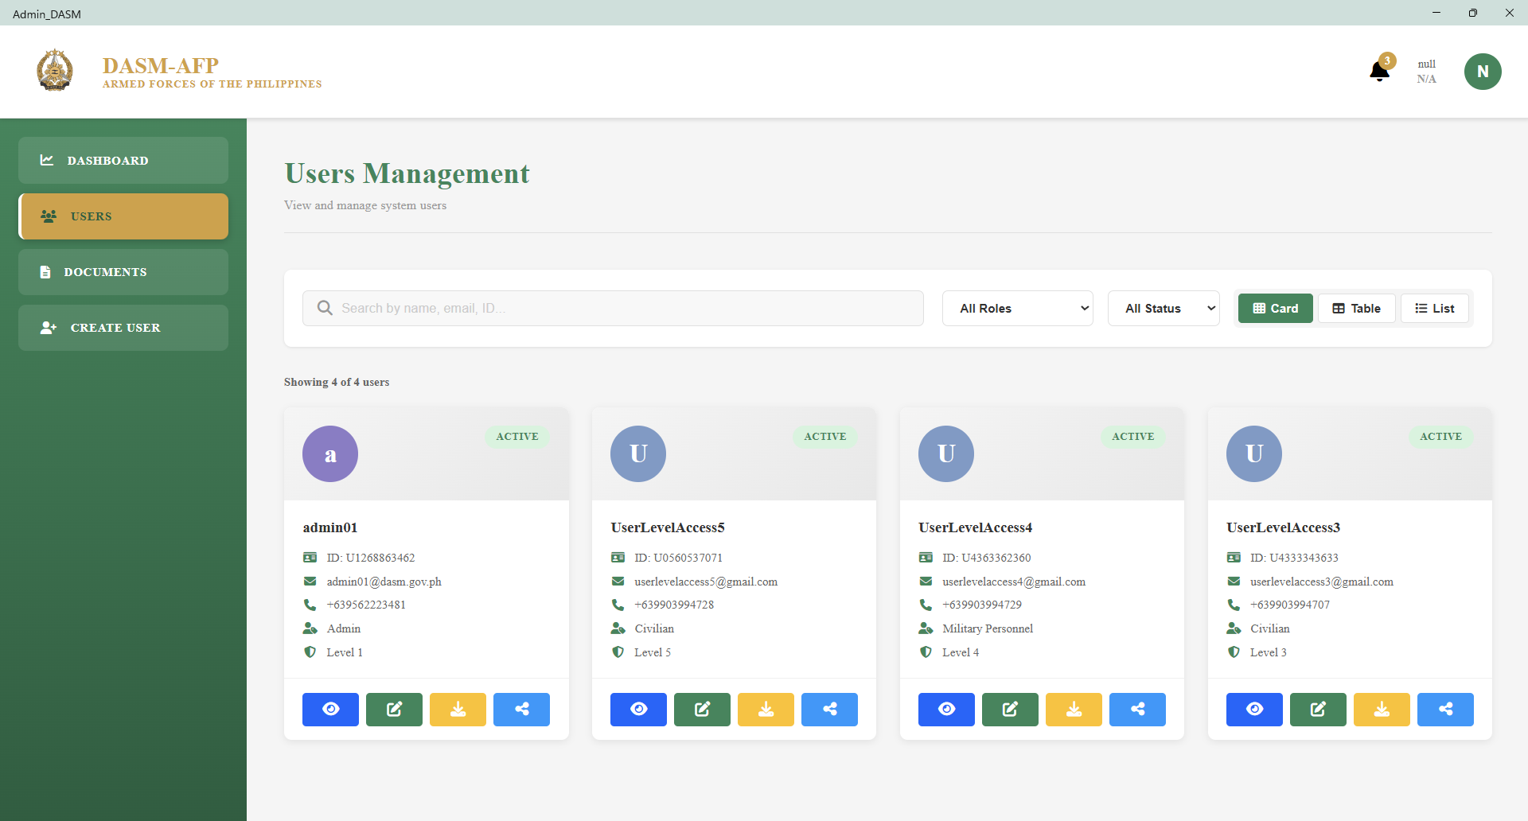
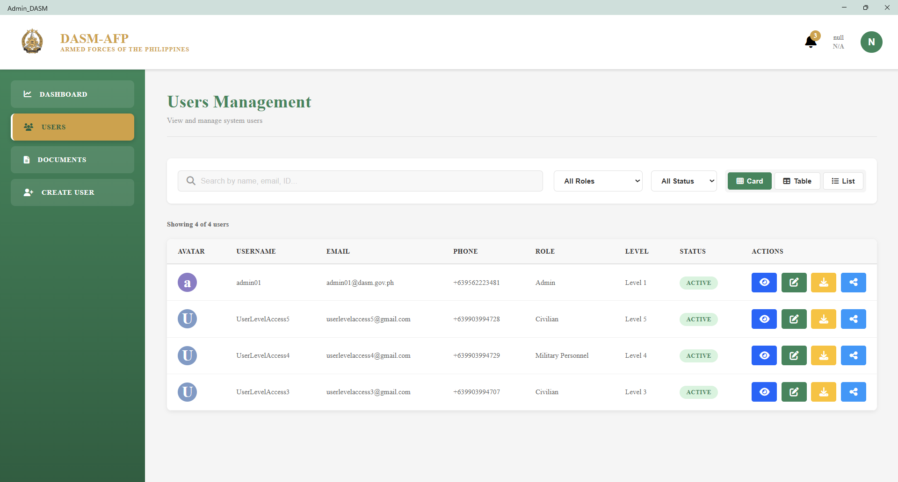
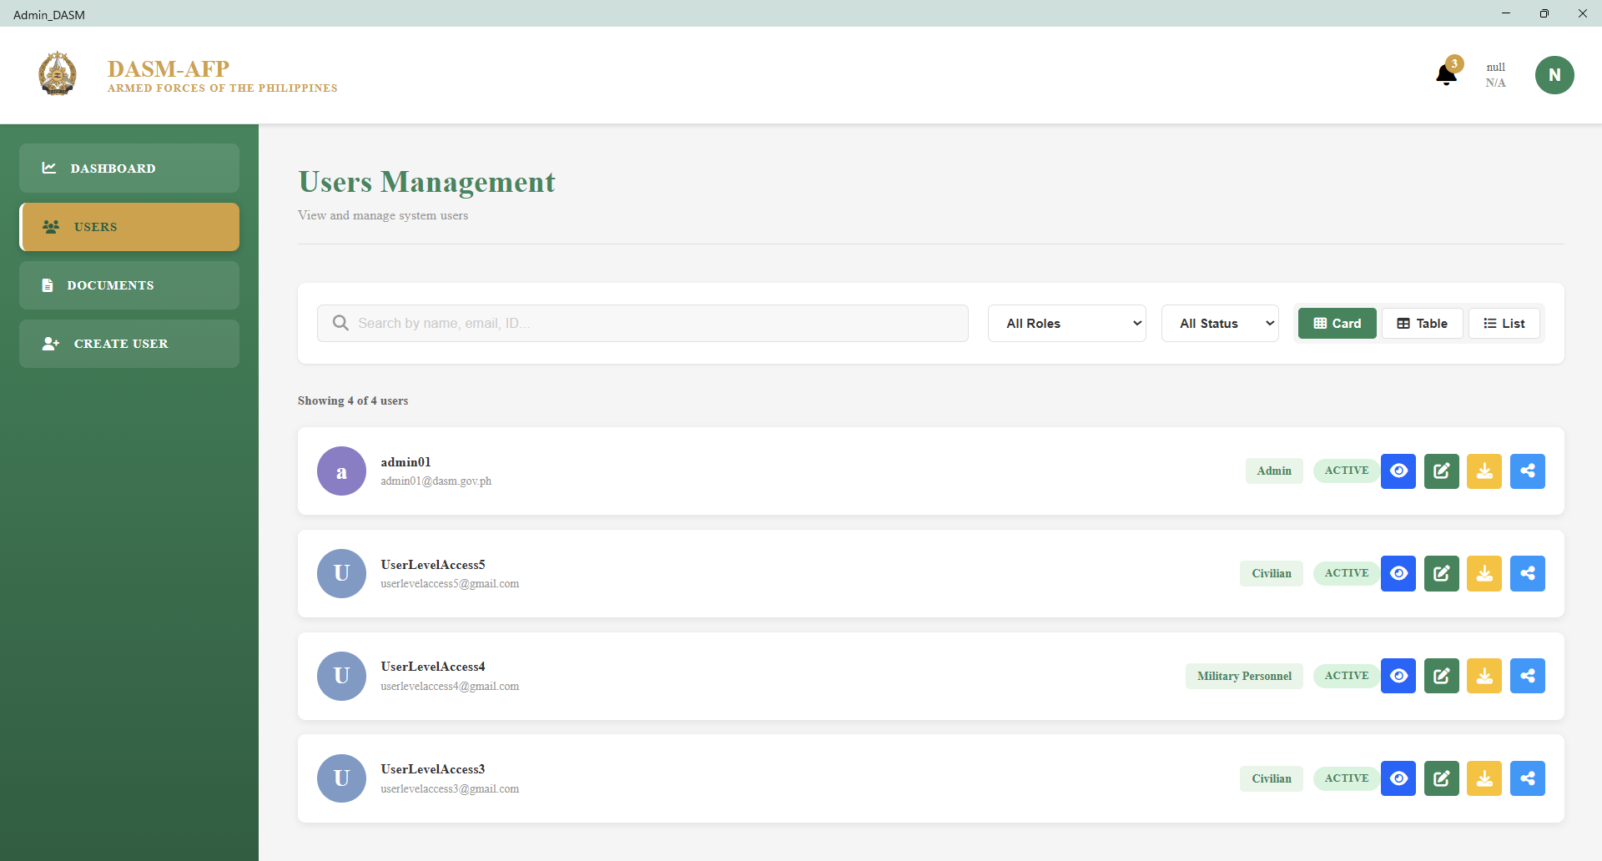
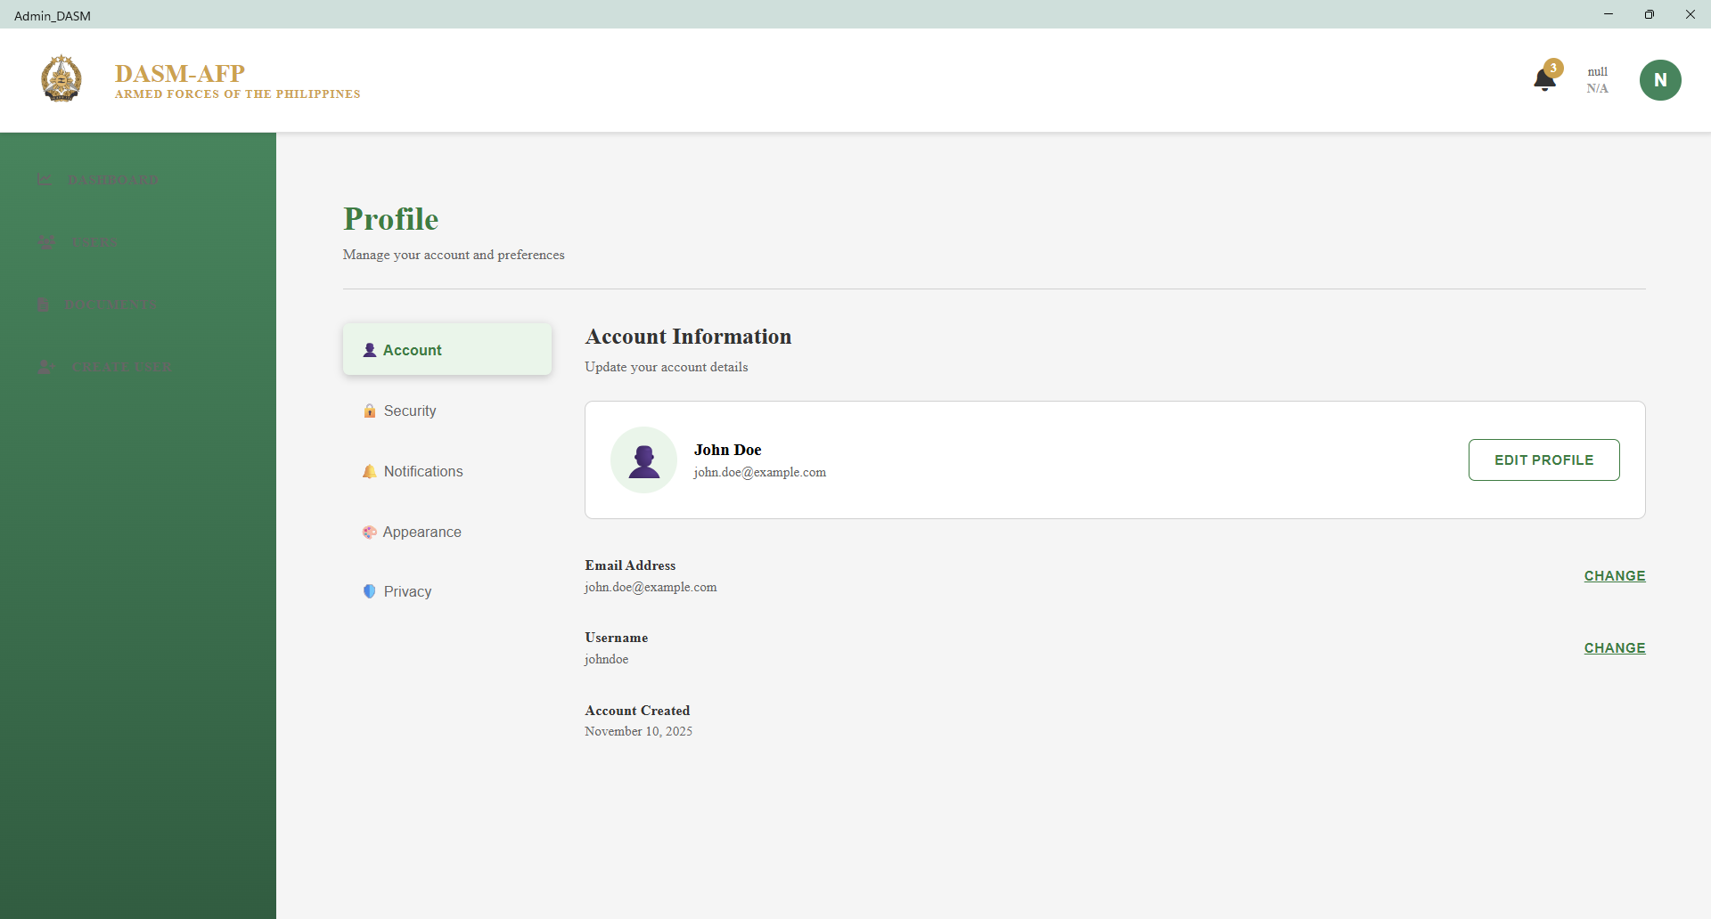
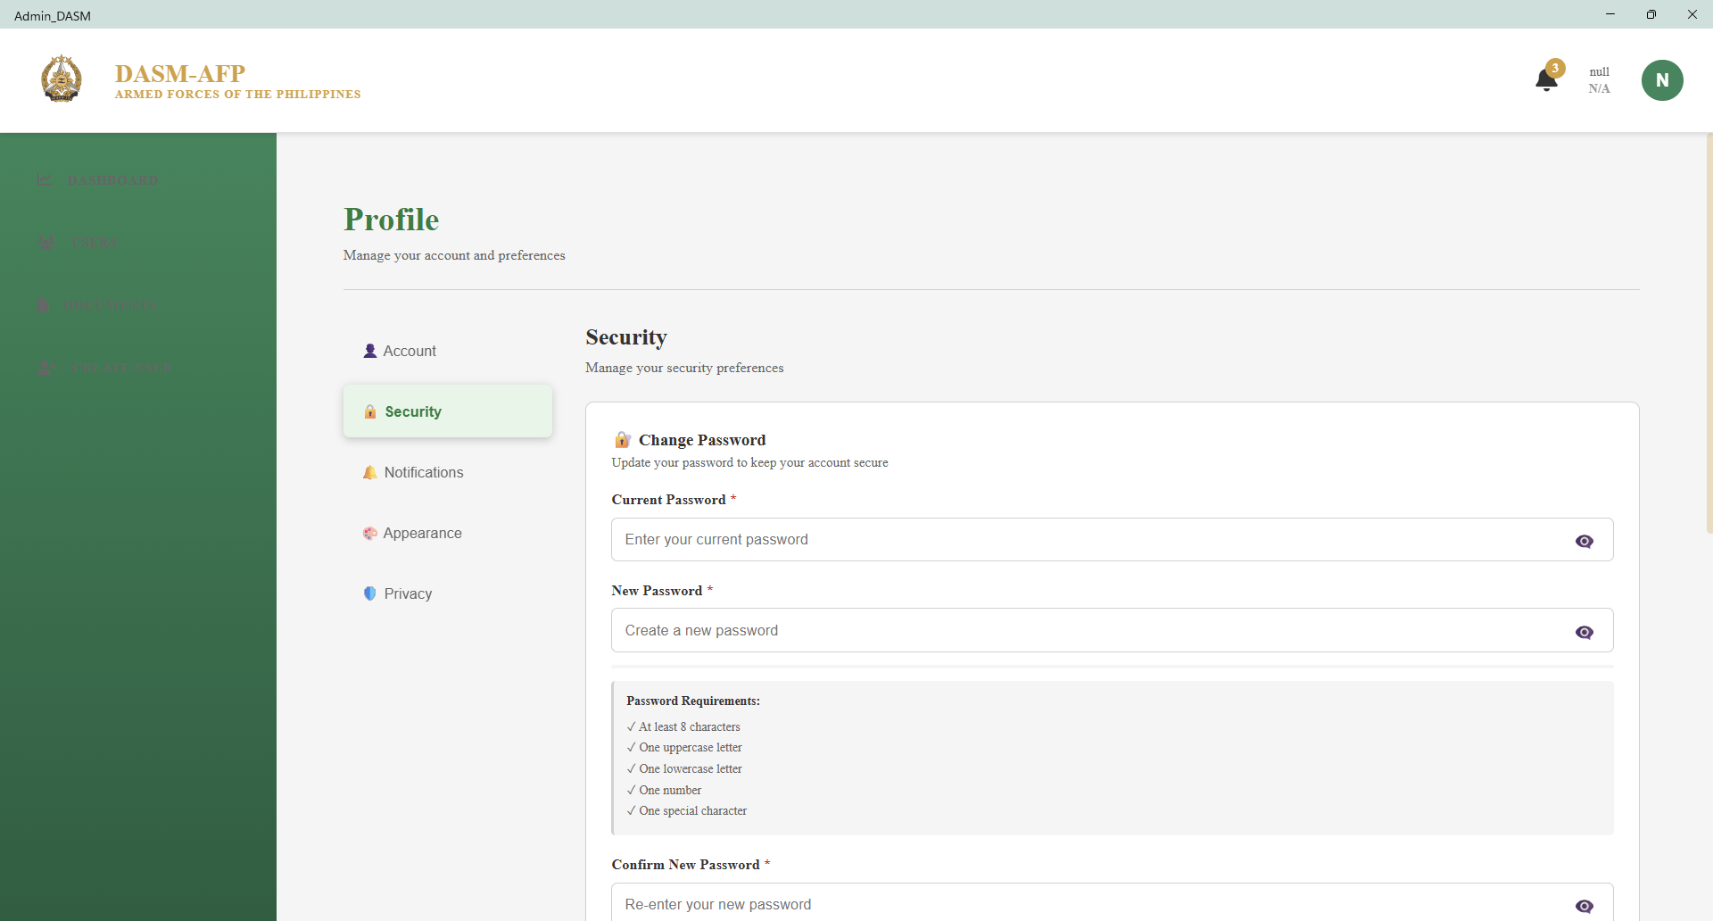
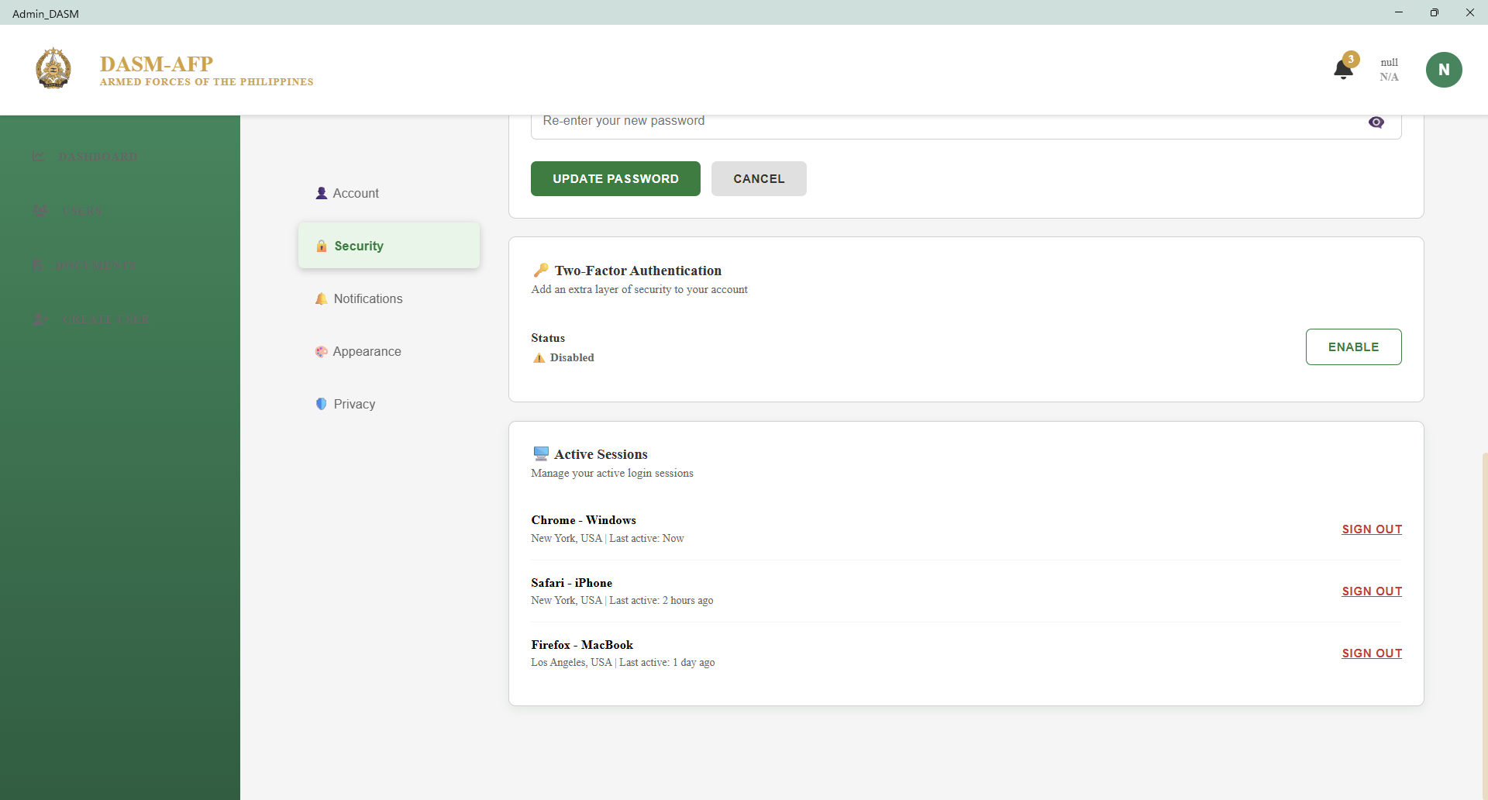
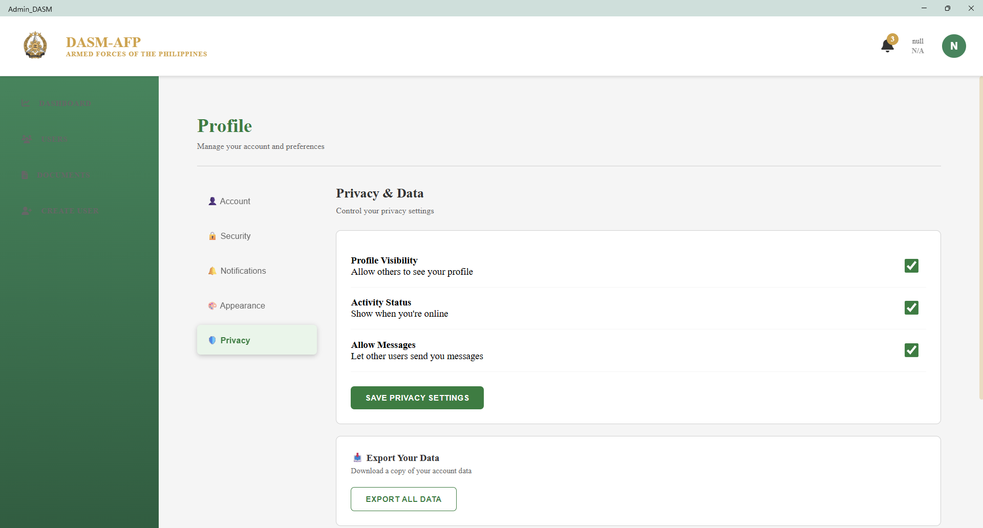
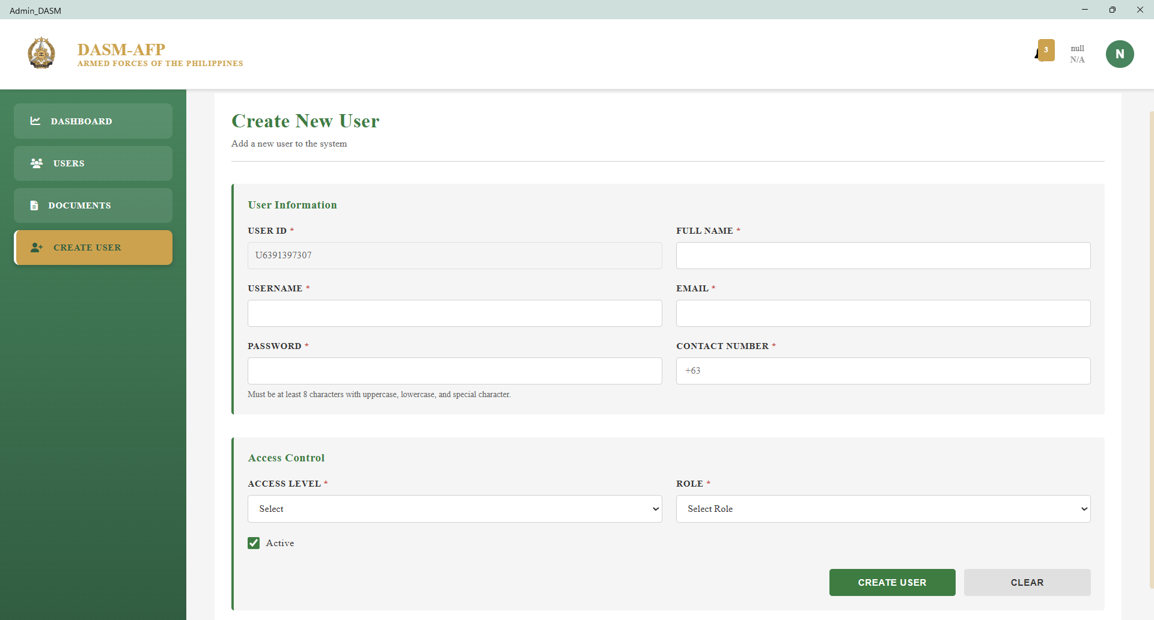
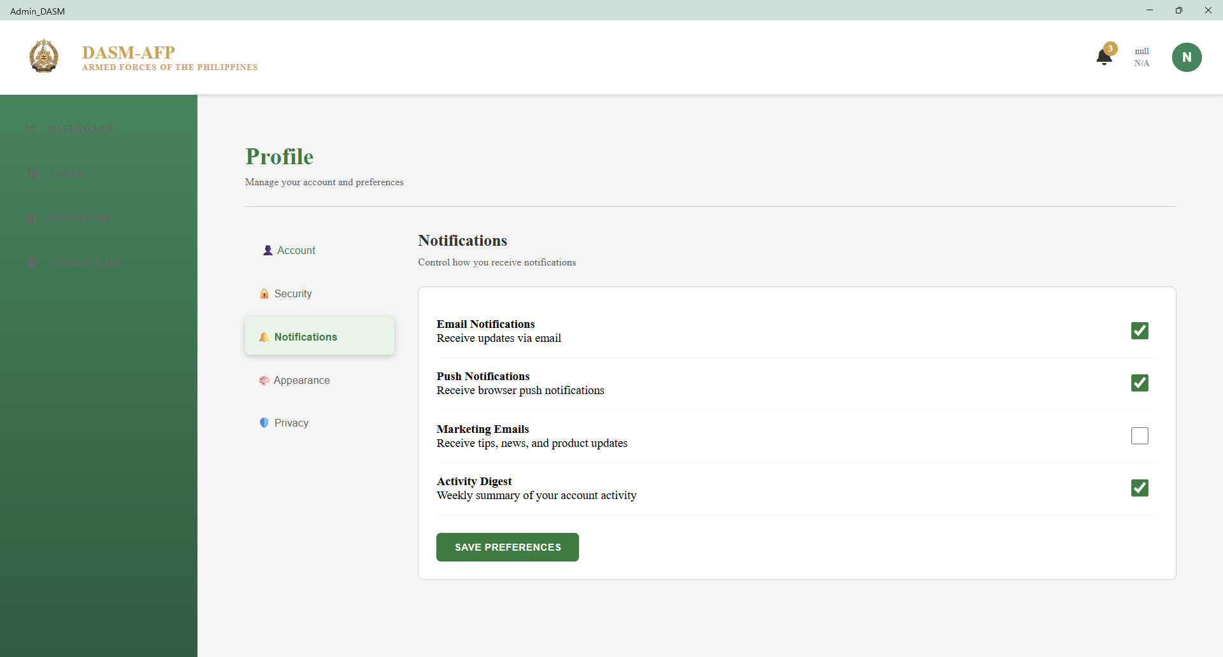
DASM-AFP: Computer-based Document Archiving and Security Management for Armed Forces of the Philippines

Slide 25
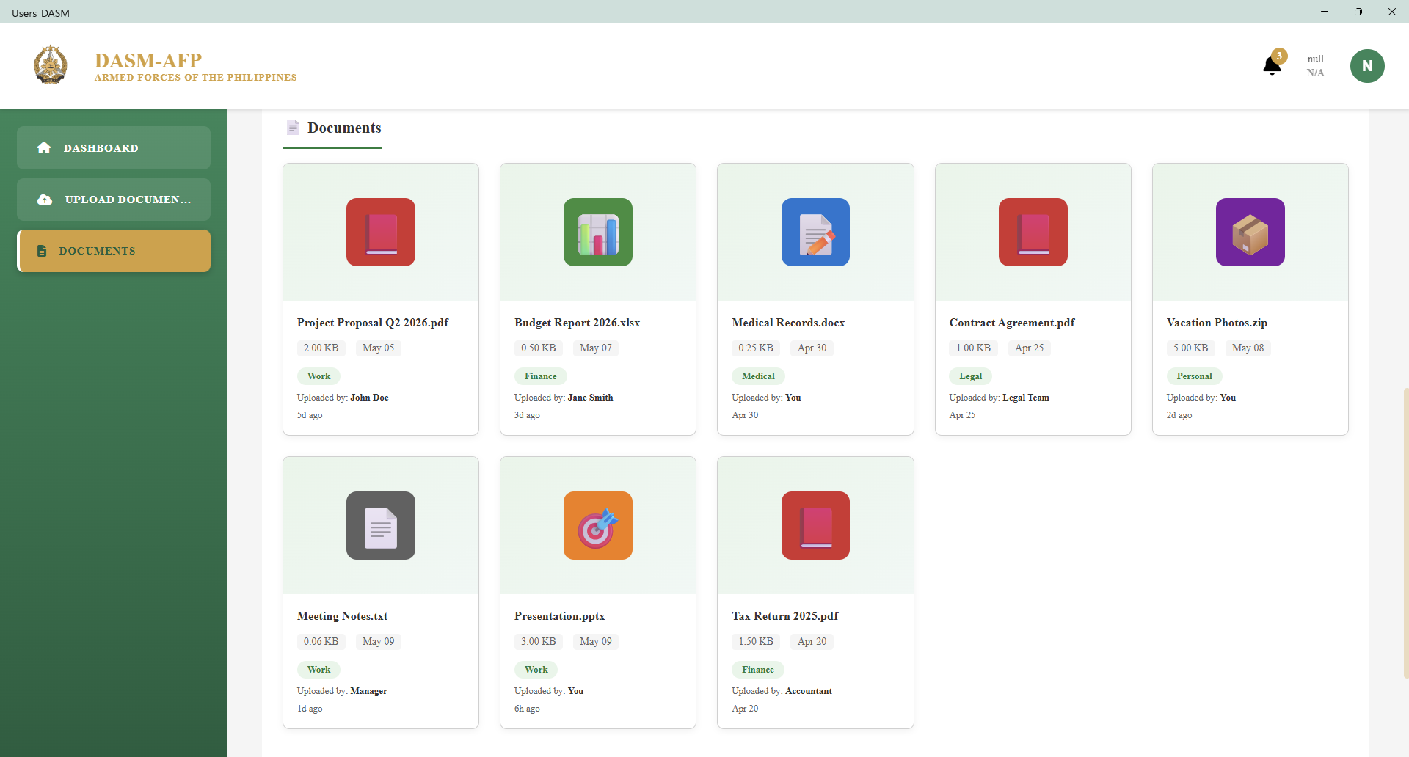
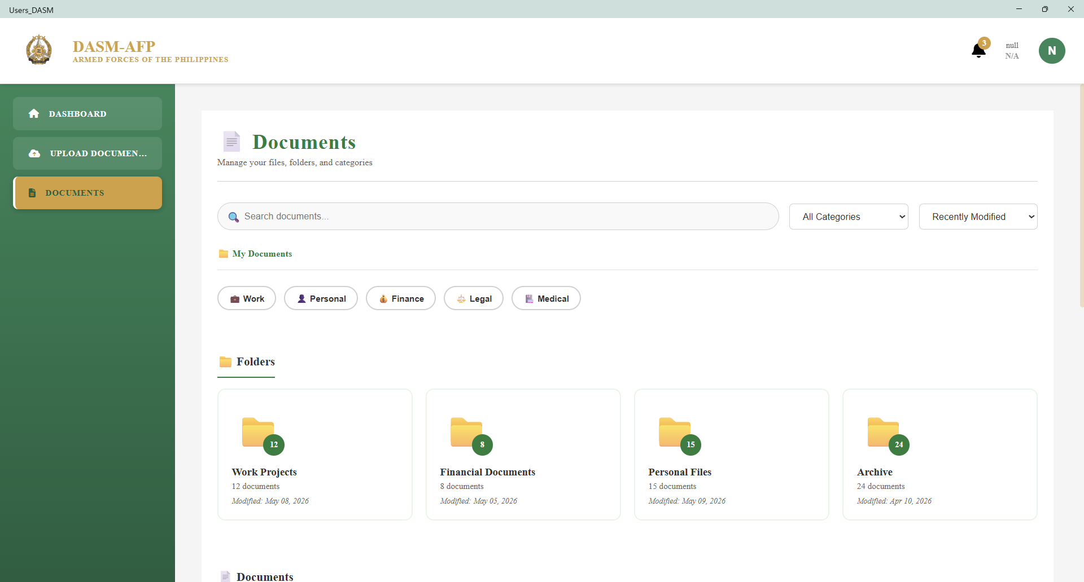
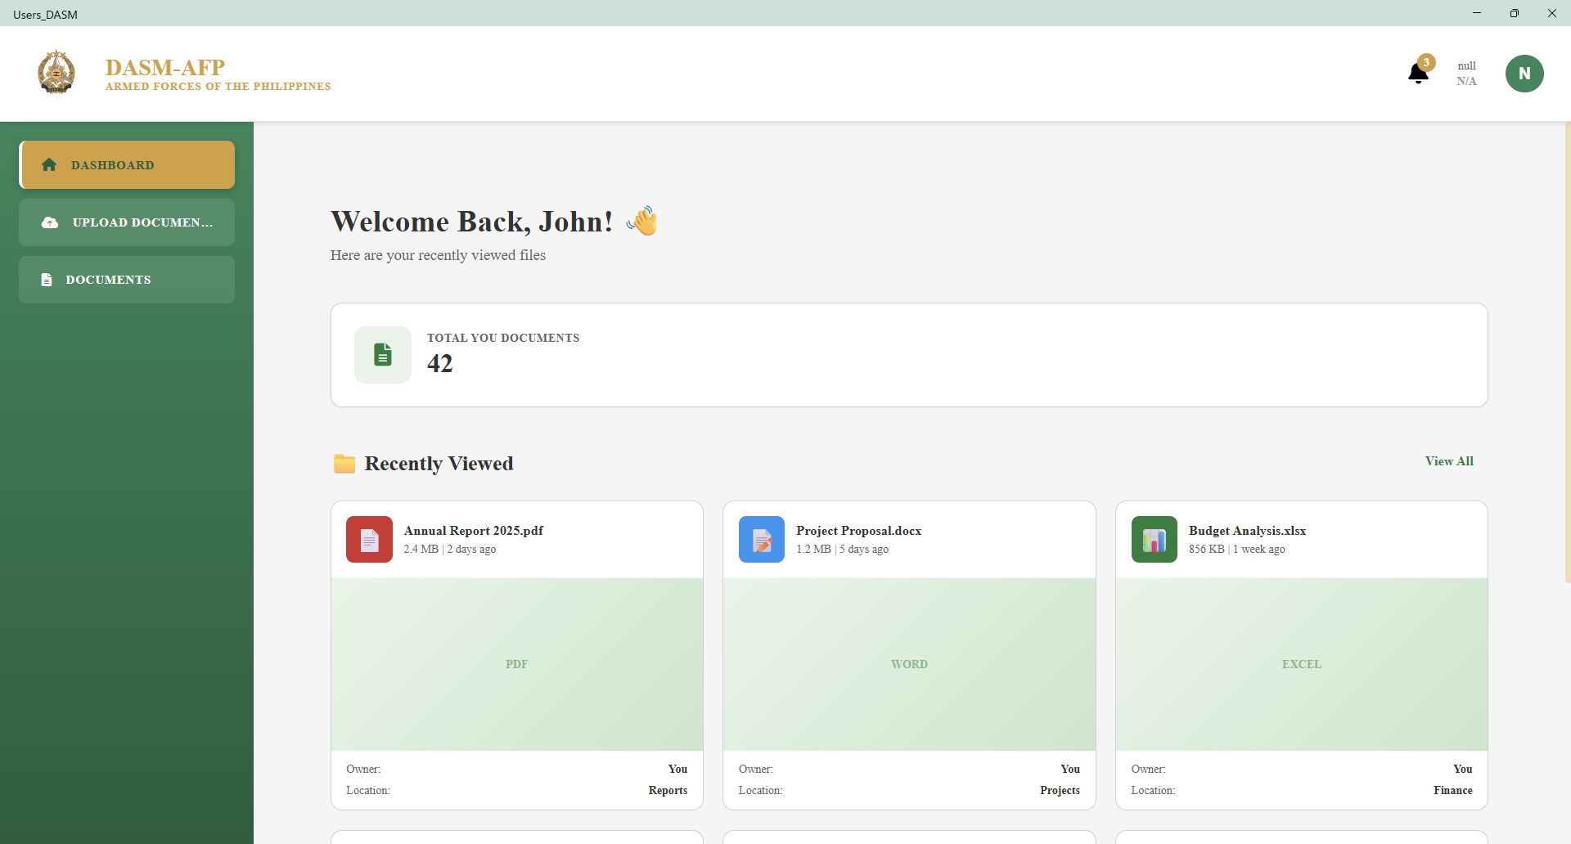
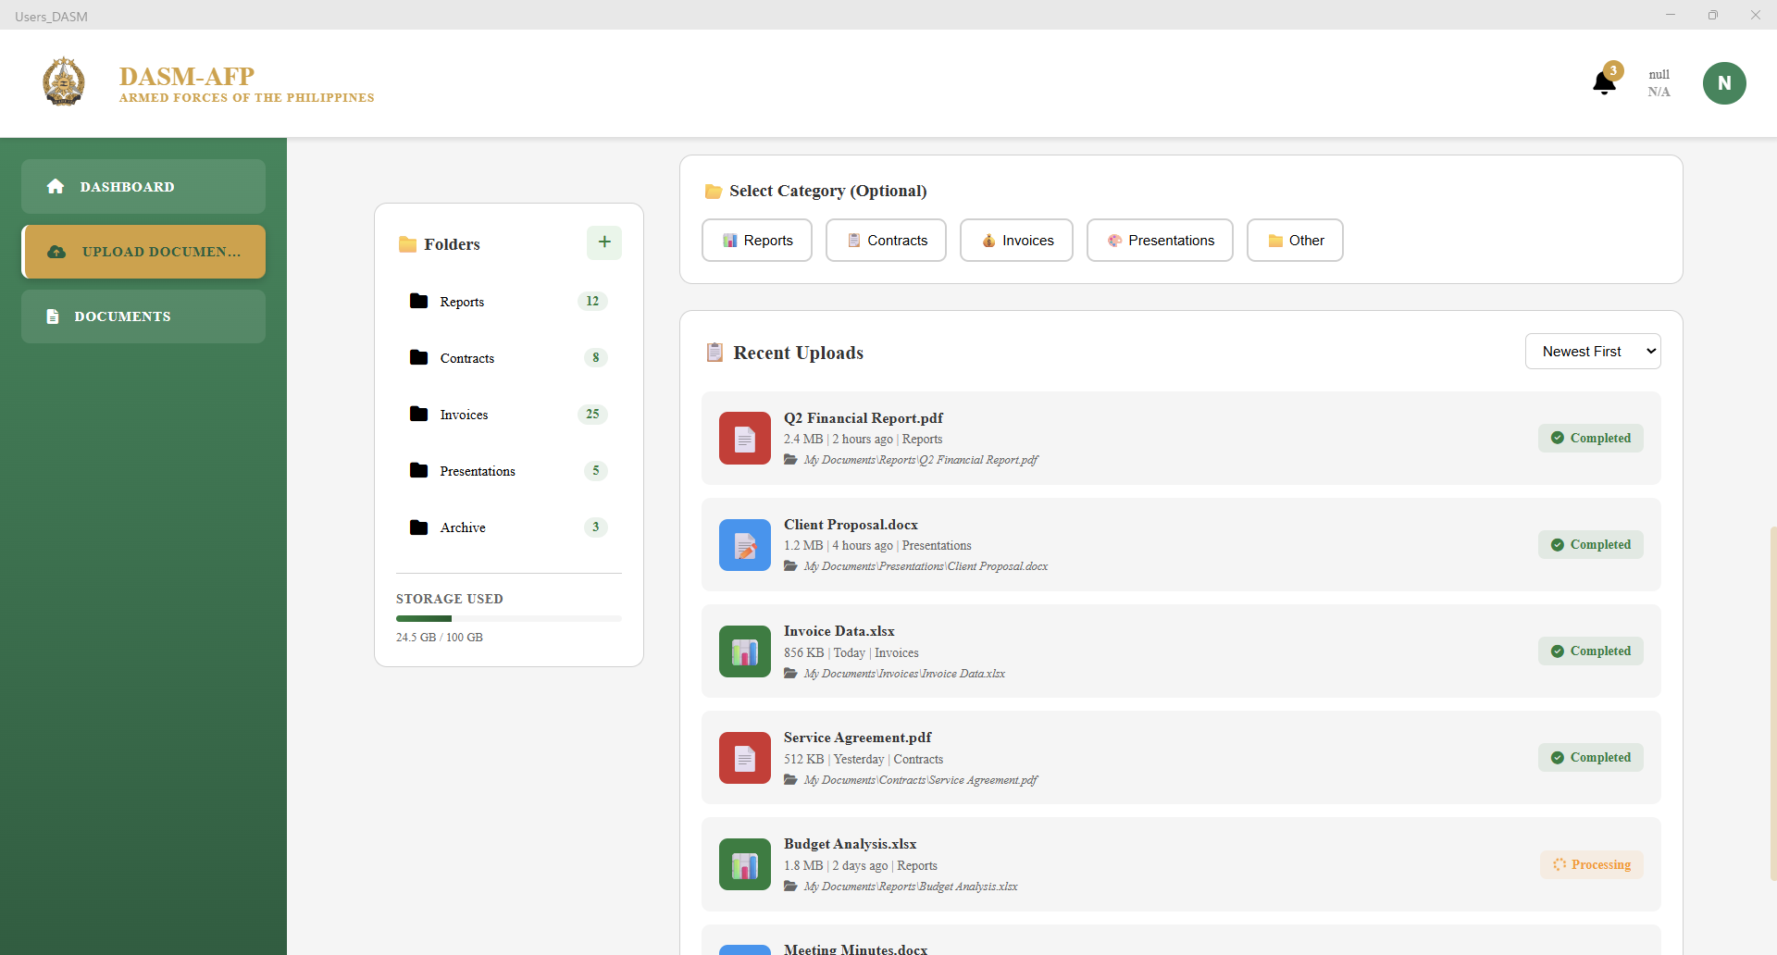
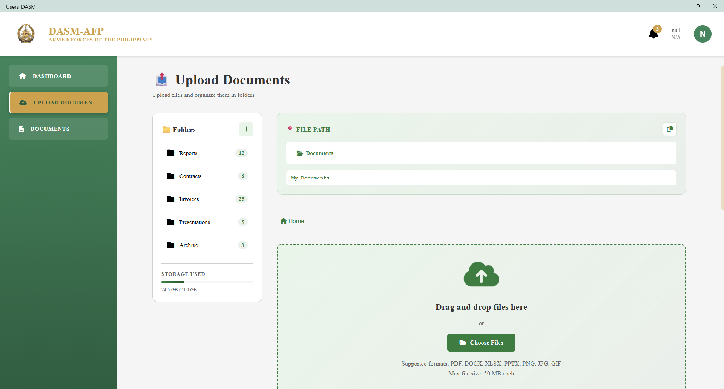
DASM-AFP: Computer-based Document Archiving and Security Management for Armed Forces of the Philippines

Slide 26
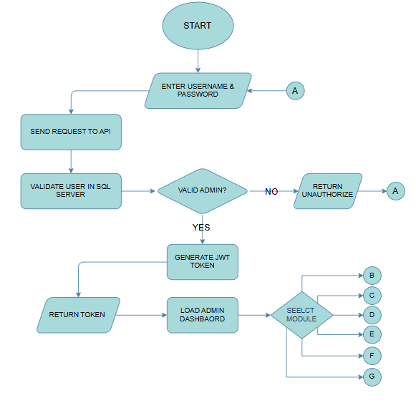
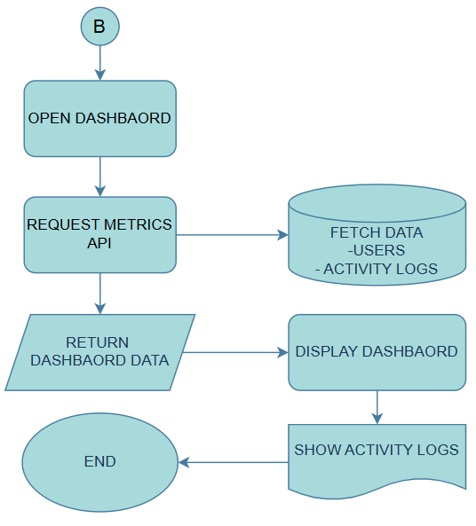
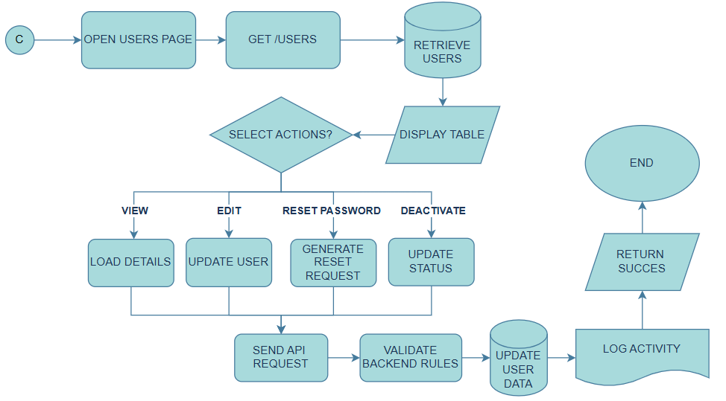
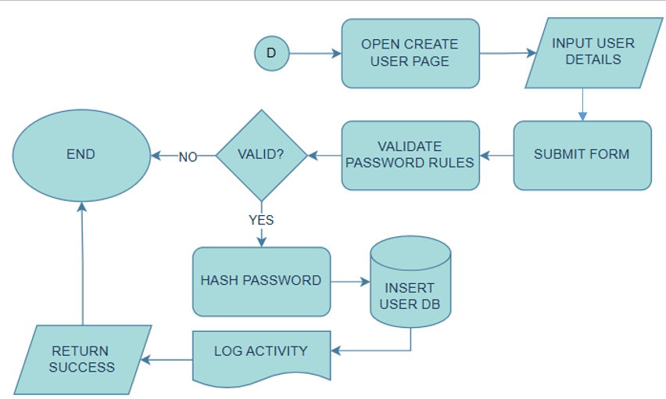
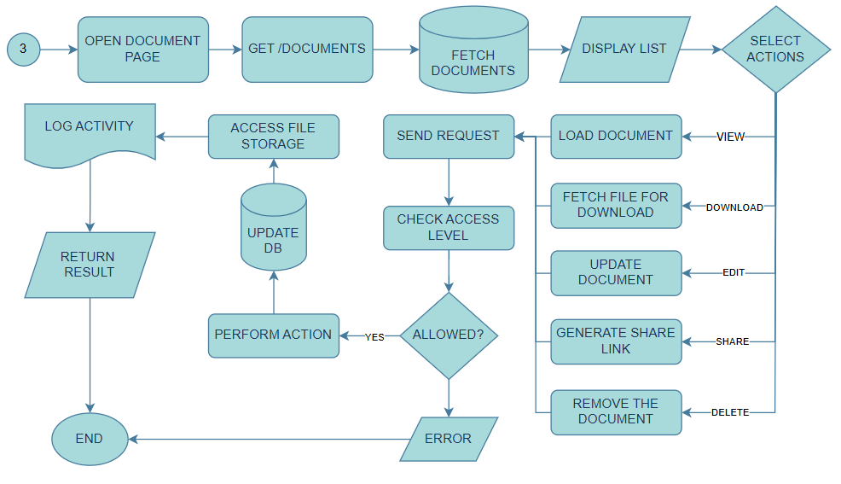
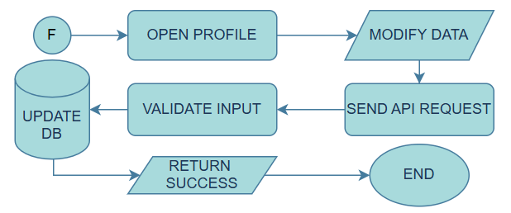
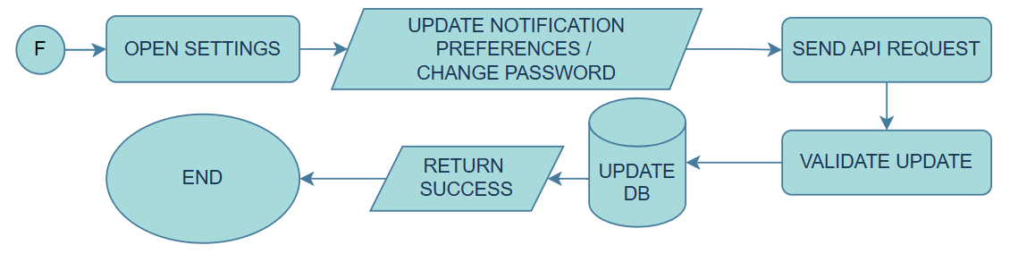
Program Flowchart: Admin
Admin Setting
Admin Profile
Admin Authentication Flow
Admin Dashboard
Admin Create User Account
Admin Document Management
Admin User Management
DASM-AFP: Computer-based Document Archiving and Security Management for Armed Forces of the Philippines

Slide 27
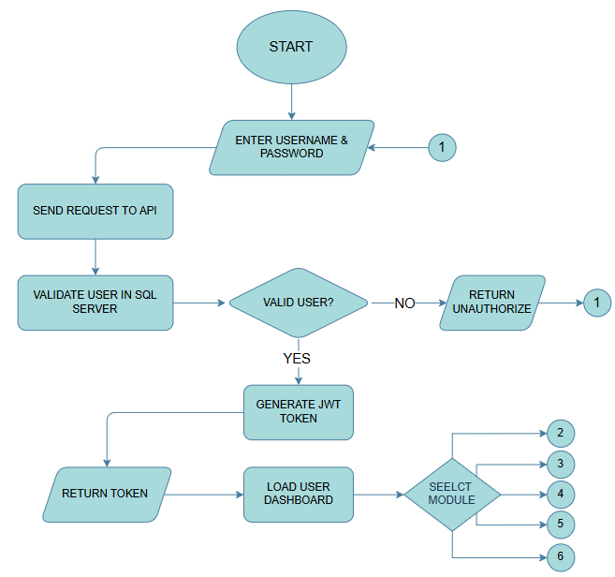
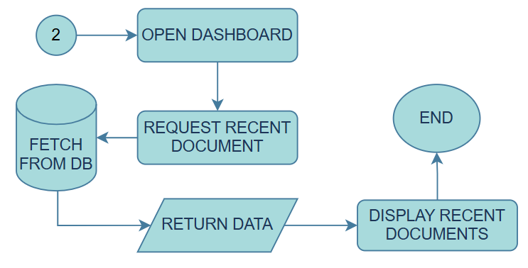
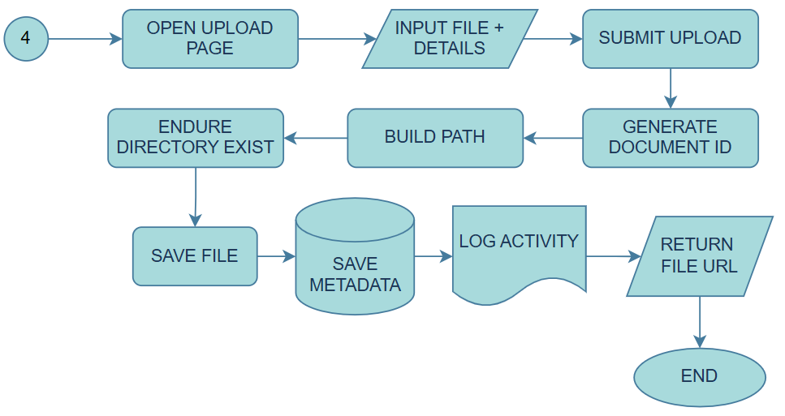
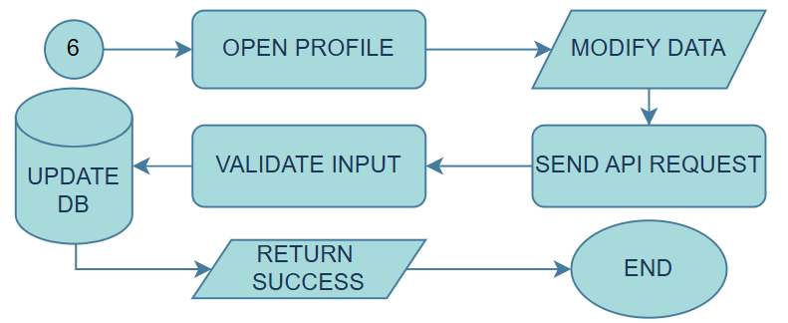
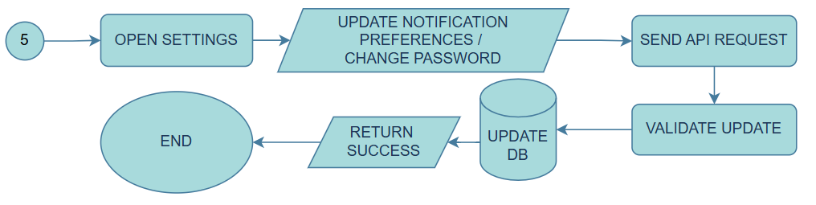
Program Flowchart: User
User’s Settings
User’s Profile
User’s Dashboard
User’s Authentication Flow
User’s Document Management
User’s Authentication Flow
DASM-AFP: Computer-based Document Archiving and Security Management for Armed Forces of the Philippines

Slide 28
REQUIREMENT ANALYSIS
Category | Description
WHO | Admin, Office Staff, Records Personnel
WHAT | Digitization and secure document management
WHERE | AFP LAN Environment
WHEN | Daily office operations
HOW | Scanning + centralized database + RBAC
DASM-AFP: Computer-based Document Archiving and Security Management for Armed Forces of the Philippines

Slide 29
REQUIREMENTS DOCUMENTATION
Proposed System: DASM-AFP
Purpose:
A secure computer-based document archiving and access control system for AFP.
Main Functions
  Digital document storage
  Secure access management
  Faster retrieval
  Centralized archiving
DASM-AFP: Computer-based Document Archiving and Security Management for Armed Forces of the Philippines

Slide 30
REQUIREMENTS DOCUMENTATION
Major System Modules
1. Administration and Security Module
  User account management
  Role assignment
  Access control
  Activity monitoring
2. Audit Trail
  Tracks login activity
  Records uploads and edits
  Monitors user actions
3. Document Archiving Module
  Upload documents
  Categorize records
  Search and retrieve files
DASM-AFP: Computer-based Document Archiving and Security Management for Armed Forces of the Philippines

Slide 31
REQUIREMENTS DOCUMENTATION
Key Features of DASM-AFP
  Secure document upload
  Centralized database storage
  Role-based access control
  Audit trail monitoring
  Fast document retrieval
DASM-AFP: Computer-based Document Archiving and Security Management for Armed Forces of the Philippines

Slide 32
THANK YOU FOR LISTENING
DASM-AFP: Computer-based Document Archiving and Security Management for Armed Forces of the Philippines

