Slide 1
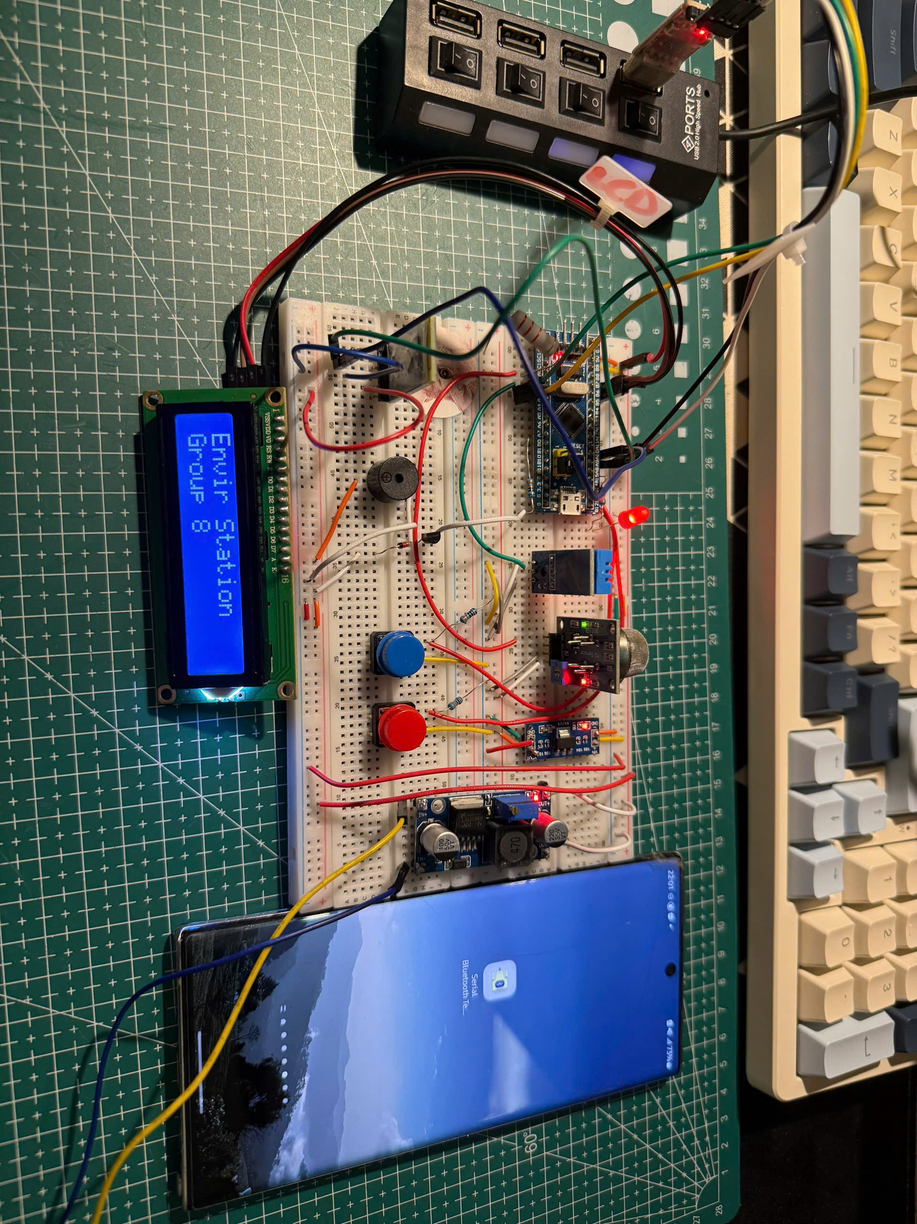
Mini Environmental Monitoring Station
Embedded System Design — Final Project Presentation
Instructor: MSc. Bui Quoc Bao
Name | ID
Pham Thanh Vinh | 2351075
Pham Hong An | 2310188
Ho Chi Dung | 2351016

Slide 2
Presentation Contents
01
02
Project Overview
System Requirements
03
04
System Architecture & Hardware
Firmware Architecture
05
06
Integration & Testing
Demo

Slide 3
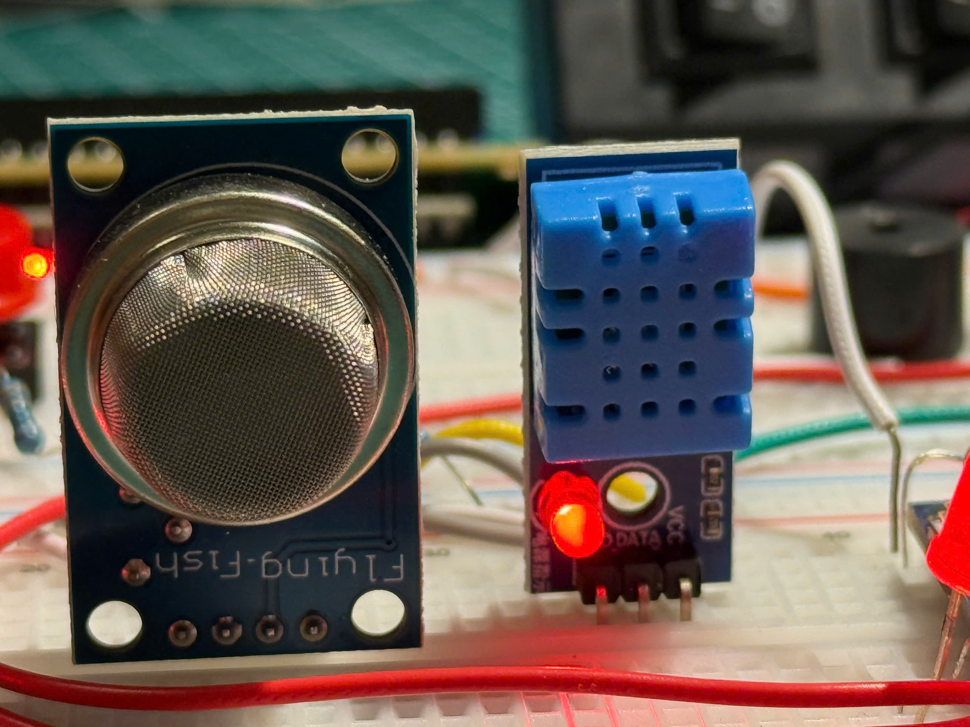
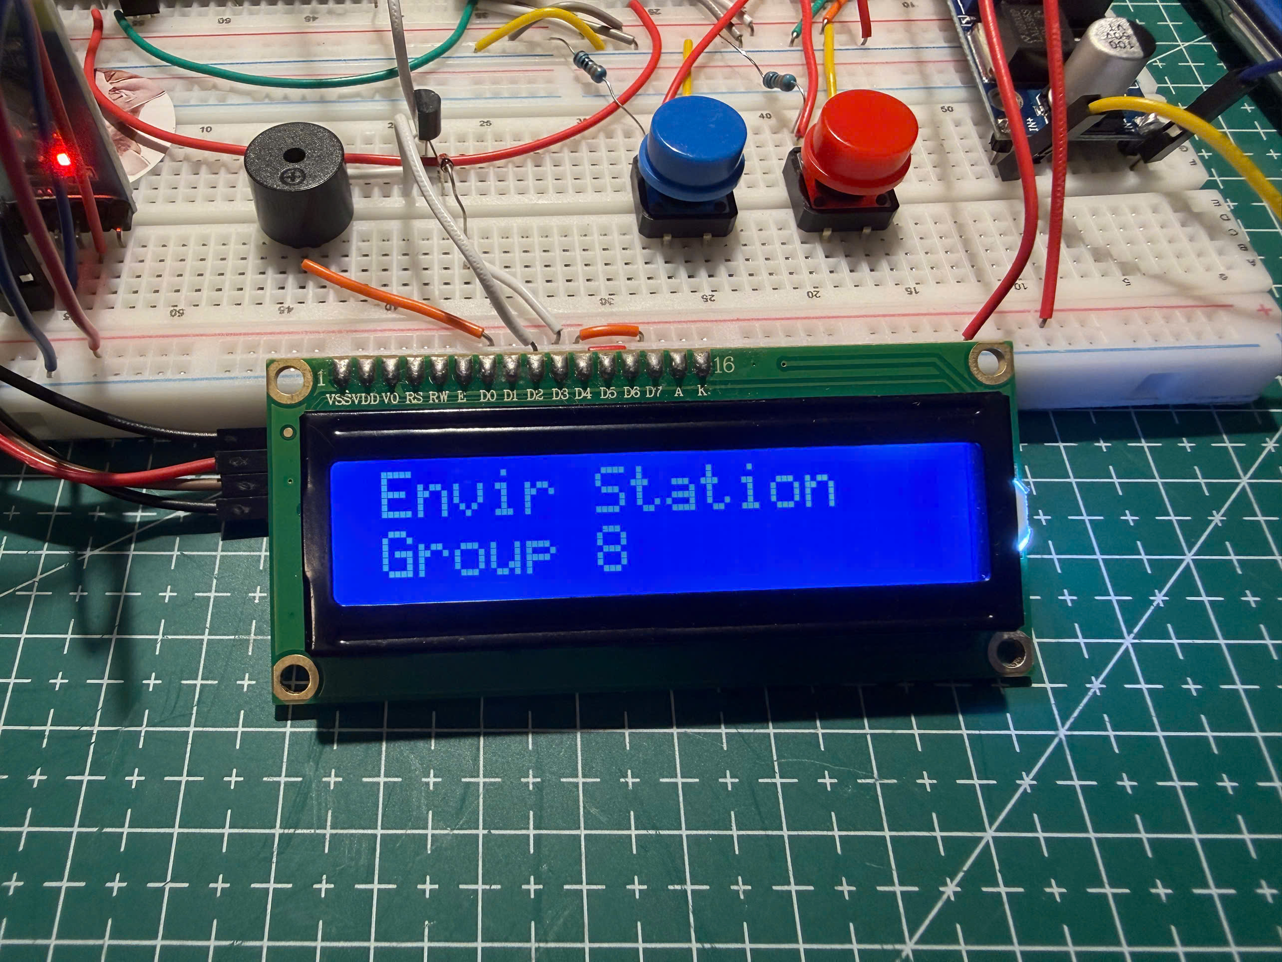
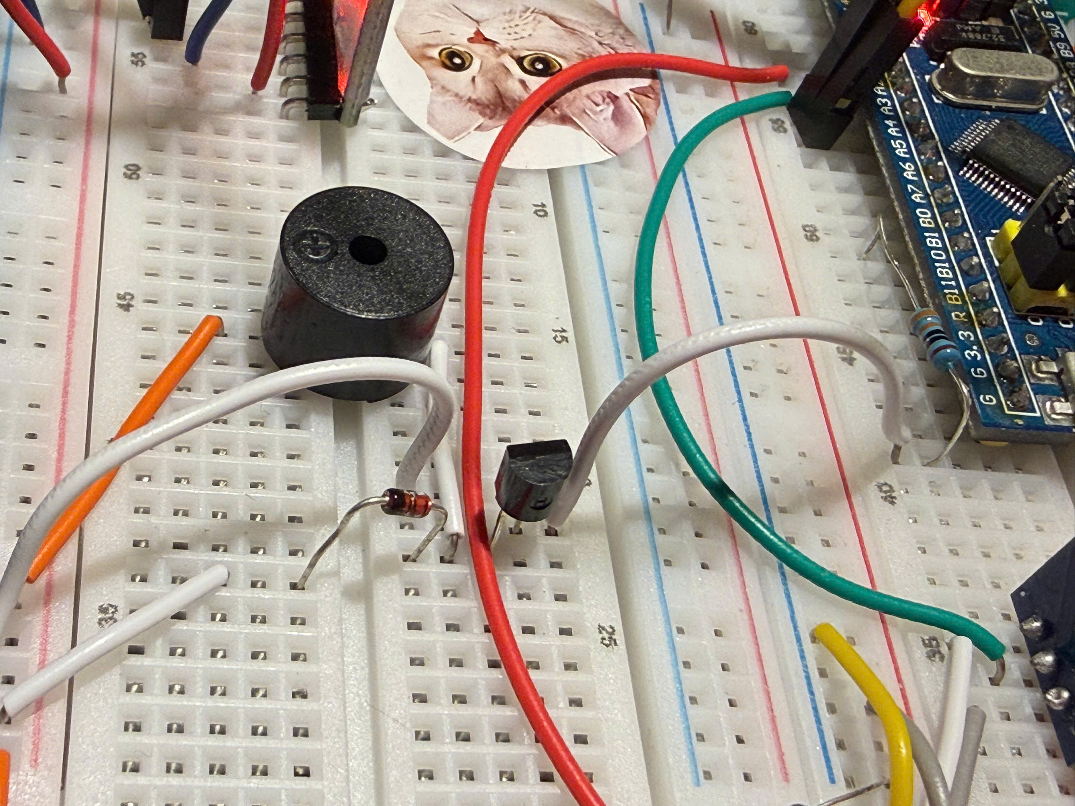
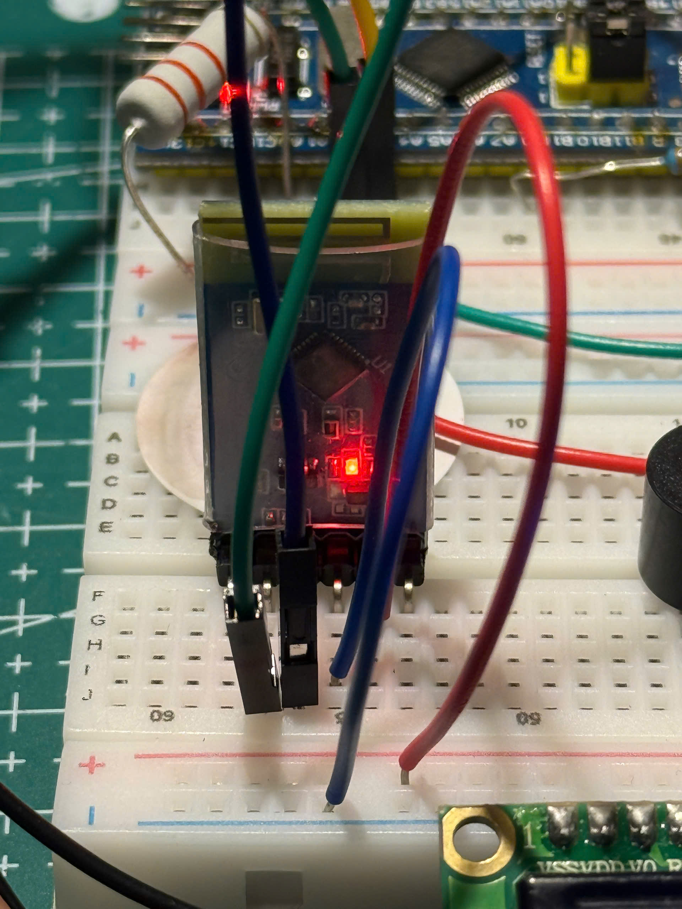
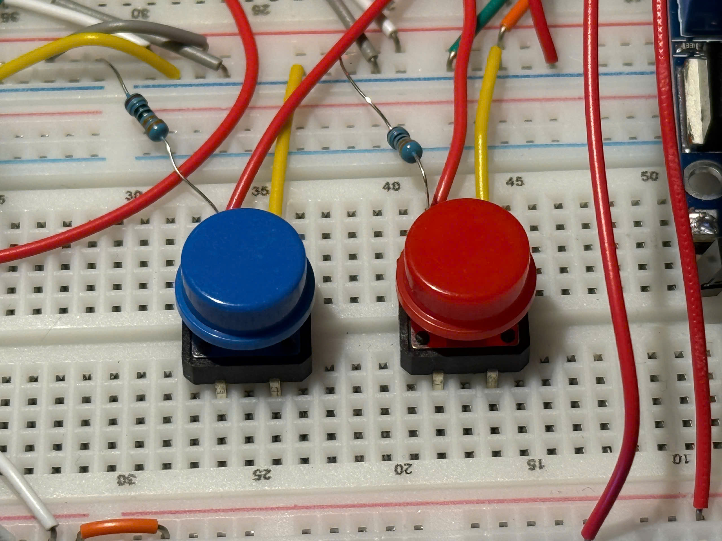
Project Overview
Sensors
Measure temperature, humidity, and gas/smoke concentration
Display
Show environmental information on a 16x2 LCD
Alert
Activate the buzzer when gas concentration exceeds the threshold
Wireless transmission
Transmit data to a smartphone via Bluetooth module
User interface
Complete the full embedded workflow from design to testing, with 2 user interaction buttons.

Slide 4
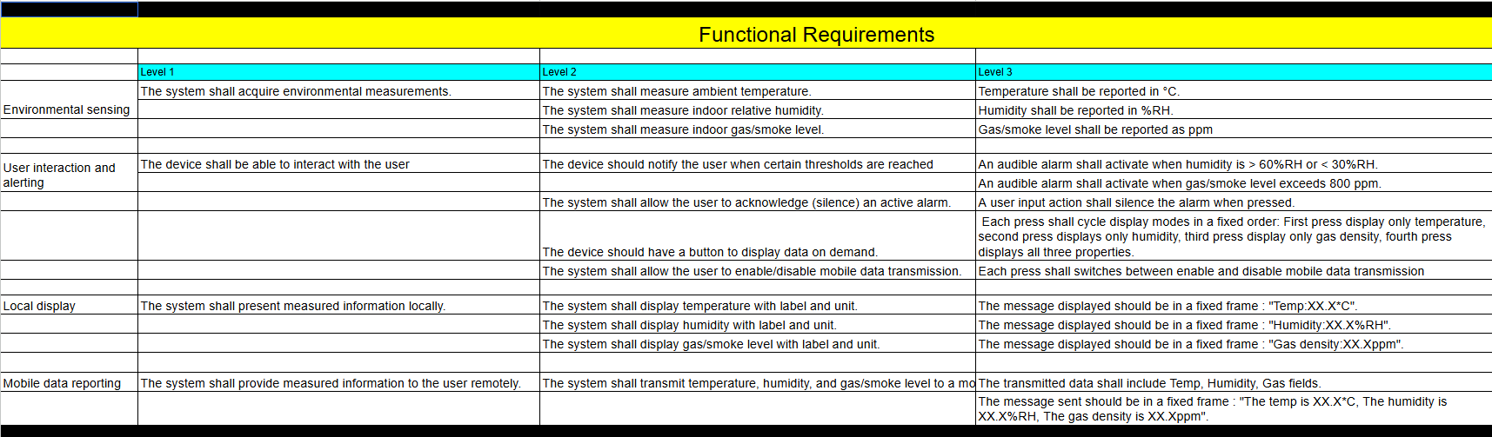
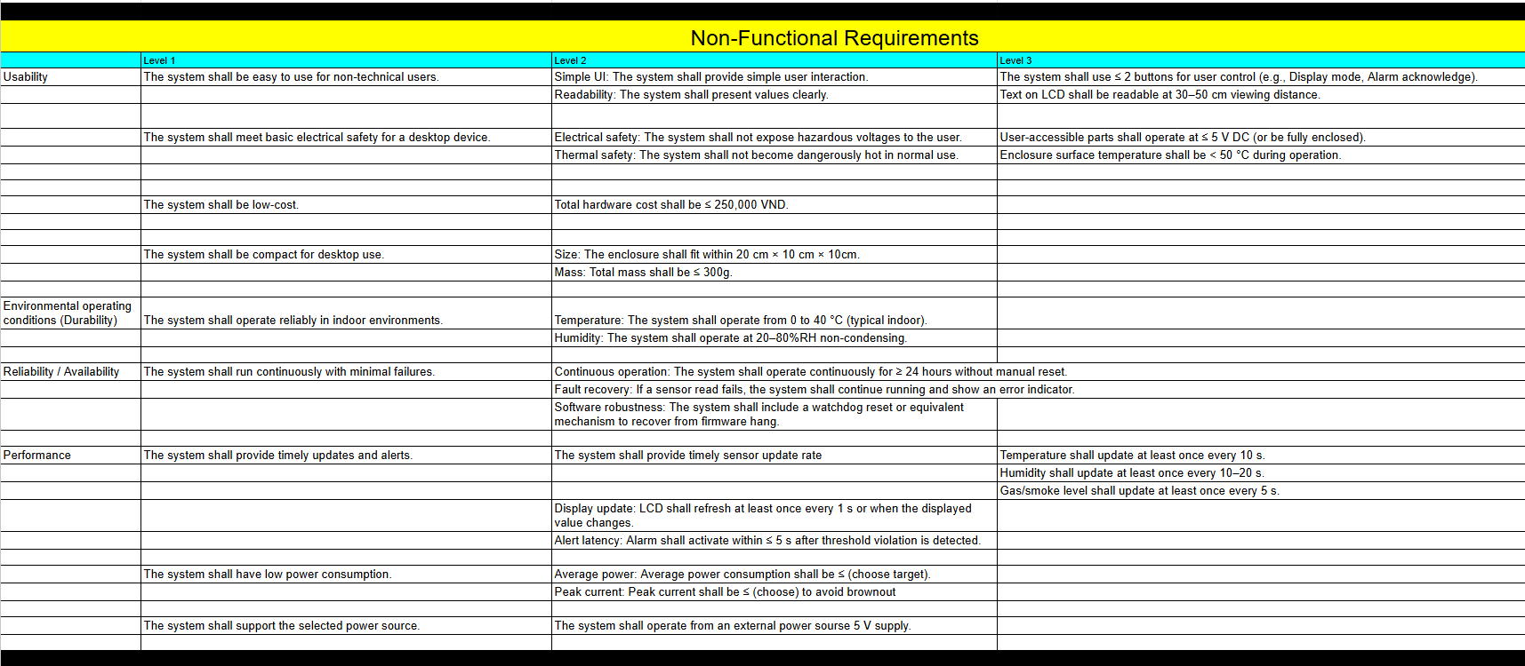
System Requirements

Slide 5
Functional Requirements
Measure temperature in °C.
Measure humidity in %RH.
Measure gas density in approximate ppm.
Display values locally on LCD.
Send environmental data wirelessly to phone.
Activate buzzer when gas density exceeds threshold.
BUTTON_1 changes gas threshold between 660 ppm and 10 ppm.
BUTTON_2 cycles LCD display mode.

Slide 6
Non - Functional Requirements
Low-cost and compact desktop device.
Easy to use with only 2 buttons.
Stable 5V / 3.3V power distribution.
Readable LCD output.
Continuous operation for normal indoor monitoring.
Modular code structure for easy debugging and extension.
Real-time update and quick alarm response.

Slide 7
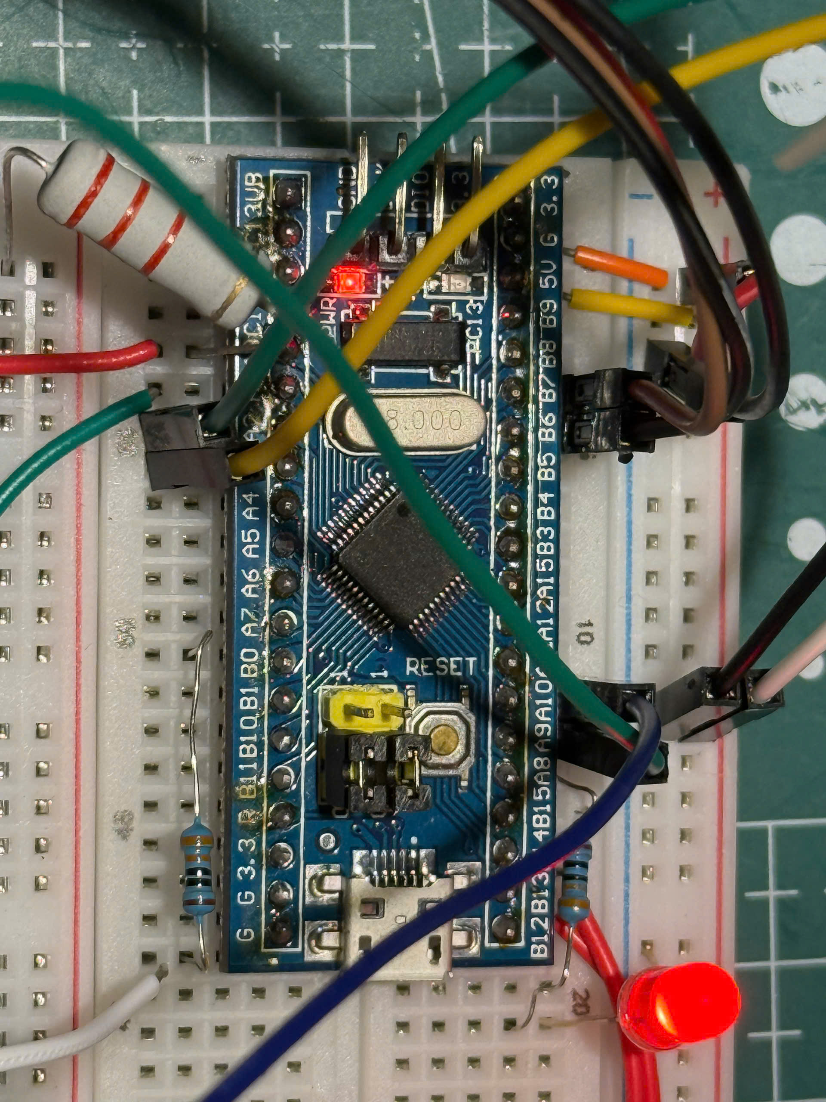
System Architecture
Central controller: STM32F103C8T6.
.

Slide 8
System Architecture
Input blocks: MQ2, DHT11, Button 1, Button 2.

Slide 9
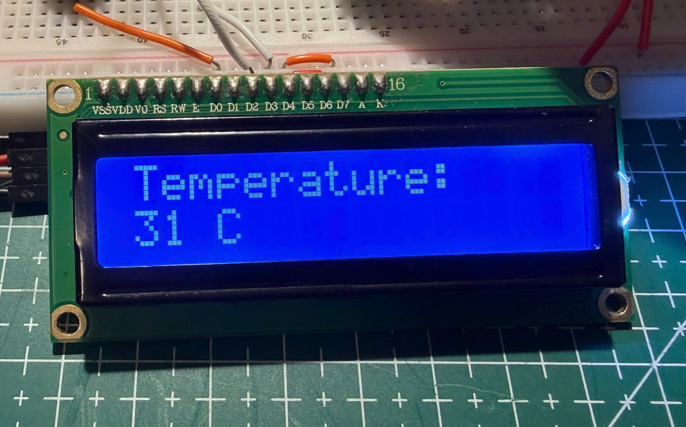
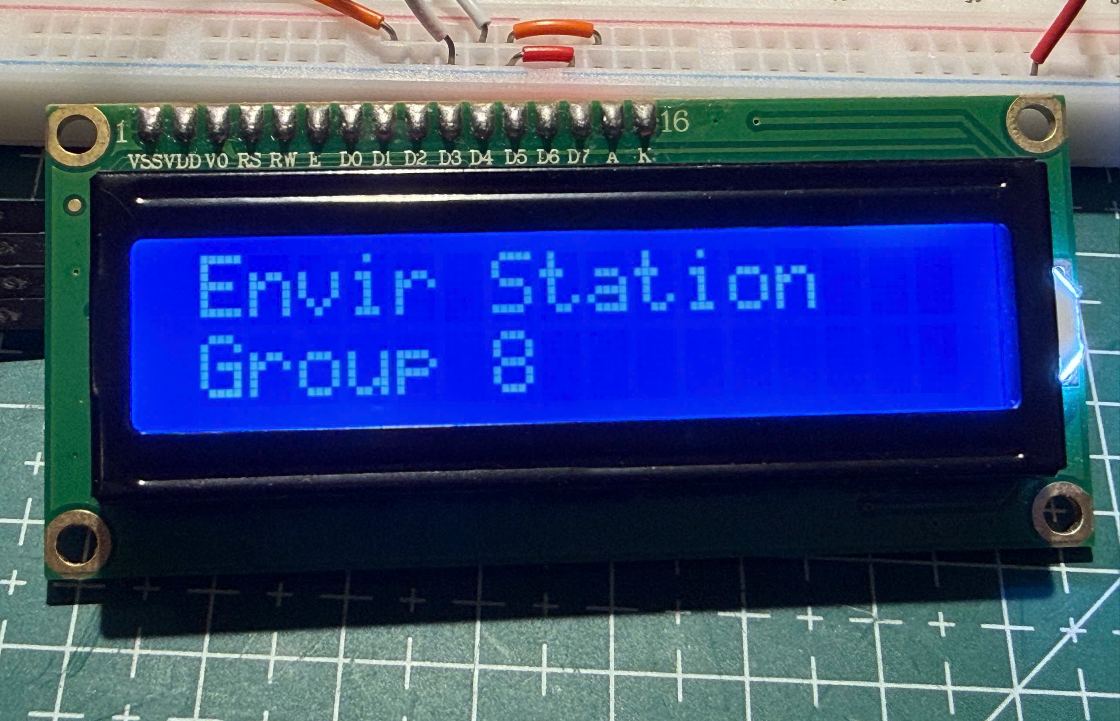
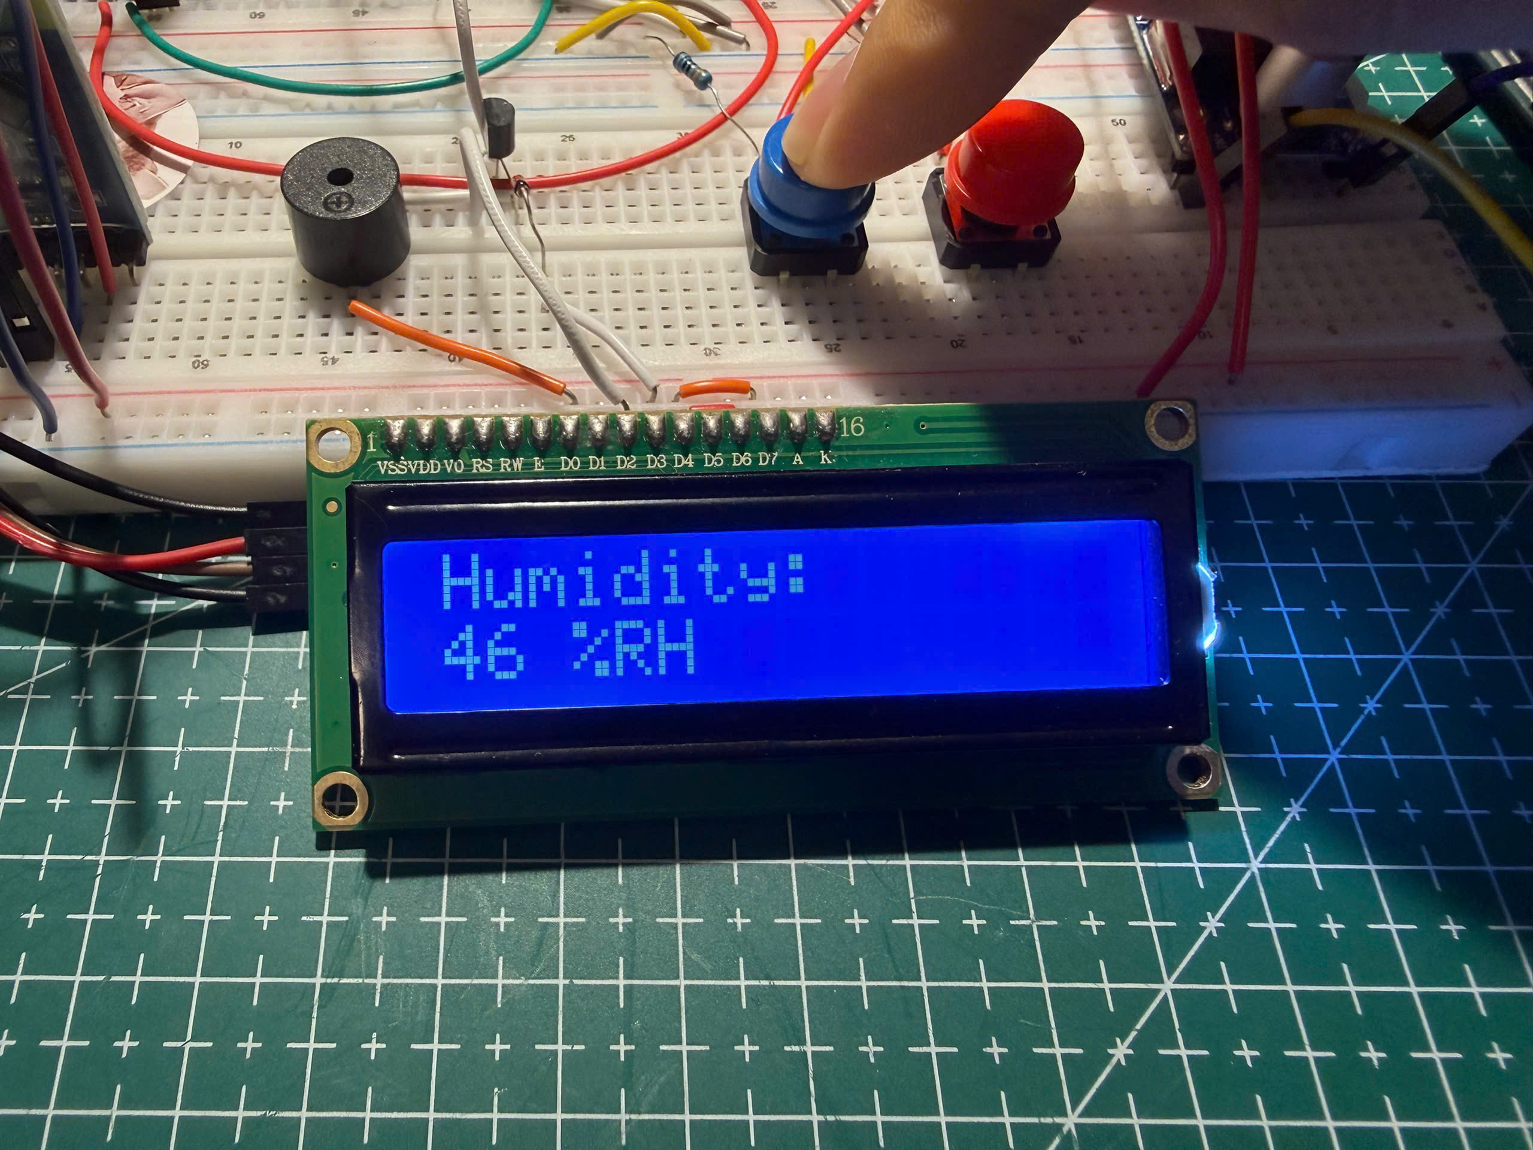
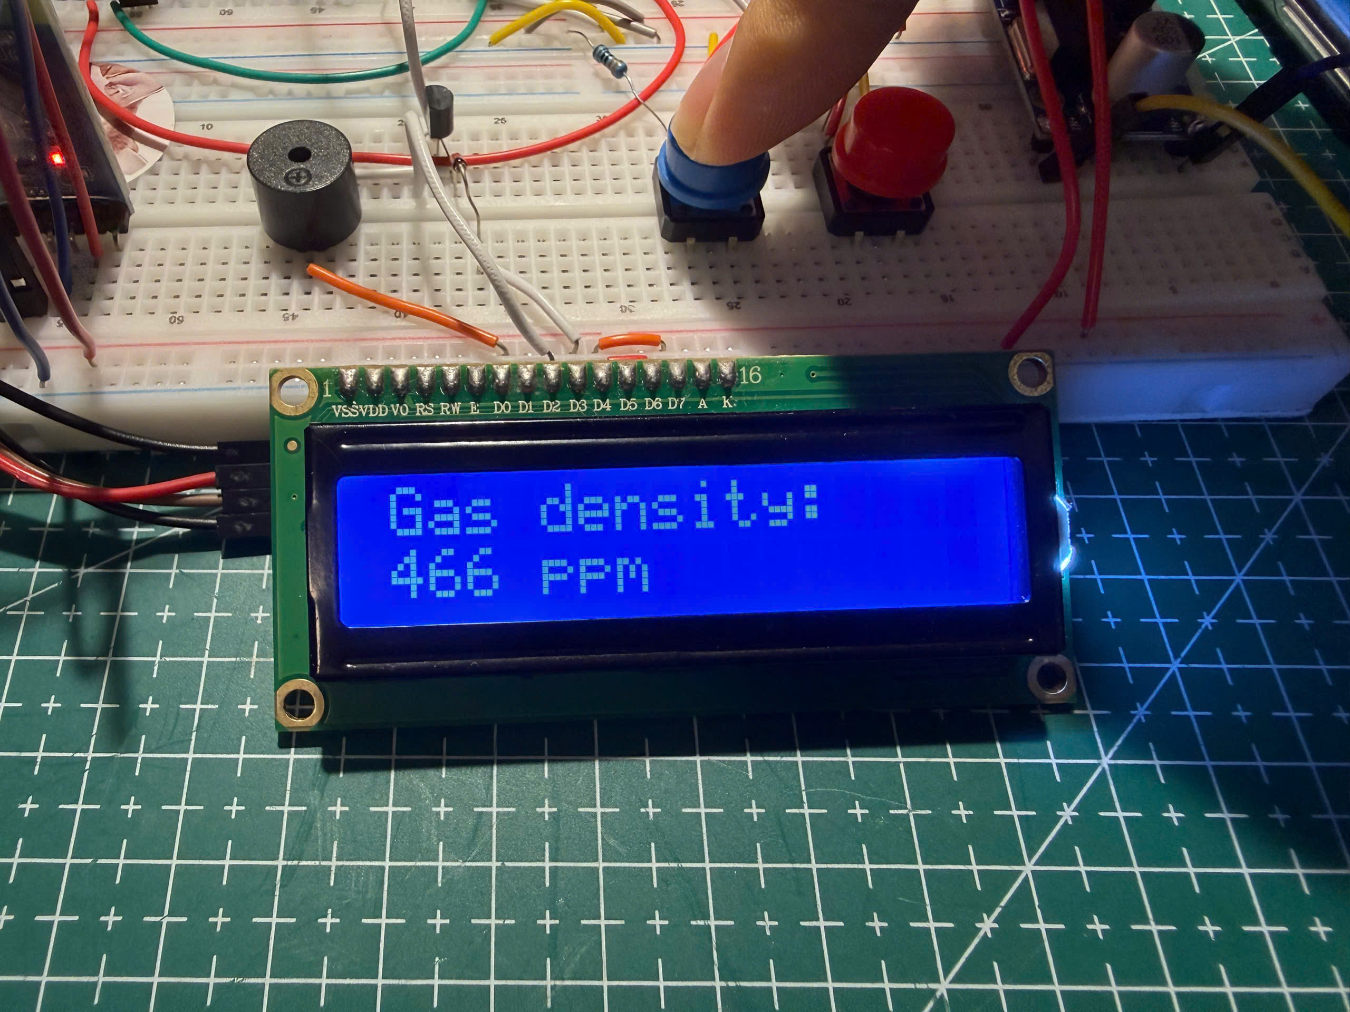
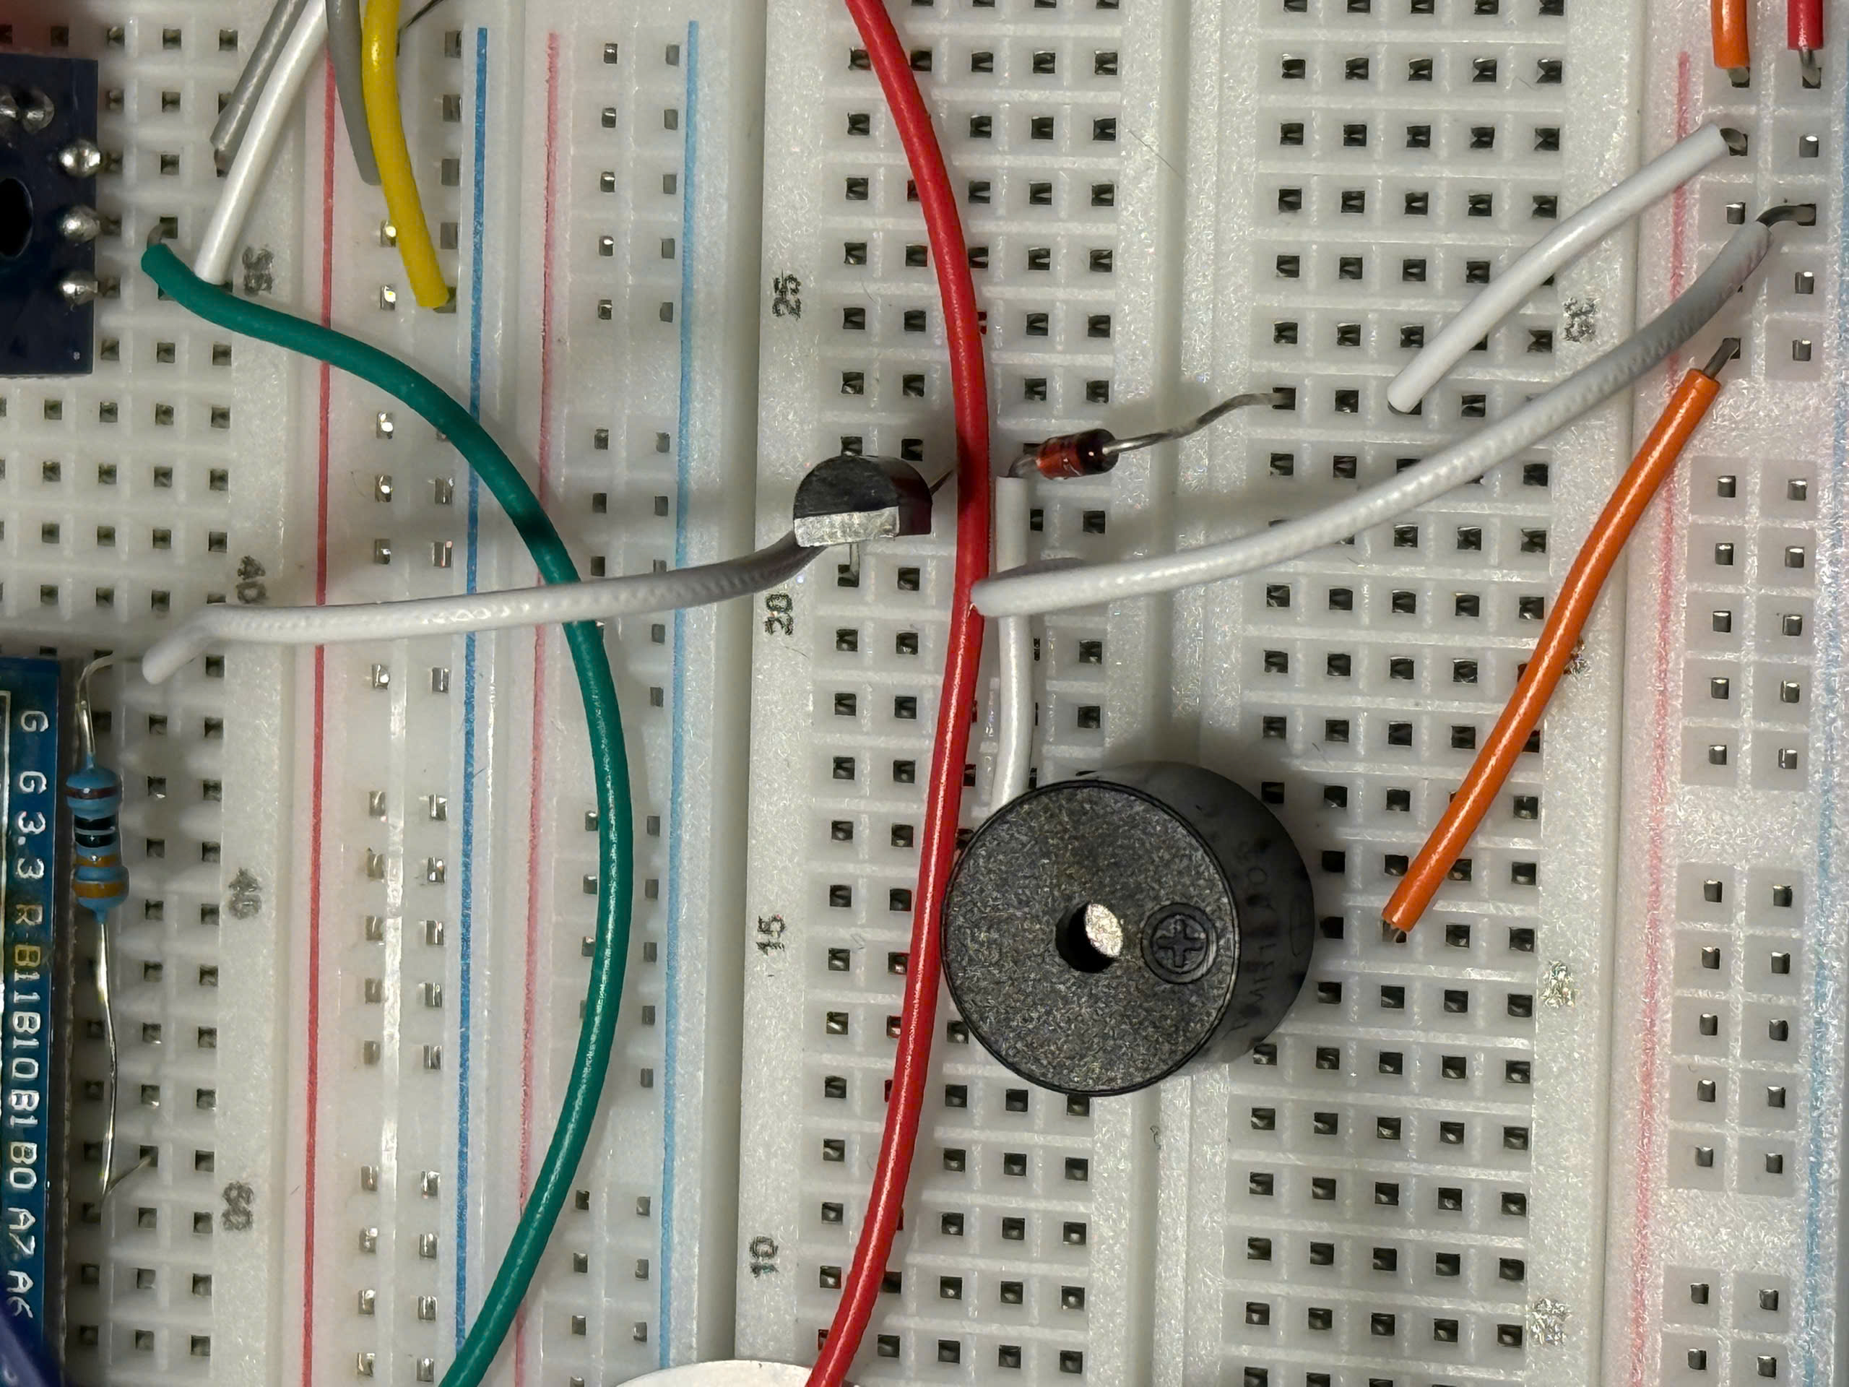
System Architecture
Output blocks: LCD, Buzzer, LED, Bluetooth module.

Slide 10
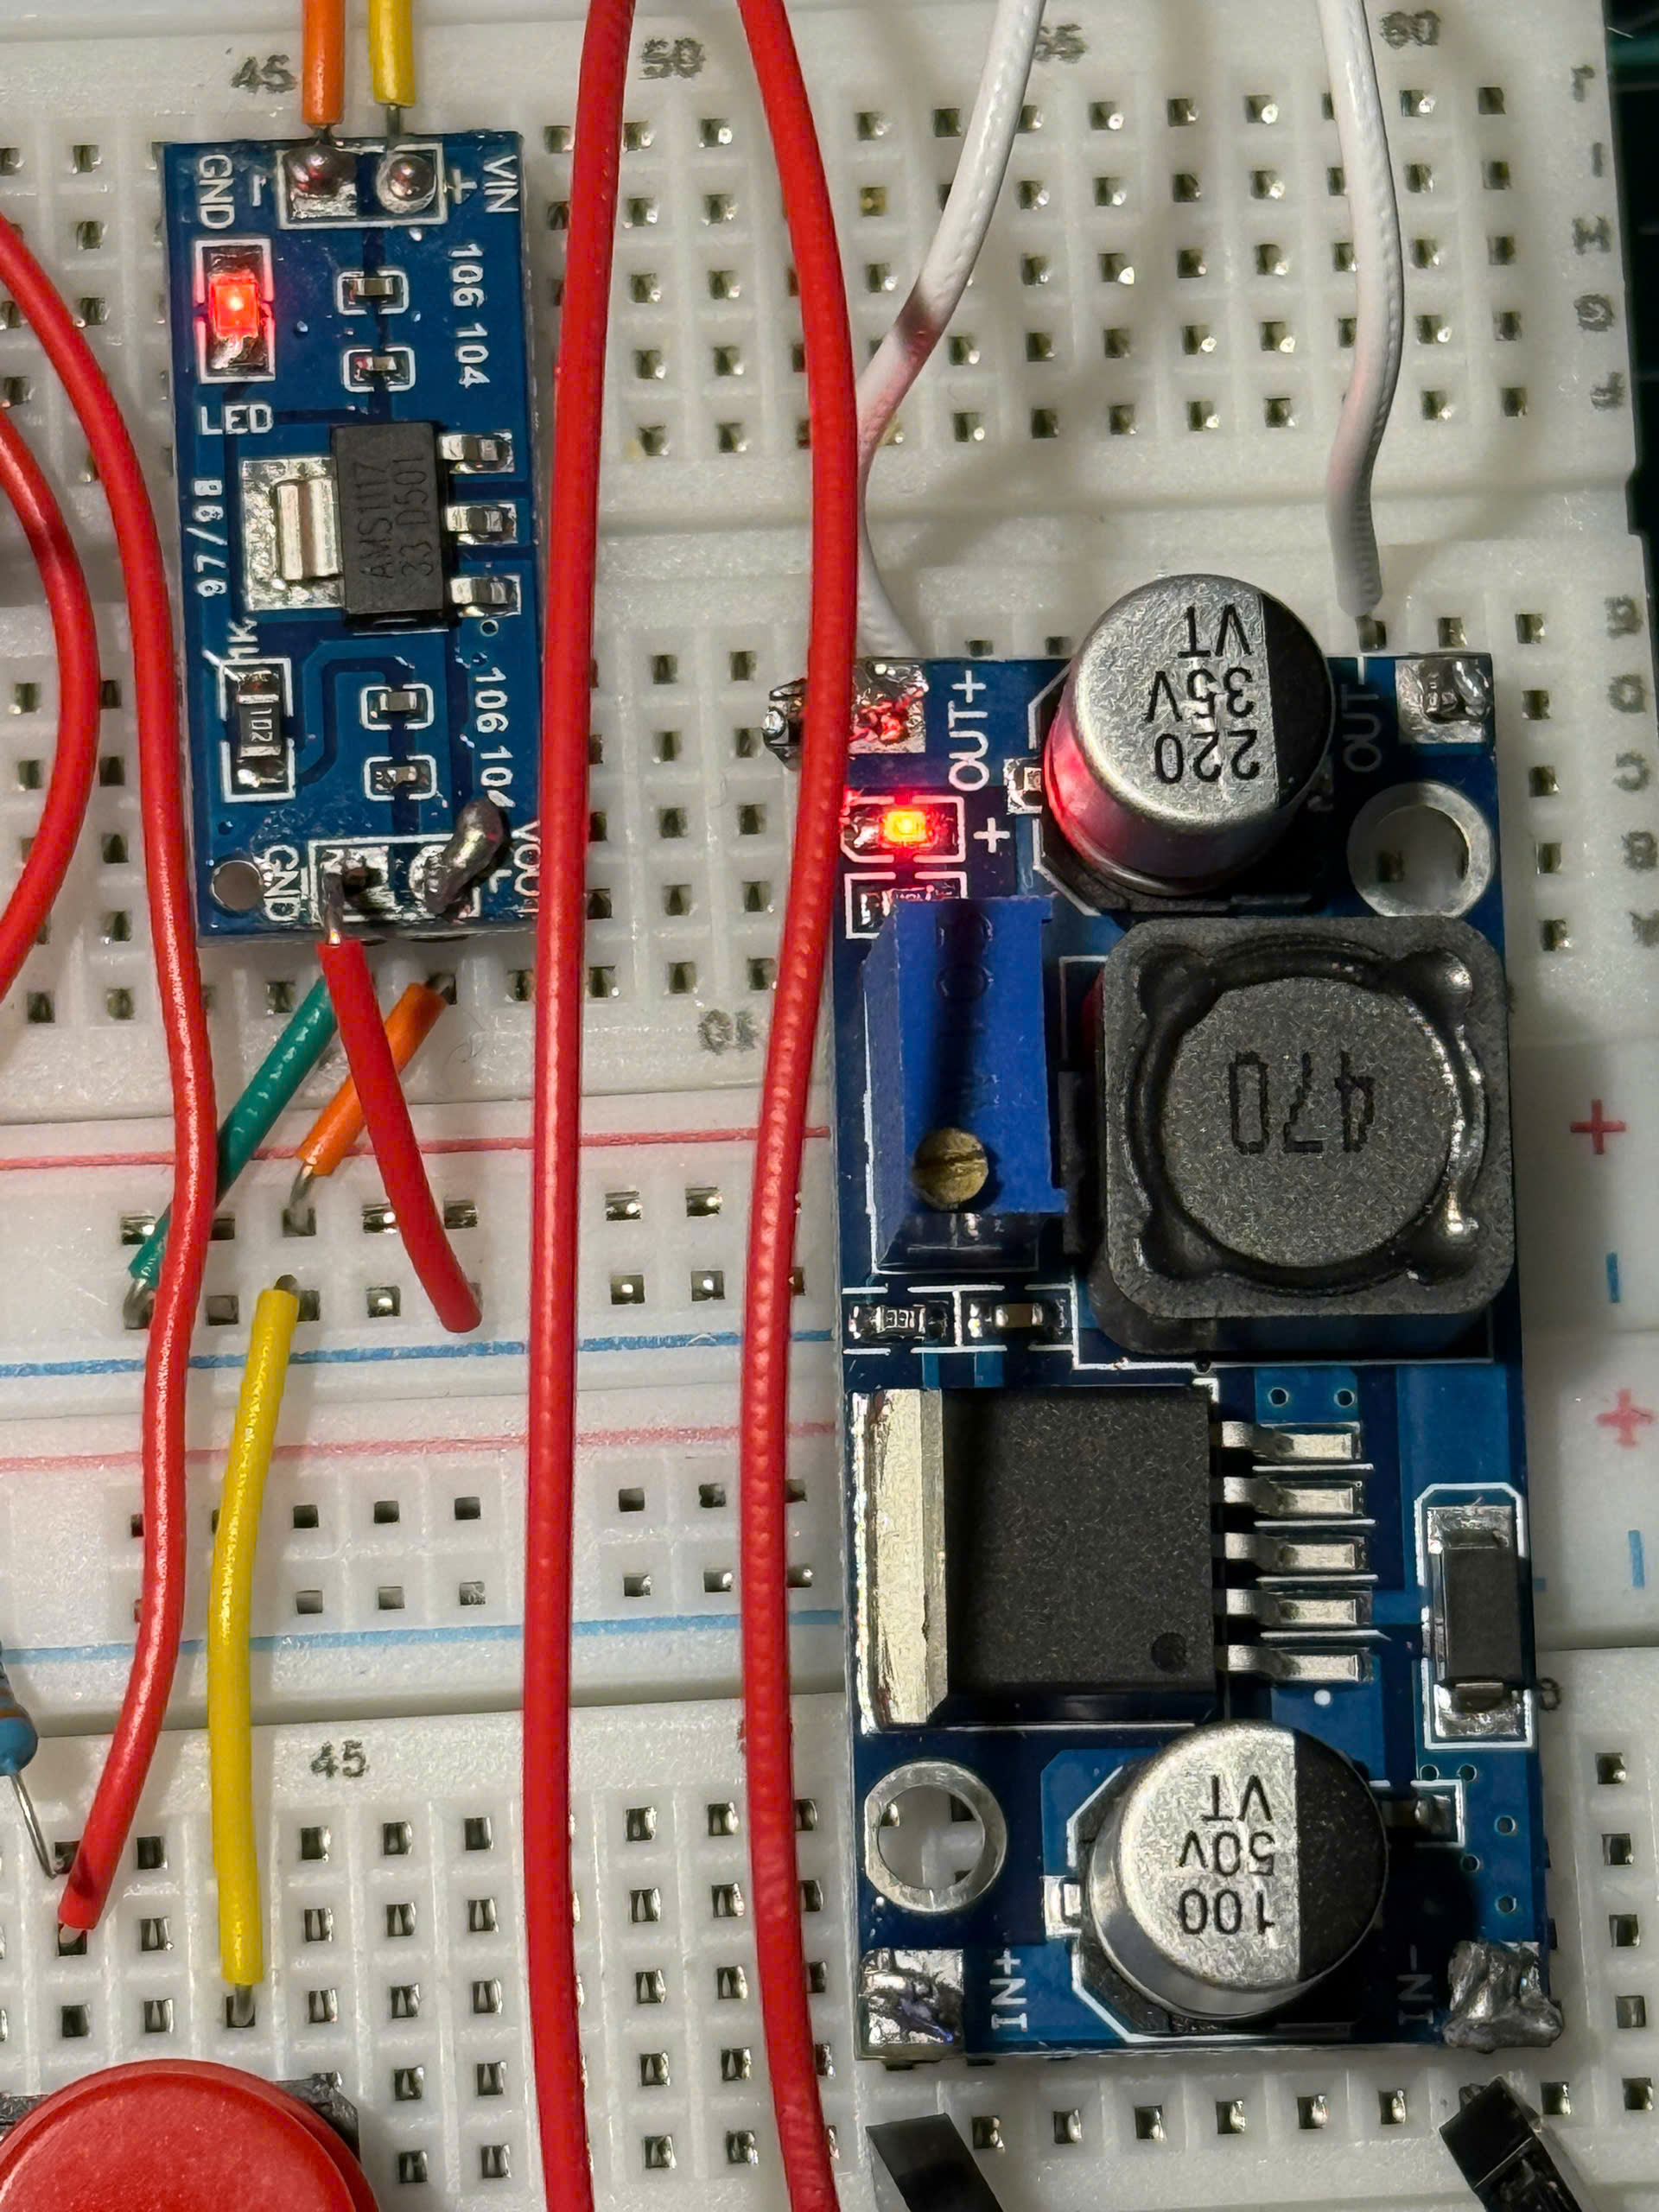
System Architecture
Power subsystem: 9V input, LM2596 to 5V, AMS1117 to 3.3V.

Slide 11
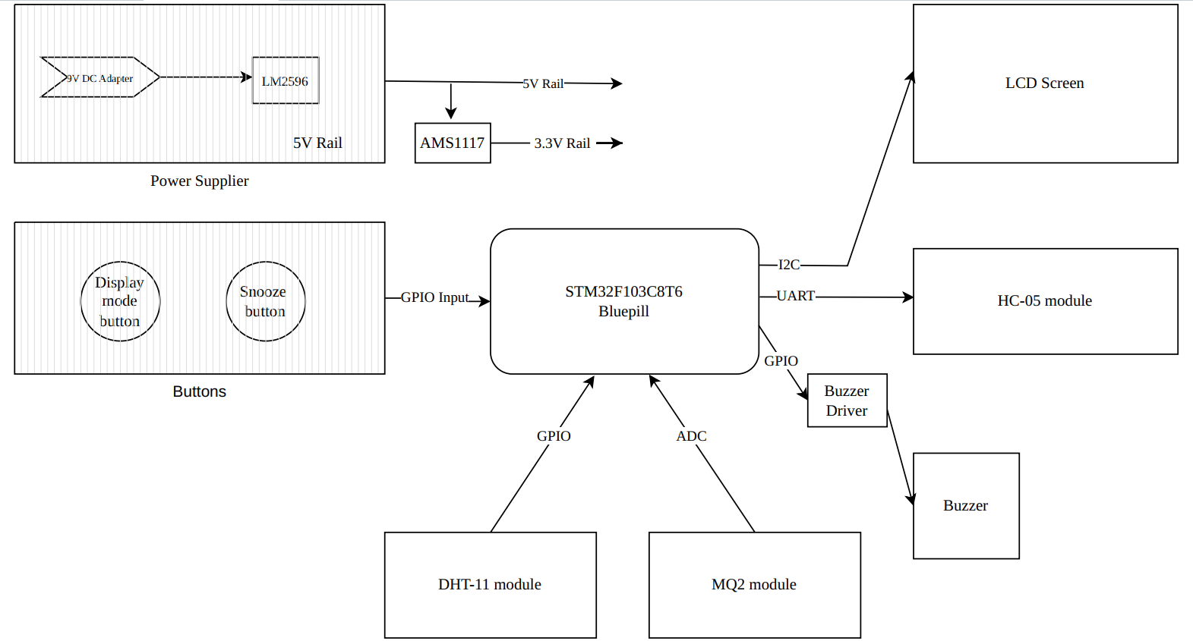
Block diagram

Slide 12
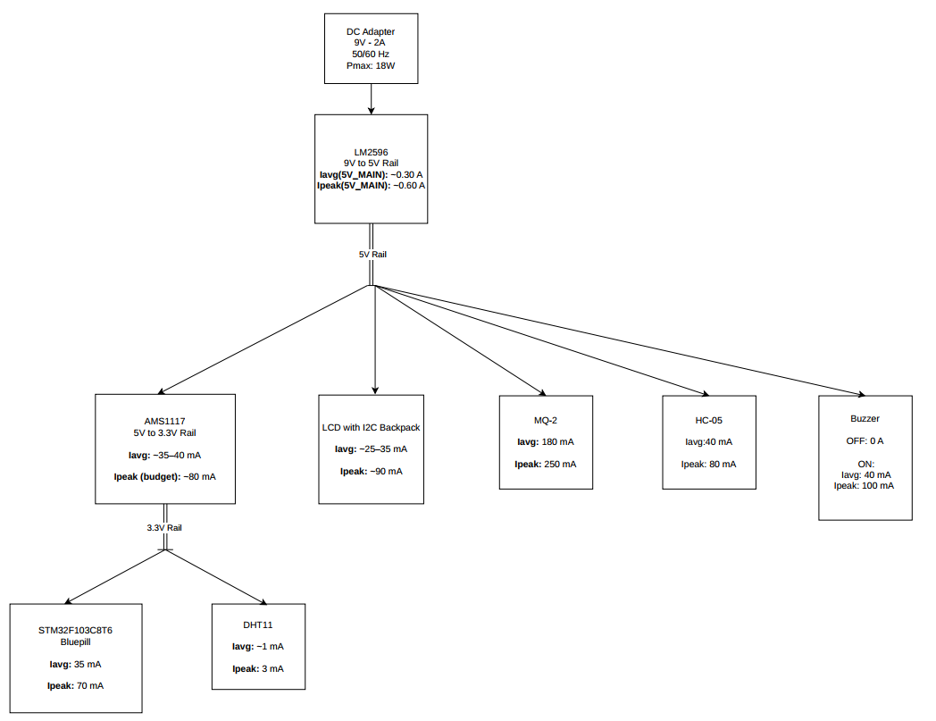
Power tree
9V adapter as input source.
LM2596 generates 5V rail.
AMS1117 generates 3.3V rail.
5V powers LCD, gas sensor module, buzzer module, Bluetooth module.
3.3V powers MCU and logic-level blocks.

Slide 13
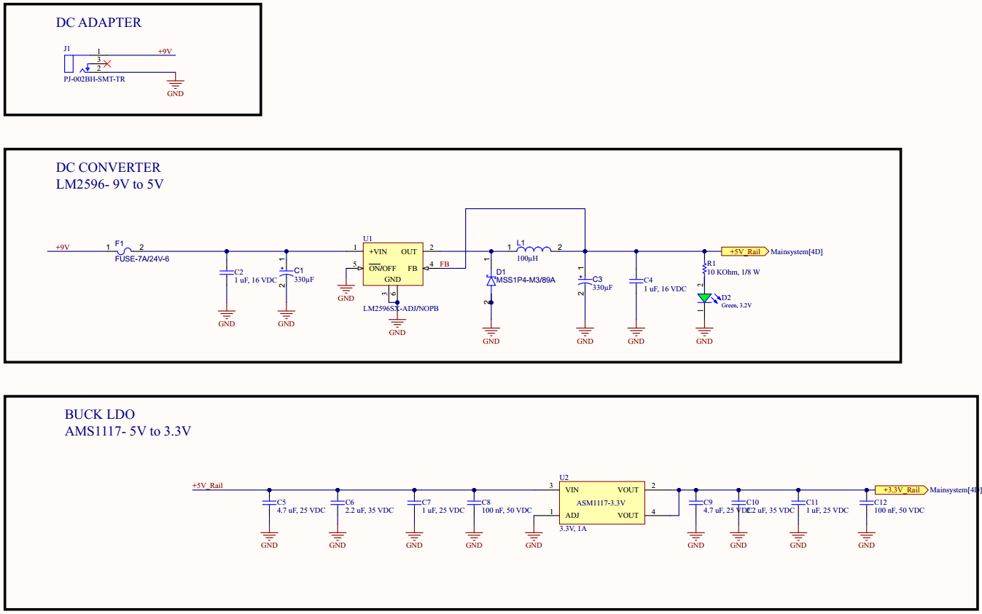
Main schematic – Power supply

Slide 14
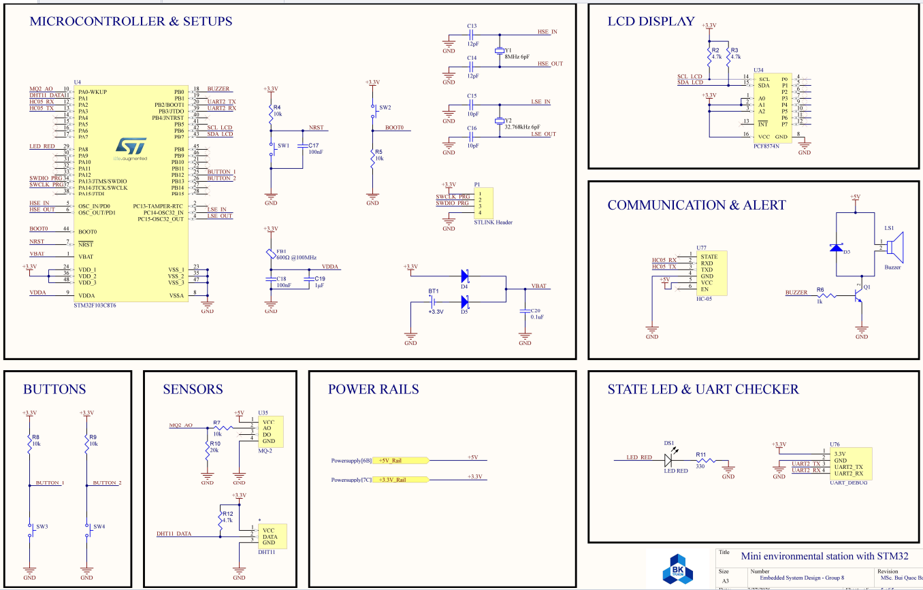
Main schematic – Main system

Slide 15
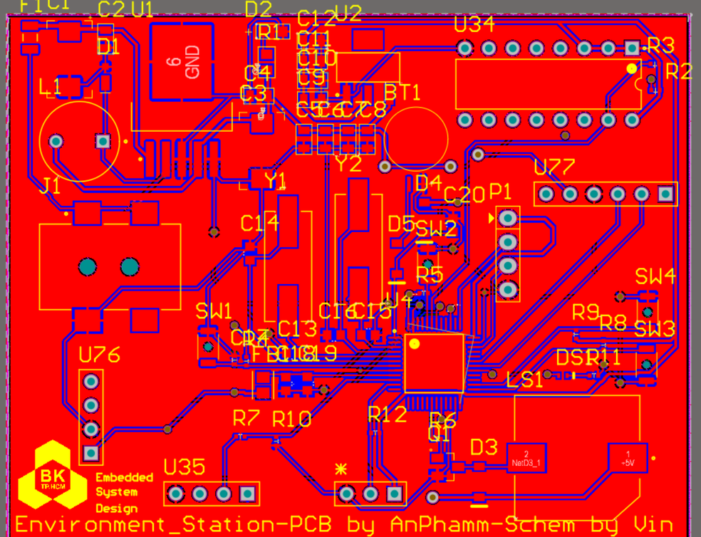
PCB Layout
·PCB designed in Altium.
·2D layout and 3D render completed.
·Fabricated PCB successfully received.
·Breadboard was still used for fast debugging and subsystem validation before final full deployment.
2D View

Slide 16
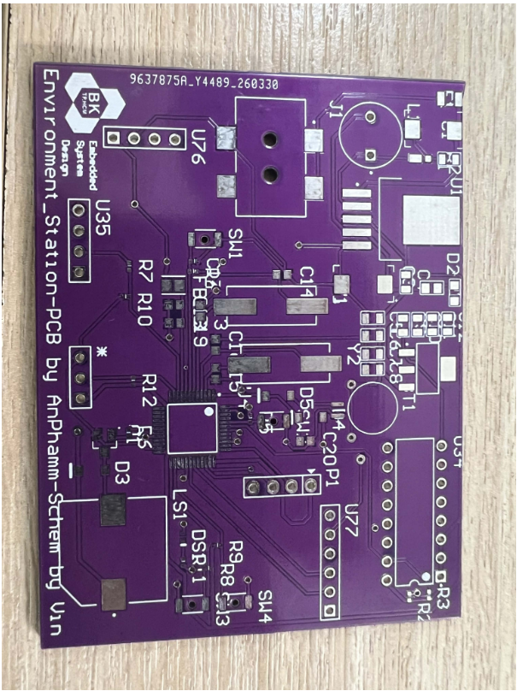
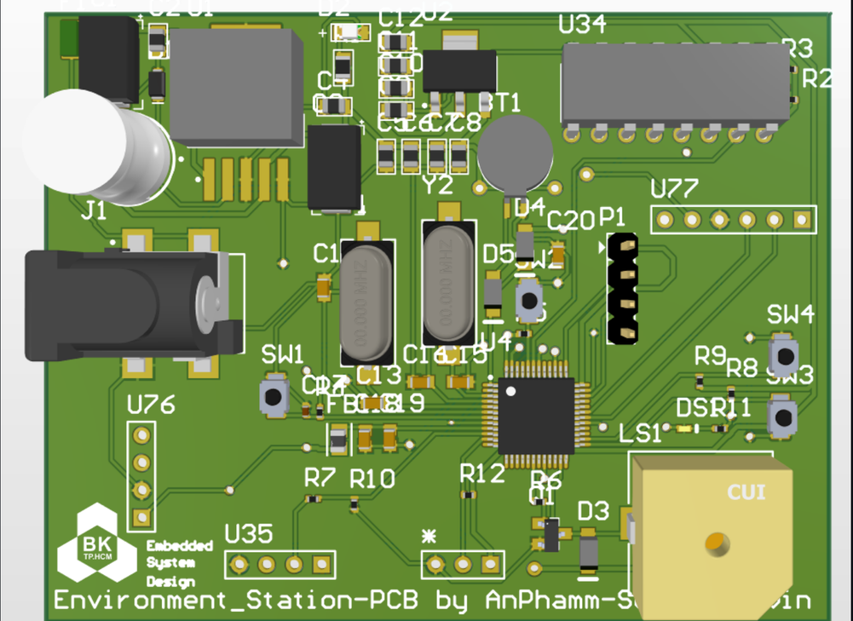
PCB Layout
3D View
Printed PCB

Slide 17
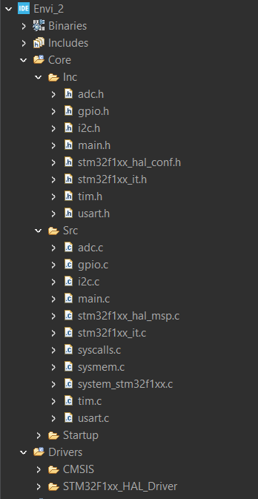
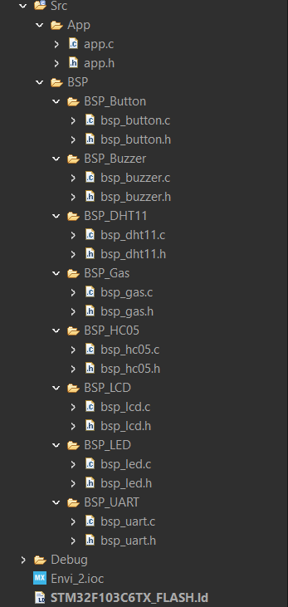
Firmware Architecture
·Firmware organized into two layers: BSP layer and APP layer.
·BSP contains low-level drivers for each hardware block.
·APP contains the main system logic.
·Benefits: modularity, easier debugging, easier future extension

Slide 18
Integration, Testing & Results
Full test: https://youtu.be/GwvQwB3FSAY
Gas test: https://youtu.be/L1KeKjgLLEk
Temp test: https://youtu.be/eYzAX3KRrvM

Slide 19
Thank you

