Slide 1
Event Management System
Karina Bakhtiyarova

Slide 2
Agenda
Tasks
Diagrams
Demo

Slide 3
Tasks
Designed an interface of Event Management System
Registration of users
Log-in/ Log-out
Create a new event

Slide 4
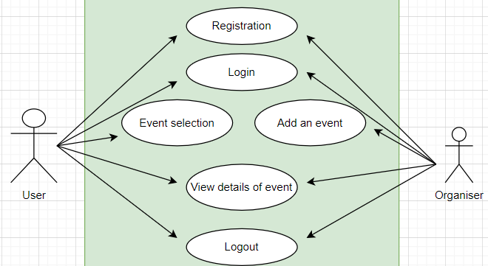

Slide 5
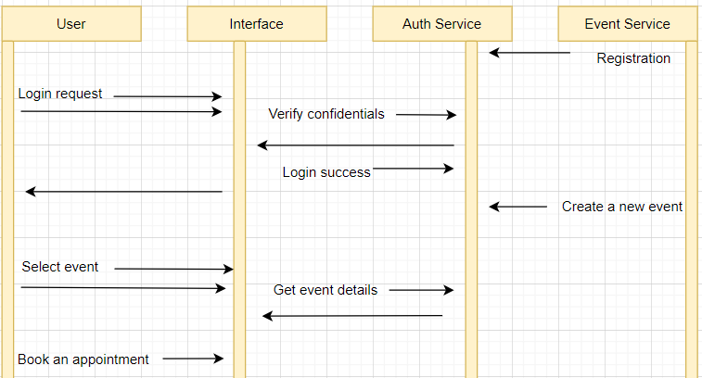

Slide 6
DEMO

