Slide 1
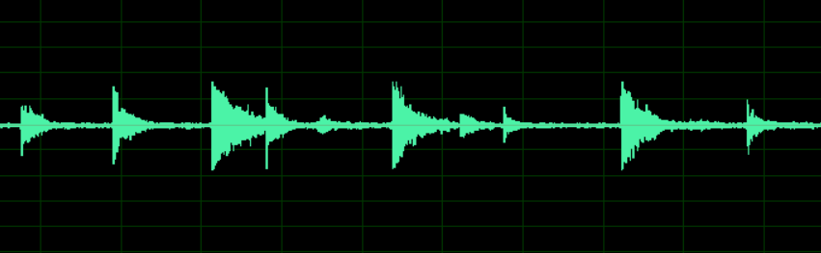
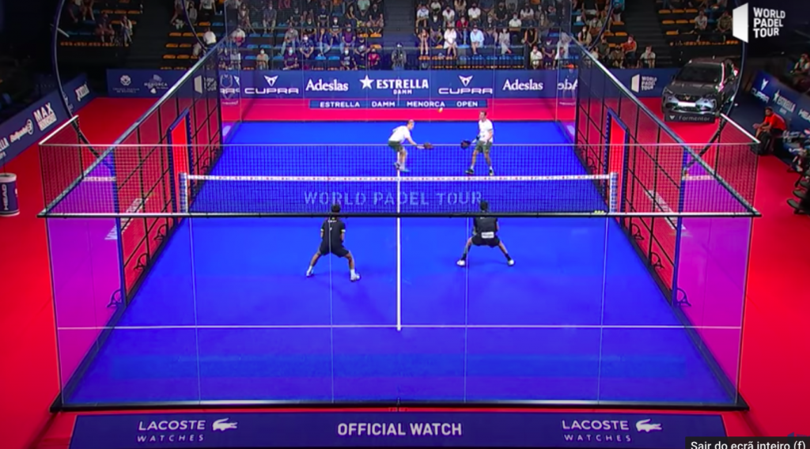
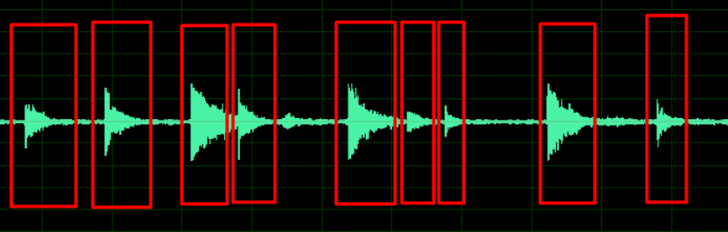



Audio
Video
Ball hits selection
+
=
Audio features extraction
(B)
Human ear audio
annotattion
(A)
Dataset with features and labels
(C)

Slide 2
Video
Audio
Audio data Processing
(offline)
Audio events classification
Show ball hit highlights

Slide 3
Video
Video segmentation (1 min each)
Video to audio conversion
Human ear annotation
Feature extraction
Labeling
(for each video)
Input data

Slide 4
ML algoritm choice (via ODM)
Define/ adjust hyper-parameters
Train with cross validation
Choose model with best results on test set
Classifier (model)

Slide 5
Generate clips
(with Python)
Show results
Organize clips and information associated in directory
Copy directory to Netbeans project app
Reterieve information from directory

Slide 6
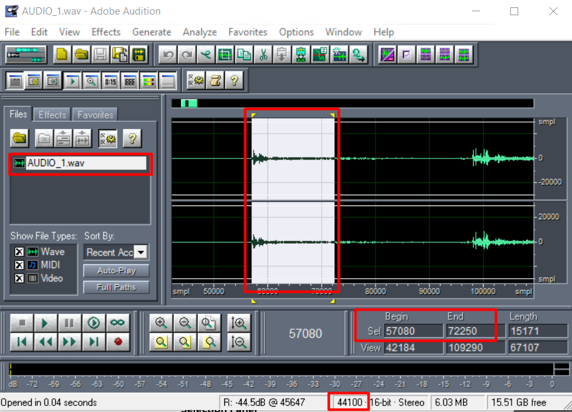
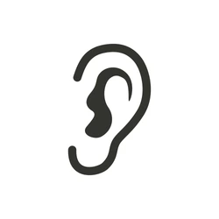
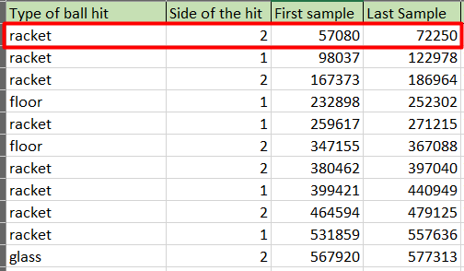
Ball hit selection
Ball hits annotation

Slide 7
Available Videos
Video_09_08_2022_15_48
Video_10_08_2022_15_48
Video_25_08_2022_15_48
…

Slide 8
all v
Audio
Video
Thumbnail da 1ª frame
ball-hit v
ball-hit v
noise v
ball-hit v
noise v
Previous
Next
<
>
…
Reset
Submit

Slide 9
all v
Start
End
Prob. (%)
Video: Video_10_08_2022_15_48
ball-hit v
--:--:--
--:--:--
--,--
Select
ball-hit v
--:--:--
--:--:--
--,--
Select
noise v
--:--:--
--:--:--
--,--
Select
ball-hit v
--:--:--
--:--:--
--,--
Select
noise v
--:--:--
--:--:--
--,--
Select
…
Previous
<
>
Next
Sort by probability
Reset
Submit

Slide 10
Ordenado por probabilidade crescente de ser batida de bola
Em “All” pode ter as opções: ball-hits, noise ou “all”
Video só apresenta a 1ª frame
Como nome da janela aparece o nome do vídeo: Video_09_08_2022_15_48

Slide 11



User
Browser
Data
Server

Slide 12
