Slide 1

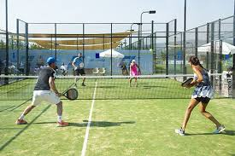
Department of Electronics, Telecommunications and Computer Engineering Degree in Informatics and Multimedia Engineering Academic Year of 2021/22
#47 - ANNOTATION OF SOUND EVENTS IN VIDEO
NR. 45118 - Carina Fernandes
Requirements Analysis
Guiding Teachers:
Joel Paulo
Paulo Trigo
Paulo Vieira

Slide 2
Contents to be addressed…
Aims and objectives
Clients
Goals to be achieved
Functional Requirements
Non Functional Requirements
Use Cases
Use Cases – Main scenario

Slide 3
Aims and Objectives
This project will develop a system that extracts relevant events from tennis (or padel) matches. The system in question will allow a general analysis of the game, which helps coaches, players or other entities in the analysis of the performance, through statistics;
Example of a relevant event: the impact of a ball on the racket, the floor, or the wall, noise from the audience (spectators).

Slide 4
Clients
This tool is intended for...
Sports centers for tennis and/or paddle tennis;
Amateur athletes;
Coaches who accompany various athletes;
Other spectators;
Basically, all entities that want to see a summary of the game...

Slide 5
Goals to be achieved
It is intended that the system will contribute to:
Identify the most important events;
Perform statistics to assist in the post-game analysis;
Save time.

Slide 6
Functional Requirements
Requirement | Function | Category
R1.1 | Extracting sound from video | Invisible
R1.2 | Sound processing and analysis (getting the features of relevant sounds) | Invisible
R1.3 | Machine learning of the sounds | Invisible
R1.4 | Labeling of the most relevant events in the game from sound | Evident
R1.5 | Identification of the most important moments, considering the events | Invisible
R1.6 | Make statistics that help in the post-game analysis | Evident
R1.7 | Show the result of all processing to the user | Evident

Slide 7
Non Functional Requirements
Atribute | Detail / Constraint | Category
Human-Machine Metaphor | Detail Easy-to-learn interface | Mandatory

Slide 8
System Functional and Non Functional Requirements
Ref.# | Function | Category | Attribute | Detail/Constraint | Category
R1.7 | Show the result of all processing to the user | Evident | Human-Machine Metaphor | Detalhe Interface fácil de aprender a usar | Obrigatório

Slide 9
Use Cases (I)
Ator | Processo
Coach | Get the most important events Watch the most relevant moments Get a performance review
Player | Get the most important events Watch the most relevant moments Get an analysis of (his) performance
Spectator | Get the most important events Watch only the most relevant moments of the game

Slide 10
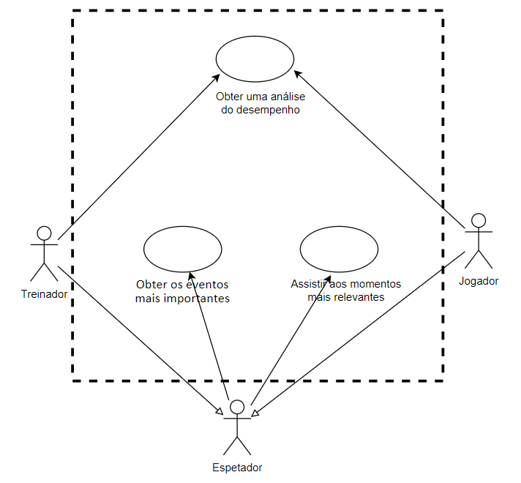
Use Cases (II)

Slide 11
Use Cases (III)
Main Scenario
Header
Name: | Get the most important events
Summary: | A listing with statistics relating to the game
References: | R1.1, R1.2, R1.3, R1.4, R1.5, R1.6, R1.7
Main Scenario
Actor Action |  | System Response
1 | The Use Case starts when the spectator indicates that he/she wants to make a statistical analysis of a certain game
2 | The spectator uploads the game video
 |  | 3 | Extracting sound from video
 |  | 4 | Extracting relevant features
 |  | 5 | Machine Learning of Sounds
 |  | 6 | Identification of the most relevant moments
 |  | 7 | Show the game statistics

Slide 12

Any Questions?

