Slide 1

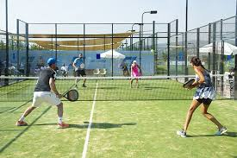
Department of Electronics, Telecommunications and Computer Engineering Degree in Informatics and Multimedia Engineering Academic Year 2021/22
ANOTAÇÃO DE EVENTOS SONOROS EM VÍDEO
Carina Fernandes (Nr. 45118)
Advisors:
Joel Paulo
Paulo Trigo
Paulo Vieira
PRJ: #47

Slide 2
Contents
Objectives
Requirement Analysis
Class and sequence diagrams
Dataset Construction
Technologies and version control
Related research
2

Slide 3
Requirements Analysis

Slide 4
Objectives
Simulate the human ear (recognizing ball hits)
Develop a system that extracts ball hits from padel matches
Dataset Construction
Provide a general summary of the game (statistics)
4

Slide 5
Clients
This tool is intended for...
Amateur athletes
Coaches who accompany various athletes;
Other spectators
Basically, all entities that want to see a summary of the game...

Slide 6
Goals
It is intended that the system will contribute to:
Identify the most important events
Perform statistics to assist in the post-game analysis
Save time

Slide 7
Functional Requirements
Dataset Construction
Requirement | Function | Category
R1.1 | Extract sound from video | Invisível
R1.2 | Sound labeling | Invisível
R1.3 | Get features vector | Invisível
R1.4 | Organize the features and corresponding labeling | Invisível
R1.5 | Comparing models on Orange Data Mining | Invisível

Slide 8
Functional Requirements
Classification
Requirement | Function | Category
R1.6 | Extract sound from video | Invisible
R1.7 | Get features vector | Invisible
R1.8 | Classification of the events | Invisible
R1.9 | Get the most relevant events | Evident
R1.10 | Perform Statistics | Evident
R1.11 | Show the game statistics | Evident

Slide 9
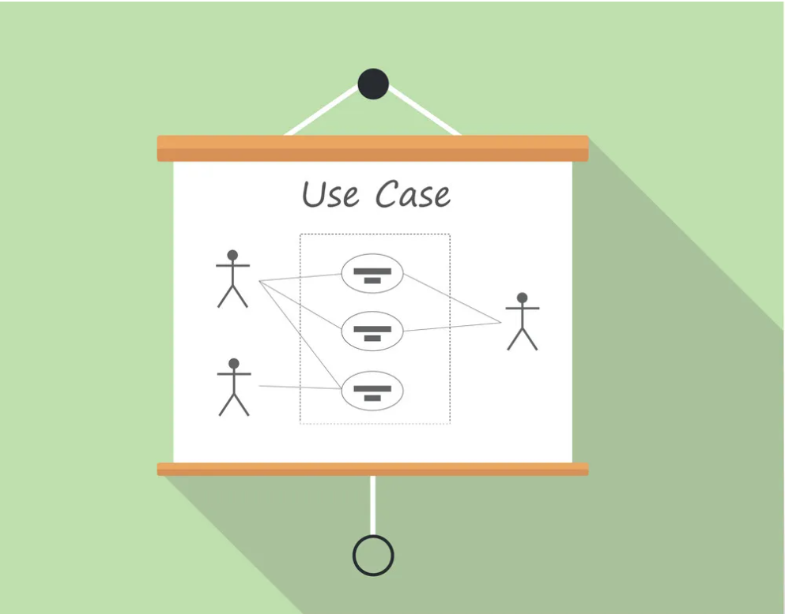
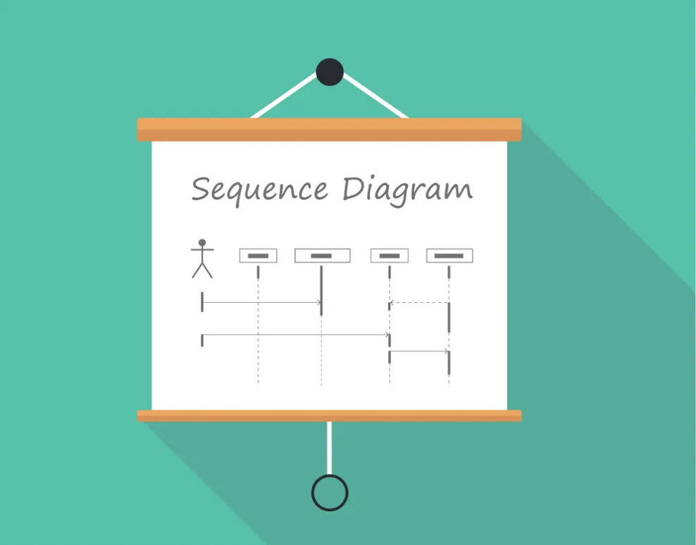
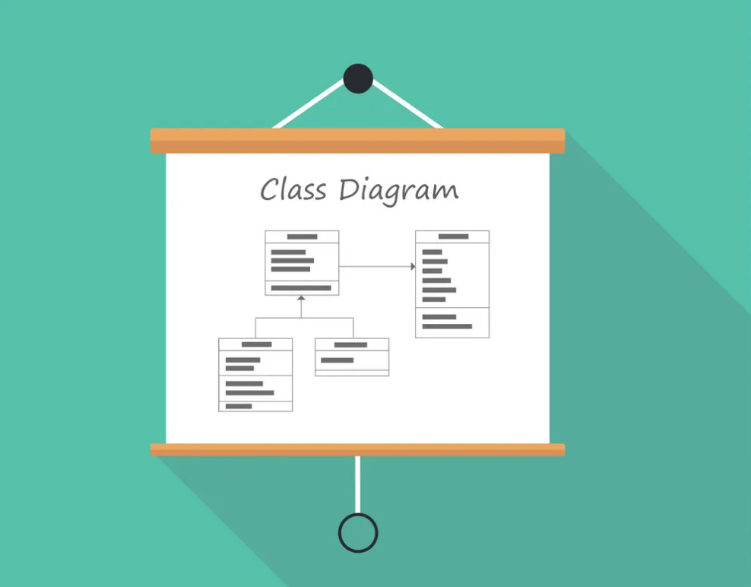
Models and Diagrams

Slide 10
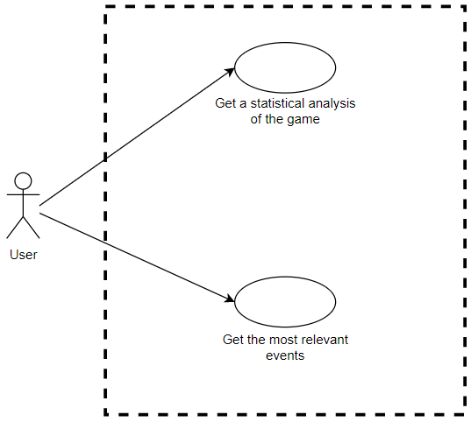
Use Cases
Diagram

Slide 11
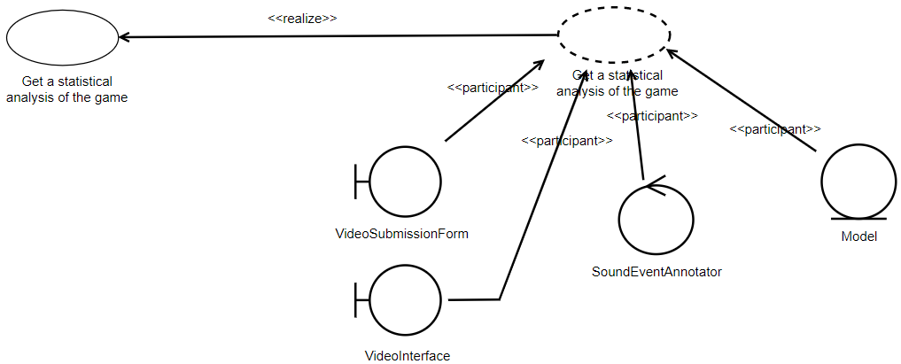
Class Diagram
Use Case Diagram → Class Diagram

Slide 12
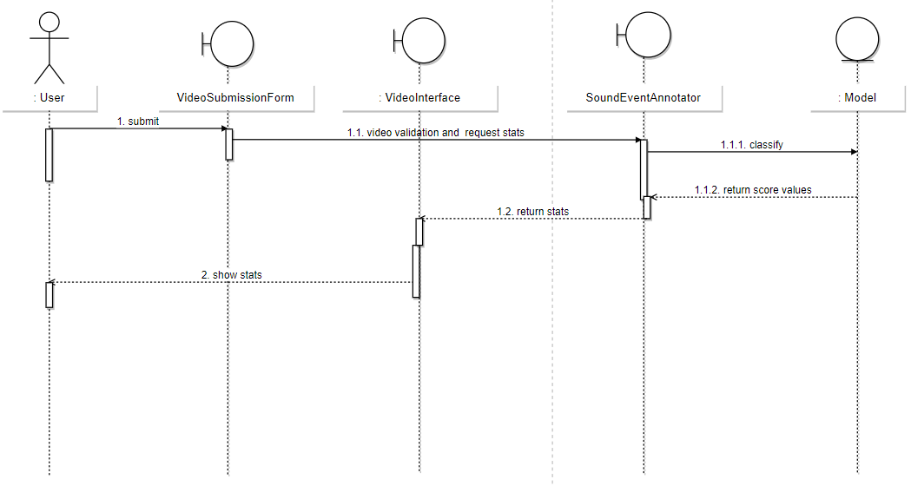
Sequence Diagram
Sequence Diagram

Slide 13
Dataset Construction

Slide 14
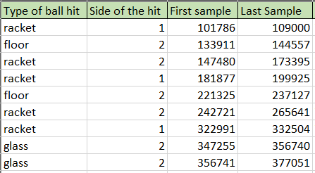
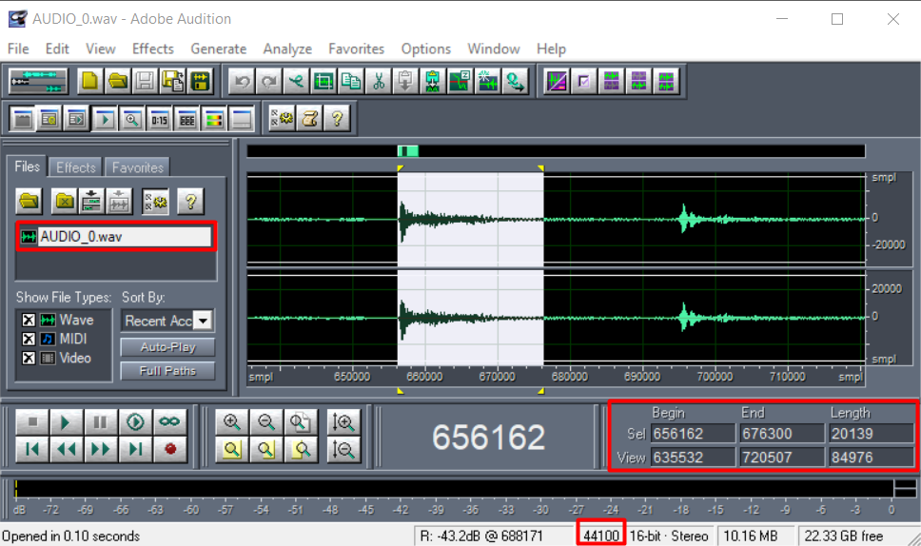
Labeling
Registration of events
Selection Panel
Ball hit selection
Sample rate: 44100Hz

Slide 15
Features
Onset
identifies the beginning of a sound
RMS
measures the signal level/energy
Spectral Flux
measures how the difference between two consecutive windows
[11]
[12]
[13]
Notes:
Estas características podem ser obtidas através da biblioteca librosa

Slide 16
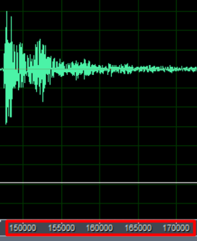
Features
The audio is taken at a sampling frequency of 44100Hz
The librosa library
uses the STFT
allows you to choose the number of hops in the feature calculation
first approach: we can choose a value of 1024 for the hop length
0.5 s = 22 050 samples = 22 050 / 1024 ≈ 20 groups of 1024 samples!
impact from a ball hit ≈ 0.5s
Notes:
A STFT divide o sinal em pequenos segmentos com o mesmo tamanho e aplica a FT em cada um deles

Slide 17
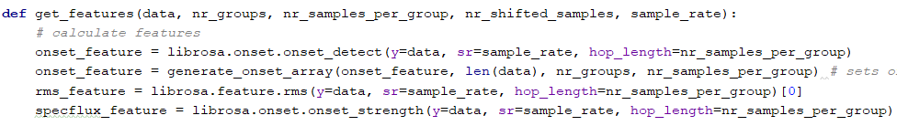
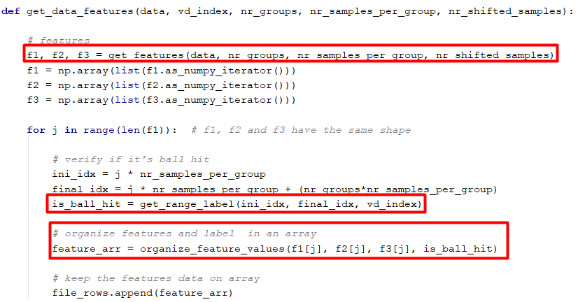
Features calculation and saving
Features calculation
Filling in the file containing the features

Slide 18
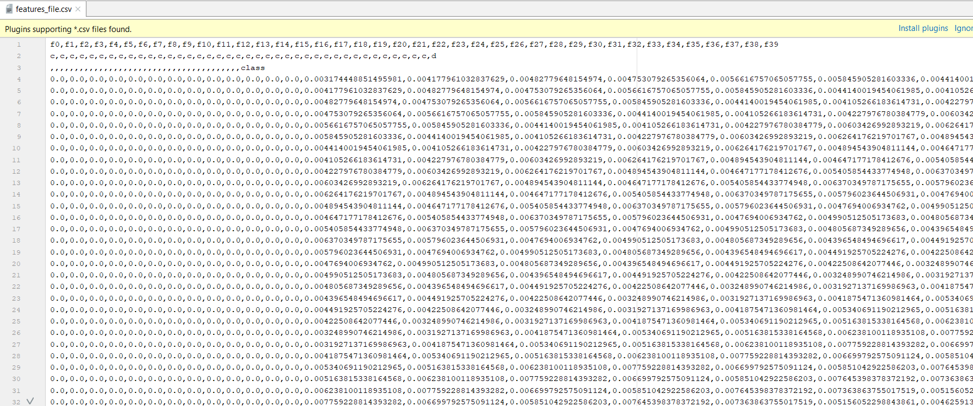
Dataset
[X1,X2,…, y]
File containing the characteristics(X) and labels(y)

Slide 19
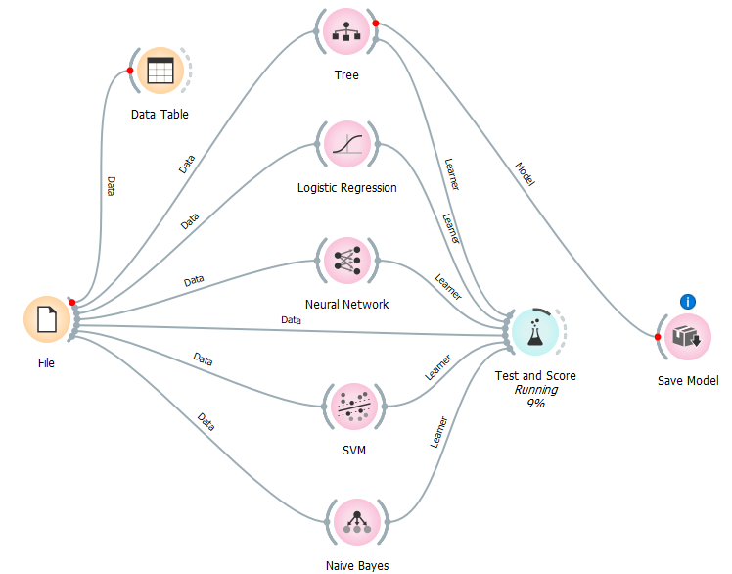
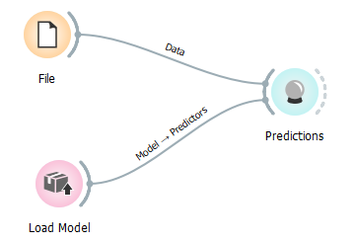
Comparing Models (I)
Classify with new data
Train and evaluate

Slide 20
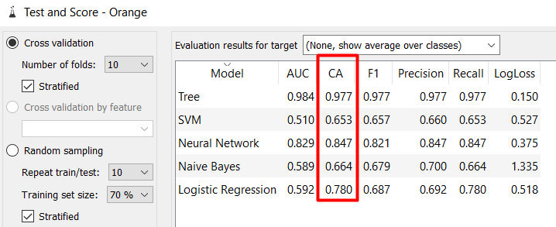
Comparing Models (II)
Best results for Decision Tree
and Neural Networks!
Results of each model

Slide 21
Neural Network Model

Slide 22
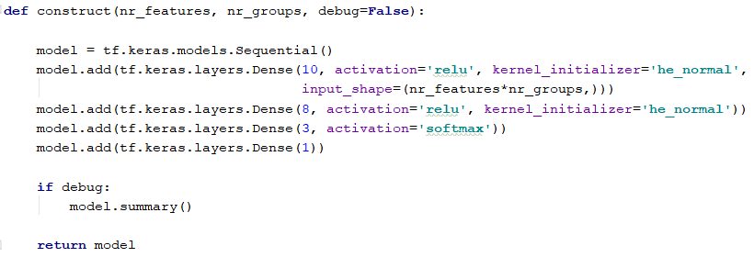
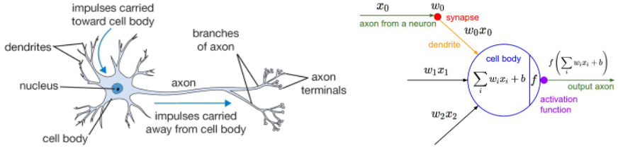
Neural Network (I)
[14]
Construct the model
Biological neuron (left) and a common mathematical model (right)

Slide 23
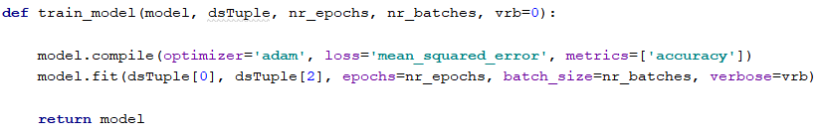

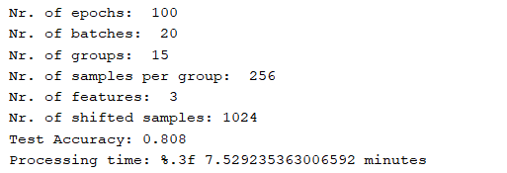
Neural Network (II)
Train the model
dsTuple = X_train, X_test, y_train, y_test
Evaluate the model
Results
Notes:
Batch size: nº de exemplos que atravessam a rede de cada vez
Epochs: cada época corresponde à passagem de todos os exemplos pelas rede

Slide 24
Tecnologies and Version Control

Slide 25
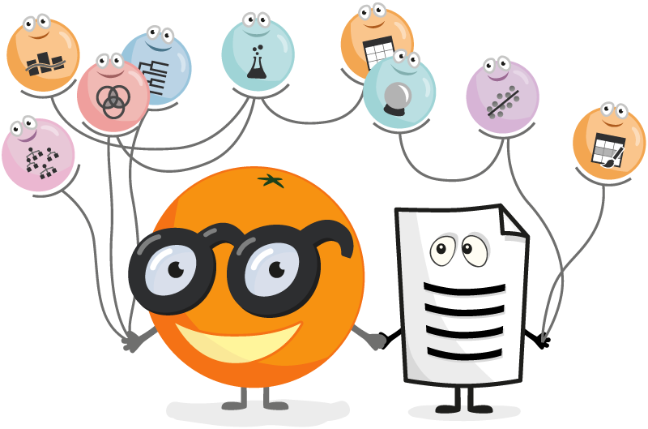





Technologies
Adobe Audition
Git and Github
Orange Data Mining
Python
Tensorflow
Librosa
Sklearn
…

Slide 26
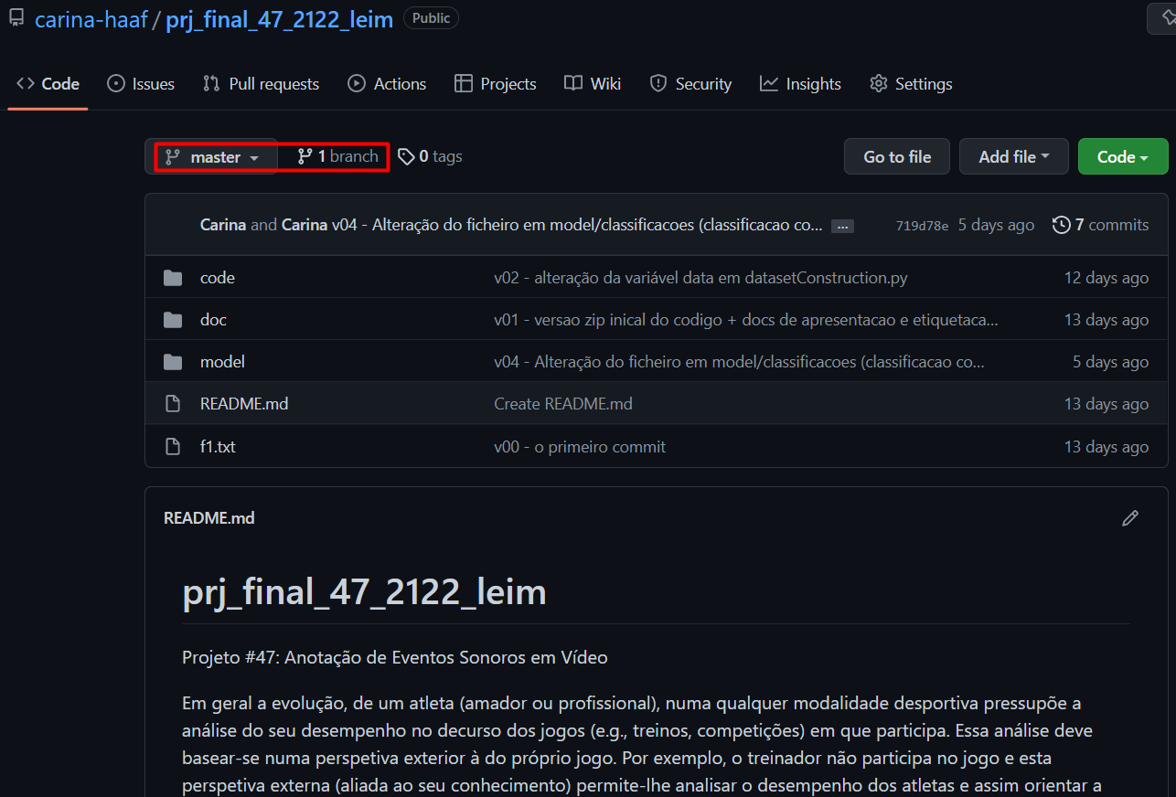
Version Control
Git Repository: https://github.com/carina-haaf/prj_final_47_2122_leim.git

Slide 27

Related Research

Slide 28
Related Research
Detection of Tennis Events from Acoustic Data
Authors: Aaron Baughman, Eduardo Morales, Gary Reiss, Nancy Greco, Stephen Hammer, Shiqiang Wang
Link: https://shiqiang.wang/papers/AB_MMSports2019.pdf
Automatic annotation of tennis games: An integration of audio, vision, and learning
Authors: Fei Yan, Josef Kittler, David Windridge, William Christmas, Krystian Mikolajczyk, Stephen Cox, Qiang Huang
Link: https://www.academia.edu/14129713/Automatic_annotation_of_tennis_games_An_integration_of_audio_vision_and_learning

Slide 29
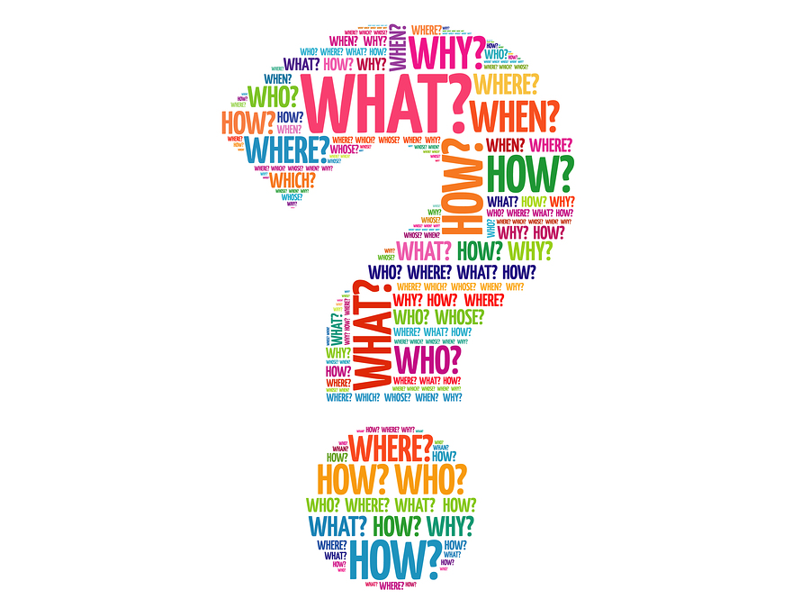
Questions?
[1]

Slide 30

[2]
30

Slide 31
Bibliografia
[1] - https://www.skipprichard.com/ask-questions-to-improve-your-leadership/
[2] - https://orangedatamining.com/
[3] - https://git-scm.com/
[4] - https://en.wikipedia.org/wiki/Python_(programming_language)
[5] - https://www.vectorstock.com/royalty-free-vector/uml-unified-modelling-language-class-diagram-vector-9300368
[6] - https://www.vectorstock.com/royalty-free-vector/uml-unified-modelling-language-use-case-diagram-vector-9300340
[7] - https://www.vectorstock.com/royalty-free-vector/uml-unified-modelling-language-sequence-diagram-vector-9300377
[8] - https://www.gov.uk/government/news/say-thank-you-to-someone-at-companies-house
[9] - https://logowik.com/content/uploads/images/adobe-audition-cc3560.jpg

Slide 32
Bibliografia
[10] - https://upload.wikimedia.org/wikipedia/commons/thumb/2/2d/Tensorflow_logo.svg/1200px-Tensorflow_logo.svg.png
[11] - https://en.wikipedia.org/wiki/Onset_(audio)#:~:text=Onset%20refers%20to%20the%20beginning,necessarily%20include%20an%20initial%20transient.
[12] - https://athina-b.medium.com/audio-signal-feature-extraction-for-analysis-507861717dc1
[13] - https://www.sciencedirect.com/topics/engineering/spectral-flux
[14] - https://towardsdatascience.com/a-gentle-introduction-to-neural-networks-series-part-1-2b90b87795bc

