Slide 1

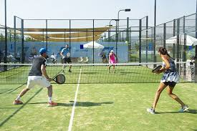
Department of Electronics, Telecommunications and Computer Engineering Degree in Informatics and Multimedia Engineering Academic Year 2021/22
ANOTAÇÃO DE EVENTOS SONOROS EM VÍDEO
Carina Fernandes (Nr. 45118)
Advised by:
Joel Paulo
Paulo Trigo
Paulo Vieira
PRJ: #47

Slide 2
Contents
Related work
Technologies and version control
Requirement analysis
Features dataset
Model construction and classification process
Schedule
2

Slide 3
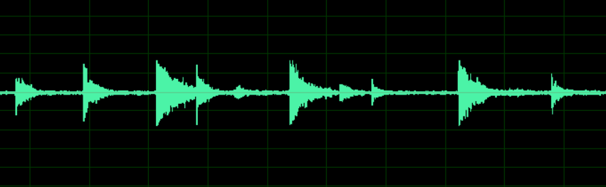
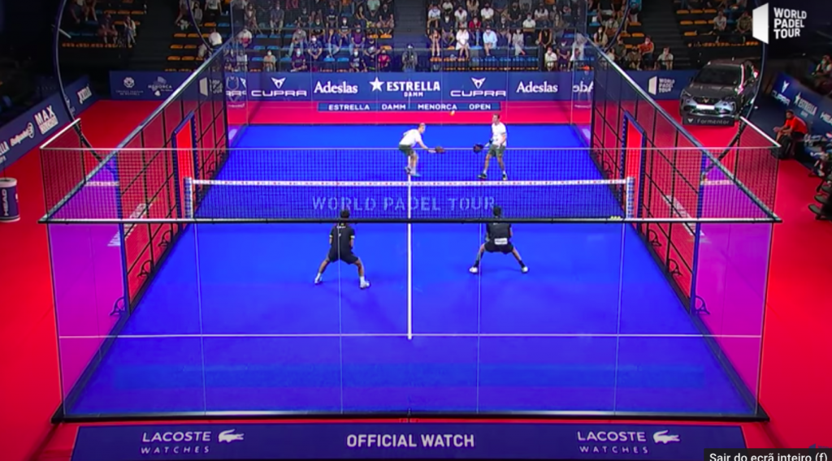
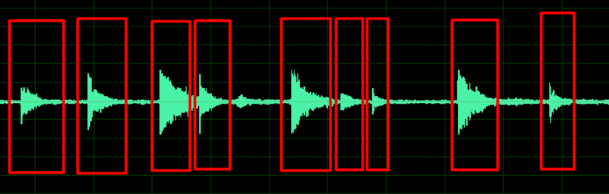



Objectives
Simulate the human ear (recognize ball hits) – A
Human ear audio annotation
Audio Features Extraction – B
Audio features dataset with fixed length (0.5 seconds)
Dataset Construction – C
C = A + B
Construct a system to classify and improve the dataset
Provide a general summary of the game (statistics)
(For each video)
Audio
Videos
Ball hits selection
+
=
Human ear audio
annotattion
(A)
Dataset with features and labels
(C)
Audio features extraction
(B)
3

Slide 4

Related Research

Slide 5
Papers
Detection of Tennis Events from Acoustic Data
Authors: Aaron Baughman, Eduardo Morales, Gary Reiss, Nancy Greco, Stephen Hammer, Shiqiang Wang
Date: October, 2019
Link: https://shiqiang.wang/papers/AB_MMSports2019.pdf
Automatic annotation of tennis games: An integration of audio, vision, and learning
Authors: Fei Yan, Josef Kittler, David Windridge, William Christmas, Krystian Mikolajczyk, Stephen Cox, Qiang Huang
Date: 2014
Link: https://www.academia.edu/14129713/Automatic_annotation_of_tennis_games_An_integration_of_audio_vision_and_learning

Slide 6

Tecnologies and Version Control

Slide 7
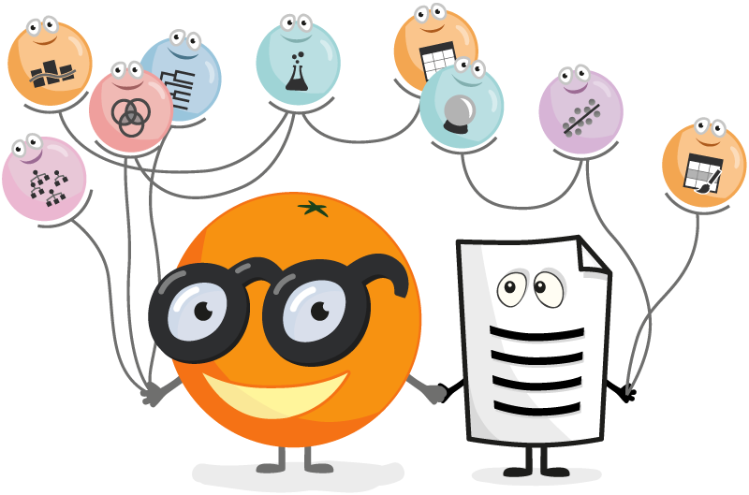





Technologies
Adobe Audition
Git and Github
Orange Data Mining
Python libraries
Tensorflow
Librosa
Sklearn
…

Slide 8
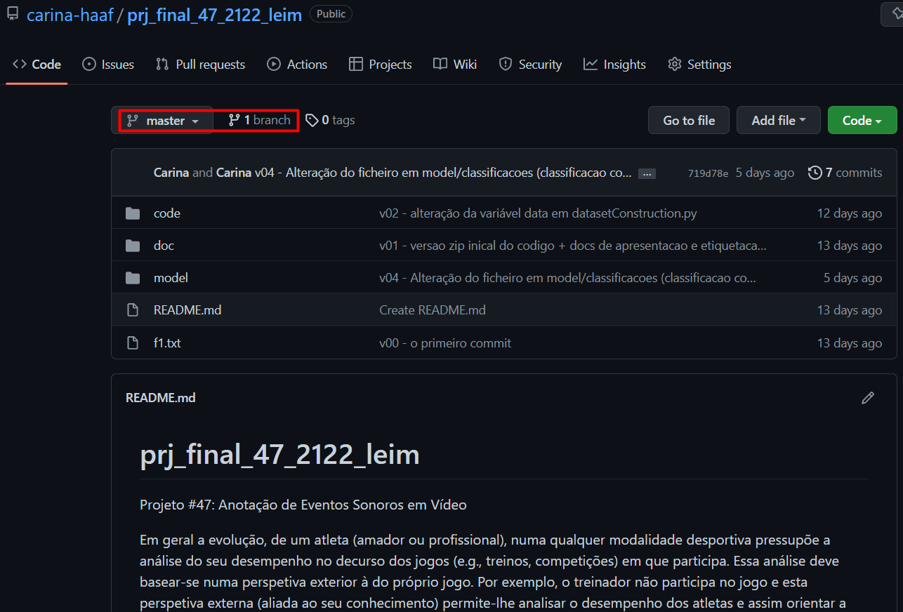
Version Control
Git Repository: https://github.com/carina-haaf/prj_final_47_2122_leim.git

Slide 9
Requirements Analysis

Slide 10
Clients POV
This tool is intended for...
Amateur athletes, coaches who accompany various athletes
Basically, all entities that want to see a summary of the game
The system will contribute to…
Identify the most important events
Perform statistics to assist in the post-game analysis
Save time

Slide 11
Functional Requirements
Dataset Construction
Requirement | Function | Category
R1.1 | Extract audio from video | Invisible
R1.2 | Human ear audio annotattion (A) | Invisible
R1.3 | Extract fixed length audio features (B) | Invisible
R1.4 | Combine A and B datasets | Invisible
R1.5 | Explore classification models (via Orange Data Mining) | Invisible

Slide 12
Functional Requirements
Classification
Requirement | Function | Category
R1.6 | Extract audio from video | Invisible
R1.7 | Extract fixed length audio features (via librosa) | Invisible
R1.8 | Apply classifier | Invisible
R1.9 | Compute statistics for hit balls | Evident
R1.10 | Show statistics | Evident

Slide 13
Dataset Construction

Slide 14
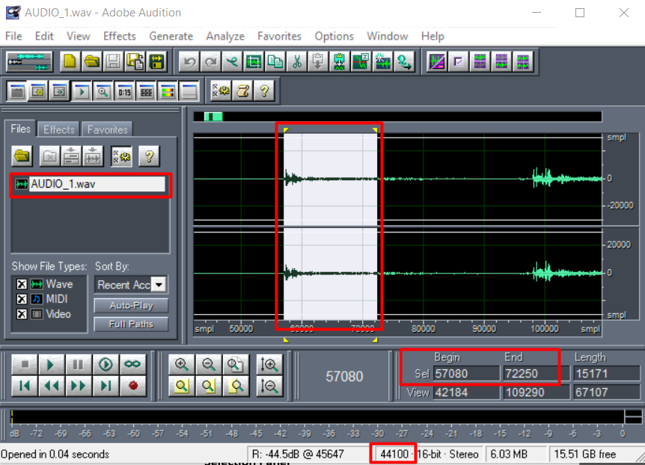

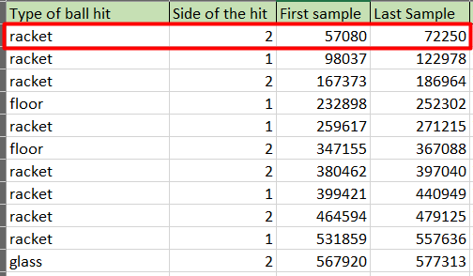
Human ear audio annotation
Registration of ball hits
Ball hits annotation
Ball hit selection
Sampling rate: 44100Hz

Slide 15
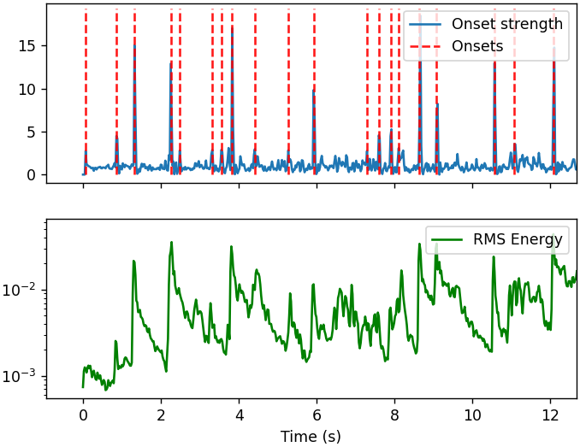
Features
Onsets
detects peaks in the signal
Onset detect
Onset strength (spectral flux)
RMS
measures the signal energy
Audio Features
Notes:
Estas características podem ser obtidas através da biblioteca librosa

Slide 16
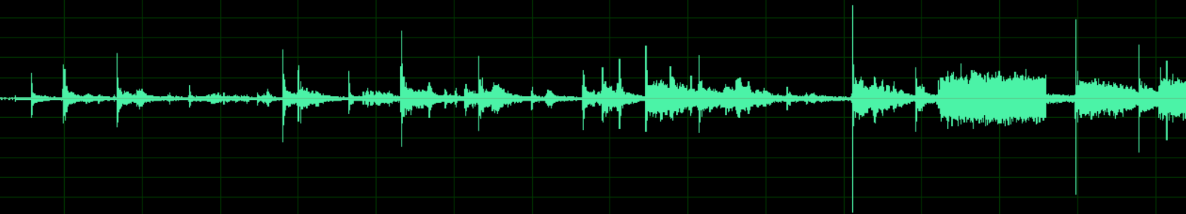
Features extraction with fixed audio length
Feature extraction
X
Audio
F1
F2
F3
f0,0
f0,1
f0,2
…
f0,M
.
.
.
N examples
F1 – RMS
F2 – Onset Detect
F3 – Onset Strength
fN,0
fN,1
fN,2
…
fN,M
0.5 seconds = M groups
Notes:
A STFT divide o sinal em pequenos segmentos com o mesmo tamanho e aplica a FT em cada um deles

Slide 17
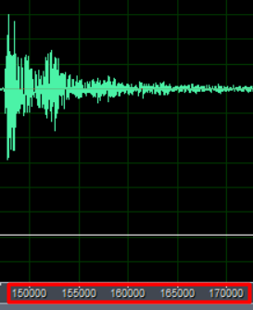
Features extraction with fixed audio length
Sampling rate
44100Hz
Ball hit length
0.5 seconds = 22050 samples
Librosa library
Calculates the features considering number of samples (hop length)
Number of samples
256 → 22 050 / 256 ≈ 86
512 → 22 050 / 512 ≈ 43
1024 → 22 050 / 1024 ≈ 21
2048 → 22050 / 2048 ≈ 10
First approach
hop length = 1024
impact from a ball hit ≈ 0.5s
Notes:
A STFT divide o sinal em pequenos segmentos com o mesmo tamanho e aplica a FT em cada um deles

Slide 18
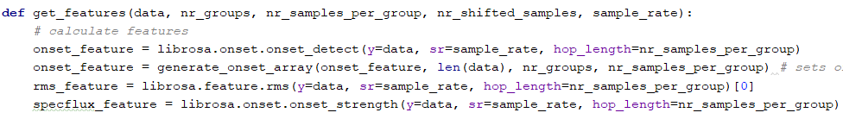
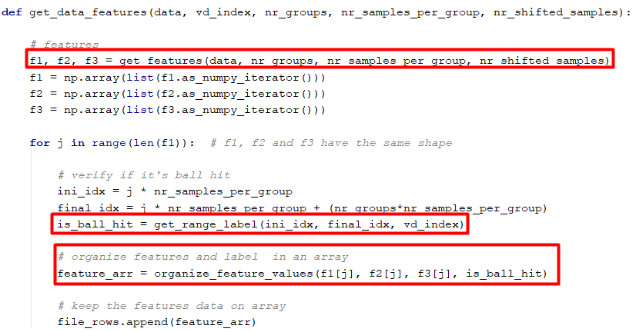
Combining datasets
Features calculation
Features
Dataset
Labels
(Store dataset on a file)
Filling in the file containing the features

Slide 19
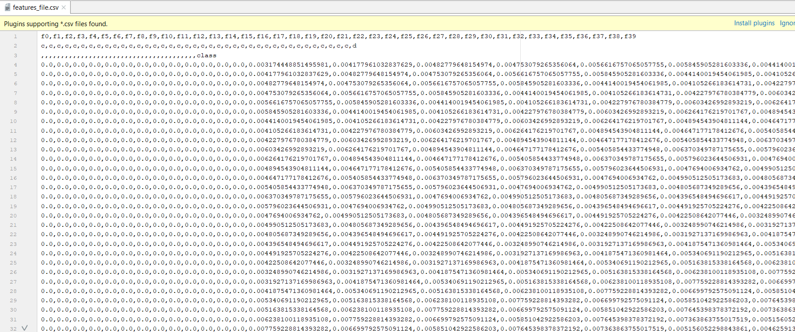
Dataset
[F1, F2, F3, y]
CSV file containing the features(X) and labels(y)

Slide 20
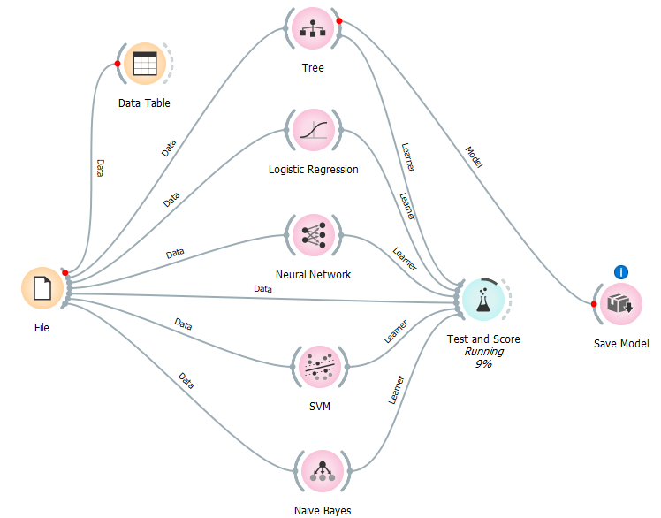
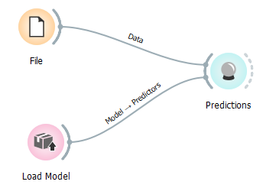
Exploring Classification Models (I)
Load model and classify with new data
Train and evaluate

Slide 21
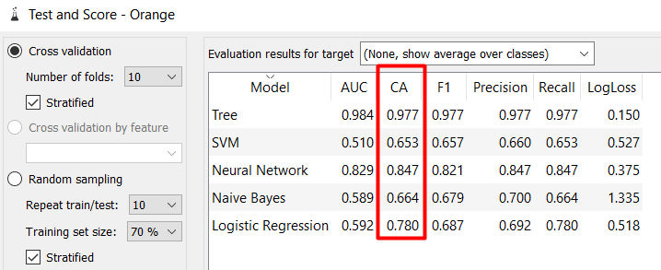
Exploring Classification Models (II)
Best results for Decision Tree
and Neural Networks!
Results of each model

Slide 22
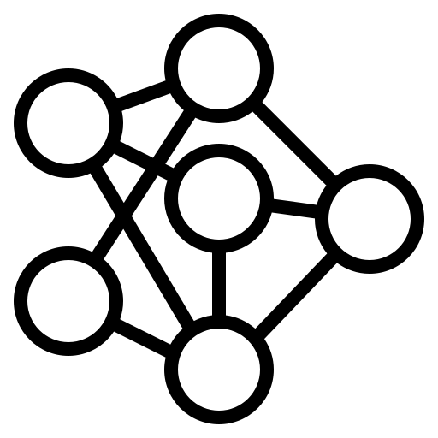
Neural Network Model

Slide 23
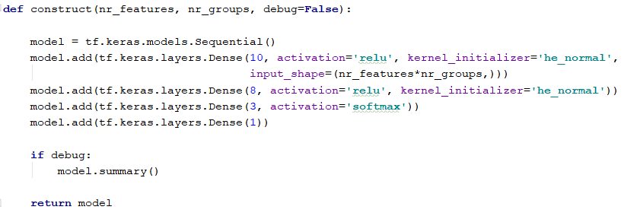
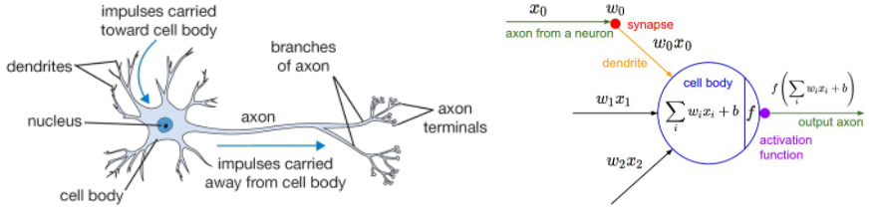
Neural Network (I)
[14]
Construct the model
Biological neuron (left) and a common mathematical model (right)

Slide 24
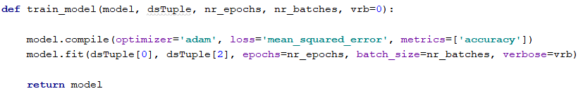

Neural Network (II)
Train the model
dsTuple = [X_train, X_test, y_train, y_test]
Evaluate the model
Notes:
Batch size: nº de exemplos que atravessam a rede de cada vez
Epochs: cada época corresponde à passagem de todos os exemplos pelas rede

Slide 25
Classification process
X
y_est
New Video
Audio
Audio features
Model
Audio estimated classes
Notes:
Batch size: nº de exemplos que atravessam a rede de cada vez
Epochs: cada época corresponde à passagem de todos os exemplos pelas rede

Slide 26

Some Results
Y = 1 → Ball hit
Y = 0 → Non ball hit
Audi Scan
False Positive
False Negative
y_true = 0 and y_est = 1
y_true = 1 and y_est = 0
y_est
y_est
Audio estimated classes
True Positive
True Positive
y_true = 1 and y_est = 1
y_true = 0 and y_est = 0
y_true
Audio true classes
Notes:
Batch size: nº de exemplos que atravessam a rede de cada vez
Epochs: cada época corresponde à passagem de todos os exemplos pelas rede

Slide 27

Planning

Slide 28
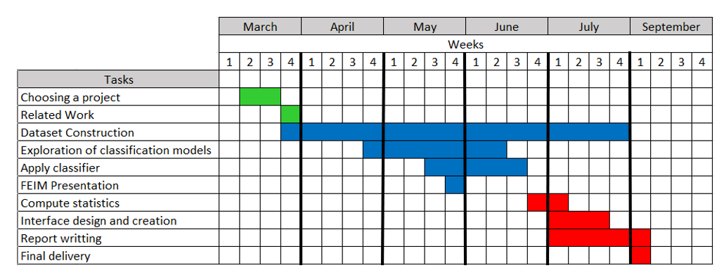
Schedule
 |  | To be done
 |  | On execution
 |  | Done
Notes:
Batch size: nº de exemplos que atravessam a rede de cada vez
Epochs: cada época corresponde à passagem de todos os exemplos pelas rede

Slide 29

[2]
29

Slide 30
Bibliografia
[1] - https://www.skipprichard.com/ask-questions-to-improve-your-leadership/
[2] - https://orangedatamining.com/
[3] - https://git-scm.com/
[4] - https://en.wikipedia.org/wiki/Python_(programming_language)
[5] - https://www.vectorstock.com/royalty-free-vector/uml-unified-modelling-language-class-diagram-vector-9300368
[6] - https://www.vectorstock.com/royalty-free-vector/uml-unified-modelling-language-use-case-diagram-vector-9300340
[7] - https://www.vectorstock.com/royalty-free-vector/uml-unified-modelling-language-sequence-diagram-vector-9300377
[8] - https://www.gov.uk/government/news/say-thank-you-to-someone-at-companies-house
[9] - https://logowik.com/content/uploads/images/adobe-audition-cc3560.jpg

Slide 31
Bibliografia
[10] - https://upload.wikimedia.org/wikipedia/commons/thumb/2/2d/Tensorflow_logo.svg/1200px-Tensorflow_logo.svg.png
[11] - https://en.wikipedia.org/wiki/Onset_(audio)#:~:text=Onset%20refers%20to%20the%20beginning,necessarily%20include%20an%20initial%20transient.
[12] - https://athina-b.medium.com/audio-signal-feature-extraction-for-analysis-507861717dc1
[13] - https://www.sciencedirect.com/topics/engineering/spectral-flux
[14] - https://towardsdatascience.com/a-gentle-introduction-to-neural-networks-series-part-1-2b90b87795bc
[15] - https://bluecourts.pt/wp-content/uploads/2021/10/Captura-de-ecra%CC%83-2021-10-11-a%CC%80s-15.28.29-1024x568.png
[16] - https://www.dreamstime.com/write-document-icon-website-design-desktop-envelopment-development-premium-pack-write-document-vector-thin-line-icon-image165365932

Slide 32
Bibliografia
[17] - https://static.thenounproject.com/png/2200230-200.png
[18] - https://thumb1.shutterstock.com/image-photo/stock-vector-ear-icon-on-white-background-vector-illustration-250nw-308905124.jpg

