Slide 2
=crediit history=?
5
unlnown
4bad
5good
2high
2low
1moderate
1high
2low
2moderate
3high
1moderate

Slide 3
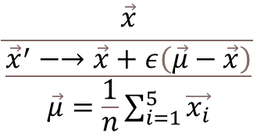
$$\frac{\vec{x}}{\frac{{\vec{x}}^{′}−→\vec{x}+ε\left(\vec{μ}−\vec{x}\right)}{\vec{μ}=\frac{1}{n}\sum_{i=1}^{5}{\vec{x_{i}}}}}$$

Slide 4
環境刺激
背景刺激(10度視角)
色刺激(2度視角)

