Slide 1











Home
About Us
Portfolio
Contact
03
ATM安全模組
Security Function Modules of ATMChain

Slide 2




Trusted Authentication Module
Trusted Authentication Module
T-ATMChain
可信任認證模組
Data Sharing Module
S-ATMChain
Access Control Module A-ATMChain
資料共享模組
存取控制模組
Home
About Us
Portfolio
Contact

Slide 3
Trusted Authentication Module
Trusted Authentication Module, T-ATMChain 模組設計
分散式特徵
透過數位憑證（T-Cert）實現身分驗證。將數位憑證（T-Cert）集成到區塊鏈中，對完整之生命周期和驗證域間信任關係進行管理。
解決PKI／CA 驗證中證書路徑構建困難的問題
確保 ATM 用戶存取與資料共享的安全性。
實現 4A 安全模型中的身份驗證功能
保證系統與用戶之間的信任機制。
Home
About Us
Portfolio
Contact

Slide 4
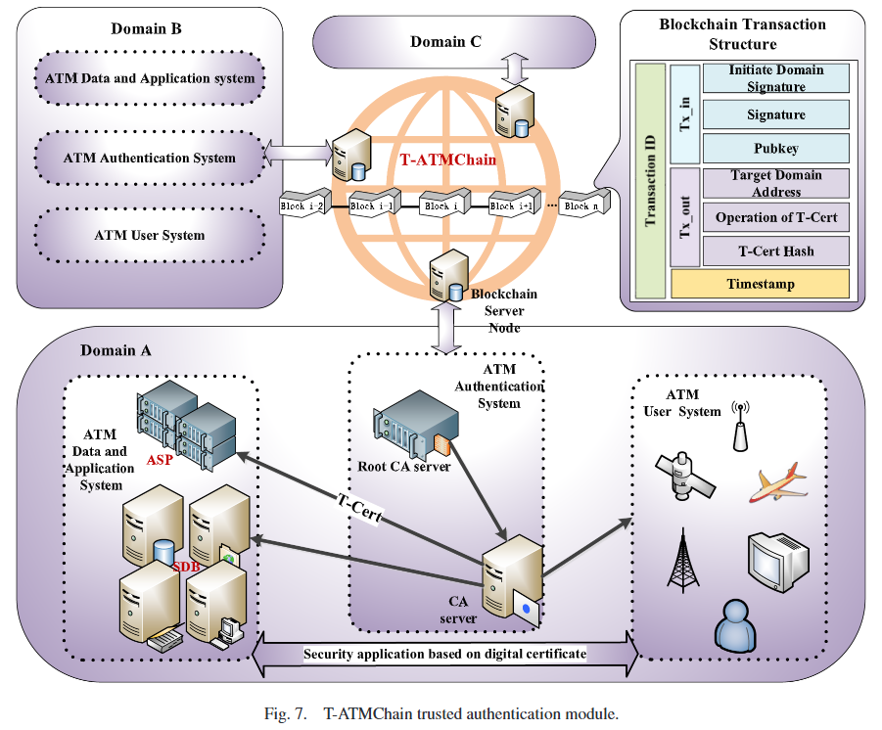
Trusted Authentication Module

Slide 5
Trusted Authentication Module
Trusted Authentication Module, T-ATMChain 模組設計
分散式驗證
驗證系統 (ATM Authentication Subsystem)
資訊應用系統 (Data Application Subsystem)
ATM 用戶系統 (ATM User Subsystem)
Home
About Us
Portfolio
Contact

Slide 6
Trusted Authentication Module

Slide 7




Trusted Authentication Module
T-ATMChain 身分驗證過程
域內驗證
跨域驗證
驗證請求者提交
T-Cert
CA 節點將 T-Cert 進行雜湊（hash），生成 T-CertH
在 T-CertH-Set 中查找相同的 T-CertH
驗證請求者提交
T-Cert
驗證請求者所屬驗證域的 RCA 的 T-CertH
更嚴格的雙重驗證機制
Notes:
域內驗證步驟：
驗證請求者提交 T-Cert
CA 節點將 T-Cert 進行雜湊（hash），生成 T-CertH
在 T-CertH-Set 中查找相同的 T-CertH
跨域驗證步驟：
驗證請求者的 T-CertH
驗證請求者所屬驗證域的 RCA 的 T-CertH
增加了更嚴格的雙重驗證機制

Slide 8
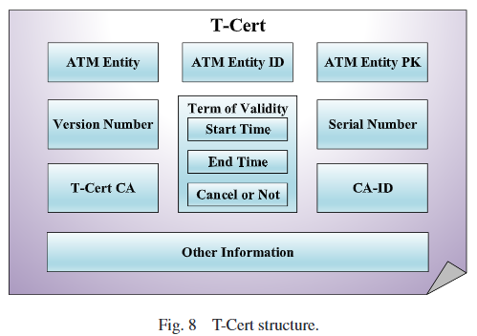
Trusted Authentication Module
T-Cert 數位憑證
相較於 X.509，移除了簽名模組，增加有效期限與撤銷標記功能。
憑證的撤銷或過期透過區塊鍊交易記錄，有效管理ATM機制內信任關係。
ATM 的 PKI 驗證方法通過使用數位簽章確保憑證持有者的身份與公鑰的綁定流程的真實且可信的，並使數位憑證防偽，以判斷憑證是否被篡改。
Notes:
相較於 X.509，移除了簽名模組，增加有效期限與撤銷標記功能。
憑證的撤銷或過期透過區塊鍊交易記錄，有效管理ATM機制內信任關係。
ATM 的 PKI (public key infrastructure, 公鑰基礎架構)驗證方法通過使用數位簽章確保憑證持有者的身份與公鑰的綁定流程的真實且可信的，並使數位憑證防偽，以判斷憑證是否被篡改。

Slide 9
Data Sharing Module
Data Sharing Module, S-ATMChain 模組設計
實現 4A 安全模型中的計費與審計功能，支持 ATM 部門間的資訊共享與追溯。傳統資料庫架構缺乏信任機制，S-ATMChain 透過區塊鏈確保共享資料的一致性與可追溯性。
ATM資料上鏈
DD-SC區塊鏈錨定。
ATM資料採集
DQ-SC區塊鏈查詢。
Home
About Us
Portfolio
Contact

Slide 10
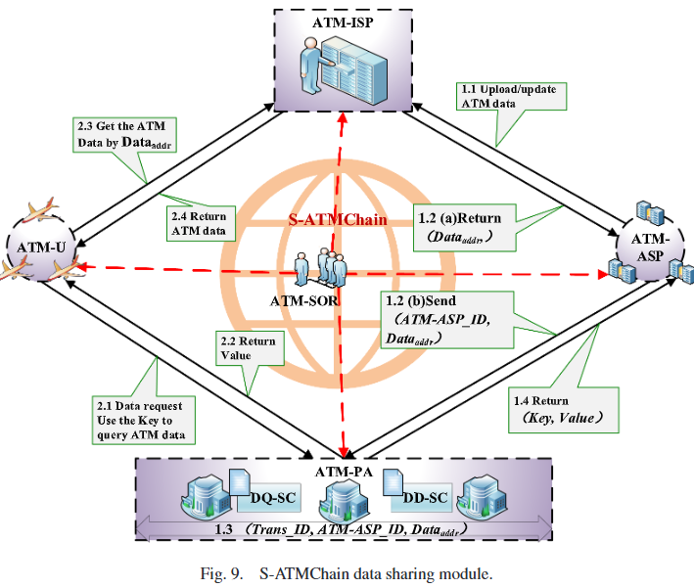
Data Sharing Module

Slide 11
Data Sharing Module
1.1 ATM資料上傳至雲端：當ATM資料被上傳或更新，ATM-ASP對資料進行雜湊處理並簽名。
1.2(a) 驗證與資料儲存：ATM-ISP驗證ATM-ASP的身分及資料，並返回資料儲存位址（Dataaddr）。
1.2(b) 資料傳遞與上鏈：ATM-ASP收到（Dataaddr）後，將資料（ATM-ASP_ID與Dataaddr）傳送至ATM-PA。
1.3 交易生成與共識：ATM-PA在區塊鏈（S-ATMChain）中進行交易生成、廣播並達成共識，組裝交易Key（ATM-ASP_ID, Trans_ID），將（Key, Dataaddr）儲存至區塊鏈的狀態資料庫中。
ATM 資料上鏈流程
Home
About Us
Portfolio
Contact

Slide 12
Data Sharing Module
DD-SC 區塊鏈錨定
資料分發智能合約（DD-SC）
在此時被調用，將ATM資料“錨定”至區塊鏈上。
Verify_TCert()：對T-Cert進行身分認證，通過前述提及的T-ATMChain的安全模組來完成。
Write_load()：經過認證後，DD-SC會將交易資訊（包括Trans_ID, ATM-ASP_ID, 和Dataaddr）打包成交易並廣播。
Return_metadata()：當交易達成共識後，DD-SC會生成並返回（Key, Value），回傳給ATM-ASP。
1.4 返回資料：資料上鏈完成，（Key,Value）被返回給ATM-ASP。
Home
About Us
Portfolio
Contact

Slide 13
Data Sharing Module
ATM 資料採集流程
資料請求：ATM-U通過S-ATMchain向ATM-ASP發起資料存取請求，ATM-ASP會返回（Key）。
2.1 存取控制驗證：ATM-U使用（Key）進行資料搜尋時，系統會利用A-ATMChain安全模組進行存取控制的驗證，確保資料存取範圍的相關安全性。
2.2 驗證完成後資料返回：經過驗證後，ATM-PA會將對應的（Value）返回給ATM-U，完成資料搜尋過程。
2.3 ／ 2.4 解析與資料存取：ATM-U收到資料（Value）後，解析（Value）中的（Dataaddr），以利後續在ATM-ISP系統中取得所需的ATM資料。
Home
About Us
Portfolio
Contact

Slide 14
Data Sharing Module
DQ-SC 區塊鏈查詢
資料查詢智能合約（DQ-SC）在此時被調用，，以幫助ATM-U獲取ATM資料在雲端的儲存位址。
Verify_TCert()：對T-Cert進行身分認證，身分驗證通過前述提及的T-ATMChain的安全模組來完成。
Query_key()：經過身分認證後，利用Key查詢對應的Value（即ATM資料），並將這一查詢過程作為交易廣播到區塊鏈中。
Return_value()：當交易達成共識後，將查詢結果，即Value，返回給ATM-U。
透過 S-ATMChain存取，確保資訊真實且未被篡改。S-ATMChain 利用區塊鏈分佈式架構來減輕 ATM 部門對失去資料控制權和主導權的擔憂，並確認 ATM 資料的權屬。
Home
About Us
Portfolio
Contact
Notes:
DQ-SC區塊鏈查詢：DQ-SC contains three smart contract functions, Verify_TCert(), Query_key(), and Return_value()，資料查詢智能合約（簡稱DQ-SC）將被調用，以幫助ATM-U獲取ATM資料在雲端的儲存位址。
DQ-SC的功能：
Verify_TCert()
對T-Cert進行身分認證，身分驗證通過前述提及的T-ATMChain的安全模組來完成。
Query_key()
經過身分認證後，利用Key查詢對應的Value（即ATM資料），並將這一查詢過程作為交易廣播到區塊鏈中。
Return_value()
當交易達成共識後，將查詢結果，即Value，返回給ATM-U。

Slide 15
Access Control Module
Access Control Module, A-ATMChain 模組設計
基於屬性的存取控制
使用者群體增加、提升ATM網路複雜度，資訊存取相關議題越來越嚴重。
結合ABAC和 ATMChain 設計A-ATMChain 存取控制模組，透過用戶屬性，動態決定用戶對資料的存取權限。
區塊鏈技術加強授權
所有授權行為均記錄於區塊鏈，過程透明可追溯。
智能合約自動化授權，降低人為干預風險。
實現 4A 安全模型中的授權功能
控制用戶對 ATM 資料與服務的存取權限。
Home
About Us
Portfolio
Contact
Notes:
實現 4A 安全模型中的授權功能，控制用戶對 ATM 資料與服務的存取權限。
A-ATMchain 模組設計
基於屬性的存取控制：
使用者群體增加、提升ATM網路複雜度，資訊存取相關議題越來越嚴重。
結合ABAC和 ATMChain 設計A-ATMChain 存取控制模組，透過用戶屬性（如角色、地理位置、使用時間等），動態決定用戶對資料的存取權限。
區塊鏈技術加強授權：
所有授權行為均記錄於區塊鏈，過程透明可追溯。
智能合約自動化授權，降低人為干預風險。

Slide 16
Access Control Module
策略管理點（Policy administration point, PAP）：負責生成和管理存取控制策略。
策略決策點（Policy decision point, PDP）：根據策略和屬性資訊做出存取決策。
策略資訊點（Policy information point, PIP）：提供存取控制決策所需的屬性資訊。
A-ATMChain
策略執行點（Policy enforcement point, PEP）：負責接收存取請求並執行策略決策。
屬性管理機構（Attribute authority, AA）：負責管理屬性資訊，並確保屬性資訊的真實性。
核心組件
PAP、PDP 和 PIP 分別被智能合約取代
屬性管理機構（AA）被 ATMChain 取代
Notes:
A-ATMChain 存取控制模組
包含以下五個核心組件：
策略執行點（Policy enforcement point, PEP）：負責接收存取請求並執行策略決策。
屬性管理機構（Attribute authority, AA）：負責管理屬性資訊，並確保屬性資訊的真實性。
策略管理點（Policy administration point, PAP）：負責生成和管理存取控制策略。
策略決策點（Policy decision point, PDP）：根據策略和屬性資訊做出存取決策。
策略資訊點（Policy information point, PIP）：提供存取控制決策所需的屬性資訊。
在 A-ATMChain 中，屬性管理機構（AA） 被 ATMChain 取代，屬性資訊存儲於 ATMChain 中，這樣可以確保屬性資訊的真實性和一致性。而 PAP、PDP 和 PIP 分別被智能合約取代，由參與者調用ATMchain中的智能合約來執行相應功能。

Slide 17
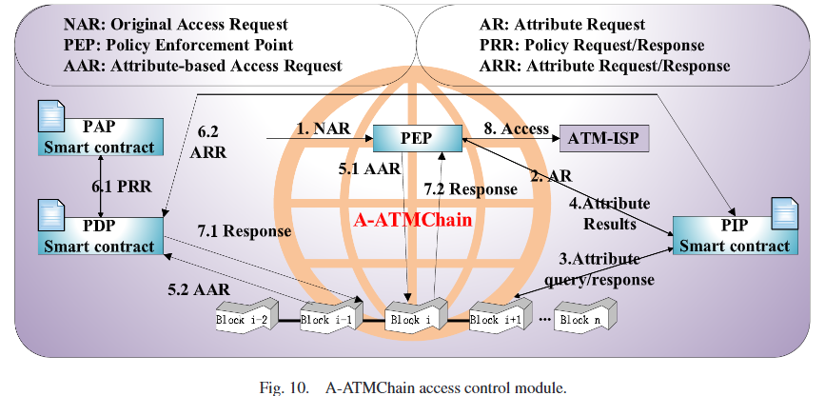
Access Control Module
接收請求
PEP 接收到存取請求（NAR）。
查詢屬性資訊
PEP 調用 PIP 智能合約，從 A-ATMChain 區塊鏈中查詢與 NAR 相關的屬性資訊，回傳後建構 基於屬性的存取請求（AAR）。
執行決策
PEP 傳遞 AAR 給 PDP 智能合約。
PDP 調用 PAP 智能合約 獲取策略，並根據策略和屬性資訊判斷授權與否。
廣播與共識
決策結果封裝為交易，通過 A-ATMChain 廣播並達成共識。
執行結果
PEP 接收授權結果，若授權通過，即執行存取控制資料。
A-ATMChain 存取控制過程
Home
About Us
Portfolio
Contact
Notes:
A-ATMChain 存取控制過程
接收請求
PEP 接收到存取請求（NAR）。
查詢屬性資訊
PEP 調用 PIP 智能合約，從 A-ATMChain 區塊鏈中查詢與 NAR 相關的屬性資訊，回傳後建構 基於屬性的存取請求（AAR）。
執行決策
PEP 傳遞 AAR 給 PDP 智能合約。
PDP 調用 PAP 智能合約 獲取策略，並根據策略和屬性資訊判斷授權與否。
廣播與共識
決策結果封裝為交易，通過 A-ATMChain 廣播並達成共識。
執行結果
PEP 接收授權結果，若授權通過，即執行存取控制資料。

Slide 18
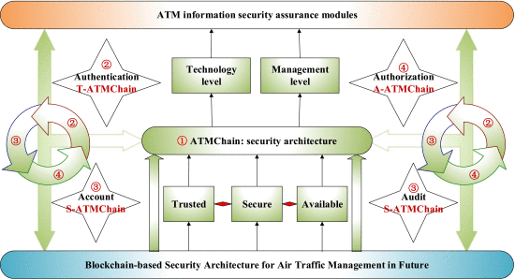
Access Control Module
ATMchain安全模組整體架構
Notes:
A-ATMChain 存取控制模組的優勢與特性：
資料存取透明性
存取控制資訊公開，能根據區塊鏈的時間戳和簽名資訊進行追蹤。
可信任的存取控制策略與防竄改
基於ABAC和ATMchain所設計出的A-ATMchain之存取控制策略和權限可信任、可供驗證，雙方在通訊過程中不需要第三方的背書。存取相關的共識屬性和策略都儲存在區塊鏈上，資料無法被篡改，有效阻止惡意攻擊者進行針對性的篡改或刪除。
去中心化的授權決策
授權決策權分散在聯盟鏈的各個節點中，避免集中式控制。
自動化存取控制裁決
通過智能合約執行ABAC 的核心步驟，自動判斷存取請求，消除了人工干預、減少了裁決過程中的困難和人為錯誤。
模組協作：
與 可信任認證模組（T-ATMChain） 協作完成身份驗證。
與 資料共享模組（S-ATMChain） 確保資料完整性與跨部門協作。
與 存取控制模組（A-ATMChain） 支援動態授權與操作記錄功能。
形成可信任（Trusted）、安全（Secure）、可用（Available）的ATM資訊安全機制。
T-ATMchain實現 4A 安全模型中的身份驗證（Authentication）功能。
S-ATMchain實現 4A 安全模型中的計費與審計（Account and Audit）功能。
A-ATMchain實現 4A 安全模型中的授權（Authorization）功能。
將目前ATM使用的4A資訊安全保障理念與區塊鏈結合，更具可行性，也更容易在未來部署應用。

Slide 19
Access Control Module
A-ATMChain 優勢與特性
1.資料存取透明性
存取控制資訊公開，能根據區塊鏈的時間戳和簽名資訊進行追蹤。
2.可信任的存取控制策略與防竄改
存取控制策略和權限可信任、可供驗證，雙方在通訊過程中不需要第三方的背書。
結合區塊鏈技術，有效阻止惡意攻擊者進行針對性的篡改或刪除。
3.去中心化的授權決策
授權決策權分散在聯盟鏈的各個節點中，避免集中式控制。
4.自動化存取控制裁決
通過智能合約執行ABAC 的核心步驟，自動判斷存取請求，消除了人工干預、減少了裁決過程中的困難和人為錯誤。
Home
About Us
Portfolio
Contact
Notes:
A-ATMChain 存取控制模組的優勢與特性：
資料存取透明性
存取控制資訊公開，能根據區塊鏈的時間戳和簽名資訊進行追蹤。
可信任的存取控制策略與防竄改
基於ABAC和ATMchain所設計出的A-ATMchain之存取控制策略和權限可信任、可供驗證，雙方在通訊過程中不需要第三方的背書。存取相關的共識屬性和策略都儲存在區塊鏈上，資料無法被篡改，有效阻止惡意攻擊者進行針對性的篡改或刪除。
去中心化的授權決策
授權決策權分散在聯盟鏈的各個節點中，避免集中式控制。
自動化存取控制裁決
通過智能合約執行ABAC 的核心步驟，自動判斷存取請求，消除了人工干預、減少了裁決過程中的困難和人為錯誤。

Slide 20
Trusted Authentication Module

Slide 21
HEADLINE
Please enter the font and title you think is appropriate in the box, and change your color,
HEADLINE
Please enter the font and title you think is appropriate in the box, and change your color,
HEADLINE
Please enter the font and title you think is appropriate in the box, and change your color,
HEADLINE
Please enter the font and title you think is appropriate in the box, and change your color,
HEADLINE
Please enter the font and title you think is appropriate in the box, and change your color,
Home
About Us
Portfolio
Contact

Slide 22
HEADLINE
HEADLINE
Please enter the font and title you think is appropriate in the box, and change your color,
Please enter the font and title you think is appropriate in the box, and change your color,
HEADLINE
HEADLINE
Please enter the font and title you think is appropriate in the box, and change your color,
Please enter the font and title you think is appropriate in the box, and change your color,
HEADLINE
HEADLINE
Please enter the font and title you think is appropriate in the box, and change your color,
Please enter the font and title you think is appropriate in the box, and change your color,

Slide 23












Home
About Us
Portfolio
Contact
BUSINESS
REPORT PLAN
Business Power Point
Work report refers to a comprehensive and systematic general inspection and evaluation of the work that has been done in a certain period of time

Slide 24










Home
About Us
Portfolio
Contact
CONTENTS
01
介紹
Please enter the font and title you think
02
ENTER YOUR TITLE
Please enter the font and title you think
03
ENTER YOUR TITLE
Please enter the font and title you think
04
ENTER YOUR TITLE
Please enter the font and title you think

Slide 25
Home
About Us
Portfolio
Contact
01
ENTER YOUR TITLE
Please enter the font and title you think

Slide 26

https://www.ypppt.com/
HEADLINE
Please enter the font and title you think is appropriate in the box, and change your color, Please enter the font and title you think is appropriate in the box, and change your color,
enter the font and title you think is appropriate in the box,
enter the font and title you think is appropriate in the box,
enter the font and title you think is appropriate in the box,
enter the font and title you think is appropriate in the box,
Home
About Us
Portfolio
Contact

Slide 27
HEADLINE
Please enter the font and title you think is appropriate in the box, and change your color,
HEADLINE
Please enter the font and title you think is appropriate in the box, and change your color,
80%
90%
10%
60%
70%
50%
HEADLINE
Please enter the font and title you think is appropriate in the box, and change your color,
2020
2021
2022
2023
2024
2025
HEADLINE
Please enter the font and title you think is appropriate in the box, and change your color,
Please enter the font and title you think is appropriate in the box, and change your color,
Home
About Us
Portfolio
Contact

Slide 28
68%
34%
Please enter the font and title you think is appropriate in the box, and change your color, Please enter the font and title you think is appropriate in the box, and change your color
Please enter the font and title you think is appropriate in the box, and change your color, Please enter the font and title you think is appropriate in the box, and change your color
HEADLINE
HEADLINE
HEADLINE
Please enter the font and title you think is appropriate in the box, and change your color。
Please enter the font and title you think is appropriate in the box, and change your color。
Please enter the font and title you think is appropriate in the box, and change your color。

Slide 29


HEADLINE
HEADLINE
Please enter the font and title you think is appropriate in the box, and change your color,
Please enter the font and title you think is appropriate in the box, and change your color,
HEADLINE
HEADLINE
Please enter the font and title you think is appropriate in the box, and change your color,
Please enter the font and title you think is appropriate in the box, and change your color,
HEADLINE
HEADLINE
Please enter the font and title you think is appropriate in the box, and change your color,
Please enter the font and title you think is appropriate in the box, and change your color,
Home
About Us
Portfolio
Contact

Slide 30
Home
About Us
Portfolio
Contact
02
ENTER YOUR TITLE
Please enter the font and title you think

Slide 31
TITLE
TITLE
TITLE
TITLE
TITLE
90%
70%
50%
30%
10%
HEADLINE
HEADLINE
Please enter the font and title you think is appropriate in the box, and change your color,
Please enter the font and title you think is appropriate in the box, and change your color,
Home
About Us
Portfolio
Contact

Slide 32
HEADLINE
HEADLINE
Please enter the font and title you think is appropriate in the box, and change your color,
Please enter the font and title you think is appropriate in the box, and change your color,
Presentation
funding
HEADLINE
HEADLINE
Please enter the font and title you think is appropriate in the box, and change your color,
Please enter the font and title you think is appropriate in the box, and change your color,
Home
About Us
Portfolio
Contact

Slide 33
HEADLINE
HEADLINE
HEADLINE
HEADLINE
50
24%
89
$32
Please enter the font and title you think is appropriate in the box, and change your color,
Please enter the font and title you think is appropriate in the box, and change your color,
Please enter the font and title you think is appropriate in the box, and change your color,
Please enter the font and title you think is appropriate in the box, and change your color,
Please enter the font and title you think is appropriate in the box, and change your color, Please enter the font and title you think is appropriate in the box, and change your color, Please enter the font and title you think is appropriate in the box, and change your color, Please enter the font and title you think is appropriate in the box, and change your color, Please enter the font and title you think is appropriate in the box
Home
About Us
Portfolio
Contact

Slide 34
HEADLINE
HEADLINE
HEADLINE
Please enter the font and title you think is appropriate in the box, and change your color,
Please enter the font and title you think is appropriate in the box, and change your color,
Please enter the font and title you think is appropriate in the box, and change your color,
HEADLINE
HEADLINE
Please enter the font and title you think is appropriate in the box, and change your color,
Please enter the font and title you think is appropriate in the box, and change your color,
Home
About Us
Portfolio
Contact
Notes:
https://www.ypppt.com/

Slide 35
HEADLINE
HEADLINE
HEADLINE
Please enter the font and title you think is appropriate in the box, and change your color,
Please enter the font and title you think is appropriate in the box, and change your color,
Please enter the font and title you think is appropriate in the box, and change your color,
HEADLINE
HEADLINE
HEADLINE
Please enter the font and title you think is appropriate in the box, and change your color,
Please enter the font and title you think is appropriate in the box, and change your color,
Please enter the font and title you think is appropriate in the box, and change your color,
Home
About Us
Portfolio
Contact

Slide 36
Product 1
Product 2
Jan
Feb
Mar
Apr
May
Jun
Jul
Aug
Sep
Oct
Nov
Dec
HEADLINE
HEADLINE
Please enter the font and title you think is appropriate in the box, and change your color,
Please enter the font and title you think is appropriate in the box, and change your color,
Home
About Us
Portfolio
Contact

Slide 37
HEADLINE
Please enter the font and title you think is appropriate in the box, and change your color, Please enter the font and title you think is appropriate in the box, and change your color, Please enter the font and title you think is appropriate in the box, and change your color, Please enter the font and title you think is appropriate in the box, and change your color, Please enter the font and title you think is appropriate in the box, and change your color, Please enter the font and title you think is appropriate in the box, and change your color,
90%
70%
HEADLINE
HEADLINE
Please enter the font and title you think is appropriate in the box, and change your color, Please enter the font and title you think is appropriate in the box, and change your color,
Please enter the font and title you think is appropriate in the box, and change your color, Please enter the font and title you think is appropriate in the box, and change your color,
Home
About Us
Portfolio
Contact

Slide 38
HEADLINE
Please enter the font and title you think is appropriate in the box, and change your color,
HEADLINE
Please enter the font and title you think is appropriate in the box, and change your color,
HEADLINE
Please enter the font and title you think is appropriate in the box, and change your color,
HEADLINE
Please enter the font and title you think is appropriate in the box, and change your color,
Home
About Us
Portfolio
Contact

Slide 39
HEADLINE
HEADLINE
Please enter the font and title you think is appropriate in the box, and change your color,
Please enter the font and title you think is appropriate in the box, and change your color,
HEADLINE
HEADLINE
Please enter the font and title you think is appropriate in the box, and change your color,
Please enter the font and title you think is appropriate in the box, and change your color,
HEADLINE
HEADLINE
Please enter the font and title you think is appropriate in the box, and change your color,
Please enter the font and title you think is appropriate in the box, and change your color,

Slide 40
Home
About Us
Portfolio
Contact
04
ENTER YOUR TITLE
Please enter the font and title you think

Slide 41
HEADLINE
Please enter the font and title you think is appropriate in the box, and change your color,
HEADLINE
Please enter the font and title you think is appropriate in the box, and change your color,
HEADLINE
Please enter the font and title you think is appropriate in the box, and change your color,
HEADLINE
Please enter the font and title you think is appropriate in the box, and change your color,
Home
About Us
Portfolio
Contact

Slide 42
HEADLINE
Please enter the font and title you think is appropriate in the box, and change your color,
HEADLINE
Please enter the font and title you think is appropriate in the box, and change your color,
HEADLINE
Please enter the font and title you think is appropriate in the box, and change your color,
HEADLINE
Please enter the font and title you think is appropriate in the box, and change your color,
HEADLINE
Please enter the font and title you think is appropriate in the box, and change your color,
Home
About Us
Portfolio
Contact

Slide 43
YOUR HEADLINE
Please enter the font and title you think is appropriate in the box, and change your color。Please enter the font and title you think is appropriate in the box, and change your color。Please enter the font and title you think is appropriate in the box, and change your color。
2020
2021
2022
HEADLINE
HEADLINE
HEADLINE
Please enter the font and title you think is appropriate in the box, and change your color。
Please enter the font and title you think is appropriate in the box, and change your color。
Please enter the font and title you think is appropriate in the box, and change your color。
Home
About Us
Portfolio
Contact

Slide 44
HEADLINE
HEADLINE
HEADLINE
Please enter the font and title you think is appropriate in the box, and change your color。
Please enter the font and title you think is appropriate in the box, and change your color。
Please enter the font and title you think is appropriate in the box, and change your color。
Home
About Us
Portfolio
Contact

Slide 45
HEADLINE
Please enter the font and title you think is appropriate in the box, and change your color,
HEADLINE
HEADLINE
HEADLINE
HEADLINE
Please enter the font and title you think is appropriate in the box, and change your color, Please enter the font and title you think is appropriate in the box, and change your color,
Home
About Us
Portfolio
Contact

Slide 46
Home
About Us
Portfolio
Contact
THANKS
Business Power Point
Work report refers to a comprehensive and systematic general inspection and evaluation of the work that has been done in a certain period of time
SPEAKER：第一PPT

Slide 47
更多精品PPT资源尽在—优品PPT！
www.ypppt.com
PPT模板下载：www.ypppt.com/moban/ 节日PPT模板：www.ypppt.com/jieri/
PPT背景图片：www.ypppt.com/beijing/ PPT图表下载：www.ypppt.com/tubiao/
PPT素材下载： www.ypppt.com/sucai/ PPT教程下载：www.ypppt.com/jiaocheng/
字体下载：www.ypppt.com/ziti/ 绘本故事PPT：www.ypppt.com/gushi/
PPT课件：www.ypppt.com/kejian/
Notes:
模板来自于 优品PPT https://www.ypppt.com/

