Slide 1
practiceppt
Chante Davis

Slide 2
Many uses for R - more than the analysis of data

Slide 3
The what and why of R
R is a language: concepts apply to all coding/automation
Why code? I’m not running fancy models…
- Efficiency - Accuracy - reproducibility

Slide 4
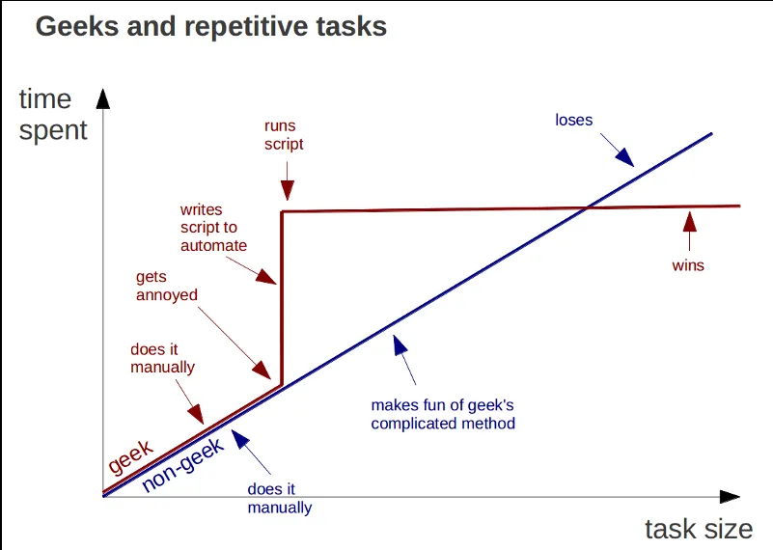
Improving your Effeciency on repetitive tasks

Slide 5
Slide with R Output example Latreese code
summary(cars)
## speed dist ## Min. : 4.0 Min. : 2.00 ## 1st Qu.:12.0 1st Qu.: 26.00 ## Median :15.0 Median : 36.00 ## Mean :15.4 Mean : 42.98 ## 3rd Qu.:19.0 3rd Qu.: 56.00 ## Max. :25.0 Max. :120.00

Slide 6
The ‘meta’ moment
You’ve been looking at R this entire time

