Slide 1



A Framework for ETL Systems Development
Carine Calixto Aguena (cca6@cin.ufpe.br)
Valéria Cesário Times (vct@cin.ufpe.br)

Slide 2
Sumário / Conteúdo
Introdução
  Contextualização
  Motivação
  Objetivos
Revisão de Literatura
Trabalho proposto
  Requisitos de software do ETL4NoSQL
  Modelagem do Domínio e Especificação
  Especificação de Componentes
  Interfaces de Programação
Evaluation
Conclusion

Slide 3
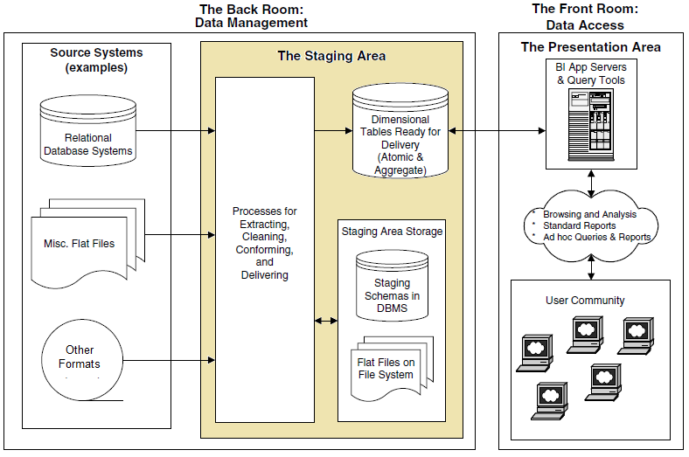
Contextualization
ETL - Extract, Transform and Load Data
  ETL Systems retrieve operational data, execute data transformations and populate decision-making databases.

Slide 4
Contextualization
ETL - Extract, Transform and Data Load
  ETL Systems retrieve operational data, execute data transformations and populate decision-making databases.
  ETL systems consume about 70% of the DW deployment resources.
  Academy gave few attention to ETL systems before 2000.
  There are dozens of ETL tools based on GUI, such as Clover, Talend, and Pentaho.

Slide 5
Contextualization
ETL - Extract, Transform and Data Load
  Difficulties found in the use of ETL tools currently available:
    Limitation to perform custom ETL transformations for specific domains.
    ETL Integration with internal systems developed by companies is often a complex task.
    ETL systems often provide distinct environments for the modeling of processes and the extension of data transformations
    Most ETL tools provide proprietary notations and non-standard GUIs.

Slide 6
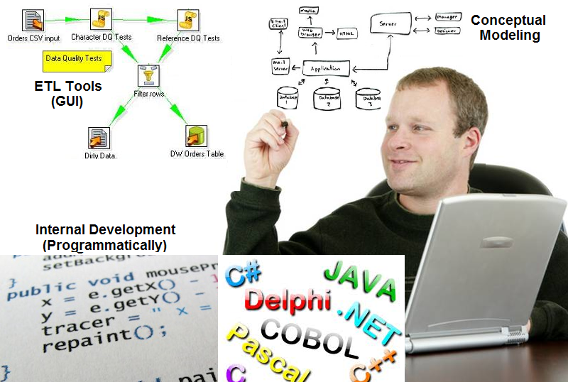
Motivation
  Many companies ignore the use of ETL tools based on GUI, by adopting general-purpose programming language.

Slide 7
Motivation
  Many companies ignore the use of ETL tools based on GUI, by adopting general-purpose programming language.
  Difficulties in adopting general-purpose languages ​​for ETL applications.
  Lack of support to the fundamentals of ETL
  Reuse is limited
  Difficulty of implementing the projects from ETL conceptual modeling

Slide 8
Objectives
  Specify a framework for ETL developing systems that offers a programmable, flexible and integrated environment for the modeling and execution of ETL process.
    Extend the proposed framework to provide support for cost proration in the field of cost accounting.
    Extend the proposed framework to facilitate the loading of data into DW modeled through star schemas.

Slide 9
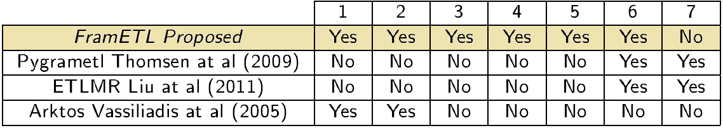
Literature Review
Architecture of reuse
Hotspot Identification
Software patterns employment
Validation in more than one specific domain
Flexibility and flexibility evaluation
Program language for customization and instantiation
Performance Tests

Slide 10
Proposed Work
  System Requirements
  FramETL Architecture
  Conceptual Model
  FramETL Specializations

Slide 11
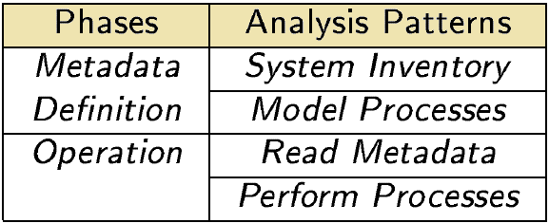
System Requirements
The analysis patterns are the basis of hotspots identification of FramETL

Slide 12
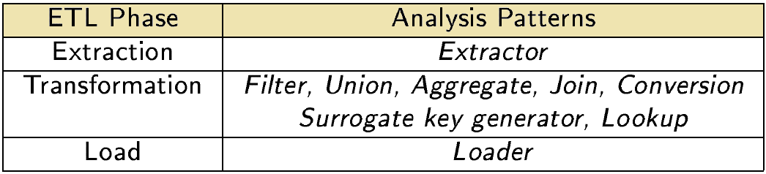
System Requirements
The most common ETL operations found in the literature are seen as essential requirements for an ETL framework.

Slide 13
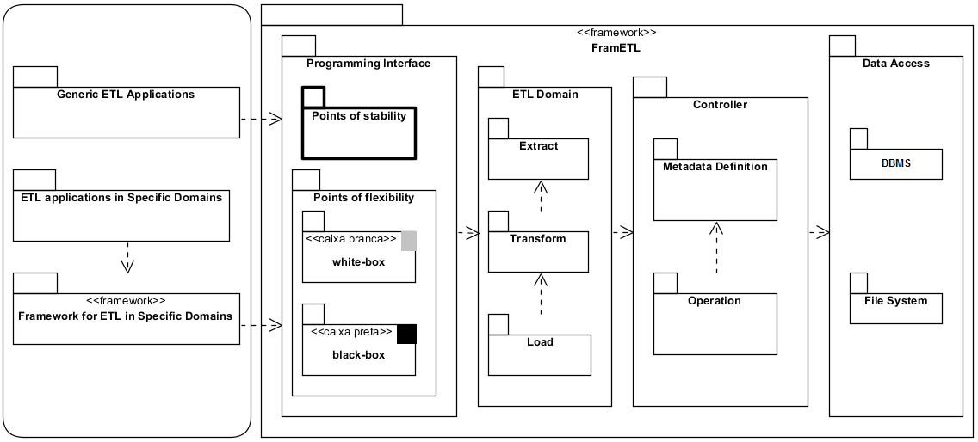
FramETL Architecture
  The FramETL architecture illustrates the possibilities of use and the dependency relationships between conceptual layers.

Slide 14
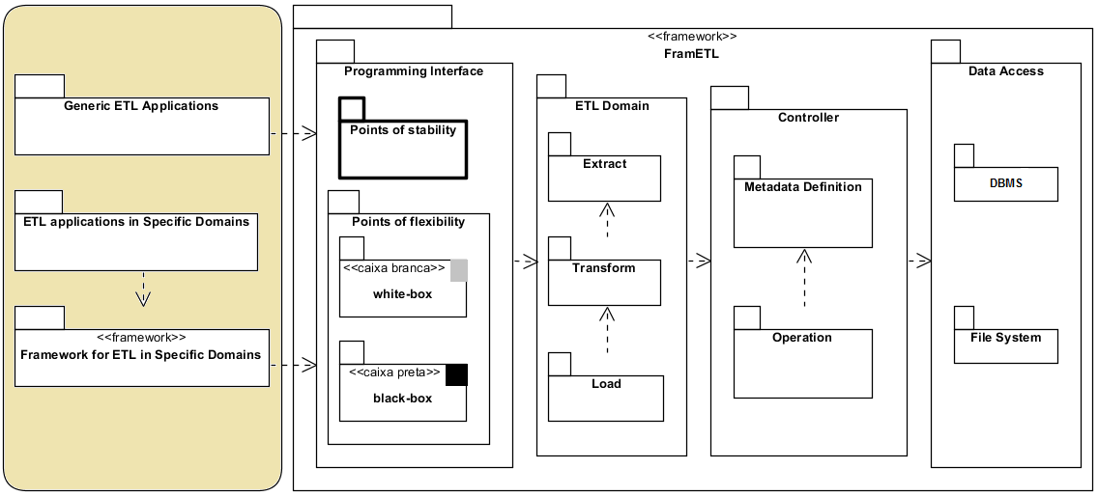
FramETL Architecture
  The FramETL architecture illustrates the possibilities of use and the dependency relationships between conceptual layers.

Slide 15
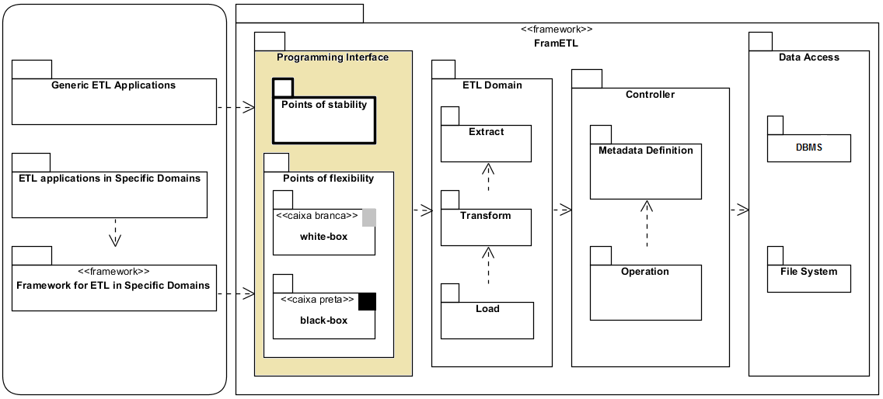
FramETL Architecture
  The FramETL architecture illustrates the possibilities of use and the dependency relationships between conceptual layers.

Slide 16
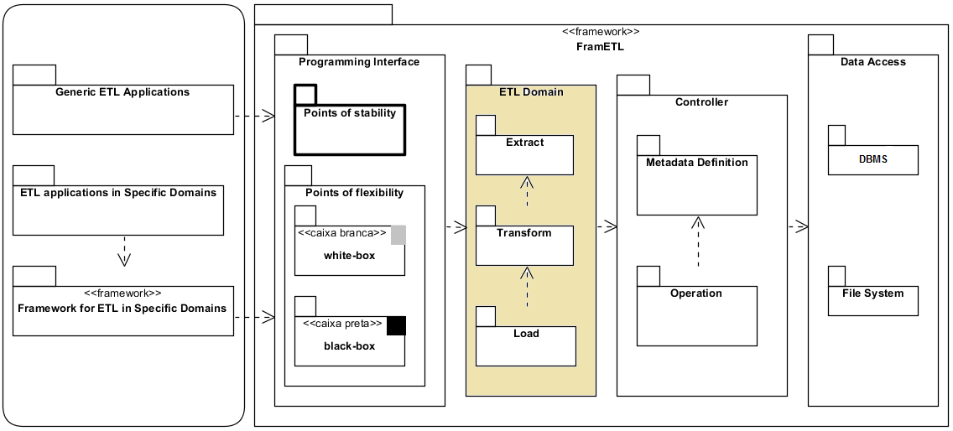
FramETL Architecture
  The FramETL architecture illustrates the possibilities of use and the dependency relationships between conceptual layers.

Slide 17
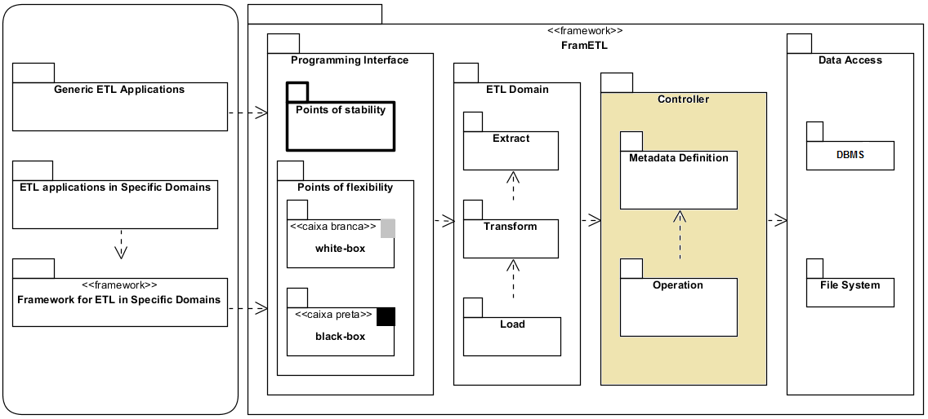
FramETL Architecture
  The FramETL architecture illustrates the possibilities of use and the dependency relationships between conceptual layers.

Slide 18
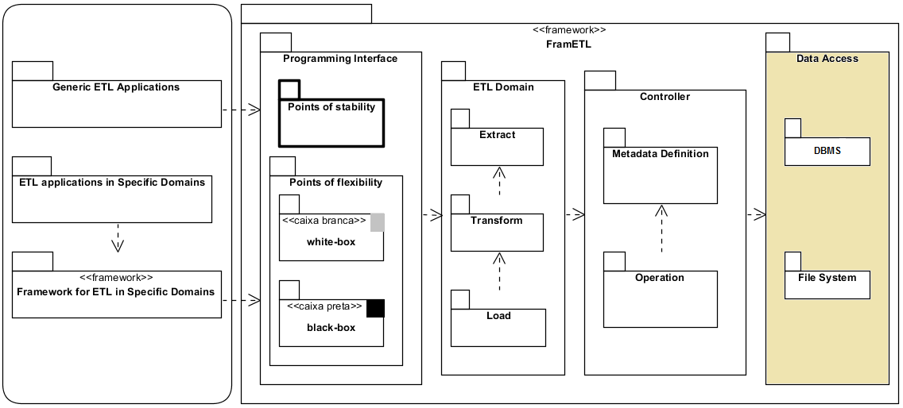
FramETL Architecture
  The FramETL architecture illustrates the possibilities of use and the dependency relationships between conceptual layers.

Slide 19
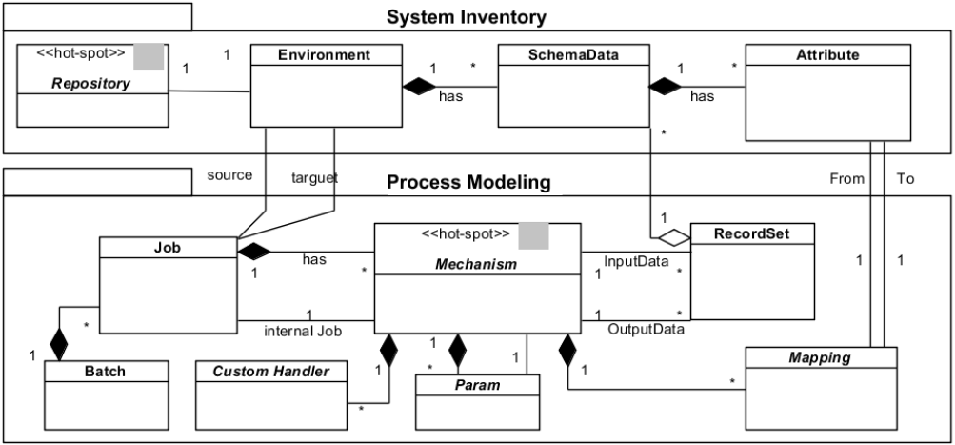
Conceptual Model
The domain model classes represent the specification of FramETL metadata and their relationships.
Hotspot Identification

Slide 20
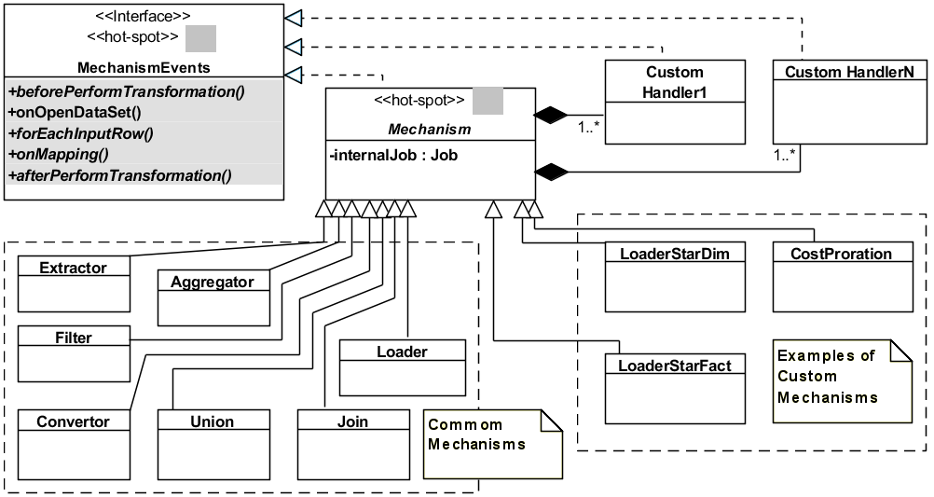
Points of Flexibility Specification
Specialization Interface for the ETL Mechanisms
Hook methods
Customization for a particular application
ETL operations in specific Domains
_{Common mechanisms}

Slide 21
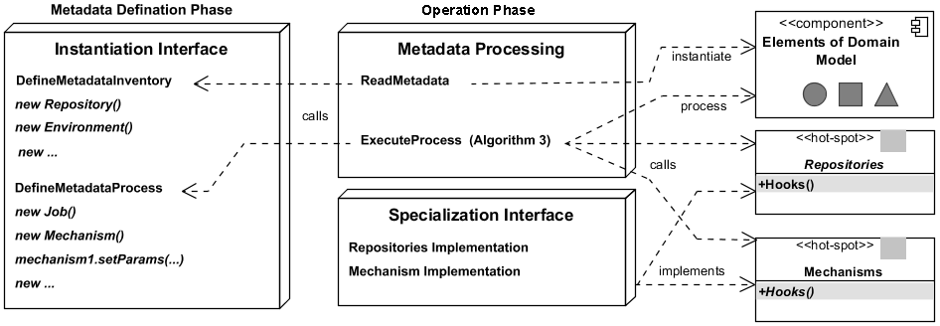
Overview of FramETL Operation

Slide 22
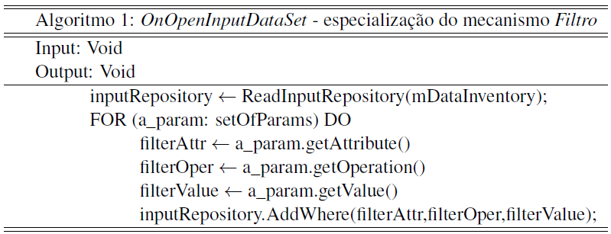
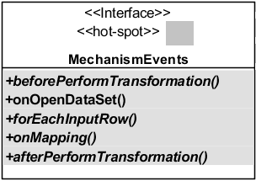
Overview of FramETL Operation

Slide 23
Overview of FramETL Operation
Metadata instantiation for system inventory and process modelling.

Slide 24
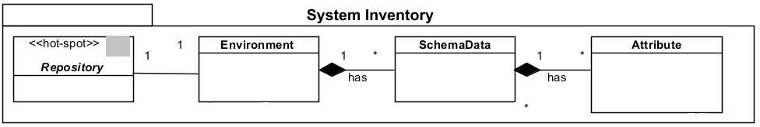
Overview of FramETL Operation

Slide 25
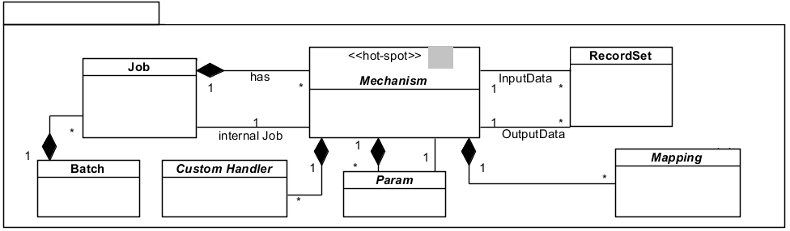
Overview of FramETL Operation

Slide 26
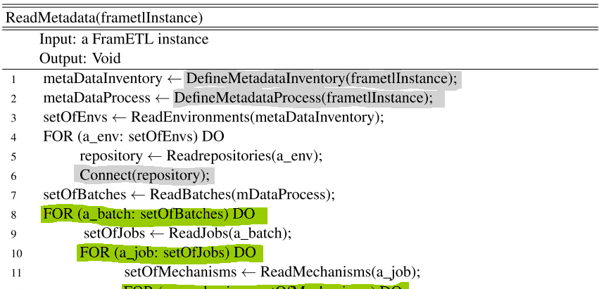
Overview of FramETL Operation

Slide 27
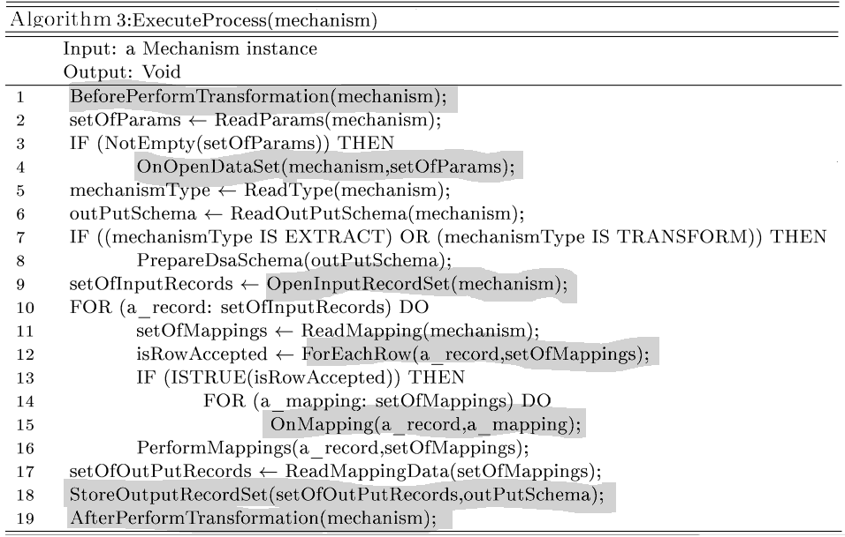
Overview of FramETL Operation

Slide 28
Operation Phase
The inversion of control principle allows to call to the points of flexibility during the implementation of the stable points.
Calls to hotspot Methods

Slide 29
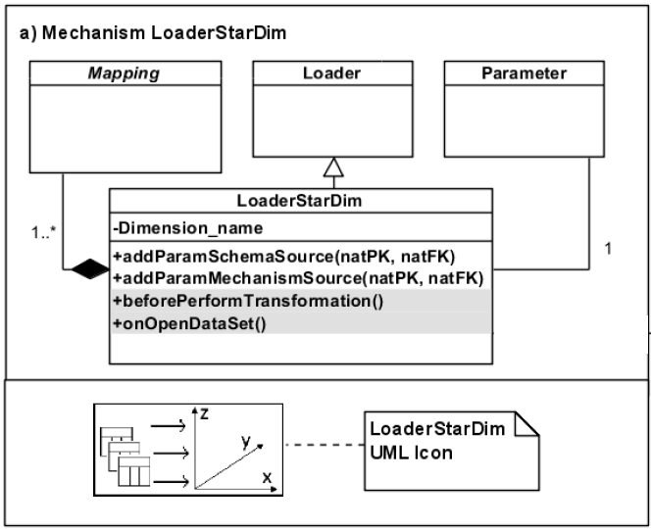
FramETL Specializations
  FramETL4StarDW
  Framework based on FramETL to load dimensions and facts into a DW modeled through star schemas that provides two customized mechanisms:
LoadStarDim Mechanism
These parameters represent the source tables of a dimension

Slide 30
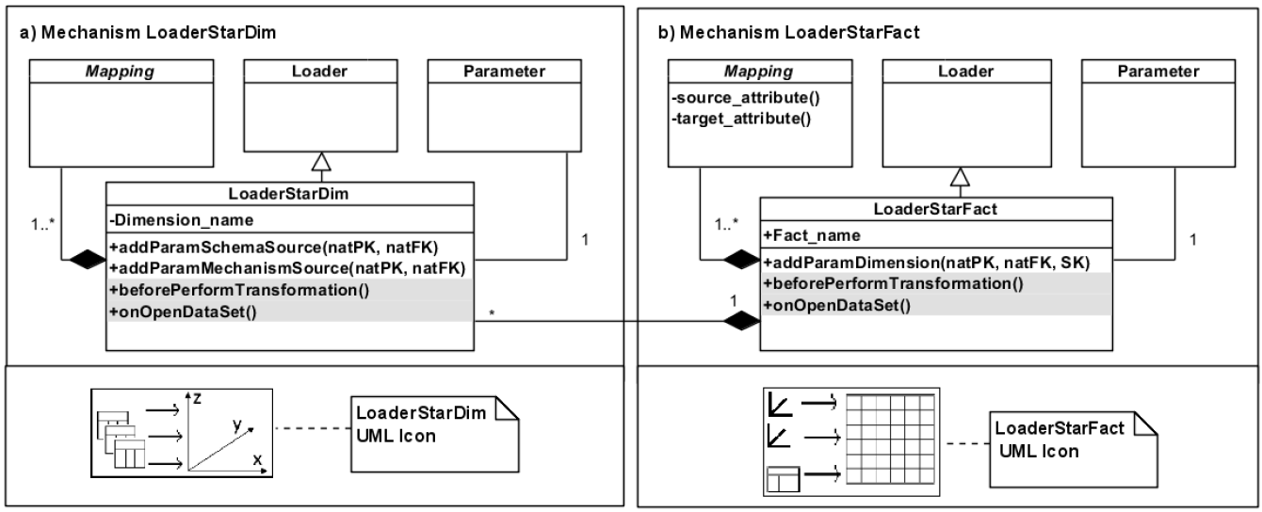
FramETL Specializations
  FramETL4StarDW
  Framework based on FramETL to load dimensions and facts into a DW modeled through star schemas that provides two customized mechanisms:
LoadStarDim Mechanism
LoadStarFact Mechanism
These parameters represent the source tables of a dimension
These parameters represent the dimensions of a fact table

Slide 31
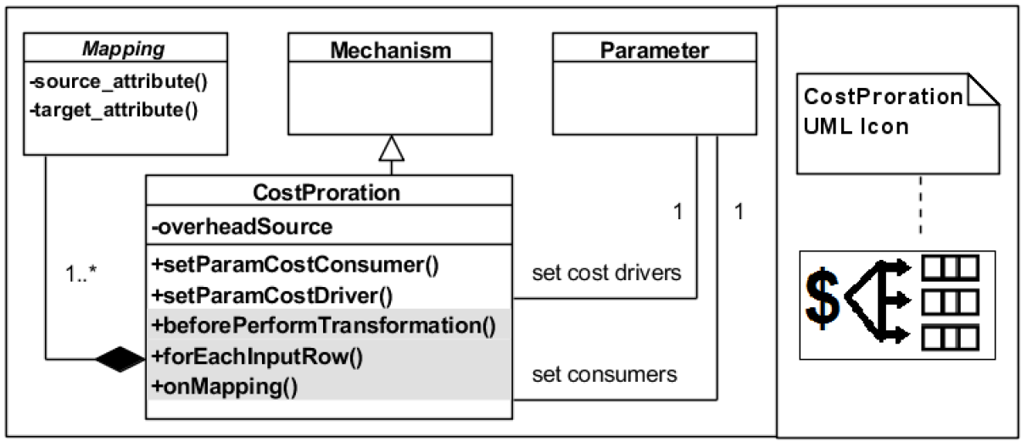
FramETL Specializations
  FramETL4CostAccount
  Framework based on FramETL for the cost accounting domain that provides a customized mechanism to help in the apportionment of overheads.
CostProration Mechanism
Two Parameters which represent the cost drivers and the cost consumers

Slide 32
Evaluation
  Two ETL applications for different domains were implemented to evaluate the characteristics of flexibility and reuse of FramETL.
  The applications implement real-world scenarios, which present requirements of transactional data extraction and generation of analytical data:
    Generation of a Data Mart for Sales
    Requirements presented by an industry of mineral water bottling.
    Data Integration and Cost Proration
    Requirements presented by a company of shrimp farming in captivity.

Slide 33
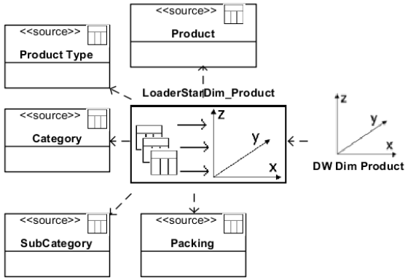
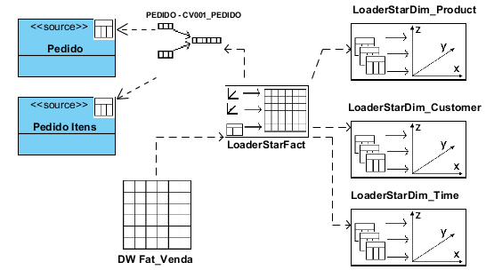
Example application: Data Mart for Sales
  The FramETL4StarDW was used to implement the ETL processes for generation of a Data Mart.
Conceptual modeling of ETL process to load the product dimension by using the Mechanism LoadStarDim
Source tables for Product Dimension
Conceptual modeling of an ETL process to load the fact table by using the Mechanism LoadStarFact .
Source tables for Sales fact

Slide 34
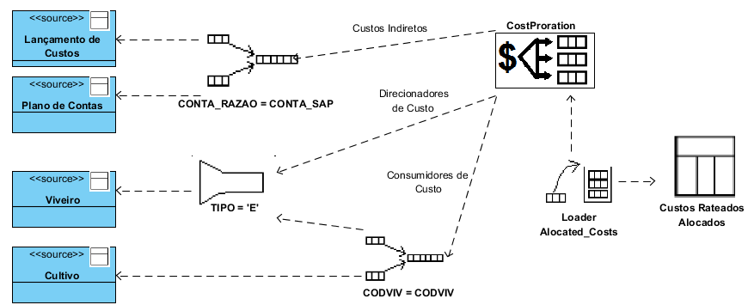
Example application: Cost Account
  The FramETL4CostAccount was used to implement the ETL processes for data integration and cost proration.
  Conceptual modeling of ETL process by reusing the customized mechanism CostProration
Customized Mechanism
Join Mechanism
DBMS Oracle
DBMS Firebird
Filter Mechanism
DBMS Firebird
Loader Mechanism
Join Mechanism

Slide 35
Conclusion
  Main Contributions
  Future Works

Slide 36
Main Contributions
Creation of a framework for assisting in the development of ETL systems based on a programmable, flexible and integrated environment for modeling and executing processes.
FramETL specialization for helping in the creation of ETL processes of data warehouses modeled through star schemas.
FramETL specialization for generating cost prorate in the cost account ETL domain.
The use of software engineering concepts such as analysis patterns and software framework facilitated the documentation and reuse of a generic framework for ETL, which is an important issue of the database area.

Slide 37
Future Works
  Improvement of the FramETL4CostAccount to perform custom transformations according to different costing methodologies.
  Extension of FramETL for the extraction and generation of data in the Extensible Business Report (XBRL) format (Siqueira at all, 2009).
  Use of the Business Process Modeling Notation for ETL (BPMN4ETL) (Akkaoui et al., 2011) to provide support in the processes modeling of FramETL.
  Use of Parallel Programming (Thomsen and Pedersen 2011) and MapReduce [Liu et al. 2011] in order to help in the execution of performance tests to further evaluate the FramETL.

Slide 38

Thank you !
Mário Sergio da Silva (mss6@cin.ufpe.br)
Valéria Cesário Times (vct@cin.ufpe.br)
Michael Mireku Kwakye (mmire083@uottawa.ca)

