Slide 1
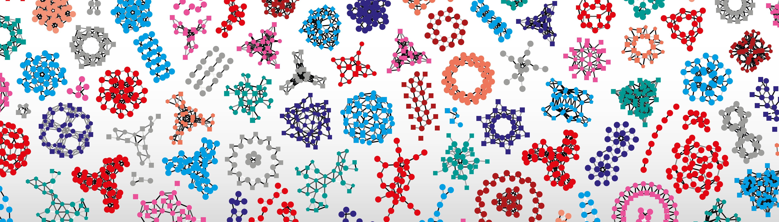


First steps with Python in life sciences
Wandrille Duchemin
Robin Engler
Rocio Rama Ballesteros

Slide 2
Course schedule
Day 1
morning:
Introduction to Jupyter Notebook
Python basics: variables, functions and object types.
Code flow: conditional statements (if… else), loops (while…, for …) and functions.
afternoon:
Day 2
morning:
Code flow: conditional statements (if… else), loops (while…, for …) and functions.
Reading / writing files.
Python modules: import and re-use existing code.
afternoon:
Biopython
Numpy
Scipy
Matplotlib
Pandas
Day 3
Additional modules :

Slide 3
Course introduction overview
01
What is python? Why use it?
02
Computer ressources and how (not) to use them
03
FAIR practices in coding
04
Practice, practice and more practice

Slide 4

But first - getting to know you
Have you programmed before ? Which language ?
Any experience with command line ?
Why do you want to program :
to analyze data ?
to create scripts that serve as glue in my pipeline ?
to implement my cool new model ?
to become one of the cool kids ?
to have something to do on my Sundays ?

Slide 5
Course introduction overview
01
What is python ? Why use it ?
02
Computer ressources and how (not) to use them
03
FAIR practices in coding
04
Practice, practice and more practice

Slide 6
What is Python ?
“Python is an interpreted, high-level, general-purpose programming language.” wikipedia
Interpreted: no compilation of the program prior to execution
+ platform independence (portability), dynamic typing
- usually slower, buggy program may still run
High level: abstracted from details of the machine (e.g. memory management)
+ focus on the application itself
- possibly counter-intuitive behaviors (e.g. mutable vs. immutable objects).
General-purpose: not domain specific, can be used in a broad range of software application
+ wide user base, usable for any purpose
- core language fairly simple → modules for domain specific uses

Slide 7

Python - a brief history
1991: First version of Python (0.9.0) publicly released by Guido van Rossum.
Its name is a tribute to the British comedy group “Monty Python”, it later adopted the two snakes as logo symbol.
2000: Python 2.0
2008: Python 3.0 (backward incompatible with python2)
2015 2020 : end of Python 2.7 support
Current version : 3.8 (as of February 2020)

Slide 8
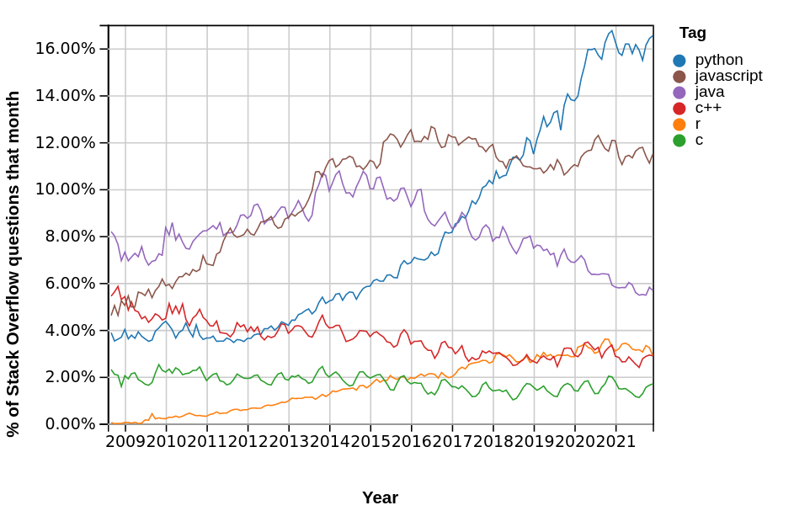
Python - is it used ?
Source: https://insights.stackoverflow.com/trends?tags=python%2Cr

Slide 9
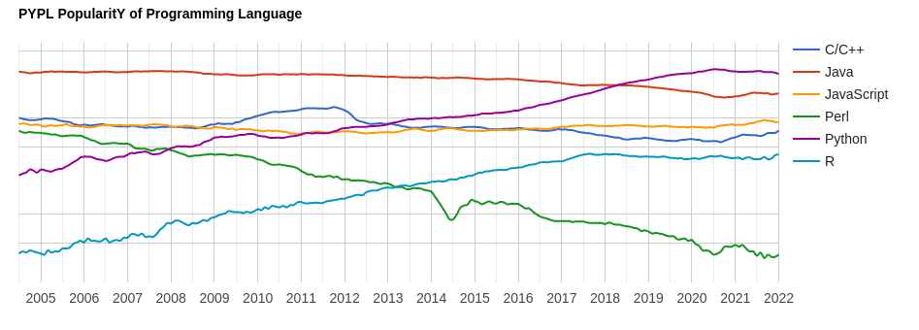
Python - is it used ?
Source: http://pypl.github.io/PYPL.html

Slide 10
Python – sum up
“Python is an interpreted, high-level, general-purpose
programming language.” wikipedia
Easy to learn - you will experience that first hand !
Portable: coding for Windows, MacOS or Linux is (almost) the same.
Broad range of applications: can be used for anything !
Widely used, including in science application:
Huge community to get help/tutorials.
Huge number of modules for domain specific applications.

Slide 11
Overview
01
What is python ? Why use it ?
02
Computer ressources and how (not) to use them
03
FAIR practices in coding
04
Practice, practice and more practice

Slide 12
A computer’s ressources
CPU: main computing unit. Nowadays multi-core and multi-threaded
GPU: graphical processor: like CPU but with lots of slower cores
RAM: ‘short term memory’ of the computer. Fast read/write access.
Hard disk: ‘long term memory’ of the computer. Slow access.
HDD : older, ‘cheap’, slow
SSD : newer, ‘expensive’, faster
… external? file/computation accessed through the network?

Slide 13
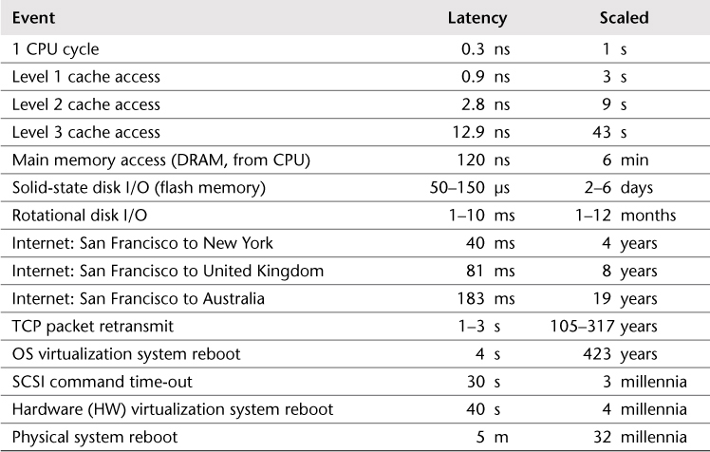
A computer’s ressources
Courtesy of R.Cabezon and M.Jacquot

Slide 14
Overview
01
What is python ? Why use it ?
02
Computer ressources and how (not) to use them
03
FAIR practices in coding
04
Practice, practice and more practice

Slide 15
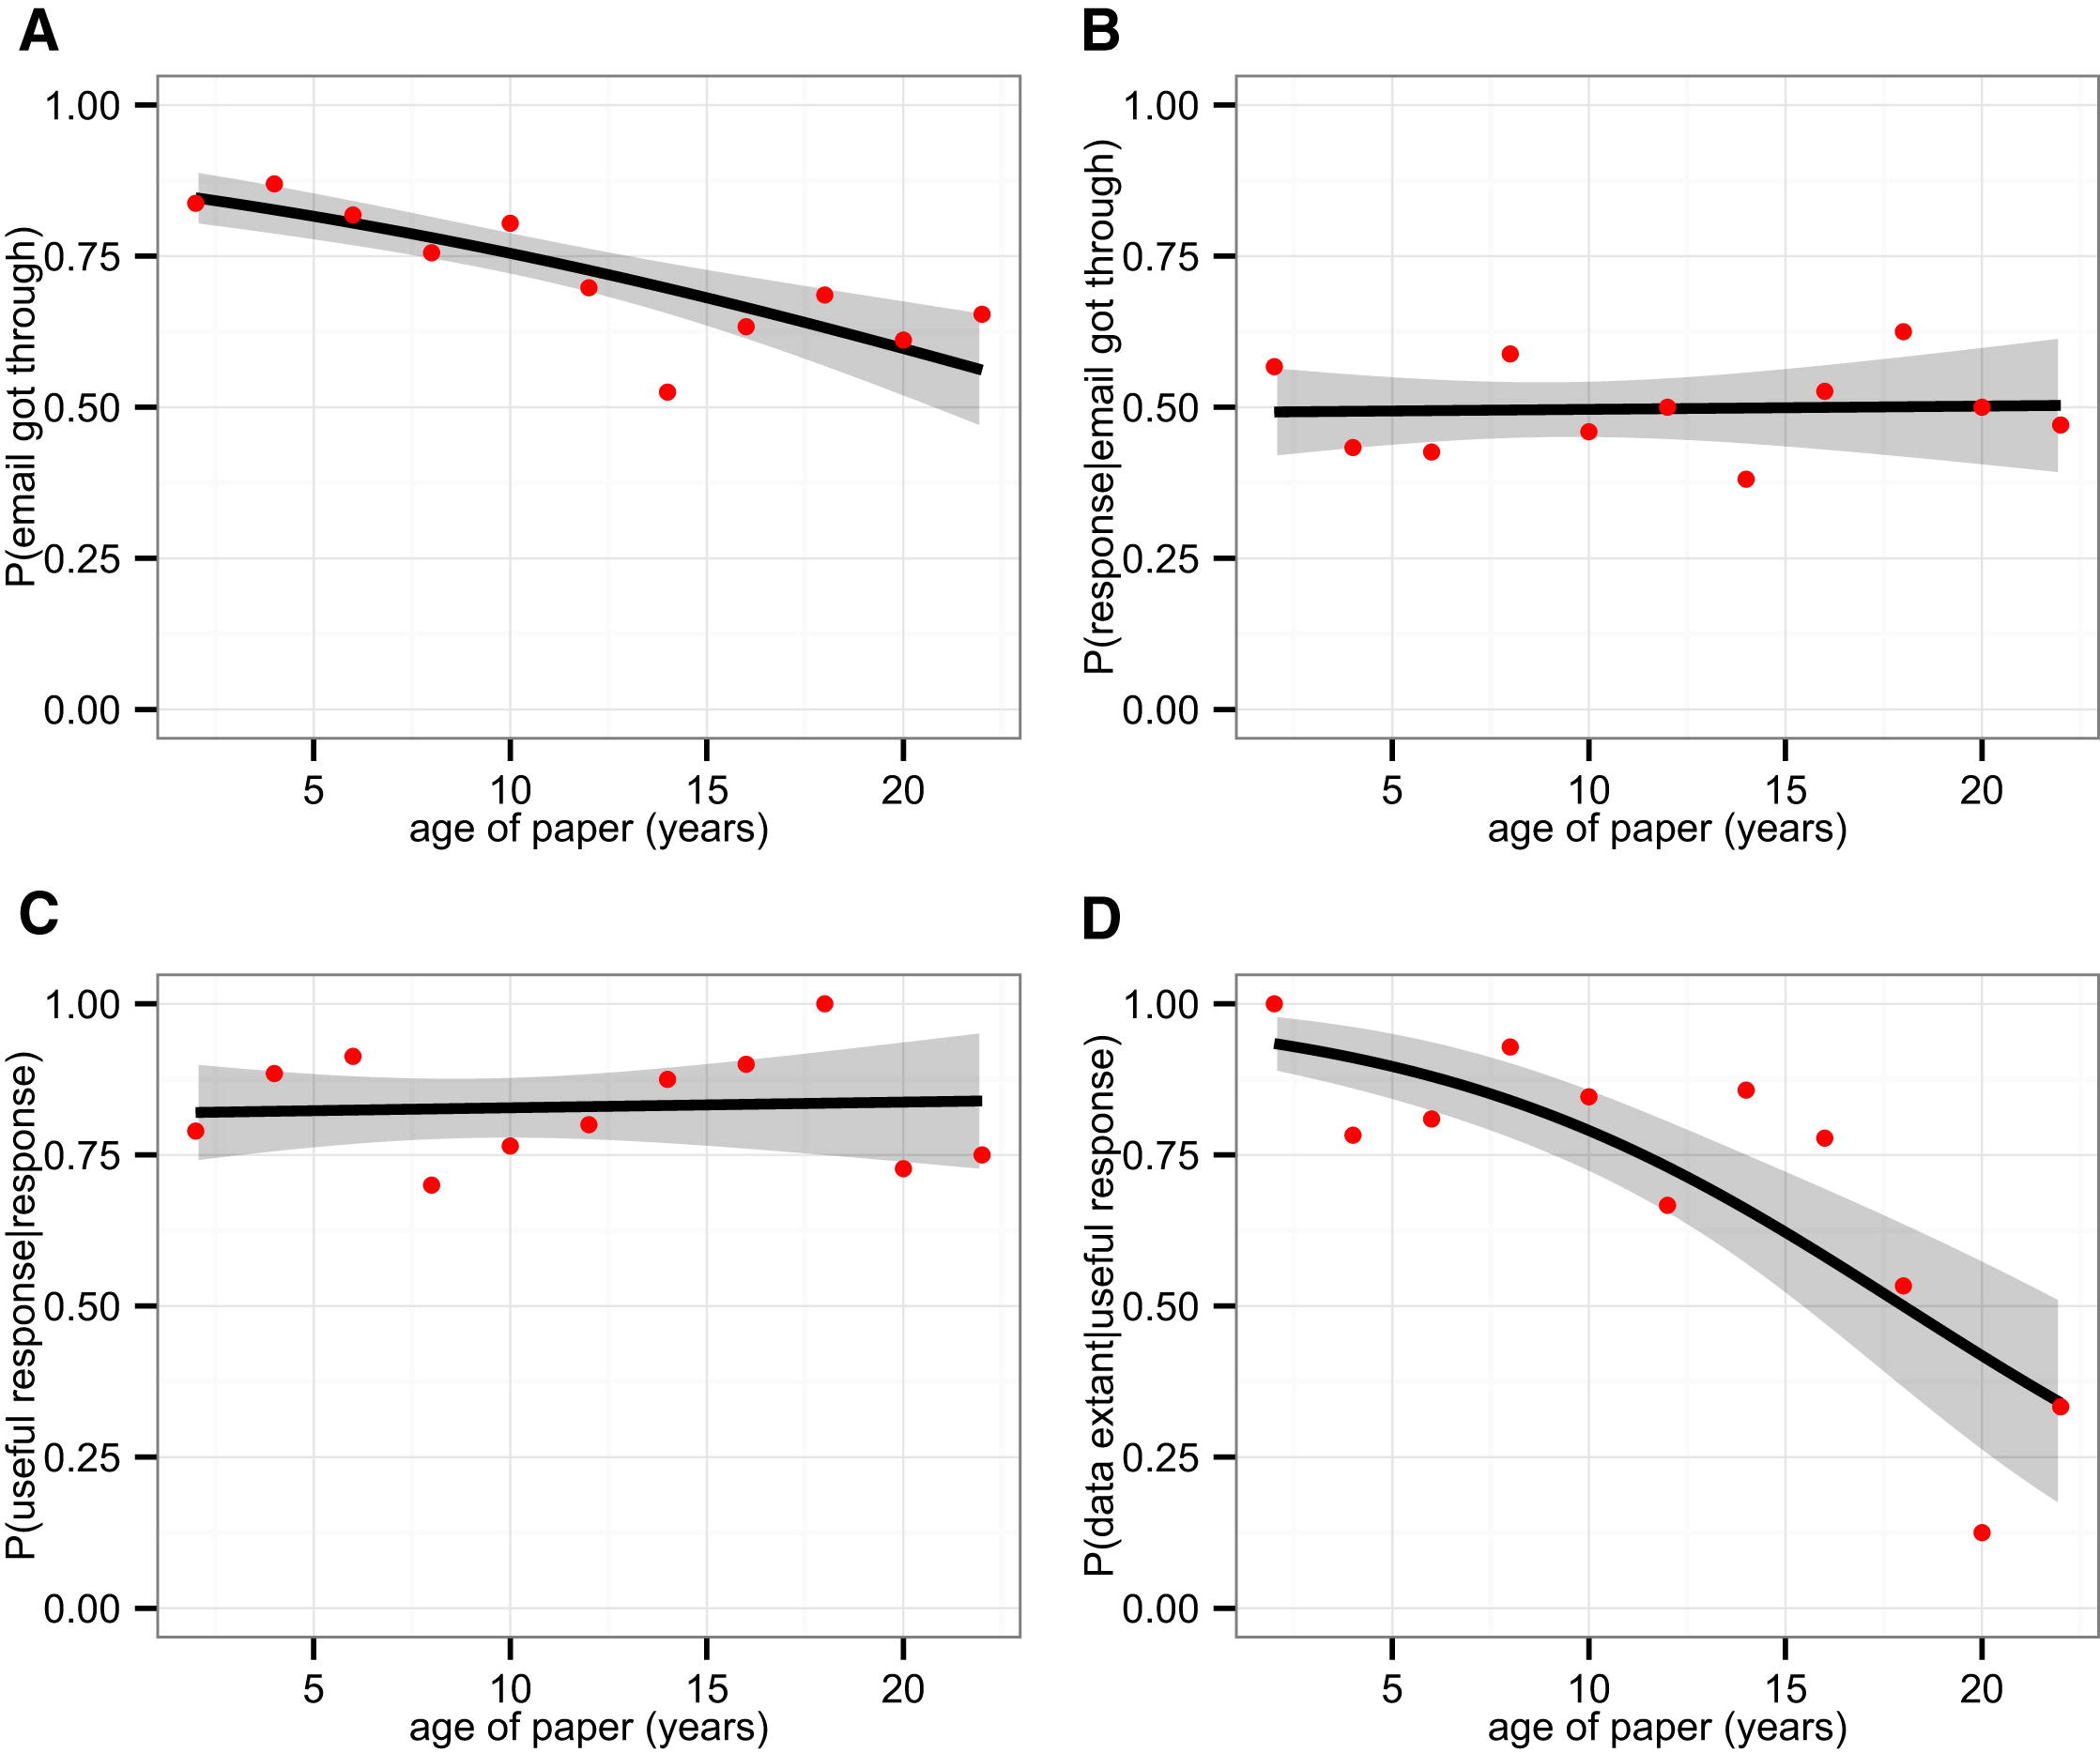
The reproducibility crisis
Survey of 516 studies:
- 17% data availability per year.
Only 19% retrieval rate after 10 year...
Vines et al. (2014) Curr. Biol. doi.org/10.1016/j.cub.2013.11.014

Slide 16
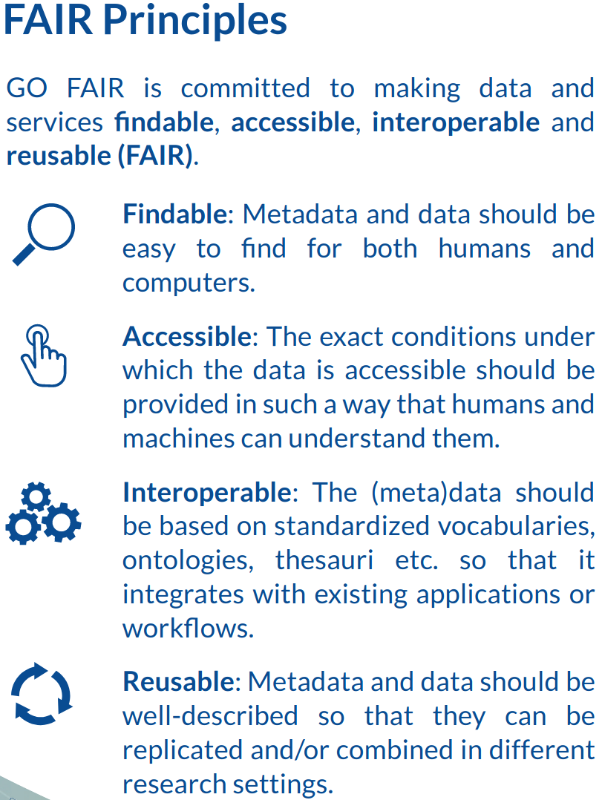
The FAIR guiding principles
Findable: Metadata and data should be easy to find for both humans and computers (unique global identifier, rich description, machine readable and searchable).
Accessible: The data can be retrieved using a standard communication protocol (e.g. https or sftp). Where needed, authentication and authorization procedures are available and documented.
Interoperable: the (meta)data should be based on standardized vocabulary and ontologies (categories and their relations), so that it integrates with existing applications and workflows.
Reusable: Metadata and data should be well described so that data can be replicated and/or combined in different research settings (rich metadata, clear license term, origin of data, data meets domain-relevant community standards).
M.D.Wilkinson, et al. The FAIR Guiding Principles for scientific data management and stewardship. Sci Data. 2016;3:160018. doi:10.1038/sdata.2016.18. https://www.go-fair.org

Slide 17
FAIR applied to code
Write code that also acts as documentation, and clearly communicates the analysis.
Apply the standard you would expect of a ‘wet-lab’ protocol.
Will a reasonably competent colleague understand your code ?
Will you understand your code in 6 month ??
To achieve this, you should:
Comment as much as needed.
Use explicit names when naming things (variables, functions, classes).
Possibly use a support that allows to easily mix code and text, e.g. Jupyter notebook or Jupyter-lab.
Also, you can look at:
Schwen LO, Rueschenbaum S (2018) Ten quick tips for getting the most scientific value out of numerical data. PLoS Comput Biol 14(10): e1006141. https://doi.org/10.1371/journal.pcbi.1006141.

Slide 18
Overview
01
What is python ? Why use it ?
02
Computer ressources and how (not) to use them
03
FAIR practices in coding
04
Practice, practice and more practice

Slide 19
Step 1: how do I use python ?
Three main modes of interaction:
Interactive console.
Python code file (.py files).
Jupyter Notebook (.ipynb files).
Because of its ability to mix nicely formatted text (Markdown) with code, Jupyter Notebook / Jupyter Lab is well suited for data analysis.
Jupyter Notebook will be used for this course.

Slide 20
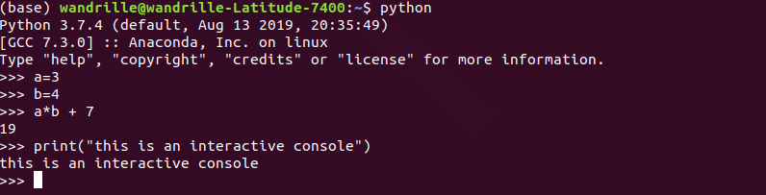
Python – using the console
Interactive : the code is executed as you press ‘Enter’
Great for quickly testing things out.
But, you keep no trace of your workflow/environment.
Only use it to test little bits of code

Slide 21
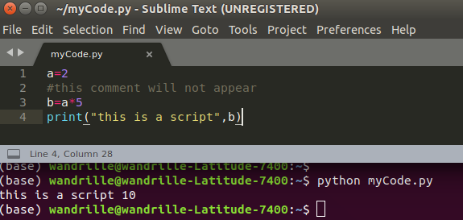
Python – writing a code in a .py file
Write a script in a .py text file, then execute it.
Main way python code is shared.
Ideal for standalone programs and modules.
Code and results are kept separate (may be a good or a bad thing).
Good for general purpose coding, “operational script”.

Slide 22
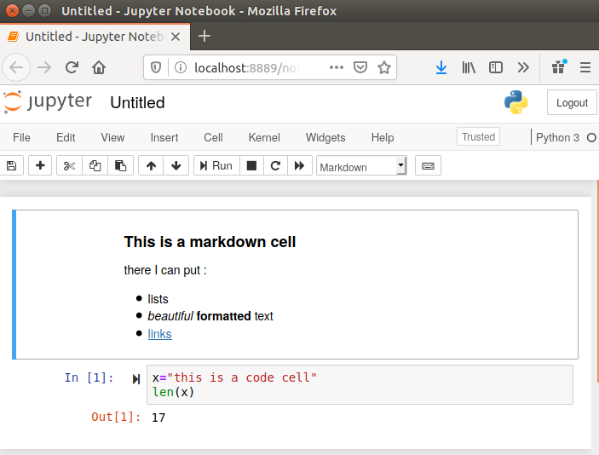
Jupyter notebook / Jupyter Lab
Browser based interface (but runs locally on your machine).
Interlace Markdown and code ‘cells’.
Execute code cell by cell.
Commentary, code, and results together in the same file.
Visually pleasant and fairly ergonomic.
The ability to have documentation, code and results in a single file makes it ideal for data analysis: helps reproducibility of results.
Jupyter Notebook will be used in this course.

Slide 23
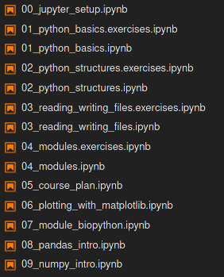
Step 2: your turn to work
How this course will be taught:
Each lesson has 2 associated notebooks (.ipynb):
Theory and examples (*.ipynb).
Exercises (*.exercises.ipynb).
Each lesson will be introduced by going through (some of) the theory together.
Time is allocated for you to try to do the exercises on your own, before we correct them together.
Feel free to ask questions at anytime.
PS : don’t despair - a certain amount trial and error is normal (and somewhat necessary) when learning a language!

