Slide 1


Slide 3
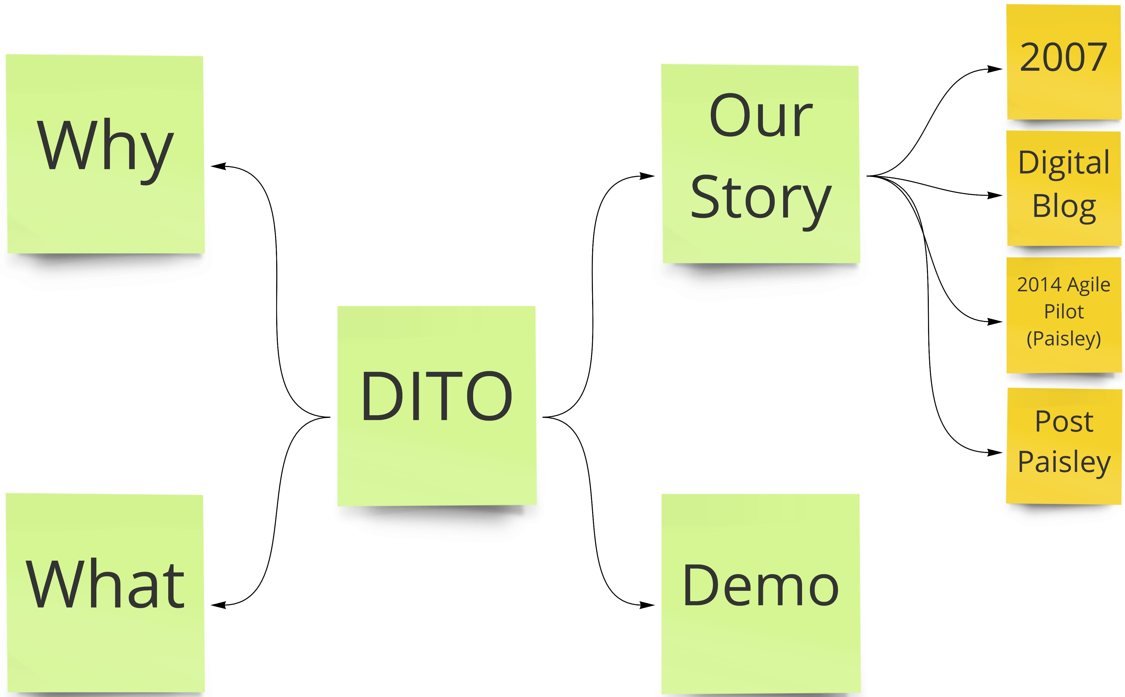

Slide 4
https://scotentsd.github.io/

Slide 5
