Slide 1
Lecture 2-2: Python Sequence Types
Statistics in Python
ISS 2022
Kyung Park

Slide 2
Contents
Structured Sequence Types
Tuple
Range
List
String (text sequence)
Dictionary
List Manipulation
Dictionary objects

Slide 3
Classification of Sequence Types
Immutable sequence types
Tuple
Range
Strings
Mutable sequence types
List
Dict

Slide 4
Structured Sequence Type Objects (1): Tuple Type
Tuple type object
An object, which can embed objects
A simple generalization of strings
An immutable (unalterable) ordered sequence of elements of any heterogenous (different) types in parentheses
Tuple construction in many ways:
Using a pair of parentheses: ()
Using a tailing comma for a singleton tuple: a, (a,)
Separating items with commas: a, b, c or(a, b, c)
Using the tuple() built-in function, define a tuple type object: tuple(iterable)
Example) tuple('abc') ➔ ('a', 'b', 'c')
tuple([1, 2, 3]) ➔ (1, 2, 3)

Slide 5
Structured Sequence Type Objects (1): Tuple Type
Tuple type object (cont.)
Operations
Concatenation (+), repetition (*), indexing ([i]), and slicing ([i:j])
Membership (in) operation with for or if statement
Multiple assignments to extract the individual elements only if you know the length of a sequence (tuple here)

Slide 6
Define Functions for Printing Data and Checking Membership
show_data() definition
def show_data(data, name="data"):
print("**********************************************")
print(name + ":")
print(data)
print("Type of {0}: {1}".format(name, type(data)))
print("**********************************************")
existIn() definition
def existIn(item, seqObjName, seqObj):
if item in seqObj:
print("True: {0} is in {1}: ".format(item, seqObjName))
else:
print("False: {0} is not in {1}: ".format(item, seqObjName))

Slide 7
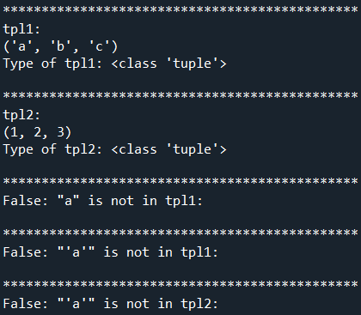
Structured Sequence Type Objects (1): Tuple Function
Build tuple type objects
tuple() function
# 1.1 Tuple: heterogenous types in parentheses, ()
tpl1 = tuple('abc') # Tuple from separating a string
show_data(tpl1, "tpl1")
tpl2 = tuple([1, 2, 3])
show_data(tpl2, "tpl2")
# 1.2 in membership operation with tuple
existIn('"a"', "tpl1", tpl1)
existIn("\"'a'\"", "tpl1", tpl1)
existIn("\"'a'\"", "tpl2", tpl2)

Slide 8
Structured, Sequence Type Objects (2): Range Function
Range type object
An immutable object like strings and tuples as the ordered sequences of integers
range function returns an object of, type range, not a collection of elements
range function takes three integer arguments
range(start, stop, step)
>>> list(range(10))
[0, 1, 2, 3, 4, 5, 6, 7, 8, 9]
>>> list(range(1, 11))
[1, 2, 3, 4, 5, 6, 7, 8, 9, 10]
>>> list(range(0, 30, 5))
[0, 5, 10, 15, 20, 25]
>>> list(range(0, 10, 3))
[0, 3, 6, 9]
>>> list(range(0, -10, -1))
[0, -1, -2, -3, -4, -5, -6, -7, -8, -9]
>>> list(range(0))
[]
>>> list(range(1, 0))
[]
Commonly used for looping a specific number of times in for loops

Slide 9
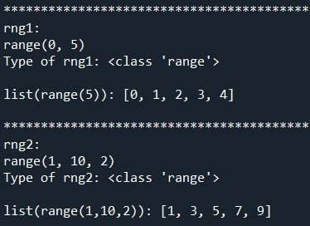

Structured, Sequence Type Objects (2): Range Function
Build range type objects
range() function
# 1.3 Range function: ordered sequences of integers, used for looping
rng1 = range(5)
show_data(rng1, "rng1")
print("list(range(5)):", list(range(5)))
rng2 = range(1, 10, 2)
show_data(rng2, "rng2")
print("list(range(1,10,2):", list(range(1, 10, 2)))
# 1.4 Used for looping a specific number of times in for loops
for i in rng1:
print("---" + str(i))
for j in rng2:
print("---" + str(j))

Slide 10
Structured, Sequence Type Objects (3): List
List type object
A mutable ordered sequence of values of any heterogenous types
Formed by enclosed square brackets (e.g., [1, 2, 3, … ])
Each value is identified by an index.
List construction in many ways:
Using a pair of square brackets: []
Using square brackets, separating items with commas: [], [a, b, c]
Using a list comprehension: [x for x in iterable]
Special compact syntax: no need to use append() for each element of the iterable object
Using the type constructor: list() or list(iterable)
Note: iterable may be either a sequence, a container that supports iteration, or an iterator object.

Slide 11
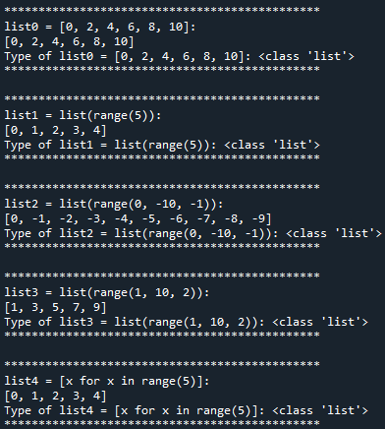
List Construction (1)
Build list type objects
list0 = [0, 2, 4, 6, 8, 10]
list1 = list(range(5))
list2 = list(range(0, -10, -1))
list3 = list(range(1, 10, 2))
show_data(list0, "list0 = [0, 2, 4, 6, 8, 10]")
show_data(list1, "list1 = list(range(5))")
show_data(list2, "list2 = list(range(0, -10, -1))")
show_data(list3, "list3 = list(range(1, 10, 2))")
list4 = [x for x in range(5)]
show_data(list4, "list4 = [x for x in range(5)]")

Slide 12

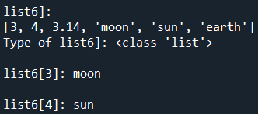
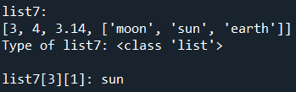

List Construction (2)
List Comprehension
Provides a concise way to apply an operation to the values in a sequence
Creates a new list in which each element is the result of applying a given operation to a value from a sequence
list5 = [x**2 for x in range(1,4)]
print(list5)
→ [1, 4, 9]
if statement is applied to the values produced by the for clause
list6 = [3, 4, 3.14, 'moon', 'sun', 'earth']
print("list6[3]:", list6[3])
list7 = [3, 4, 3.14, ['moon', 'sun', 'earth']]
print("list6[4]:", list6[4])
print("list7[3][1]:", list7[3][1])
list8 = [x**2 for x in list7 if type(x) == int]
show_data(list8, "list8")

Slide 13
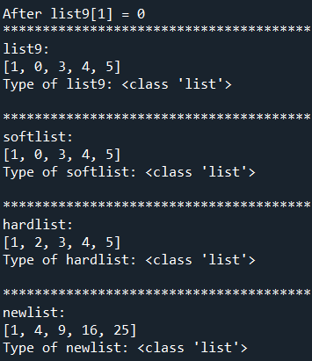
Soft and Hard Copy
Build list objects using soft and hard copy
list9 = list(range(1,6))
softlist = list9 # soft copy, pass-by-reference
hardlist = list(list9) # hard copy, pass-by-value
newlist = [x**2 for x in list9]
list9[1] = 0
print("\nAfter list9[1] = 0")
show_data(list9, "list9")
show_data(softlist, "softlist")
show_data(hardlist, "hardlist")
show_data(newlist, "newlist")

Slide 14
Text Sequence Type – str
str type (or strings)
Immutable sequence of Unicode code
String literals are written in a variety of ways:
Single quotes: 'allows embedded "double" quotes'
Double quotes: "allows embedded 'single' quotes"
Triple quotes: '''Three single quotes''', """Three double quotes"""
Triple quoted strings may span multiple lines –
All whitespace will be included in string literals
https://docs.python.org/3/library/stdtypes.html#textseq

Slide 15
String Methods (1)
s.capitalize() – Copy of s with only the first character capitalized
s.title() – Copy of s with each word capitalized
s.center(width) – Center s in a field of a new string with given width
>>> greet = "hello world"
>>> greet.capitalize()
'Hello world'
>>> greet.title() # each word capitalized
'Hello World'
>>> greet.center(30) # Center-alignment
' hello world '
>>> greet.title().center(20) # Cascading (pipelining)
' Hello World '

Slide 16
String Methods (2)
s.count(sub) – Count the number of occurrences of sub in s
s.find(sub) – Find the first position where sub occurs in s
separator.join(list) – Concatenate a list of strings into one large string using s as separator.
s.ljust(width) – Like center, but s is left-justified
s.lower() – Copy of s in all lowercase letters
s.lstrip() – Copy of s with leading whitespace removed
s.replace(oldsub, newsub) – Replace occurrences of oldsub in s with newsub

Slide 17
String Methods (3)
s.rfind(sub) – Like find, but returns the right-most position of sub
s.rjust(width) – Like center, but s is right-justified
s.rstrip() – Copy of s with trailing whitespace removed
s.split() – Split s into a list of substrings
s.upper() – Copy of s’s all characters converted to uppercase

Slide 18
Common Sequence Operations
Sequence operations for both immutable and mutable objects
s and t: sequences of the same type
n, i, j and k: integers
x: an arbitrary object that meets any type and value restrictions imposed by s
Result | Notes
x in s | True if an item of s is equal to x, else False
x not in s | False if an item of s is equal to x, else True
s + t | the concatenation of s and t
s * n or n * s | equivalent to adding s to itself n times
s[i] | i-th item of s, origin 0
s[i:j] | slice of s from i to j (exclusive)
s[i:j:k] | slice of s from i to j (exclusive) with step k
len(s) | length of s
min(s) | smallest item of s
max(s) | largest item of s
s.index(x[, i[, j]]) | index of the first occurrence of x in s (at or after index i and before index j)
s.count(x) | total number of occurrences of x in s
https://docs.python.org/3/library/stdtypes.html

Slide 19
Additional Mutable Sequence Type Operations
Mutable sequence operations (applied to List type objects)
s: an instance of a mutable sequence type (e.g., list type)
t: any iterable object
x: an arbitrary object that meets any type and value restrictions imposed by s
Operation | Result
s[i] = x | item i of s is replaced by x
s[i:j] = t | slice of s from i to j is replaced by the contents of the iterable t
del s[i:j] | same as s[i:j] = []
s[i:j:k] = t | the elements of s[i:j:k] are replaced by those of t
del s[i:j:k] | removes the elements of s[i:j:k] from the list
s.append(x) | appends x to the end of the sequence (same as s[len(s):len(s)] = [x])
s.clear() | removes all items from s (same as del s[:])
s.copy() | creates a shallow copy of s (same as s[:])
s.extend(t) or s += t | extends s with the contents of t (for the most part the same as s[len(s):len(s)] = t)
s *= n | updates s with its contents repeated n times
s.insert(i, x) | inserts x into s at the index given by i (same as s[i:i] = [x])
s.pop([i]) | retrieves the item at i and also removes it from s
s.remove(x) | remove the first item from s where s[i] is equal to x
s.reverse() | reverses the items of s in place
https://docs.python.org/3/library/stdtypes.html

Slide 20
Common features of tuple, range, list, and str
Common features of tuple, range, list, and str
seq[i]: returns the i^{th} element in the sequence
len(seq): returns the length of the sequence
seq1 + seq2: returns the concatenation of the two sequences except for ranges
n*seq: returns a sequence that repeats seq n times except for ranges
seq[start:end]: returns a slice of the sequence
e in seq: is True if e is contained in the sequence and False otherwise
e not in seq: is True if e is not in the sequence and False otherwise
for e in seq: iterates over the elements of the sequence

Slide 21
Compare tuple, range, list, and str
Type | Type of elements | Examples of literals | Mutable
tuple | any type | (), (1,), ('abc', 4) | No
range | integer | range(6), range(1, 10, 2) | No
list | any type | [], [3], ['abc', 10] | Yes
str | characters | '', 'a', 'Hello', '0123456789' | No
List is preferred for its mutable characteristics.
Whereas, tuples can be used as keys in dictionaries.
Strings are less versatile than tuples or lists.
But there are many built-in methods, returning values without side-effect
s.split(d): splits s using d as a delimiter

Slide 22
Useful Sequence Type, dict (1)
Dictionary: dict type
Similar to lists except that we index dict using keys
A set of key-value pairs: unordered sequence
Enclosed in curly braces with each element written as a key followed by a colon (:) followed by a value
monthNumbers = {'Jan':1, 'Feb':2, 'Mar':3, 'Apr':4, 'May':5, 1:'Jan', 2:'Feb', 3:'Mar', 4:'Apr', 5:'May'}
print('The third month is ' + monthNumbers[3])
dist = monthNumbers['Apr'] - monthNumbers['Jan']
print('Apr and Jan are', dist, 'apart')
→
The third month is Mar
Apr and Jan are 3 apart

Slide 23
Useful Sequence Type, dict (2)
A dict type object is mutable like list
Add an entry
monthNumbers['Jun'] = 6
Modify an entry
monthNumbers['May'] = 'V'
print("monthNumbers:", monthNumbers)
→
monthNumbers: {'Jan': 1, 'Feb': 2, 'Mar': 3, 'Apr': 4, 'May': 'V', 1: 'Jan', 2: 'Feb', 3: 'Mar', 4: 'Apr', 5: 'May', 'Jun': 6}
keys()
Returns an object of type dict_keys, an example of a view object
print(monthNumbers.keys())
→
dict_keys(['Jan', 'Feb', 'Mar', 'Apr', 'May', 1, 2, 3, 4, 5, 'Jun'])

Slide 24

Useful Operations on Dictionaries
As with list, there are many useful methods associated with dictionaries.
len(d): returns the number of items in d
d.keys(): returns a view of the keys in d
d.values(): returns a view of the values in d
k in d: returns True if key k is in d
d[k] = v: associates the value v with the key k in d.
*Note: If there is already a value associated with k, that value is replaced.
del d[k]: removes the key k from d
for k in d: iterates over the keys in d
for key in monthNumbers:
print("({0}, {1})".format(key, monthNumbers[key]))

