Slide 1
Lecture 3-1: Python NumPy Overview
Statistics in Python
ISS 2022
Kyung Park

Slide 2
Contents
NumPy Overview

Slide 3
References
Python for Probability, Statistics, and Machine Learning, 2nd Ed.
Author: José Unpingco
Publisher: Springer International Publishing
Introduction to Computation and Programming Using Python, 2nd Ed.
Author: John V. Guttag
Publisher: The MIT Press, Cambridge, MA
Python Programming, An Introduction to Computer Science, 3rd Ed.
Author: John Zelle
Publisher: Franklin, Beedle

Slide 4
NumPy: Numerical Arrays in Python
NumPy
The de facto standard for numerical arrays in Python
Construction of NumPy array
Import NumPy library as np
Create an array of 32-bit floating-point numbers
Property of NumPy array
itemsize property : shows the number of bytes per item
import numpy as np
xarr = np.array([1,2,3], dtype=np.float32)
print()
print("xarr:", xarr)
print("xarr.itemsize:", xarr.itemsize)

Slide 5
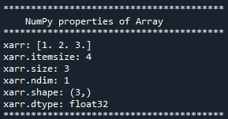
More Properties of NumPy Arrays
Properties of an NumPy array
itemsize: the number of bytes per item
size: the number of items in the array
ndim: the number of axis (dimensions) of the array
shape: the shape of the array
dtype: the type of array elements
print("****************************************")
print(" NumPy Properties of Array ")
print("****************************************")
print("xarr:", xarr)
print("xarr.itemsize:", xarr.itemsize)
print("xarr.size:", xarr.size)
print("xarr.ndim:", xarr.ndim)
print("xarr.shape:", xarr.shape)
print("xarr.dtype:", xarr.dtype)
print("****************************************")

Slide 6
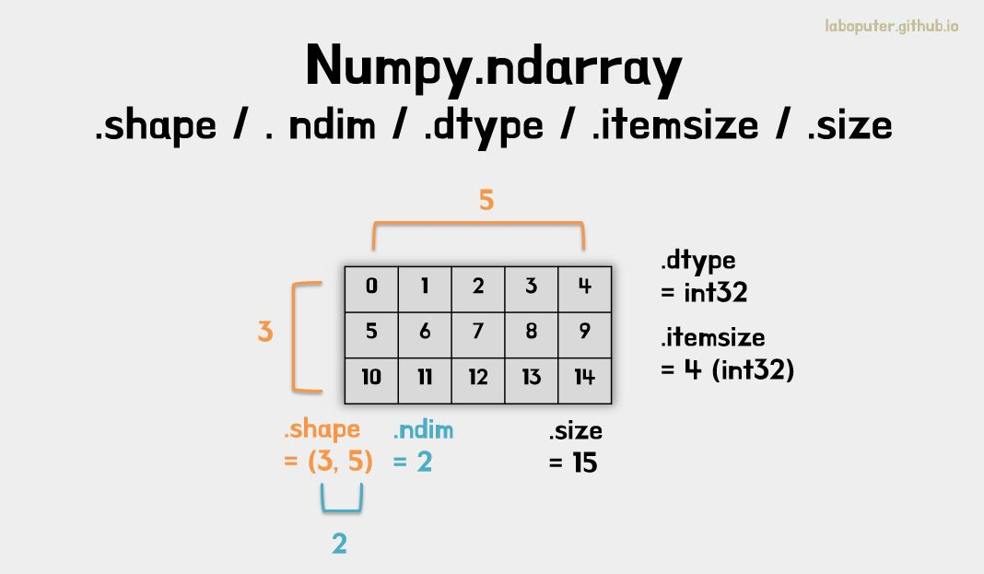
https://laboputer.github.io/assets/img/ml/python/numpy/1.JPG

Slide 7

Repeating of Statements as a Function
Function definition using def keyword:
Argument, arr, as input to the function
Default argument, name, the name of the array
def show_property(arr, name="arr"):
print("****************************************")
print(" NumPy Properties of", name, "array")
print("****************************************")
print(name + ":")
print(arr)
print(name + ".itemsize:", arr.itemsize)
print(name + ".size:", arr.size) # No. of items
print(name + ".ndim:", arr.ndim) # Np. of dimesion
print(name + ".shape:", arr.shape) # (row, col, ...)
print(name + ".dtype:", arr.dtype) # item type print("****************************************")
show_property(xarr, "xarr")
Equally spaced indentation is mandatory in Python.

Slide 8
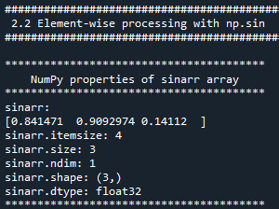
Element-Wise Operation of NumPy Arrays
A list of sine values of [1, 2, 3]
from math import sin
sinlist = [round(sin(i), 3) for i in [1,2,3]] # Loop comprehension
print("sinlist2 from loop comprehension: ", sinlist)
Element-wise processing of Arrays without explicit looping
Element-wise sine computation of the input array
np.sin(np.array([1,2,3], dtype=np.float32))
# Assign np.sin to sinarr
sinarr = np.sin(np.array([1,2,3], dtype=np.float32))
show_property(sinarr, "sinarr")

Slide 9
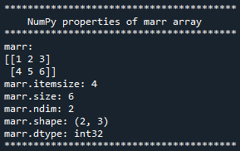
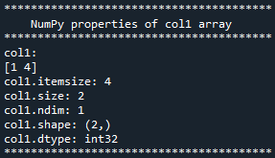
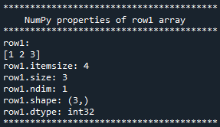
Multi-dimensional Array
Two-dimensional 2x3 array from two Python lists
marr = np.array([ [1,2,3], [4,5,6] ])
show_property(marr, "marr")
Slicing syntax in Python
Basic slice syntax: i:j:k, where i is starting index, j is stopping index, and k is the steps
Python slicing operation
Extracting columns and rows
: colon character: selects all elements along a particular axis
col1 = marr[:, 0] # 1st column
col2 = marr[:, 1] # 2nd column
col3 = marr[:, 2] # 3rd column
row1 = marr[0, :] # 1st row
row2 = marr[1, :] # 2nd row
show_property(col1, "col1")
show_property(col2, "col2")
show_property(col3, "col3")
show_property(row1, "row1")
show_property(row2, "row2")

Slide 10

Subsection Operations of Arrays
More slicing examples
begin:end from begin to end (exclusive)
marr[:, 1:] # all rows, the 2nd column thru the last column
::2 every other items
marr[:, ::2] # all rows, every other column
::-1 reverse order of columns or rows
marr[:, ::-1] # reverse order of columns

Slide 11
Understanding How Array Memory Works: Slicing Operations with Views
Basic slicing operations are views into the array without implicit copying
Basic slicing returns a view.
NumPy array uses pass-by-reference semantics.
Slicing creates views (no copying) and advanced indexing creates copies.
c.f., Making a new and independent copy of an array requires copy operation
Invoke .copy() on the array
cparr = arr.copy()

Slide 12


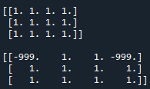
Copying Arrays with copy()
Create all ones 3x3 array
onesarr = np.ones((3, 3))
show_property(onesarr, "onesarr")
Copy onesarr to cparr
cparr = onesarr.copy()
cparr[0, 0] = -999
show_property(cparr, "cparr")
Duplicate the last dimension
Create a view
print(onesarr[:, [0, 1, 2, 2]])
print(cparr [:, [0, 1, 2, 0]])

Slide 13


Viewing, Pass-by-Reference Examples
Viewing on an array with an assignment
dup1 = onesarr[:, [0, 1, 2, 2]]
extarr = dup1
# Update (0,0) element on extarr
extarr[0, 0] = -999
show_property(dup1, "dup1")
show_property(extarr, "extarr")
Note: extarr is just a view into the dup1 array.
Copying with indexing: Pass-by-Value, copying array
show_property(onesarr, " onesarr")

Slide 14
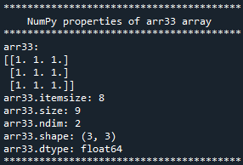
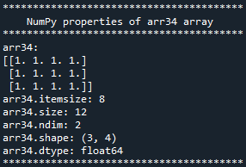


Walk through Advanced Indexing
Create 3x3 all ones NumPy array
arr33 = np.ones((3,3))
show_property(arr33, "arr33")
Duplicate the last dimension (column)
arr34 = arr33[:, [0,1,2,2]]
show_property(arr34, "arr34")
arr34 has its own memory because the relevant parts of arr33 were copied
Assign an element to arr33
arr33[0,0] = 999
print("After assigning an element to arr33\n")
show_property(arr33, "arr33")
show_property(arr34, "arr34")

Slide 15
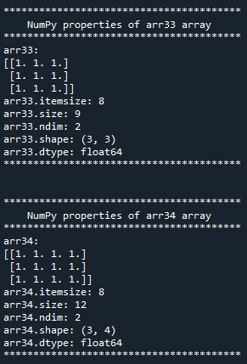
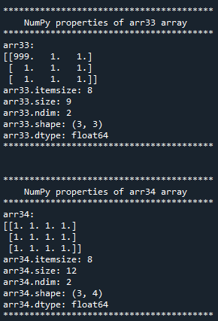
Before and After arr33[0,0] = 999

Slide 16




Slicing
Creating 3x3 all ones NumPy array
brr33 = np.ones((3,3))
show_property(brr33, "brr33")
Slicing 3x3 to 2x2 array
Slicing creates views.
brr22 = brr33[:2, :2] # No advanced indexing
Assign an element to brr33
brr33[0,0] = 999
print("After assigning an element to brr33\n")
show_property(brr33, "brr33")
show_property(brr22, "brr22")

Slide 17
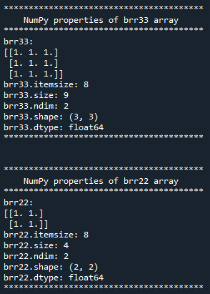
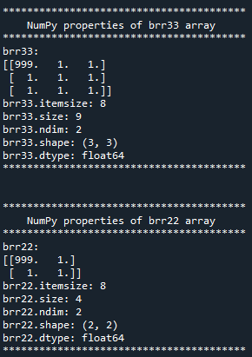
Before and After brr33[0,0] = 999

Slide 18
Advanced Indexing (AI) Examples
Advanced indexing creates copies.
Advanced indexing is significantly more flexible.
It always returns a copy of data, while basic slicing returns a view.
Indexing is available thru integer list or Boolean list.
Advanced indexing where the indexing object (i.e., the item between the brackets) is:
A non-tuple sequence object
c.f., Tuple is enclosed by parentheses (i.e., (start, end))
A NumPy array (n-dim array) of type integer or boolean
A tuple with at least one sequence object or NumPy array

Slide 19
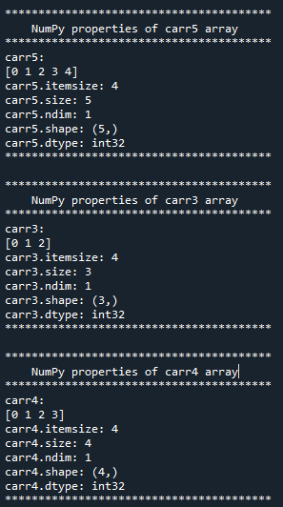
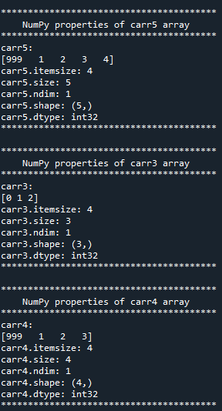
Advanced Indexing with Integer List
Create an array
carr5 = np.arange(5)
show_property(carr5, "carr5")
Copy with index by integer list
carr3 = carr5[[0, 1, 2]] # AI: Non-tuple seq. obj
show_property(carr3, "carr3") # Copy is made
Slicing: creates view
carr4 = carr5[:4] # Creates a view
show_property(carr4, "carr4")
Change element of carr5
carr5[0] = 999
print("After assigning an element to carr5\n")
show_property(carr5, "carr5")
show_property(carr3, "carr3")
show_property(carr4, "carr4")

Slide 20
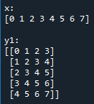

Reusing Memory Blocks with as_strided()
Handling overlapping memory blocks
Memory is reused with as_strided() function (sliding window)
as_strided(org_matrix, dim_tuple, overlap_step_tuple)
as_strided() creates a view
Filling in unpredictable when the target matrix is not filled by the available data → No default filling by zeros, depending on the current value
Step, (4, 4): Reuse memory by sliding 4 bytes along the columns and rows.
from numpy.lib.stride_tricks import as_strided
n = 8
k = 5
x = np.arange(n)
y1 = as_strided(x, (k, n-k+1), (x.itemsize,)*2)
y2 = as_strided(x, (k, n-k+1), (4,4))
y3 = as_strided(x, (k+2, n-k+1), (4,4))
y4 = as_strided(x, (k+5, n-k+1), (4,4))

Slide 21
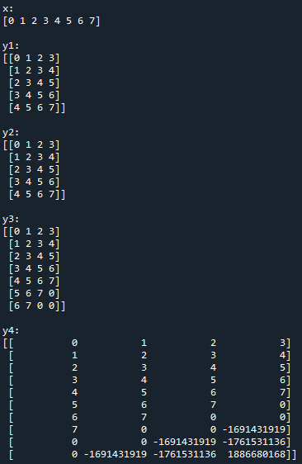
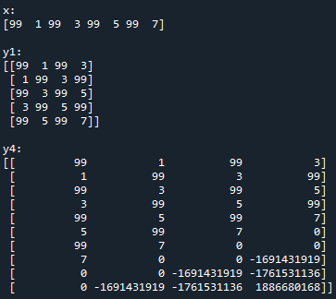
Creating a View with as_strided()
Assign every other value
x[::2] = 99
print("x:")
print(x)
print("y1:")
print(y1)
print("y4:")
print(y4)

