Slide 1
Lecture 3-2: Basic Statistics− Probability
Statistics in Python
ISS 2022
Kyung Park

Slide 2
Contents
Definition of Probability
Random Variables as Mapping Functions
Probability Function
Dice Rolling Examples

Slide 3
References
Python for Probability, Statistics, and Machine Learning, 2nd Ed.
Author: José Unpingco
Publisher: Springer International Publishing

Slide 4

Probability from a Geometric Point of View
Probability as a new number concept that allows you to deal with problems that have a special kind of uncertainty built into them.
Key Idea
Let’s suppose there is a number, x, with its pair, say, f(x).
The f(x) represents the uncertainties about the value of x.
Uncertainty
Randomness here is “you don’t know which bee in particular is going to sting you!”
Once this happens, the uncertainty goes away.
Until that happens, all we have is a concept of a swarm, density of bees in the hive.
➔ a Potentiality of which bee will sting you!

Slide 5
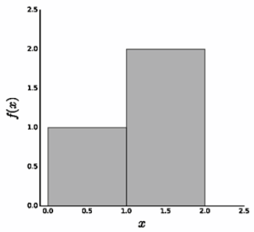
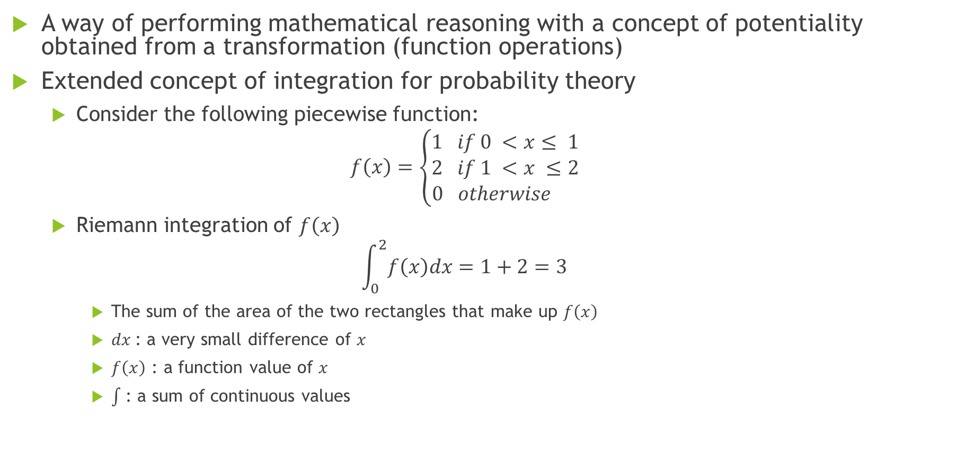
Probability, Mathematical Reasoning
A way of performing mathematical reasoning with a concept of potentiality obtained from a transformation (function operations)
Extended concept of integration for probability theory
Consider the following piecewise function:
$$f\left(x\right)=\left\{\begin{aligned}1 if 0 <x≤ 1 \\ 2 if 1 <x ≤2 \\ 0 otherwise \end{aligned}\right.$$
Riemann integration of $f\left(x\right)$
$$\int_{0}^{2}{f\left(x\right)dx}=1+2=3$$
The sum of the area of the two rectangles that make up $f\left(x\right)$
$dx$: a very small difference of $x$
$f\left(x\right)$ : a function value of $x$
: a sum of continuous values

Slide 6


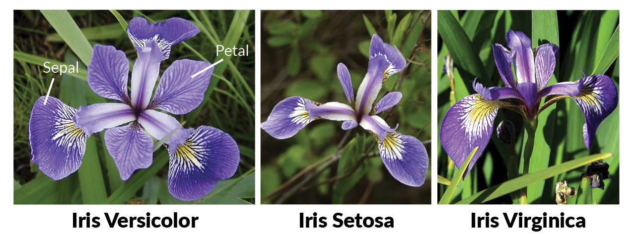
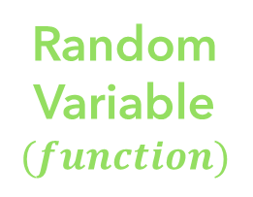
Random Variables as Mapping Functions
Random variable is a mapping function that assigns real number to each element of the sample space.
Transform Samples to Real Numbers
It can be understood as a measurable function.
e.g., Sepal_Length, Sepal_Width, Patel_Length
Iris Species Data
Real
Numbers:
discrete or
continuous
Samples
Random
Variable
$$(function)$$

Slide 7
Discrete and Continuous Random Variables
Discrete Random Variables: Outputs of a random variable (function) are finite discrete (countable) values (0, 1, 2, …).
Number of heads when tossing 3 coins
Number of confirmed COVID-19 cases in South Korea
Number of correct answers on the exam
Continuous Random Variables: Outputs of a random variable (function) are continuous values.
Flight delay time at JFK airport
Newborn’s weight
Petal length and width of the iris sample

Slide 8


Probability Function
Probability function maps real number of random variable (X) into probability value of [0, 1].
Real
Numbers:
discrete or
continuous
$$\text{P}=f\left(Real Number\right)$$
Samples
Random
Variable
$$(function)$$
Probability
Function
0
1
Probability value

Slide 9
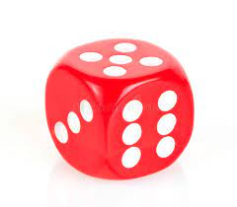
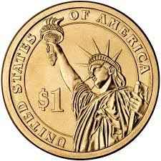
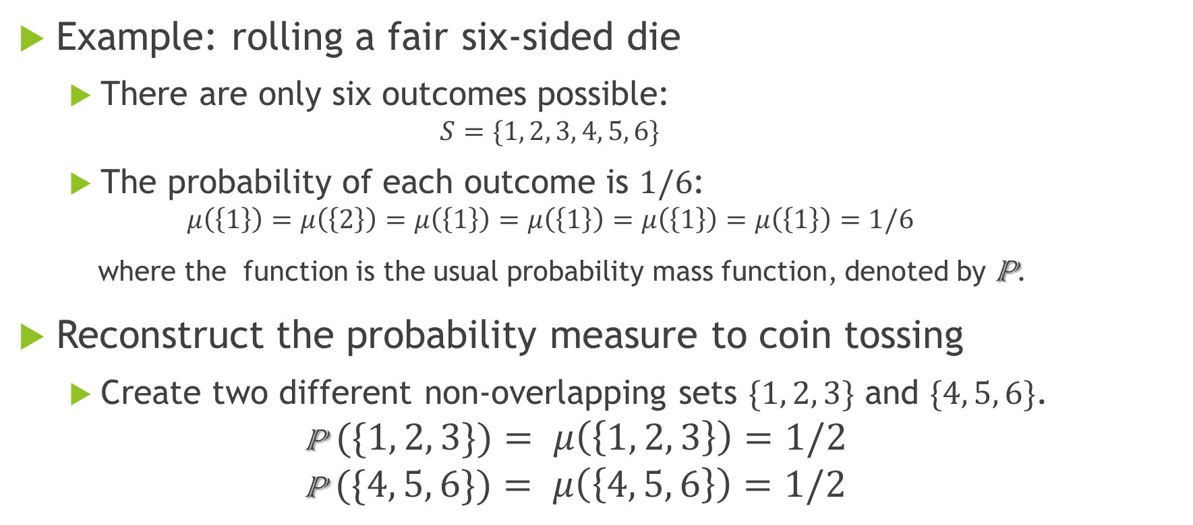
Random Variable to Probability Function
Example: rolling a fair six-sided die
There are only six outcomes possible:
$$S=\{1, 2, 3, 4, 5, 6\}$$
The probability of each outcome is $1/6$:
$$μ\left(\left\{1\right\}\right)=μ\left(\left\{2\right\}\right)=μ\left(\left\{1\right\}\right)=μ\left(\left\{1\right\}\right)=μ\left(\left\{1\right\}\right)=μ\left(\left\{1\right\}\right)=1/6$$
where the function is the usual probability mass function, denoted by P.
Reconstruct the probability measure to coin tossing
Create two different non-overlapping sets $\{1, 2, 3\}$ and $\{4, 5, 6\}$.
$$\text{P} (\{1, 2, 3\})= μ\left(\left\{1, 2, 3\right\}\right)=1/2$$
$$\text{P} (\{4, 5, 6\})= μ\left(\left\{4, 5, 6\right\}\right)=1/2$$

Slide 10
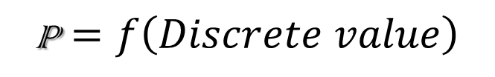
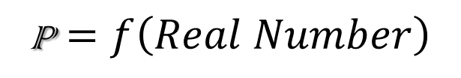
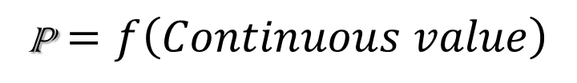
Probability Function Classification
$$\text{P}=f\left(Real Number\right)$$
$$\text{P}=f\left(Discrete value\right)$$
$$\text{P}=f\left(Continuous value\right)$$
Probability Mass Function
(PMF)
Probability Density Function
(PDF)

Slide 11
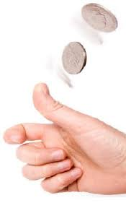

Probability Mass Function: Coin Example
Tossing two coins
H: Head, T: Tail
Sample space (S): { (H,H), (H,T), (T,H), (T,T) }
Random Variable, X = Number of heads
X = { 0, 1, 2 }
Probability mass function
P(X=0)=1/4 P(X=1)=2/4 P(X=2)=1/4
PMF plot
$$\text{P}$$
1
1/2
1/4
0
X
0
1
2

Slide 12
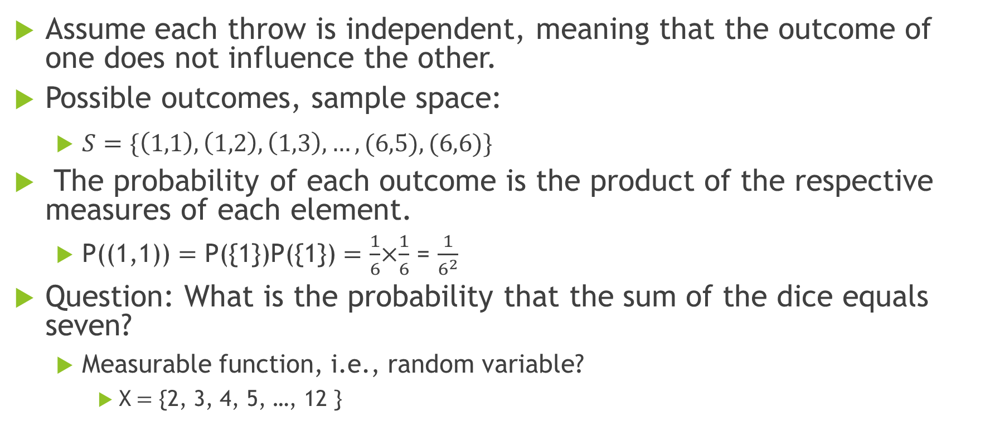
Programming: Two Dice Rolling
Assume each throw is independent, meaning that the outcome of one does not influence the other.
Possible outcomes, sample space:
$S=\{\left(1,1\right), \left(1,2\right), \left(1,3\right), …, (6,5), (6,6)\}$
The probability of each outcome is the product of the respective measures of each element.
P((1,1)) $=$ P({1})P({1}) $=$ $\frac{1}{6}$×$\frac{1}{6}$ = $\frac{1}{6^{2}}$
Question: What is the probability that the sum of the dice equals seven?
Measurable function, i.e., random variable?
X$=$ {2, 3, 4, 5, …, 12 }

Slide 13
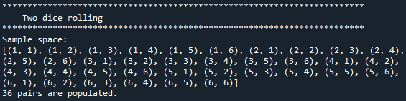
Print All Possible Random Variables?
Build and print all possible pairs of numbers, [1, 6]
sample_space = [(i,j) for i in range(1, 7) for j in range(1, 7)]
#sample_space = {(i,j) for i in range(1, 7) for j in range(1, 7)}
print("**************************************************************")
print(" Rolling two dice")
print("**************************************************************")
print("Sample space:")
print(sample_space)
print("{0} pairs are populated.".format(len(sample_space)))
print()

Slide 14

Build a Dictionary of Random Variable with (die1, die2): die1 + die2
Build a dictionary composed of key:value pairs
Key: a pair of two dice values, (die1, die2)
Value: sum of two dice values, die1 + die2
Print a dictionary of key:value combinations
print("Random variable of die1 + die2:")
RV_add = {(i,j): i+j for i in range(1, 7) for j in range(1, 7) }
print(RV_add)

Slide 15
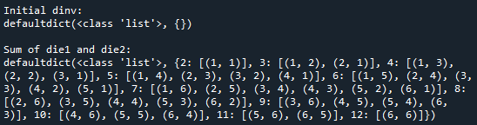
Construct a Dictionary with die1 + die2: a list of (die1, die2)
Reverse RV_add dictionary with sum as the key and pairs of dice values as the list value
Create an initial dictionary with values as a list
from collections import defaultdict
dinv = defaultdict(list)
print("Initial dinv:")
print(dinv)
Reverse RV_add dictionary
for key, value in RV_add.items():
dinv[value].append(key)
print("Sum of die1 and die2:")
print(dinv)

Slide 16

Random Variables and Probability Mass Function (PMF)
All possible random variables form dinv dictionary
print("All possible sums:", len(dinv))
print(dinv.keys())
print("List of sum of die1 and die2 of 7:")
print(dinv[7])
print("Only {0} pairs have a sum of 7.".format(len(dinv[7])))
Probability Mass Function (PMF)
Build a dictionary of Probability Mass Function (PMF) for each sum
Prove the sum of all probabilities to be one
Print probability of each sum and max, min probabilities

Slide 17
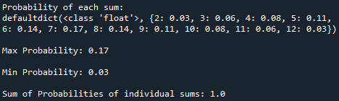
Probability Mass Function (PMF)
Probability Mass Function (PMF) (cont.)
n_samples = len(sample_space)
sum = 0
pmf = defaultdict(float)
for key, value in dinv.items():
prob = len(value) / n_samples
pmf[key] = round(prob, 3)
sum += prob
print("Probability of each sum:")
max_key = max(pmf, key=pmf.get)
print("Max Probability:",pmf[max_key])
min_key = min(pmf, key=pmf.get)
print("Min Probability:", pmf[min_key])
print("Sum of Probabilities of individual sums:", round(sum, 1))

Slide 18
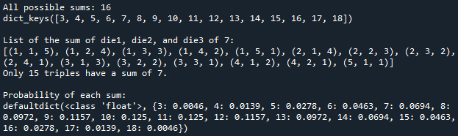
Lab2-1: Three Dice Rolling
Please extend the previous two dice rolling into three dice rolling.
When rolling three dice, find the most probable sum of the three dice values.

Slide 19
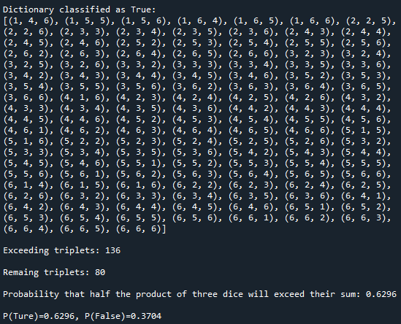
Lab 2-2: Extend Three Dice Rolling
What is the probability that half the product of three dice will exceed their sum?

Slide 20

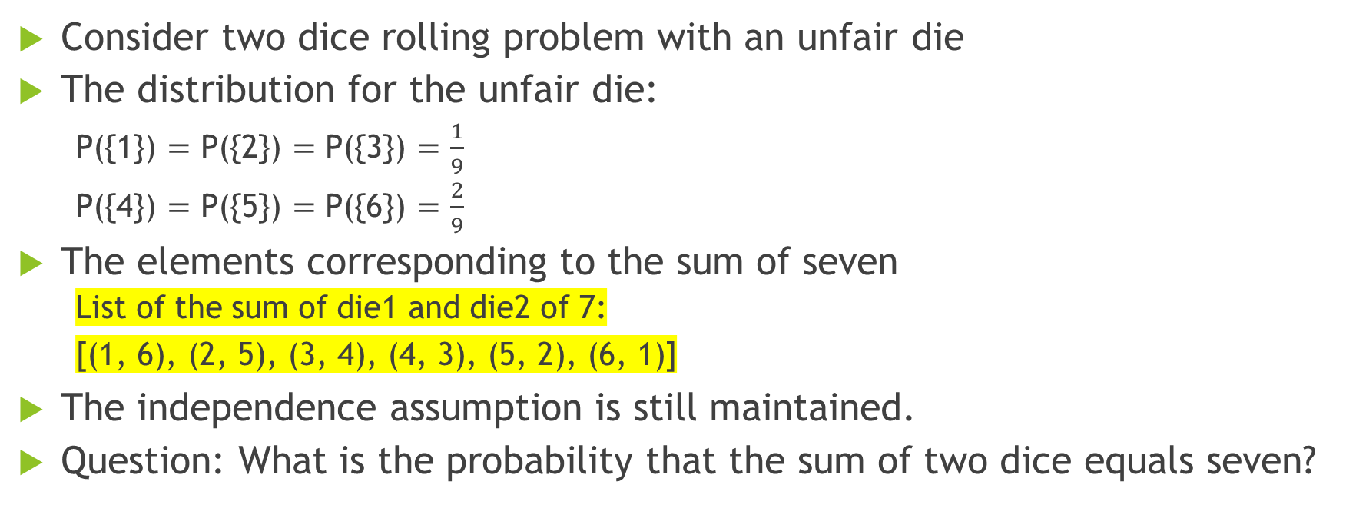
HW3-1: Probability of Seven with One Unfair Die
Consider two dice rolling problem with an unfair die
The distribution for the unfair die:
P({1}) $=$ P({2}) $=$ P({3}) $=$ $\frac{1}{9}$
P({4}) $=$ P({5}) $=$ P({6}) $=$ $\frac{2}{9}$
The elements corresponding to the sum of seven
List of the sum of die1 and die2 of 7:
[(1, 6), (2, 5), (3, 4), (4, 3), (5, 2), (6, 1)]
The independence assumption is still maintained.
Question: What is the probability that the sum of two dice equals seven?

