Slide 1
Lecture 2-3: More About List, Function, and Dictionary Object
Statistics in Python
ISS 2022
Kyung Park

Slide 2
Contents
String Manipulation
List Manipulation
Function Definitions
Function Parameters
Dictionary objects

Slide 3
References
Introduction to Computation and Programming Using Python, 2nd Ed.
Author: John V. Guttag
Publisher: The MIT Press, Cambridge, MA
Python Programming, An Introduction to Computer Science, 3rd Ed.
Author: John Zelle
Publisher: Franklin, Beedle

Slide 4
String Manipulation
String: an immutable sequence type
* : Repetition operator
+ : Concatenation operator
phrase = 'Tell the truth without blame and judgement.'
print(len(phrase))
print(phrase[5:])
phrase2 = phrase + " " + phrase
print(len(phrase2))
print(phrase2)
phrase3 = (phrase + " ") * 3 # Repeating 3 times
print(phrase3)
for ch in phrase:
print(ch)
for i in range(len(phrase)):
print(phrase[i], end="") # Print

Slide 5
Split String Sequence into List of Words
Use split() with a proper separator
Invoke split(sep='sep_character') on a string object
words = phrase.split(sep=" ")
print(words)
Loop the list of words
for word in words:
print(word, end="-")

Slide 6


List Manipulation
Loop a list
fruits = ['apple', 'watermelon', 'cherry']
for fruit in fruits:
print(fruit)
for i in range(len(fruits)):
print(fruits[i])
Build a list
list1 = [x**2 for x in range(1,4)]
print(list1)
org = [3, 4, 3.14, ['moon', 'sun', 'earth']]
list2 = [x**2 for x in org if type(x) == int]
print(list2)

Slide 7
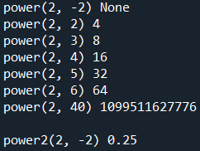
Function Definitions
Define a function using def keyword
# base = 3, exp = 3 ==> power(3, 3) returns 27
def power(base, exp):
if exp >= 0 :
product = 1
for i in range(exp):
product = product * base
else:
product = None
return product
def power2(base, exp):
return base**exp
print("power(2, -2)", power(2, -2))
print("power(2, 2)", power(2, 2))
print("power(2, 3)", power(2, 3))
print("power(2, 4)", power(2, 4))
print("power(2, 5)", power(2, 5))
print("power(2, 6)", power(2, 6))
print("power(2, 40)", power(2, 40))
print("power2(2, -2)", power2(2, -2))

Slide 8

Function fact()
Define fact()
# e.g., fact(5) = 5! = 5*4*3*2*1
def fact(num):
if num > 0:
product = 1
for i in range(num, 0, -1):
product = product * i
else:
product = None
return product
pass fact(num) as a function parameter to print() function
print(fact(2)) # 2! = 2*1
print(fact(3)) # 3! = 3*2*1
print(fact(4)) # 4! = 4*3*2*1
print(fact(5)) # 5! = 5*4*3*2*1

Slide 9
Function powerOfTwo()
powerOfTwo()
# e.g., powerOfTwo(3) = 2^3
def powerOfTwo(exp):
if exp >= 0 :
product = 1
for i in range(exp):
product = product * 2
else:
product = None
return product

Slide 10

Function applyToEach()
Define applyToEach() function
Takes a function as its parameter
def applyToEach(list, func):
""" Assumes list is a list and
func(), a function parameter.
Mutates list by applying func()
to each element, """
for i in range(len(list)):
list[i] = func(list[i])
print(list)
Apply the function to each list elements
list = [-1, -2, -3, 4]
applyToEach(list, abs)
applyToEach(list, powerOfTwo)
applyToEach(list, fact)

Slide 11

map() : Python Built-in
map(func, iterable)
func : A function to which map passes each element of the given iterable
You can pass an anonymous function using a lambda function
iter : An iterable which is to be mapped
for i in map(fact, [1, 3, 5, 10]):
print(i)
l2 = []
for i in map(lambda x, y: x**y, [1, 2, 3, 4], [4, 3, 2, 1]):
l2.append(i)
print(l2)
l3 = [i for i in map(lambda x, y: x**y, [1, 2, 3, 4], [4, 3, 2, 1])]
print(l3)

Slide 12
Dictionary Objects
Define a dictionary object as a list of key-value pairs
birthStones = {'Jan':'Garnet', 'Feb':'Amethyst', 'Mar':'Acquamarine', 'Apr':'Diamond', 'May':'Emerald'}
Extract keys
months = birthStones.keys()
Extract values
stones = birthStones.values()

Slide 13
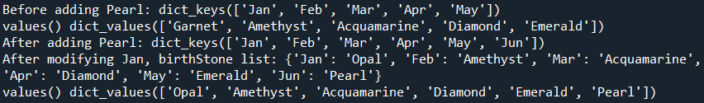
Dictionary Manipulation
Adding a new key-value pair
print('Before adding Pearl:', months)
print('values()', stones )
birthStones['Jun'] = 'Pearl'
Replacing the value of a key
print('After adding Pearl:', months)
birthStones['Jan'] = 'Opal'
print('After modifying Jan, birthStone list:', birthStones)
print('values()', stones)

